Slide 1

Bio
David Teng
David is a fun, social college junior living in Pittsburgh. He’s finally gotten the perfect house with his best friends, and he can’t wait to show off the huge backyard to everyone he knows.
College Student
Goals
Host a giant BBQ right before school really takes off so he can blow off a little steam, see his friends, and even make a little cash off the cover charge.
Frustrations
Can’t really publicize the party other than word of mouth, texting, and Facebook
Wants to open it up to his entire college but has no way to do so
Knows that collecting the cover fee is going to be difficult

Slide 2
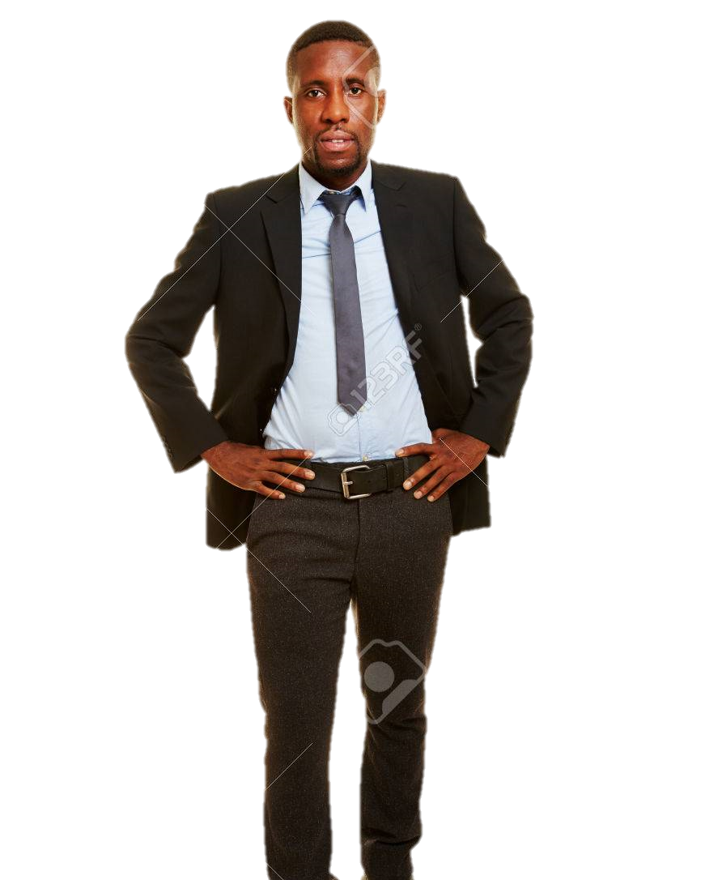
Bio
Eric Johnson
Eric is a small business owner with a loyal customer base but slowing revenue. He’s modern, determined, and willing to do whatever it takes to keep his business thriving.
Small Business Owner
Goals
Leverage modern technology and trends to attract more customers from different parts of town/different cultural groups.
Frustrations
Marketing and publicizing his small business isn’t working to bring in more people
Has very little time to focus on networking when he has the everyday business to run
Wants to attract different kinds of people but doesn’t know how to target these groups

Slide 3
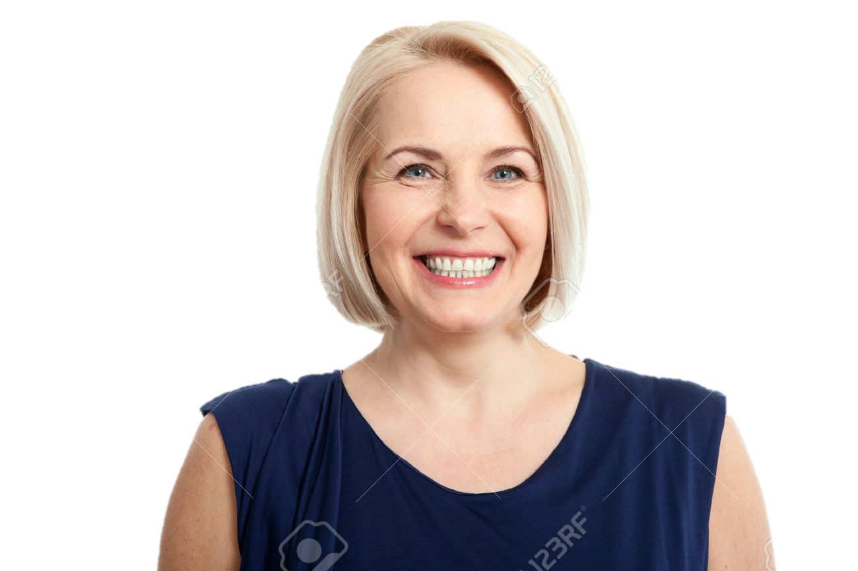
Bio
Debbie Jones
Debbie is an involved, fun mom living in the suburbs of a big city. She has two kids in elementary school, and she loves helping the PTA plan and host events. She has the perfect idea for events to help the school fundraise.
Suburban Mom
Goals
Plan fun and well thought out fundraisers for the PTA and school.
Frustrations
Planning PTA events is difficult, and it can be frustrating to divvy up tasks and expectations
The only people that attend PTA events are parents and teachers, which means there’s no added benefit to the fundraisers

