Slide 1
GROUP SEMINAR
Variational Neural Inference
From probability and gradients to interpretable neural dynamics
→
→
→
→
latent z
EM
HMM
VAE / LFADS
gpSLDS
Notes:
Timing: 1:00
Today I will build one continuous story from the basic language of probability to modern latent dynamical models. The goal is not to catalogue algorithms. The goal is to understand which modeling assumption is added at each step, which posterior quantity must be computed, and what scientific interpretation becomes possible.

Slide 2
One question connects the entire talk
How can noisy, high-dimensional observations reveal hidden neural computation?
observations
latent structure
interpretation
→
→
spikes, behavior
states, factors, dynamics
mechanism, uncertainty
02
Notes:
Timing: 1:15
Neural data are observations, not explanations. Latent-variable models insert an explicit hidden layer between measurement and interpretation. Every model in this talk differs in the structure assigned to that hidden layer and in the method used to infer it.

Slide 3
Roadmap: each model adds one assumption
Probability
uncertainty
Mixtures
discrete latent classes
HMMs
temporal dependence
VAEs
amortized nonlinear inference
LFADS
recurrent neural dynamics
gpSLDS
interpretable nonlinear flow
03
Notes:
Timing: 1:15
The progression is cumulative. Probability gives us uncertainty. Mixtures introduce hidden assignments. HMMs connect those assignments through time. VAEs replace per-datapoint optimization with a learned inference network. LFADS equips the latent state with recurrent dynamics. gpSLDS then trades some neural-network flexibility for local dynamical interpretation.

Slide 4
PART 1
Foundations
Probability, latent variables, gradients, and learning
1
04
Notes:
Timing: 0:30
I will start from the smallest set of ideas needed for every later model.

Slide 5
A probabilistic model is a data-generating hypothesis
Observed variables
Latent variables and parameters
Measured directly
Examples: spike counts, images, trajectories
Written as x
Latent z explains hidden structure
Parameters θ specify the model
A joint distribution connects them
05
Notes:
Timing: 1:40
A probabilistic model says how data could have been generated. Observed variables are what the experiment records. Latent variables are explanatory quantities that are not directly measured. Parameters define the strength and shape of the relationships. This distinction prevents us from treating a low-dimensional visualization as if it were automatically a generative explanation.

Slide 6
Bayes' rule turns a generative model into inference
posterior
what we infer after seeing data
likelihood
how the latent state explains x
prior
belief before observing x
evidence
normalization; often the hard term
06
Notes:
Timing: 1:40
Bayes' rule is the central computational operation in latent-variable modeling. The numerator combines the likelihood and prior. The denominator, the marginal likelihood or evidence, sums or integrates over all latent explanations. In simple models this is analytic. In modern models it is usually the source of intractability.

Slide 7
Learning and inference are different operations
Inference
Learning
Prediction
Given θ and x
Given x
Given new x
↓
↓
↓
estimate z
estimate θ
predict missing or future data
07
Notes:
Timing: 1:20
It is useful to separate three operations. Inference estimates hidden states for fixed parameters. Learning estimates parameters from data, usually by repeatedly invoking inference. Prediction applies the fitted model to unseen or future observations. Many apparent disagreements between algorithms disappear once we ask which of these operations they approximate.

Slide 8
Gradients tell us how to change parameters
∇θ L points toward the steepest local increase in loss
η controls the step size
Backpropagation applies the chain rule through a computation graph
Automatic differentiation computes exact derivatives of the implemented program
08
Notes:
Timing: 1:50
A gradient is a local sensitivity. It tells us how much the objective would change under a small parameter change. Gradient descent moves in the negative-gradient direction. Backpropagation is not a separate learning principle; it is an efficient application of the chain rule. Automatic differentiation records the computation and evaluates those derivatives exactly up to numerical precision.

Slide 9
Optimization does not remove modeling assumptions
Objective
Parameterization
What quantity should improve?
Which functions can the model express?
Data split
Identifiability
What evidence tests generalization?
Can different parameters explain the same data?
09
Notes:
Timing: 1:25
Better optimization cannot rescue a poorly specified scientific model. We still need to choose an objective, a parameterization, and a validation strategy. Latent models also face identifiability: labels may permute, latent axes may rotate, and multiple parameter settings may induce the same observations. Interpretation therefore requires constraints and validation beyond training loss.

Slide 10
PART 2
Mixture models and EM
The first nontrivial latent-variable learning problem
2
10
Notes:
Timing: 0:30
Mixture models are the smallest setting where uncertainty over a hidden assignment affects parameter learning.

Slide 11

A mixture model explains heterogeneity
πk
μk
Σk
component frequency
component center
component shape
Hidden assignment zn selects the component that generated xn.
11
Notes:
Timing: 1:40
A Gaussian mixture assumes that each observation came from one of K components. The latent variable z is discrete. The mixture weights describe component prevalence; each component has a mean and covariance. The marginal density is a weighted sum because the generating component is unobserved.

Slide 12
EM alternates posterior inference and parameter learning
E
Expectation step
M
Maximization step
↔
Compute responsibilities rnk = p(zn = k | xn, θ)
Refit π, μ, Σ using posterior-weighted statistics
Each full iteration does not decrease the data log likelihood.
12
Notes:
Timing: 1:55
If assignments were known, fitting each Gaussian would be easy. If parameters were known, computing assignment probabilities would also be easy. EM exploits this conditional simplicity. The E-step computes soft assignments. The M-step treats those responsibilities as fractional counts. The process monotonically improves or preserves the observed-data likelihood, although it can converge to a local optimum.

Slide 13
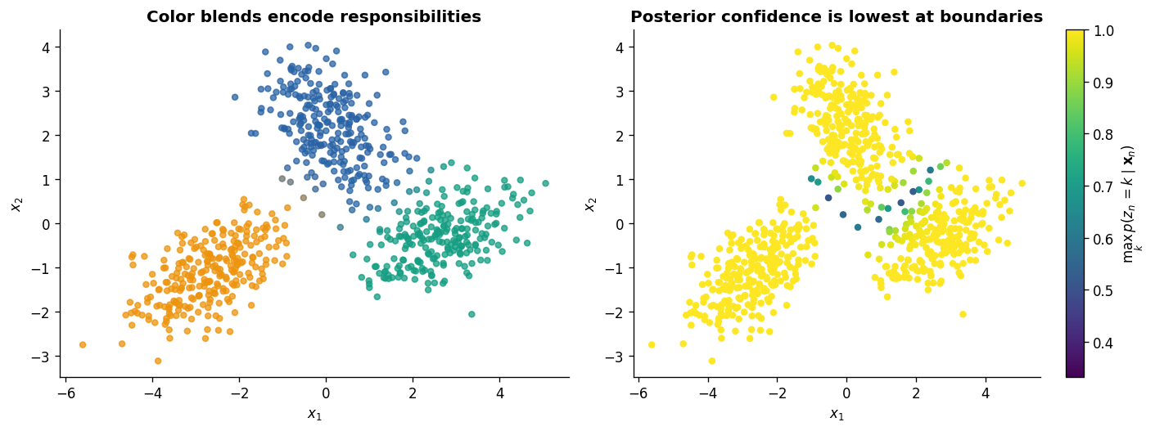
Soft assignments preserve uncertainty
Color mixtures represent posterior responsibilities; the right panel shows assignment confidence.
Source: executed notebook 02b_mixtures_em.ipynb
13
Notes:
Timing: 1:30
A hard clustering algorithm collapses uncertainty immediately. EM keeps a probability for every component. Points near overlapping regions receive mixed colors and lower confidence. This uncertainty is not cosmetic; it determines how strongly each observation contributes to each component's sufficient statistics.

Slide 14
EM is coordinate ascent on a lower bound
ELBO
+
KL gap
tractable objective
posterior approximation error
Exact E-step: q(z) = p(z | x, θ), so the KL gap becomes zero.
14
Notes:
Timing: 1:55
The ELBO identity is the bridge from EM to variational inference. The log evidence equals a lower bound plus a nonnegative KL divergence. In ordinary EM, the E-step can set q equal to the exact posterior, making the gap zero. The M-step then optimizes the bound with respect to parameters. Variational inference keeps the same logic when the exact posterior is unavailable.

Slide 15
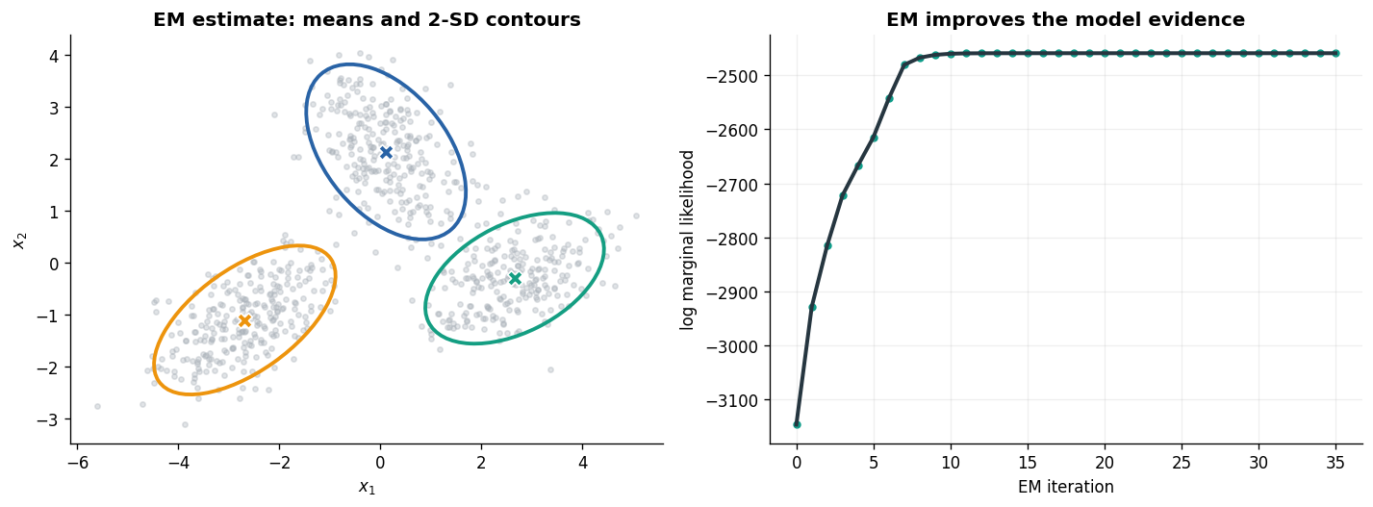
EM produces a fitted density, not only labels
Left: recovered Gaussian geometry. Right: monotonic observed-data log likelihood.
Source: executed notebook 02b_mixtures_em.ipynb
15
Notes:
Timing: 1:25
The scientific output of a mixture model is more than a colored partition. It is a probability density with component frequencies, centers, and uncertainty geometry. The likelihood trace is a basic implementation check, but held-out density and stability across initializations are stronger validation criteria.

Slide 16
What a mixture model cannot represent
Exchangeability
The model gives the same probability after any permutation of observations.
same histogram
≠
different sequence
To model persistence, switching, and prediction, z must depend on its history.
16
Notes:
Timing: 1:20
Mixture observations are exchangeable. The model sees component counts but not order. Two sequences with the same histogram are equivalent. Neural and behavioral data contain persistence, switching, and temporal prediction. The minimal extension is to connect consecutive latent assignments with a Markov transition model.

Slide 17
PART 3
Hidden Markov models
Discrete latent states with temporal persistence
3
17
Notes:
Timing: 0:30
An HMM changes one assumption: the hidden assignment now depends on the previous hidden state.

Slide 18
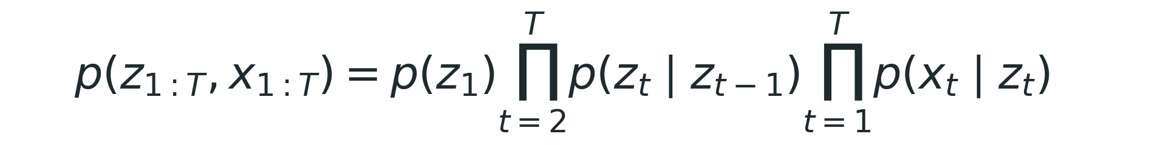
An HMM adds a Markov chain to a mixture
transition model
z1
→
z2
→
z3
→
z4
→
z5
↓
↓
↓
↓
↓
x1
x2
x3
x4
x5
emission model
18
Notes:
Timing: 1:45
The hidden state follows a first-order Markov chain: the next state depends on the current state, not the entire past. Each observation depends only on its current state. These conditional-independence assumptions are strong, but they enable exact dynamic programming rather than summing over K to the T possible state sequences.

Slide 19
Dynamic programming makes exact sequence inference possible
Forward message
Backward message
αt(k) ∝ p(xt | k) Σj αt−1(j) Ajk
βt(k) = Σj Akj p(xt+1 | j) βt+1(j)
past evidence
future evidence
smoothed posterior ∝ forward × backward
19
Notes:
Timing: 2:00
The forward message summarizes all evidence up to time t. The backward message summarizes evidence after time t. Their product gives the smoothed marginal posterior for each state. This is exact under the HMM assumptions and costs order T K squared, rather than enumerating exponentially many state paths. Scaling or log-space calculations are necessary for numerical stability.

Slide 20
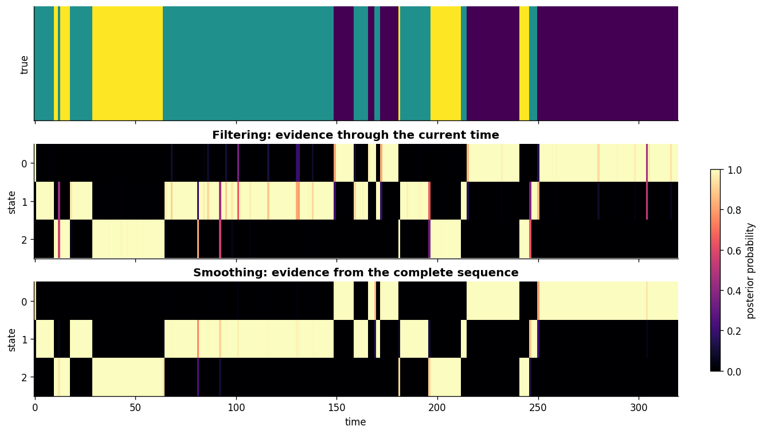
Filtering and smoothing answer different questions
Filtering uses the past and present; smoothing revises state beliefs using the complete sequence.
Source: executed notebook 03a_hmm_foundations.ipynb
20
Notes:
Timing: 1:35
Filtering is the online posterior and is appropriate for real-time decoding. Smoothing is an offline posterior and can revise ambiguous moments using future observations. The distinction matters experimentally: an offline state estimate should not be reported as if it were available causally at that time.

Slide 21
Three posterior summaries serve different goals
Marginals
Paths
p(zt | x1:T)
Uncertainty at each time
Expected occupancy and transitions
Viterbi: one MAP sequence
Posterior sampling: distribution over sequences
A single path hides ambiguity
21
Notes:
Timing: 1:35
HMM inference does not have one universal output. Marginals quantify uncertainty at each time. Viterbi decoding gives the single most probable joint sequence, which is not the same as choosing the most probable state independently at every time. Posterior path samples preserve sequence-level uncertainty and are often more honest for downstream analyses.

Slide 22
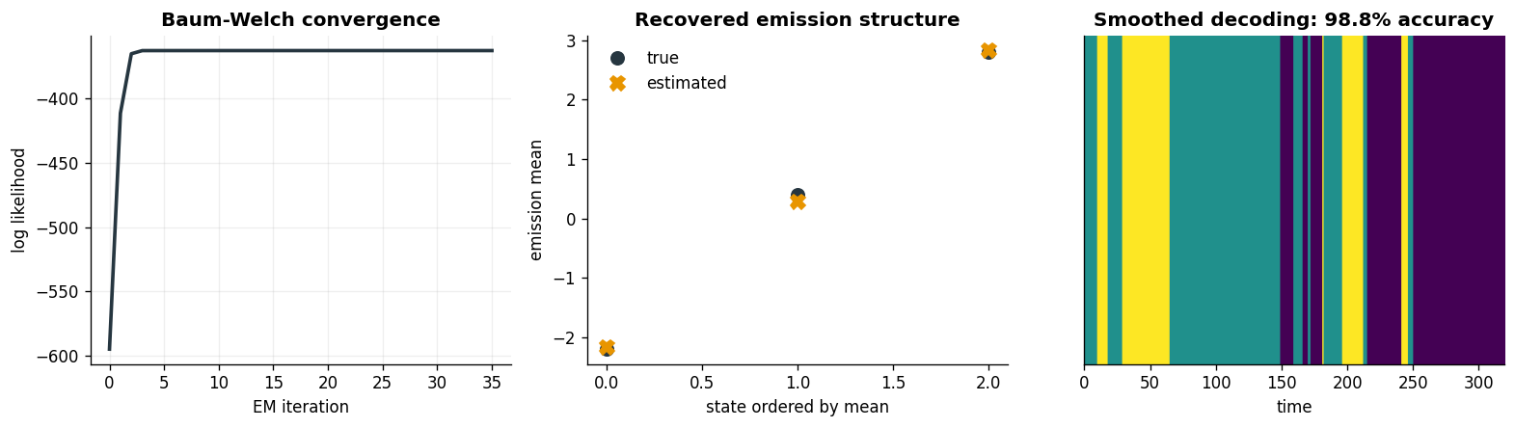
Baum-Welch is EM for an HMM
Forward-backward supplies expected state occupancies and transition counts for the M-step.
Source: executed notebook 03a_hmm_foundations.ipynb
22
Notes:
Timing: 1:45
Baum-Welch repeats exact HMM inference and parameter updates. The E-step computes smoothed state probabilities and pairwise transition marginals. The M-step updates the initial distribution, transition matrix, and emission parameters. As with mixture EM, labels may permute and local optima remain possible, so recovery is judged after label alignment and across initializations.

Slide 23
HMM assumptions determine the scientific interpretation
Model
Observation / dynamics
Interpretation
Gaussian HMM
state-specific mean/covariance
recurring static regimes
AR-HMM
state-specific autoregression
switching local dynamics
SLDS
continuous latent state + switches
piecewise linear dynamics
23
Notes:
Timing: 1:30
A state label means only what the emission and transition assumptions make it mean. In a Gaussian HMM, states represent recurring observation distributions. In an AR-HMM, each state defines local autoregressive dynamics. In an SLDS, a discrete switch selects continuous linear dynamics. This hierarchy is useful, but increasing expressiveness also weakens identifiability and raises computational cost.

Slide 24
PART 4
Variational inference and VAEs
Approximate posteriors for nonlinear latent-variable models
4
24
Notes:
Timing: 0:30
Exact inference breaks when the decoder becomes nonlinear. Variational inference replaces the intractable posterior with an optimized approximation.

Slide 25
Variational inference turns inference into optimization
Choose qφ(z | x)
Maximize the ELBO
Check the gap
a tractable posterior family
fit φ and model parameters θ
approximation quality is not guaranteed
25
Notes:
Timing: 1:45
Variational inference chooses a tractable family q and minimizes its KL divergence to the posterior indirectly by maximizing the ELBO. The approximation can be factorized, Gaussian, sequential, or represented by a neural network. A high ELBO does not prove that q captures every posterior dependency; it is an optimization target and a lower bound, not an automatic certificate of scientific validity.

Slide 26
Amortization learns a reusable inference rule
Classical variational inference
Amortized inference
new local parameters for every xn
optimize separately
accurate but expensive
shared encoder qφ(z | x)
one forward pass
fast but may introduce amortization gap
26
Notes:
Timing: 1:35
Classical variational methods optimize local variational parameters separately for every observation. A VAE amortizes that work: an encoder predicts the variational parameters from x. This enables fast inference and generalization to new data, but the shared encoder may fail to reach the best variational parameters for every datapoint, creating an amortization gap.

Slide 27
The VAE objective balances reconstruction and regularization
Reconstruction
KL regularization
Does z explain x through the decoder?
Does the inferred code remain close to the prior?
The balance controls information capacity and can cause posterior collapse.
27
Notes:
Timing: 1:50
The first ELBO term rewards reconstructions under latent samples from the encoder. The KL term regularizes the approximate posterior toward the prior. Too little regularization gives an unstructured code; too much can make the decoder ignore z, known as posterior collapse. This is especially important with powerful sequential decoders.

Slide 28
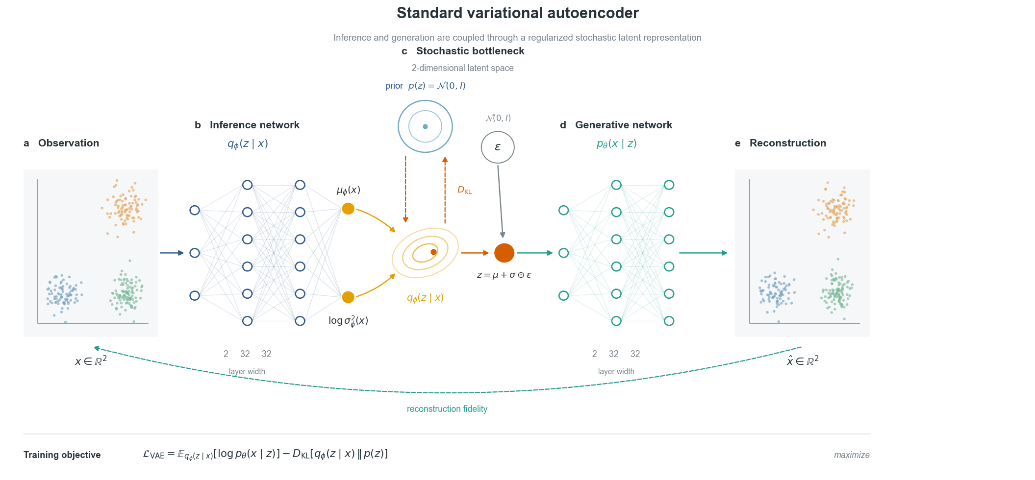
A VAE combines a generative model and an inference network
The encoder parameterizes qφ(z | x); the decoder parameterizes pθ(x | z).
Source: executed notebook 04_standard_vae.ipynb
28
Notes:
Timing: 1:35
The decoder is the generative model: latent z generates observations. The encoder is an auxiliary inference model: it maps each observation to a distribution over z. Keeping these roles separate clarifies why a VAE is not simply an autoencoder with noise. The probabilistic objective and latent prior are essential.

Slide 29
The reparameterization trick differentiates through sampling
encoder
+
fixed noise
+
sample
μ(x), σ(x)
ε ~ N(0, I)
differentiable z
Randomness is moved into ε, leaving a differentiable deterministic transformation.
29
Notes:
Timing: 1:45
Direct sampling appears to interrupt the computation graph. Reparameterization writes a Gaussian sample as a deterministic function of encoder outputs and parameter-free noise. Gradients then flow through mu and sigma. This produces a low-variance pathwise gradient estimator and makes end-to-end VAE training practical.

Slide 30
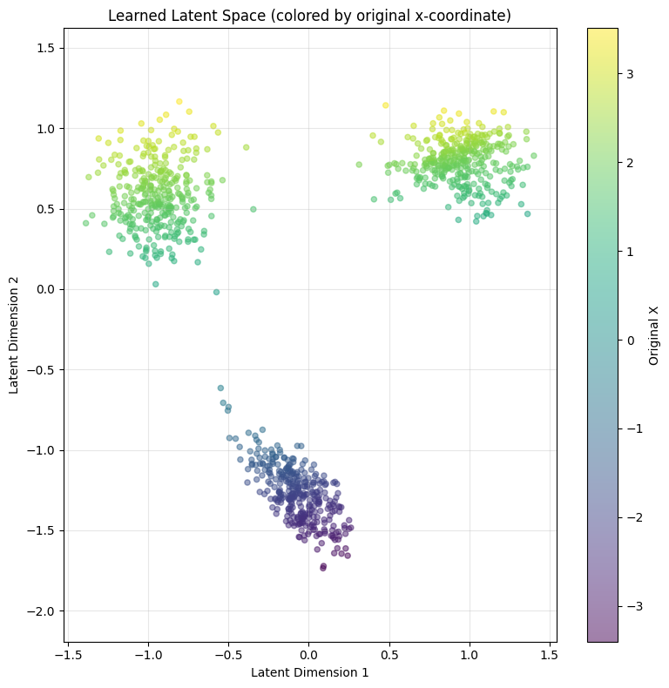
A latent space is useful only when validated
A two-dimensional code can separate structure, but orientation and scale are generally not identifiable.
Source: executed notebook 04_standard_vae.ipynb
30
Notes:
Timing: 1:30
A clean latent visualization is suggestive, not sufficient. We should test held-out likelihood or reconstruction, stability across seeds, sensitivity to latent dimension and prior, and correspondence with external variables that were not used to train the model. Latent axes can rotate or permute without changing the observation model.

Slide 31
PART 5
LFADS
A sequential VAE for latent neural dynamics
5
31
Notes:
Timing: 0:30
LFADS extends the VAE from independent observations to entire spike-train sequences generated by a recurrent dynamical system.

Slide 32
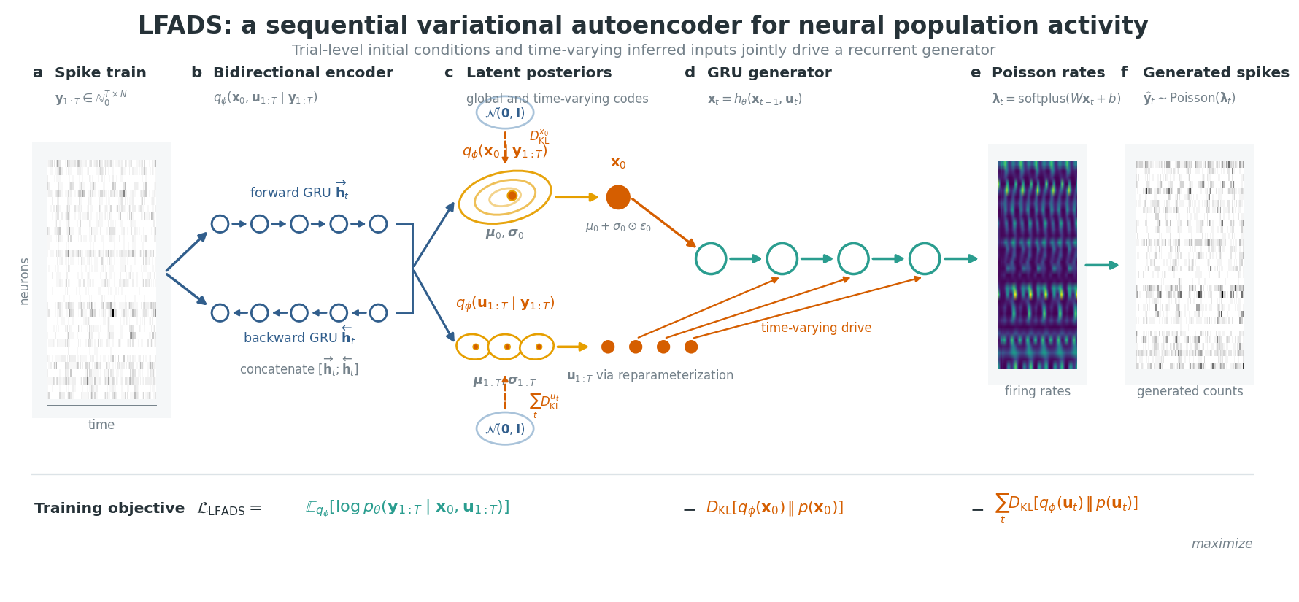
LFADS separates inferred initial condition, dynamics, and rates
An encoder infers a distribution over initial generator state; recurrent dynamics produce factors and firing rates.
Source: executed notebook 06_lfads.ipynb
32
Notes:
Timing: 1:55
LFADS treats a trial as a sequence generated by a dynamical system. The encoder summarizes the observed spikes and infers an initial condition. A recurrent generator evolves that state. A low-dimensional factor readout drives nonnegative firing rates, and spikes are modeled with a Poisson likelihood. More complete variants also infer time-varying inputs.

Slide 33
The sequential ELBO assigns uncertainty to a trajectory
Poisson reconstruction
Initial-state KL
Input KL
Do inferred rates explain held-out spikes?
How much trial-specific information enters g0?
Are inferred perturbations necessary and plausible?
Scientific danger: inferred inputs can absorb model mismatch.
33
Notes:
Timing: 1:50
The LFADS objective is a sequential ELBO. The likelihood evaluates whether inferred rates explain spike counts. KL terms constrain trial-specific initial states and, when present, inferred controller inputs. Inputs are powerful but scientifically delicate: they may represent real unobserved perturbations, or they may compensate for inadequate autonomous dynamics. Their interpretation requires perturbation timing and held-out validation.

Slide 34
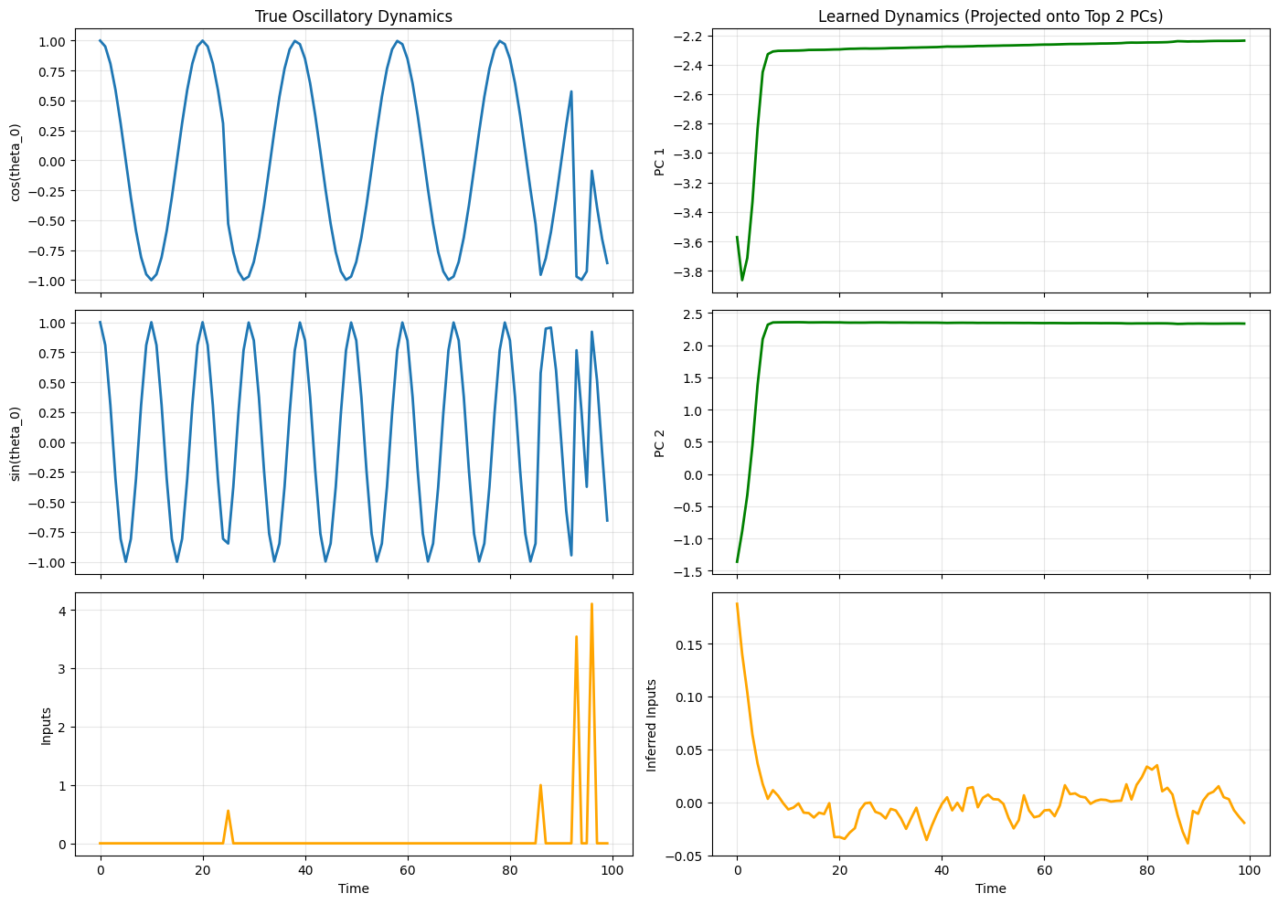
Learned dynamics must generalize beyond training trajectories
Compare learned and true vector fields, not only reconstructed observations.
Source: executed notebook 06_lfads.ipynb
34
Notes:
Timing: 1:40
For synthetic data, we can compare the learned vector field with the known system. For real data, we instead rely on held-out spike prediction, consistency across trials, perturbation responses, and dynamical invariants. Reconstruction alone can be achieved by a flexible encoder-decoder without recovering the correct autonomous dynamics.

Slide 35
PART 6
gpSLDS
Nonlinear dynamics assembled from interpretable local regimes
6
35
Notes:
Timing: 0:30
The final model retains nonlinear flexibility while exposing local linear dynamics and uncertainty.

Slide 36
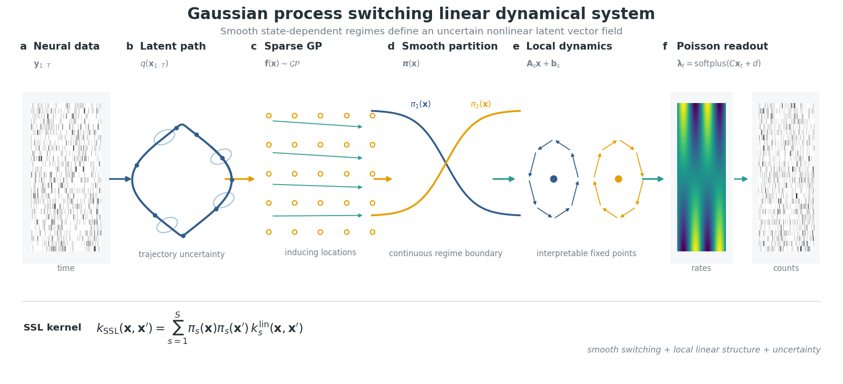
gpSLDS: nonlinear dynamics with local regimes
A smoothly switching kernel blends local linear dynamics within a global nonlinear field.
Source: executed notebook 08_gpslds.ipynb; model: Hu et al., NeurIPS 2024
36
Notes:
Timing: 1:55
A Gaussian-process switching linear dynamical system places a GP prior on the vector field. Local linear regimes define interpretable dynamical templates, while smooth gating functions blend them. Inducing points make GP inference scalable. The result is a nonlinear field with uncertainty and a local linear decomposition.

Slide 37
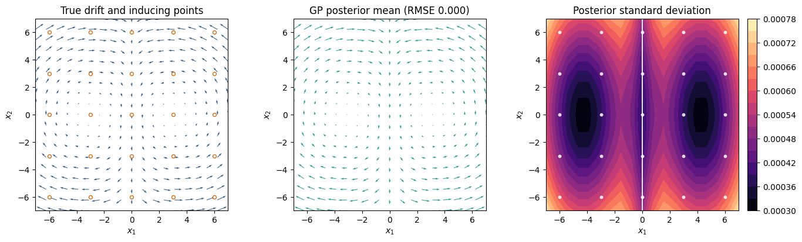
Local linear structure makes nonlinear dynamics inspectable
Regime weights partition latent space smoothly; local Jacobians support fixed-point and stability analysis.
Source: executed notebook 08_gpslds.ipynb
37
Notes:
Timing: 1:40
The key scientific advantage is inspectability. At each location we can examine regime weights, local linear operators, fixed points, and uncertainty in the vector field. However, this interpretation still depends on the latent observation model and identifiability constraints. A smooth partition is not automatically a biological module.

Slide 38
Choose the simplest model that answers the scientific question
Model
Latent structure
Inference
Best use
GMM
discrete class
exact EM
heterogeneous populations
HMM
discrete sequence
forward-backward
recurring temporal regimes
VAE
continuous code
amortized VI
nonlinear representation
LFADS
recurrent trajectory
sequential VI
population spike dynamics
gpSLDS
continuous + local regimes
variational GP
interpretable nonlinear flow
38
Notes:
Timing: 2:00
Model choice should follow the scientific question, not a hierarchy of sophistication. Use a mixture when temporal order is irrelevant. Use an HMM for discrete recurring regimes. Use a VAE for nonlinear continuous representations. Use LFADS when trial-level recurrent dynamics are central. Use gpSLDS when nonlinear flow and local dynamical interpretation are both required. More flexible models demand stronger validation.

Slide 39
A practical validation ladder
1
Implementation
synthetic recovery, invariants, numerical stability
Predictive
held-out likelihood, spikes, trajectories
2
3
Robustness
seeds, hyperparameters, latent dimension
4
Scientific
external variables, perturbations, falsifiable predictions
39
Notes:
Timing: 1:45
Validation should proceed in layers. First verify the implementation using synthetic data and mathematical invariants. Then test predictive generalization. Next test robustness across seeds and modeling choices. Finally ask whether latent variables correspond to external measurements or produce falsifiable perturbation predictions. A compelling visualization without these layers is exploratory evidence, not a mechanistic result.

Slide 40
Take-home message
1
Inference is the computation that connects a generative hypothesis to data.
2
EM, forward-backward, and VAEs share the same posterior-learning logic.
3
Temporal structure changes both the algorithm and the scientific meaning of a latent state.
4
Interpretability comes from constrained assumptions plus validation, not from low dimension alone.
Variational Neural Inference
Tutorial notebooks and references are available in this repository.
40
Notes:
Timing: 1:35
The unifying idea is that a generative model makes assumptions explicit, and inference connects those assumptions to observations. EM, HMM inference, VAEs, and sequential latent models are not isolated tricks; they are increasingly expressive solutions to the same posterior-learning problem. The value of the latent state comes from what the model constrains and what independent evidence validates.

