Slide 1
Duration reproduction under memory pressure: Modeling the roles of visual memory load in duration encoding and reproduction Xuelian Zang^{1,2}, Xiuna Zhu², Fredrik Allenmark², Jiao Wu¹, Hermann J. Müller², Stefan Glasauer³, Zhuanghua Shi² 1. Center for Cognition and Brain Disorders, Affiliated Hospital of Hangzhou Normal University, 310015, China. 2. General and Experimental Psychology, Department of Psychology, LMU Munich, 80802, Germany 3. Computational Neuroscience, Institute for Medical Technology, Brandenburg Technical University Cottbus-Senftenberg, 03046, Cottbus, Germany *. Note Xuelian Zang and Xiuna Zhu contributed equally to this manuscript.

Slide 2






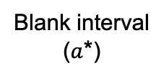
a Duration task
Duration
Encoding
Production
+
Cue (0.5 s)
Fixation (0.5 s)
Duration
(0.5 - 1.7 s)
Blank interval ($a$*)
Duration
Reproduction
Reproduction
Cue
(until response)
Reproduced
duration
Feedback
Blank interval
(1 s)

Slide 3
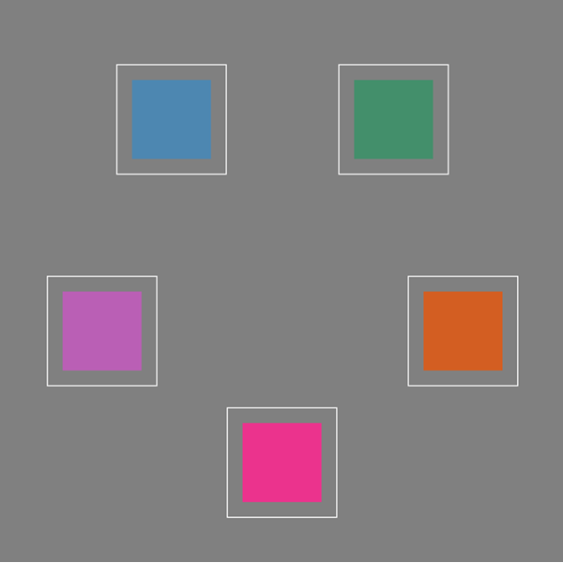


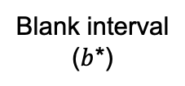

b Memory task
Memory Encoding
Memory Test
+
Fixation ($b$*)
Memory display (0.5 s)
Blank interval
($b$*)
Probe display
(until response)
Blank interval
($c$*)

Slide 4
c Trial sequence
Memory load
Exp. 1 & 4a
Memory
Encoding
Duration
Encoding
Memory
Test
Duration
Reproduction
Memory load
Exp. 2 & 4b
Duration
Encoding
Memory
Encoding
Duration
Reproduction
Memory
Test
Memory load
Exp. 3 & 4c
Duration
Encoding
Duration
Reproduction
Memory
Encoding
Memory
Test
Memory load
Exp.5
Memory
Encoding
Duration
Encoding
Duration
Reproduction
Memory
Test
Memory load
Exp. 6
Memory
Encoding
Duration
Encoding
gap
Duration
Reproduction
Memory
Test

