Slide 1
Computer Security
XSS, SQL injection, CSRF and more!

Slide 2
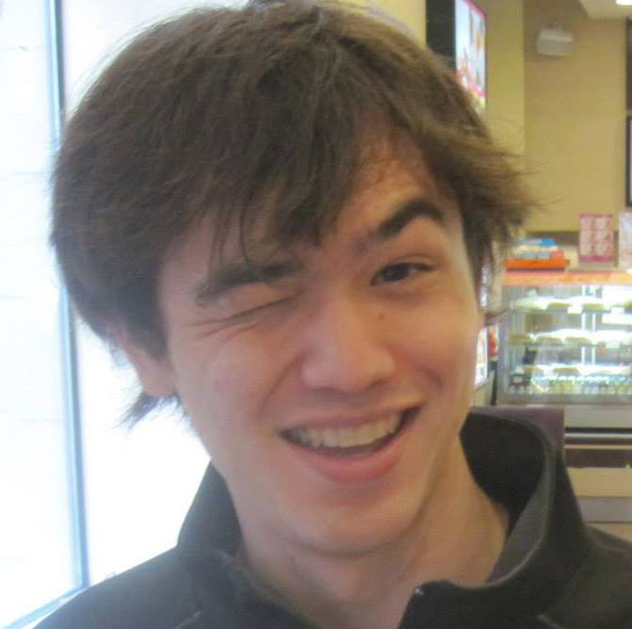
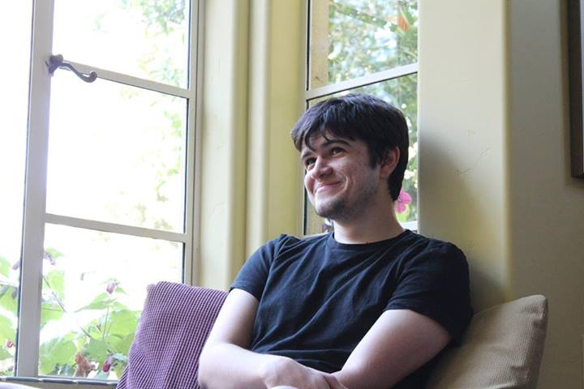
Who are we?
Maxime Serrano, CS/MS ‘15
Ryan Goulden, CS ‘15

Slide 3

Who are we?
Co-leaders of PPP
http://pwning.net
CMU’s competitive security team
Currently ranked the best in the world
First place holders at DEFCON, Hack.lu, Ghost in the Shellcode, CSAW CTF, others

Slide 4
Offensive vs Defensive Security
In this talk, we’ll talk a lot about offensive security
Executing real attacks (on contrived examples)
“The best defense is a good offense”
In the real world, you’ll likely be more concerned with defense
“How do we make sure we’re not going to get owned?”
Understanding offense makes you better at defense!

Slide 5
Security: The Core Idea
You cannot trust the user.
You cannot trust any data that the user can modify to conform to your expectations.

Slide 6
Web Applications
Basically impossible to hack a static site – no user input
But sites aren’t static HTML!
Reddit (Common Lisp, Python), Facebook (PHP), Google (C++, Java, Go), Twitter (Ruby, Python)
But there are frequently applications sitting behind web servers…
PHP, Python, Ruby, Perl, Haskell, JavaScript, even SML!
There are applications written in full-fledged programming languages sitting behind webservers and responding to user input
Full-fledged applications are full of bugs.

Slide 7
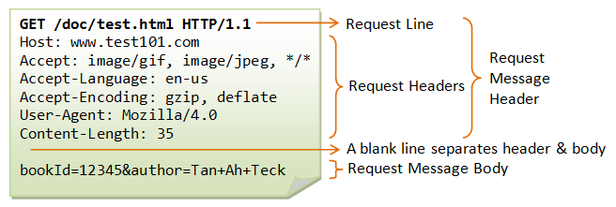
URLs and Requests
URLs
Uniform resource locator
Example: http://www.google.com/
Query strings:
http://blah.com/thing.php?secure=no
HTTP Requests
GET – I want you to give me stuff
POST – I want to send you stuff
HEAD, PUT, DELETE, others

Slide 8
Headers
Each request and response contain other fields
Can contain whatever data the browser wants to send
X-Forwarded-For, User-Agent, others

Slide 9
Easily Making Requests
Web hacking: in summary, “POST the right data to a server, or GET the right query string”
Making HTTP requests quickly and correctly is important
Don’t use telnet or nc
Use Python’s requests library, or curl, or wget

Slide 10
Web Applications
Defense: anticipate malicious input and be smart
Offense: anticipate “bad” programming and profit

Slide 11
Cookies
HTTP is stateless
There’s no “remembering” things across requests!
Workaround: cookies
Give user some data to store!
Use some cryptography to ward against malicious users
Lots of people have exposed vulnerabilities through cookies
Yahoo!, Flickr, Facebook…
In essence, they trusted user-modifiable data!

Slide 12
Cookies & Cryptography
You can’t trust users not to mess with their cookies.
Crypto that guarantees that users can’t mess with their cookies without you noticing is surprisingly hard to get right
Don’t do it by hand – there exist libraries to do it for you

Slide 13
JavaScript
The web isn’t just for HTML, CSS and media
Often, we want interactive websites…
Gmail, Facebook, etc
JavaScript is embedded in all modern browsers
There is code running in the browser, sent by the server

Slide 14
JavaScript
People often put sensitive information into their browsers
Bank account numbers, usernames, passwords, SSNs, …
If we can run code in the browser, can we steal sensitive data?
Not as another site – “Same Origin Policy”

Slide 15
Cross-Site Scripting (XSS)
A work-around for the Same Origin Policy
Inject code into a page on a domain with sensitive information
Code sends sensitive info to the attacker’s server
Code can be injected in various ways…
Gist is: put <script></script> everywhere you can find

Slide 16
XSS, a theoretical example
Our “friend” Bob uses an email service.
We know Bob reads his emails every hour on the hour.
We notice that Bob will execute JavaScript we email to him!
We make Bob do something we want!
Send us his cookies (so we can log in as Bob!)
Write/send a message
Download malware

Slide 17
An example
post '/register' do
username = params[:username]
password = params[:password]
unless username && password
die("Please specify both a username and a password.", :register)
end
unless username =~ /^\w+$/
die("Invalid username. Usernames must match /^\w+$/", :register)
end
unless DB.conn[:users].where(:username => username).count == 0
die("This username is already registered. Try another one.", :register)
end
.....

Slide 18
Notice…
Username is filtered, but not password
If passwords are ever displayed (… hopefully not …), put code in password!

Slide 19
What went wrong?
We trusted user-controlled data to appear on our site, and assumed it would play well with HTML.

Slide 20










How common is XSS?

Slide 21
Demo(s)!

Slide 22
Databases
Most interesting web software stores user data
E.g. Facebook, Gmail, forums, blogs, etc
Most dynamic pages make use of some form of database
Frequently, a SQL database

Slide 23
SQL
Structured Query Language
Allows you to make queries about particular structured data
Basic syntax:
Command table [arguments];
Command: usually SELECT, INSERT, UPDATE, REPLACE or DELETE
Table: something like “lectures” or “accounts”
Arguments: varies by command
Examples:
SELECT * FROM students WHERE school=“CMU”
INSERT INTO schools (name, location) VALUES (“CMU”, “Pittsburgh”)

Slide 24
SQL
Many, many databases store strings
… otherwise you’re not storing very interesting user data
SQL “handles” strings by quoting!
Many (many) sites do something like:
$query = “SELECT * FROM users WHERE username=‘” + $username + “’”;
run_query($query);

Slide 25
What could go wrong?
$username = “’ OR id=0; -- ”;

Slide 26
Injection
Setting fields with “special” data that leads to executing a user-controlled query
Often involves bypassing some form of filtering or escaping
Objective:
Read data you shouldn’t be able to read
Write data you shouldn’t be able to write

Slide 27
Standard Procedure
Check every field for injection
Once you have an injectable field, extract information about database format
Extract/write data desired

Slide 28
Example

Slide 29
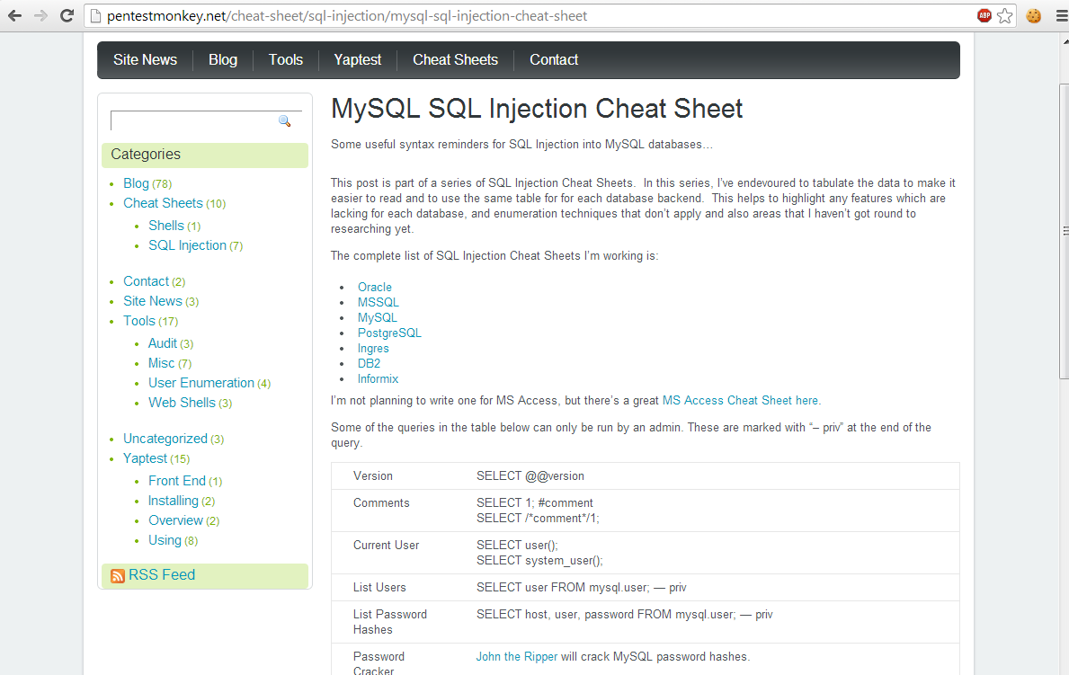
How do you remember all that?
You don’t
You Google for “SQL injection cheat sheet”

Slide 30
Filtering
People often filter incompletely
Strip spaces and tabs but not newlines or vertical tabs
Disallow JOIN keyword but not UNION keyword
Disallow more than one single quote
Disallow double quotes
All of this can be worked around!
Use abnormal whitespace
Use “weird” keywords, or use comments mid-keyword
Unicode

Slide 31
Escaping
Lots of people escape incorrectly
PHP:
mysql_escape_string (deprecated)
mysql_real_escape_string (deprecated)
mysqli_escape_string (discouraged)
mysqli_real_escape_string (discouraged)
PDO::quote
Avoid doing this. Use prepared queries instead.

Slide 32
Blind injection
SQL injection, with a catch…
We don’t get any “free” data.
Everything has to be leaked out bit-by-bit.
For example: none of the resulting data is shown on the page
How then do we extract data?
SLEEP(), BENCHMARK()

Slide 33











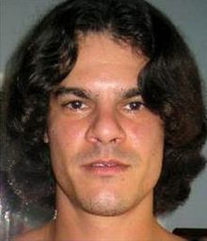

How common is SQL injection?

Slide 34
A Demo!

Slide 36
“I escape everything before showing it, and I use prepared statements. I’m clear, right?”
… Sadly, no.

Slide 37
Cross-Site Request Forgery
Also called “session riding”
What if Eve sends Alice “Hey, click this link: <a href=http://bank.example.com/withdraw?account=Alice&amount=1000000&for=Eve>click</a>”?
What if Eve serves Alice the HTML <img src=http://bank.example.com/withdraw?account=Alice&amount=1000000&for=Eve /> ?

Slide 38
Cross-Site Request Forgery
How do we protect against this?
Check headers (referrer header!)
Every such action should only come from the appropriate page.
You can only withdraw money if you came from the “withdrawal” page
You can only send a message from the “Send Message” page
You can only write a blog post from the “New Post” page
Generate a new token that must be sent back to the server for the request to be valid

Slide 39
Another Way to go Wrong
<?php
session_start();
if ($_FILES["dispic"]["error"] > 0) {
echo "<p>Error: " . $_FILES["dispic"]["error"] . "</p>";
}
else
{
$dest_dir = "uploads/";
$dest = $dest_dir . basename($_FILES["dispic"]["name"]);
$src = $_FILES["dispic"]["tmp_name"];
if (move_uploaded_file($src, $dest)) {
$_SESSION["dispic_url"] = $dest;
chmod($dest, 0644);
echo "<p>Successfully uploaded your display picture.</p>";
}
}

Slide 40
Hm…
What if my picture has code in it?

Slide 41
Thanks for coming!
If you have any more questions:
mserrano@andrew.cmu.edu
rgoulden@andrew.cmu.edu
Source code for vulnerable websites will soon™ be on my Github
github.com/mserrano/talks
Slides, too
If you want to join PPP, meetings are on Fridays at 5pm in CIC2101
Or you can join the mailing list – plaid-parliament-pwning@lists.andrew

