Slide 1
Programming Workshop:
Practice, Practice, Practice!
Beginner’s Workshop #5
17 October 2016

Slide 2
Outline
“Homework” - Completion
GitHub - Fork Our Repository (just in case!)
Review: Using Vim
Review: Input/Output ( I/O )
Dictionaries!
Overview
Syntax
Practice
Exercises

Slide 3
“Homework”
Get Linux and Python running!
Make a GitHub account and fork our repository
Go through the Codecademy Python lesson

Slide 4
Forking our GitHub Repository
Forking our repository:
Open our repo in a web browser
In the upper right side of the interface, click “fork this repository”
In the list of your repositories, select the fork of our repository
Clone your fork of our repository to your computer

Slide 5
VIM commands
Command | Description
vim <file> | Open file <file>
i | Go into insert mode
v | Go into visual mode
Arrow keys | Move up, down, left, or right
y | When in visual mode, select text, and use ‘y’ to copy (yank)
p | When not in any mode, use ‘p’ to paste on the character or row following cursor
:w | Save (write) file
:q | Exit (quit)

Slide 6
Python Basics: I/O
File input collected via:
file_reference = open(“filename”, “mode”)
Then can write to file:
file_reference.write()

Slide 7
Python Basics: I/O (cont’d)
Many types of output:
print()
open(“filename”, “mode”)
file.write()
with open() as csvfile: …
csv.writerow()

Slide 8
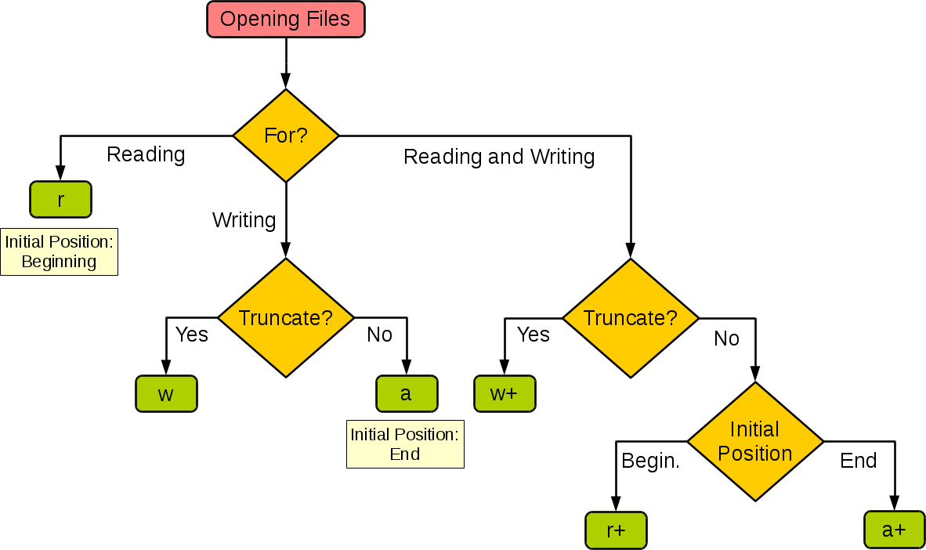
http://stackoverflow.com/questions/1466000/python-open-built-in-function-difference-between-modes-a-a-w-w-and-r

Slide 9
Updating your Fork
git remote add upstream https://github.com/mseryn/intermediate_programming_workshops
git fetch upstream
git merge upstream/master

Slide 10
Dictionaries
Called a “map” in some languages
Stores a value given some key
EX:
First_years -> [list of names]
Cans_collected -> 45
Test_set_1 -> [list of data points]
Very useful for data analysis

Slide 11
Dictionaries - Syntax
# Initialize:
new_dict = {}
other_dict = {“banana”: 2, “egg”: 10}
# Add/Overwrite items - note they’re indexed like arrays
new_dict[“hot sauce”] = 1
other_dict[“banana”] = 0
new_dict[“cheese types”] = []
new_dict[“cheese types”].append(“cheddar”)

Slide 12
Dictionaries - Practice
A little practice in the interpreter:
Make a dictionary to store people’s names by their zip codes. Have it take user inputs to collect this data.

Slide 13
Speed Exercises
# 1:
Read from the file exercise_1_inputs.txt. Each line is an integer. Average these integers, and print the average.
240 seconds

Slide 14
Speed Exercises
# 2:
Read the file dictionary_inputs.txt. Each line is a key, value pair separated by a space. Store the values under their key in a dictionary. Print the dictionary.
15 minutes

Slide 15
Speed Exercises
# 3:
Take the dictionary from #2.
Take an input from the user. If it’s a key, print that key’s value.
10 minutes

Slide 16
“Homework”
Go through the Codecademy Python lesson
Play Vim Adventures or read Vim tutorials
Finish exercises 2 and 3

