Slide 1
NETWORK DESIGN & AUTOMATION SPECIFICATION
High-Availability Automated Multi-Branch WAN Architecture
Prepared For: TechLink Solutions
Target Infrastructure: Cairo HQ Core — Alexandria & Giza Regional Branches
Document Classification: Technical Design, Deployment, & Automated Telemetry Framework

Slide 2
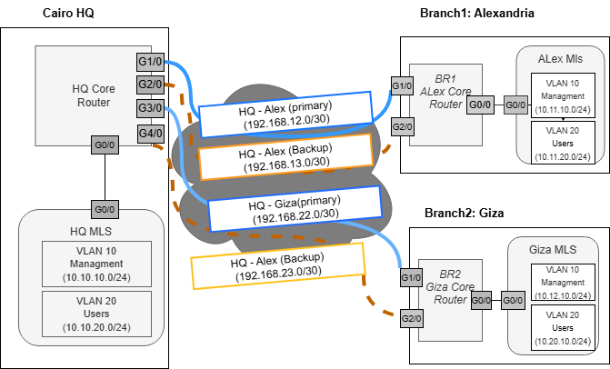
Network topology Diagram

Slide 3
Master IP Addressing Table
Master IP Addressing Table
Device name | Interface | Description | ip address | subnet mask | Default Gateway
HQ-Router |  | Router ID / Loopback | 1.1.1.1 | 255.255.255.255
 | G0/0 | Link to cairo ML switch | 10.10.1.1 | 255.255.255.252
 | G1/0 | Primary WAN Link to Alex | 192.168.12.1 | 255.255.255.252 | 192.168.12.2
 | G2/0 | Backup WAN Link to Alex | 192.168.13.1 | 255.255.255.252 | 192.168.13.2
 | G3/0 | Primary WAN Link to Giza | 192.168.22.1 | 255.255.255.252 | 192.168.22.2
 | G4/0 | Backup WAN Link to Giza | 192.168.23.1 | 255.255.255.252 | 192.168.23.2
HQ-ML-Switch | FE0/0 | Routed Port to HQ Router | 10.10.1.2 | 255.255.255.252 | 10.10.1.1
 | FE0/1(Vlan 10) | Cairo Management SVI | 10.10.10.1 | 255.255.255.0
 | FE1/0(Vlan 20) | Cairo Users SVI | 10.10.20.1 | 255.255.255.0
BR1-Alex-Router |  | Router ID / Loopback | 2.2.2.2 | 255.255.255.255
 | G0/0 | Link to Alex ML Switch | 10.11.1.1 | 255.255.255.252
 | G1/0 | Primary WAN Link to Cairo | 192.168.12.2 | 255.255.255.252 | 192.168.12.1
 | G2/0 | Backup WAN Link to Cairo | 192.168.13.2 | 255.255.255.252 | 192.168.13.1
BR1-ML-Switch | FE0/0 | Routed Port to Alex Router | 10.11.1.2 | 255.255.255.252 | 10.11.1.1
 | FE0/1(Vlan 10) | Alex Management SVI | 10.11.10.1 | 255.255.255.0
 | FE1/0(Vlan 20) | Alex Users SVI | 10.11.20.1 | 255.255.255.0
BR2-Giza-Router |  | Router ID / Loopback | 3.3.3.3 | 255.255.255.255
 | G0/0 | Link to Giza ML Switch | 10.12.1.2 | 255.255.255.252
 | G1/0 | Primary WAN Link to Cairo | 192.168.22.2 | 255.255.255.252 | 192.168.22.1
 | G2/0 | Backup WAN Link to Cairo | 192.168.23.2 | 255.255.255.252 | 192.168.23.1
BR2-ML-Switch | FE0/0 | Routed Port to Alex Router | 10.12.1.2 | 255.255.255.252 | 10.12.1.1
 | FE0/1(Vlan 10) | Giza Management SVI | 10.12.10.1 | 255.255.255.0
 | FE1/0(Vlan 20) | Giza Users SVI | 10.12.20.1 | 255.255.255.0

Slide 4
Routing & Failover Strategy
Protocol: OSPFv2 (router ospf 1, area 0) for dynamic neighbor discovery and zero manual route management.
Traffic Flow: Identical cost metrics enable ECMP (Equal-Cost Multi-Pathing). The core router splits traffic across both pipes under normal conditions to utilize all paid bandwidth.
Failover Behavior: If a primary link drops, OSPF drops the adjacency, flushes the bad route from the routing table, and swings 100% of traffic to the backup line.
Why OSPF Over Other Protocols?
vs. Static Routing: Static routes require manual scripting or brittle IP SLA tracking to failover. OSPF heals itself automatically when hello packets stop, without adding complex configurations.
vs. BGP: BGP is built for massive internet edge or carrier networks. It introduces massive configuration overhead and slower default convergence timers that are unnecessary for a lean, three-site private WAN layout.

