Slide 1
Introduction to Microarrays
BCB 504: Applied Bioinformatics
Matt Settles
Jan 23, 2013

Slide 2
Are arrays still relevant
Well established – 17+ years of technology and bioinformatics support.
Lower cost solution: making it thus possible to test various experimental conditions and to use many replicates, the latter being a necessity to account for biological variability.
  Cost is 2-3 times less per sample
  Low data handling burden: megabytes of data rather than multiple gigabytes or (Tb) of data.
  Accepted pre-processing and data analysis method: algorithms for analysis are well understood and agreed upon.

Slide 3
Microarrays
DNA microarrays rely on the hybridization properties of nucleic acids to monitor DNA or RNA relative abundance on a genomic scale in different types of cells.

Slide 4
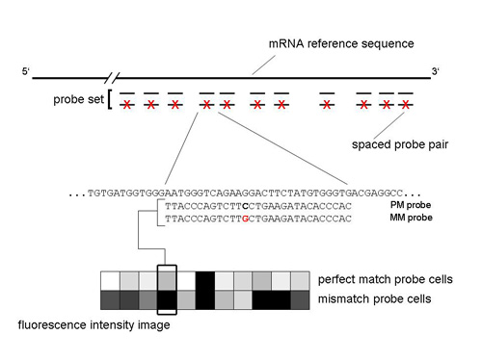
Array Design
(Affymetrix)
Affymetrix 3’ IVT GeneChip Arrays

Slide 5
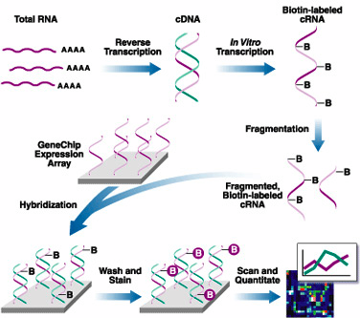
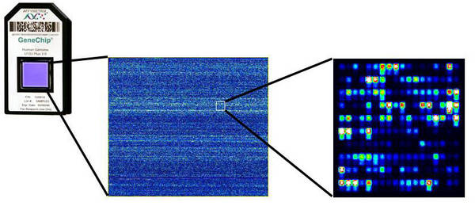
Sample Preparation and Data Acquisition

Slide 6
Basic process
You Tube Microarrays

Slide 7




Microarrays
Affymetrix
Agilant
- silica
glass
- photolithographic synthesis
- inkjet printing synthesis
25-mer probes
- 60-mer probes
- 6.5M features
- 1M features
- no multiplexing
- multiplex 8X
- biotin-labeled
- Cy3/Cy5
Nimblegen
Illumina
- glass
glass bead on silica
- maskless array synthesis
- Bead array technology
50-75mer probes
- 50-mer probes
- 4.2M featues
- 600,000 features
- multiplex 12X
- Multiplex 12X
- Cy3/Cy5
- biotin-labeled

Slide 8
Applications
 | Affymetrix | Agilant | Nimblegen | Illumina
Gene Expression Studies | ✗ | ✗ | ✗ | ✗
Comparative Genomic Hybridization (CGH) | ✗ | ✗ | ✗
Chromatin immunoprecipitation on chip (ChIP-Chip) | ✗ | ✗ | ✗
DNA Methylation | ✗ | ✗ | ✗ | ✖
Sequence Capture |  | ✗ | ✗
Comparative Genomic Sequencing |  |  | ✗
SNP Genotyping (plus CNV) | ✗ |  |  | ✖
MicroRNA |  | ✗

Slide 9
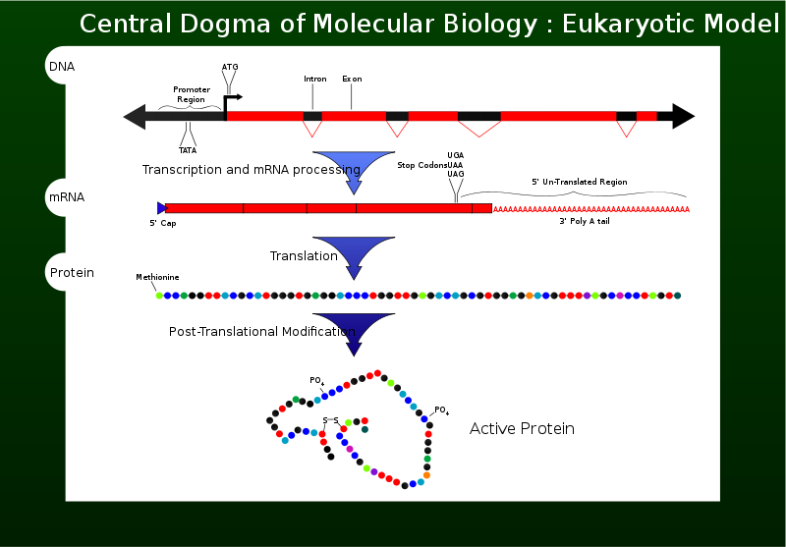
Central Dogma
Wikipedia – the central dogma of molecular biology
Notes:
What is the central Dogma
What are SNPs, indel, splice variants, polyadenylation differences, cis-acting and trans-acting

Slide 10

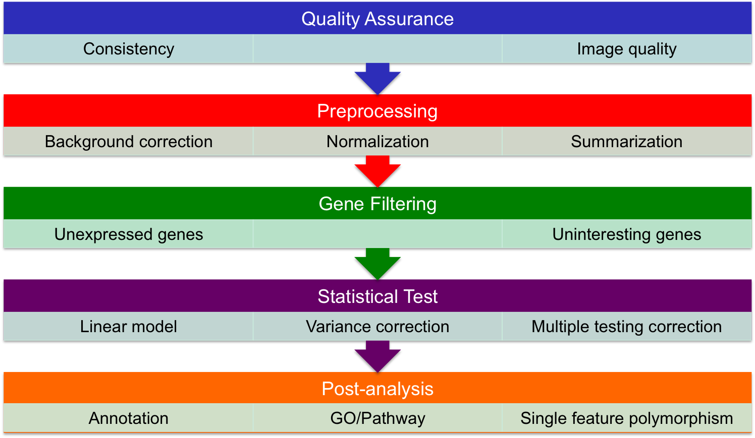
Differential Gene Expression Analysis

Slide 11
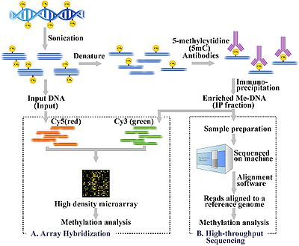
CHiP-Chip and MeDIP-Chip

Slide 12
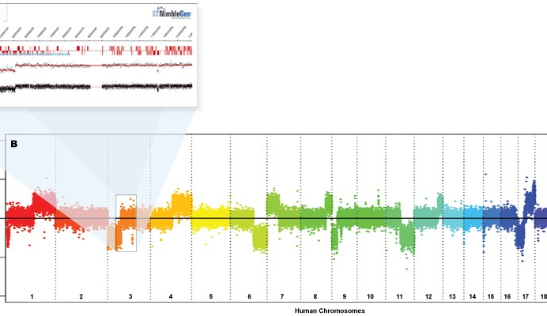
Array CGH (aCGH)

Slide 13
Custom Microarrays for non-model organisms

Slide 14
Possible Workflow
Step 1
Generate HT sequence data:
Use multiple technologies
(Illumina and 454 or Illumina and Pac Bio)
Ribosomal RNA depleted library
Strand specific library
Sloppy insert size

Slide 15
Possible Workflow
Step 2
Assemble the sequence reads:
Clean, clean, and clean the reads. Remove low quality reads, trim low quality ends, check and remove adapters in sequence.
Assemble the sequence reads into a transcriptome for downstream probe selection and functional annotation.
Choice of assemblers include: Roche Newbler, Trans-ABySS, Broad’s trinity pipeline, among others.

Slide 16
Possible Workflow
Step 3
Annotate transcriptome:
BLASTX search of the contigs and singletons against the GenBank non-redundant (nr) protein database.
Functionally annotate all transcripts using the annotation tool Blast2GO to get GO terms and unique enzyme commission (EC) numbers.

Slide 17
Possible Workflow
Step 4
Design probe library from reads rather than assembly:
Design probe library from the sequence reads.
Design one probe per sequence, starting from base 1, but designed using platform specific parameters (ie. Tm, length,etc.).
Map probes back to contigs using blat

Slide 18
Possible Workflow
Step 5
Test probes using aCGH and expression test array:
Conduct an array-based comparative genomic hybridization (aCGH) experiment with a high capacity custom array to remove probes likely due to contamination or with poor hybridization affinity.
Pay attention to probe GC content and signal.
Note: aCGH will select against probes that span intron-exon boundaries

Slide 19
Possible Workflow
Step 6
Generate array
Select probes for final custom array, based on
1) quality of signal in the aCGH and expression experiment
  2) annotation information and
3) number of quality probes available for the transcript (target at least 3, but more is better)
4) number of probes available on the array

Slide 20
Data repositories
GEO
ArrayExpress

