Slide 1
Introduction to Microarrays
BCB 504: Applied Bioinformatics
Matt Settles
Jan 17, 2012

Slide 2
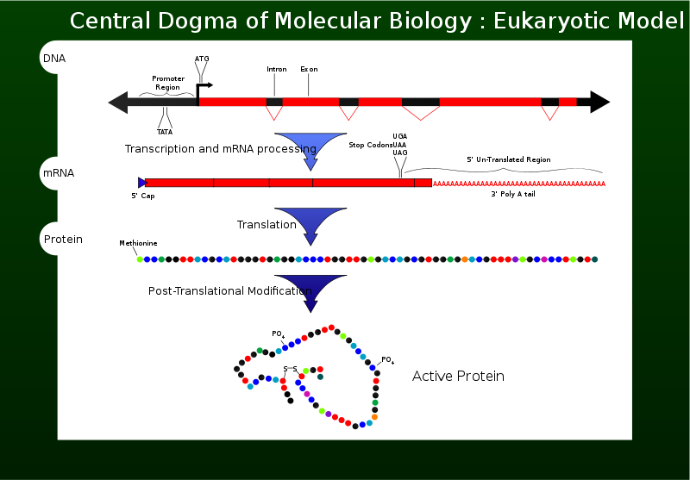
Central Dogma
Wikipedia – the central dogma of molecular biology
Notes:
What is the central Dogma
What are SNPs, indel, splice variants, polyadenylation differences, cis-acting and trans-acting

Slide 3
Microarrays
DNA microarrays rely on the hybridization properties of nucleic acids to monitor DNA or RNA relative abundance on a genomic scale in different types of cells.

Slide 4
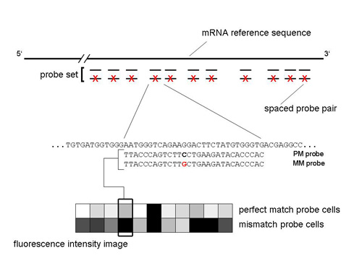
Array Design
(Affymetrix)
Affymetrix 3’ IVT GeneChip Arrays

Slide 5
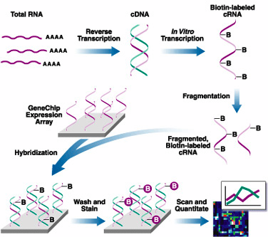
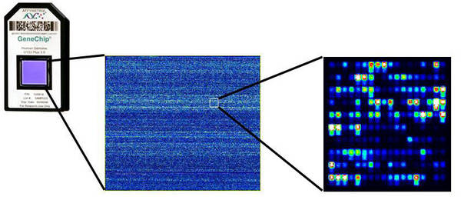
Sample Preparation and Data Acquisition

Slide 6
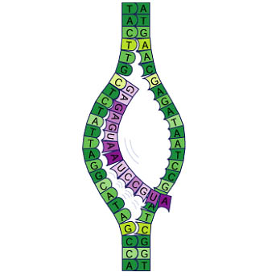
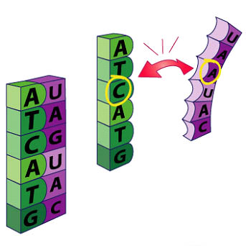
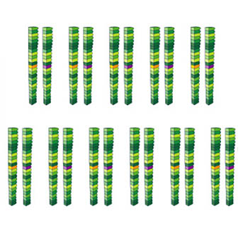
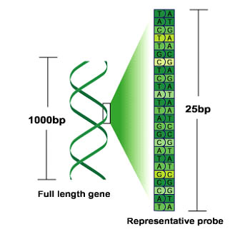
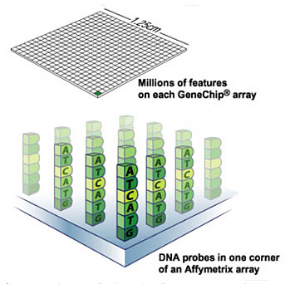
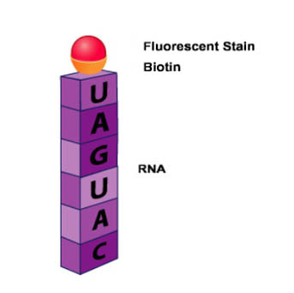
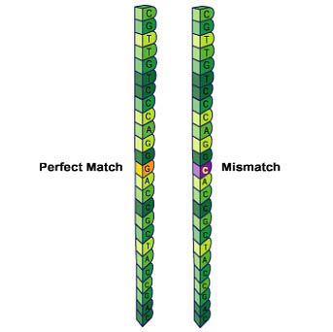
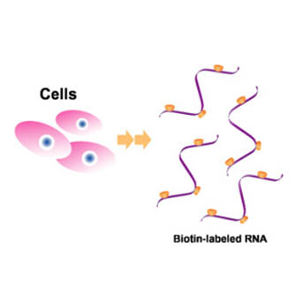
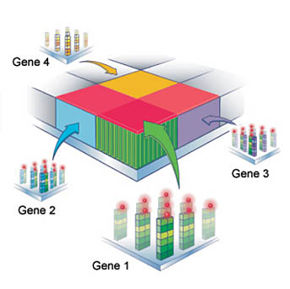
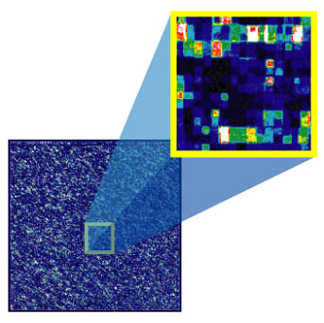
Basic process

Slide 7




Microarrays
Affymetrix
Agilant
- silica
glass
- photolithographic synthesis
- inkjet printing synthesis
25-mer probes
- 60-mer probes
- 6.5 million
- 244,000 features
- no multiplexing
- multiplex 8X
- biotin-labeled
- Cy3/Cy5
Nimblegen
Illumina
- glass
glass bead
- maskless array synthesis
- Bead array technology
50-75mer probes
- 50-mer probes
- 2.1 million
- 600,000 features
- multiplex 12X
- Multiplex 12X
- Cy3/Cy5
- biotin-labeled

Slide 8
Applications
 | Affymetrix | Agilant | Nimblegen | Illumina
Gene Expression Studies | ✗ | ✗ | ✗ | ✗
Comparative Genomic Hybridization (CGH) | ✗ | ✗ | ✗
Chromatin immunoprecipitation on chip (ChIP-Chip) | ✗ | ✗ | ✗
DNA Methylation | ✗ | ✗ | ✗ | ✖
Sequence Capture |  | ✗ | ✗
Comparative Genomic Sequencing |  |  | ✗
SNP Genotyping (plus CNV) | ✗ |  |  | ✗
MicroRNA |  | ✗

Slide 9

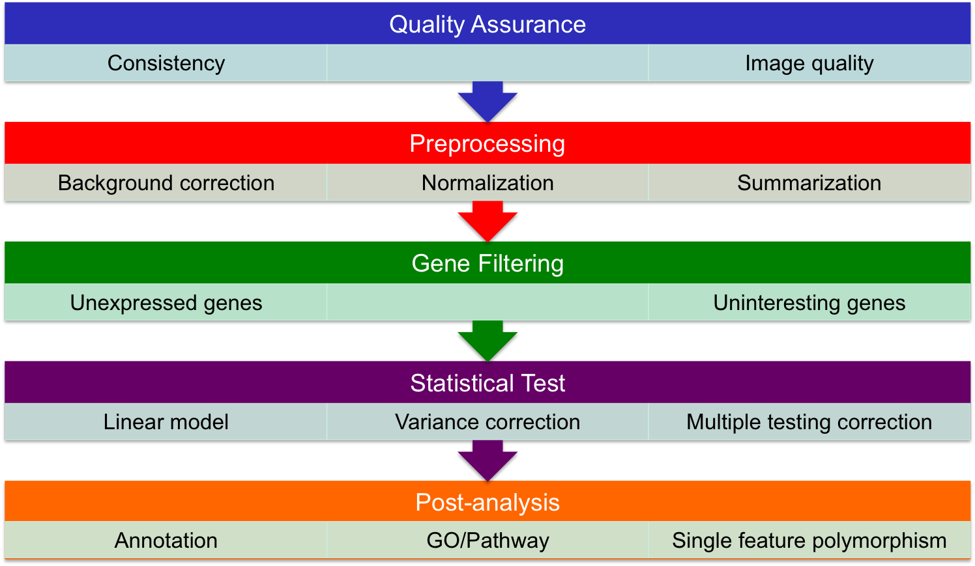
Differential Gene Expression Analysis

Slide 10
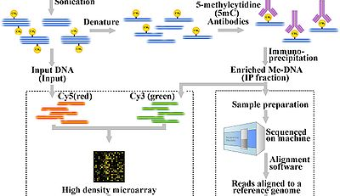

Slide 11
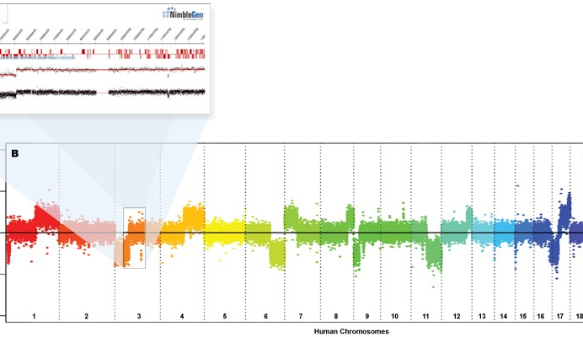

Slide 12
Data repositories
GEO
ArrayExpress

