Slide 1

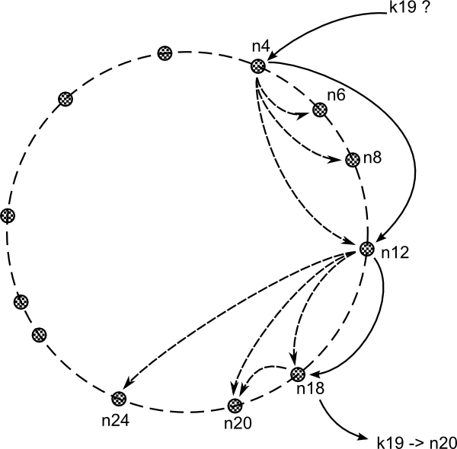
Department of Informatics
MComp (Hons) Computer Science
Academic year 2015/16
Project Title in Bold, Font Size 48
Michael Sledge
What is it
Create and maintain network of nodes
Map keys to nodes using hashes
Asynchronous network I/O for scalability and performance
Based on Chord protocol
Written in C
Network diagrams ‘n’ shit
Usage examples
Memcached
Subscribe/publish
.
Non-Blocking, Asynchronous I/O
The C10K problem
Libevent
Library for asynchronous I/O using callbacks
Your poster content should stay inside this red dotted line and tinted background. Before submitting the poster, delete the line and background.
Notes:
For instructions on the required format for the poster, see
http://www.sussex.ac.uk/ei/internal/forstudents/informatics/undergraduate/finalyearprojects/projectpresentation
Your poster content should stay inside this red dotted line and tinted background. Before submitting the poster, delete the line and background.

