Slide 1
Module 1 Final project
Mindy Jen
June 22, 2020

Slide 2
Name (primary profession)
Rating
Principals (role category)
Crew (director ID)
Basics (movie title, genre)
IMDB*
Name ID only
606648
Name & Title IDs
1028186
Title ID only
146144
Title ID only
146144
Title ID only
73856
1027912
b/c Title IDs are different for one given Name ID
1027912
b/c Name IDs are different for one given Title ID
629598
b/c Name IDs are different for one given Title ID
"One person showed up in several movies"
"One movie included several roles"
"Movies without rating info were dropped"

Slide 3
Directors only
Four rating regions
Director Name Indices
Useless columns deleted
NaN in genre removed
Data Selections/Cleaning
50077
50077
49734
49734 (4.8% left, compared to 1027912)
"Required only one role be in each movie"
9-10 R1 (425/28360), 0.85%
8-9 R2 (3592/28360), 7.22%
7-8 R3 (9534/28360), 19.17%
6-7 R4 (14809/28360), 29.78%
R1: Doc (1), Dra (2), Com (3), Bio (4), Mus (5)
R2: Dra (1), Doc (2), Com (3), Bio (4), Thr (5)
R3: Dra (1), Doc (2), Com (3), Rom (4), Thr (5)
R4: Dra (1), Com (2), Rom (3), Thr (4), Act (5)

Slide 4


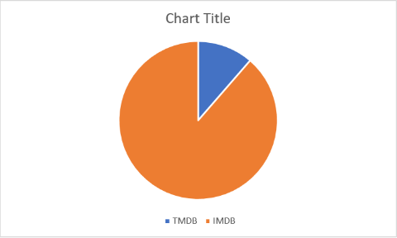
Blue : both
merely 11% of TMDB movies found in IMDB

Slide 5

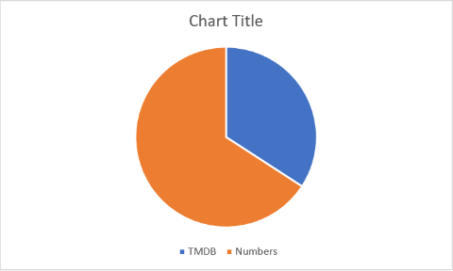
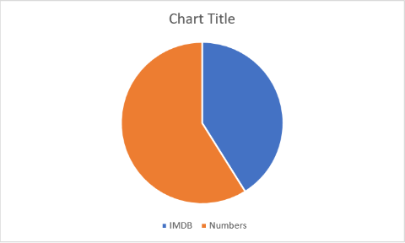
Blue : both
Blue : both
34% of TMDB movies found in TN_Budget
41% of IMDB movies found in TN_Budget

Slide 6

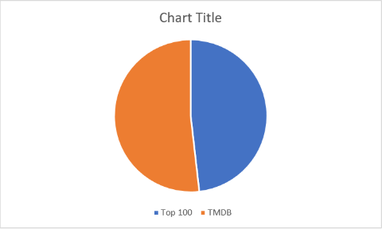

Blue : both
Blue : both
48% of Top 100 directors' movies from imdb* data-sets found in TMDB
33% of Top 100 directors' movies from imdb* data-sets found in TN_Budget

Slide 7

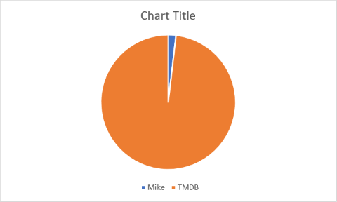
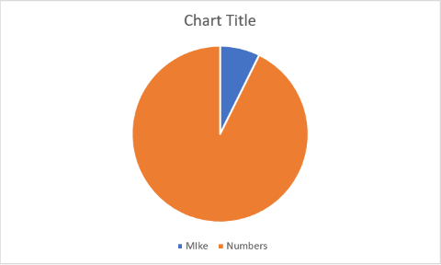
1.89% of high profit movies found in TMDB
7.89% of high profit movies found in TN_Budget

Slide 8
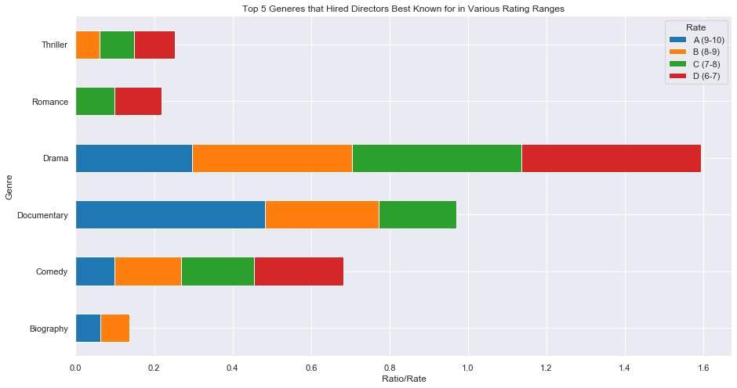
Overall Top 100 Directors & Their Movies (imdb*) over Top 5 movie genres (imdb*)
Evaluating Top 100 directors / per rating region based on different genre weights over a range of rating regions
1
1
1
2
2
4
5
5
5
5
4
4
3
3
3
3
2
2

Slide 9
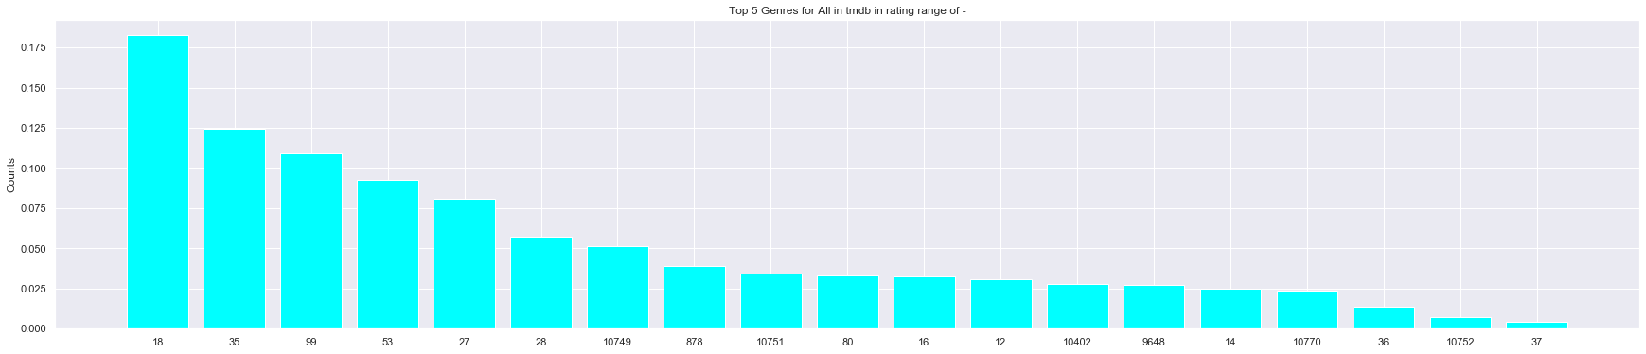
Top 19 movie genres (tmdb*)
{"genres": [{"id": 28, "name": "Action"}, {"id": 12, "name": "Adventure"}, {"id": 16, "name": "Animation"}, {"id": 35, "name": "Comedy"}, {"id": 80, "name": "Crime"}, {"id": 99, "name": "Documentary"}, {"id": 18, "name": "Drama"}, {"id": 10751, "name": "Family"}, {"id": 14, "name": "Fantasy"}, {"id": 36, "name": "History"}, {"id": 27, "name": "Horror"}, {"id": 10402, "name": "Music"}, {"id": 9648, "name": "Mystery"}, {"id": 10749, "name": "Romance"}, {"id": 878, "name": "Science Fiction"}, {"id": 10770, "name": "TV Movie"}, {"id": 53, "name": "Thriller"}, {"id": 10752, "name": "War"}, {"id": 37, "name": "Western"}]}
Top 5 high profit margin genres (based on Mike's study):
Top 1 : Mystery , Top 2 : Animation , Top 3 : Horror , Top 4 : Sci-fi , Top 5 : Adventure
Top 1 : Drama , Top 2 : Comedy , Top 3 : Documentary , Top 4 : Thriller , Top 5 : Horror

Slide 10
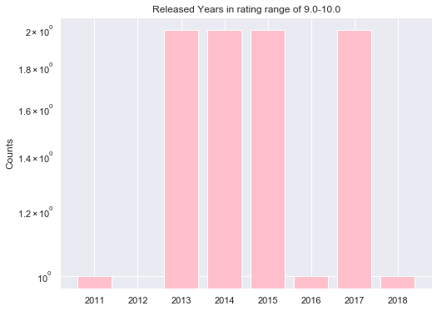
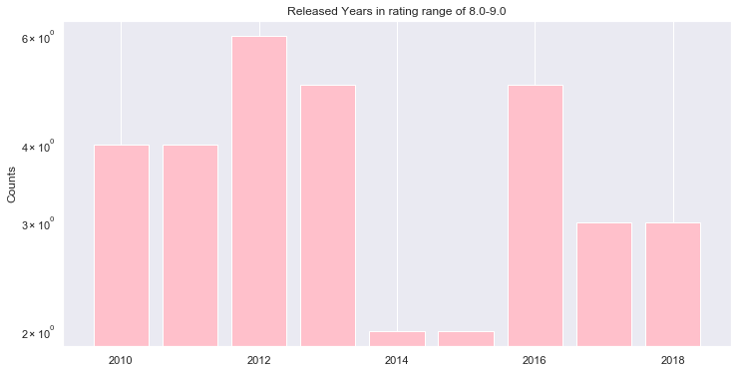
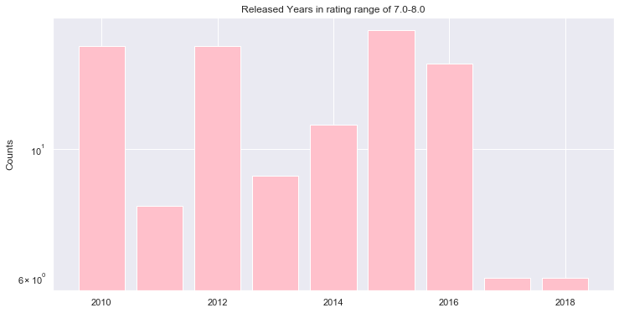
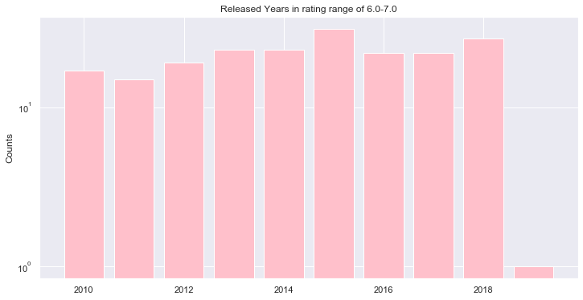
Overall Top 100 Directors & Their Movies (imdb*)
Released year (based on tmdb) all found after 2010
Rating : 9.0-10.0
11movies overlapped in Top 100
directors' imdb* movies & tmdb
Rating : 8.0-9.0
34 movies overlapped in Top 100
directors' imdb* movies & tmdb
Rating : 7.0-8.0
100 movies overlapped in Top 100
directors' imdb* movies & tmdb
Rating : 6.0-7.0
200 movies overlapped in Top 100
directors' imdb* movies & tmdb

Slide 11
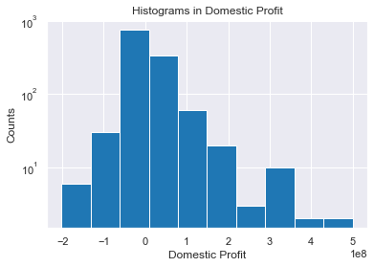
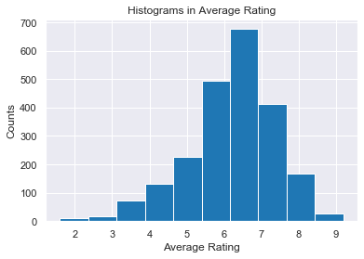
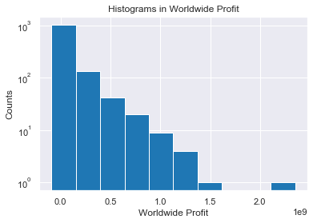
Overall average rating for those imdb* movies also appeared in The Numbers data-sets
mean 0.12843846*1e8
median –0.0250000.0*1e8
mean 6.2
median 6.3
6-7
Top 100 Directors in the search process
Domestic profit
7-8
8-9
mean 0.89897846*1e9
median 0.016438538*1e9
9-10
Top 100 Directors in the search process
Worldwide profit
Top 100 Directors in the search process

Slide 12
Top 100 Directors & their movies
(average rating: 8.0 - 9.0)
imdb* movie data-set
tn_budget movie data-set
primary_name | primary_title | start_year |  | movie | release_date | domestic_profit | worldwide_profit
Christopher Nolan | Inception | 2010 |  | Inception | 16-Jul-10 | 132576195 | 675524642
Christopher Nolan | Interstellar | 2014 |  | Interstellar | 5-Nov-14 | 23017894 | 501379375
Tim Van Someren | Coriolanus | 2014 |  | Coriolanus | 20-Jan-12 | -9250359 | -7820377
Denis Villeneuve | Incendies | 2010 |  | Incendies | 17-Sep-10 | 57096 | 9238343
Denis Villeneuve | Prisoners | 2013 |  | Prisoners | 20-Sep-13 | 15002302 | 67402302

Slide 13
Top 100 Directors & their movies
(average rating: 7.0 - 8.0)
imdb* movie data-set
tn_budget movie data-set
primary_name | primary_title | start_year |  | movie | release_date | domestic_profit | worldwide_profit
Alejandro G. Iñárritu | Biutiful | 2010 |  | Biutiful | 28-Jan-11 | -29898763 | -10312476
Spike Lee | BlacKkKlansman | 2018 |  | BlacKkKlansman | 10-Aug-18 | 34275340 | 78017335
Dexter Fletcher | Rocketman | 2019 |  | Rocketman | 31-May-19 | 16342725 | 67642725
Martin Scorsese | Hugo | 2011 |  | Hugo | 23-Nov-11 | -106135493 | 47784
Martin Scorsese | Silence | 2016 |  | Silence | 23-Dec-16 | -39399823 | -22773374
Ryan Coogler | Creed | 2015 |  | Creed | 25-Nov-15 | 72767581 | 136567581
Steven Spielberg | Lincoln | 2012 |  | Lincoln | 9-Nov-12 | 117207973 | 208346281
Dibakar Banerjee | Shanghai | 2012 |  | Shanghai | 2-Oct-15 | -49953575 | -34494078
James Wan | Aquaman | 2018 |  | Aquaman | 21-Dec-18 | 175061807 | 986894640
Robert Zemeckis | Flight | 2012 |  | Flight | 2-Nov-12 | 62772375 | 129558438
Robert Zemeckis | Allied | 2016 |  | Allied | 23-Nov-16 | -65901936 | 13266661

Slide 14
Top 100 Directors & their movies
(average rating: 6.0 - 7.0)
imdb* movie data-set
tn_budget movie data-set
primary_name | primary_title | start_year |  | movie | release_date | domestic_profit | worldwide_profit
Jaume Collet-Serra | Non-Stop | 2014 |  | Non-Stop | 28-Feb-14 | 41742160 | 172383055
Jaume Collet-Serra | Unknown | 2011 |  | Unknown | 18-Feb-11 | 23686397 | 96123083
Tim Burton | Frankenweenie | 2012 |  | Frankenweenie | 5-Oct-12 | -3712212 | 42150788
Tim Burton | Dumbo | 2019 |  | Dumbo | 29-Mar-19 | -56116682 | 175004422
David Gordon Green | Stronger | 2017 |  | Stronger | 22-Sep-17 | -25788871 | -21213248
David Gordon Green | Joe | 2013 |  | Joe | 11-Apr-14 | -3626625 | -3626625
David Gordon Green | Halloween | 2018 |  | Halloween | 19-Oct-18 | 149342015 | 244900667
Robin B. Murray | Stronger | 2017 |  | Stronger | 22-Sep-17 | -25788871 | -21213248
Steven Soderbergh | Contagion | 2011 |  | Contagion | 9-Sep-11 | 15658097 | 77551594
Steven Soderbergh | Unsane | 2018 |  | Unsane | 23-Mar-18 | 6190044 | 12744931
Ridley Scott | Prometheus | 2012 |  | Prometheus | 8-Jun-12 | 1477084 | 277448265
Paul Feig | Bridesmaids | 2011 |  | Bridesmaids | 13-May-11 | 136711718 | 257132023
Ron Howard | Inferno | 2016 |  | Inferno | 28-Oct-16 | -40656426 | 144519367
Jeff Tomsic | Tag | 2018 |  | Tag | 15-Jun-18 | 26730625 | 49026186
Daniel Espinosa | Life | 2017 |  | Life | 24-Mar-17 | -27765978 | 42929666
Pablo Larraín | Jackie | 2016 |  | Jackie | 2-Dec-16 | 4960394 | 27588512
Baltasar Kormákur | Adrift | 2018 |  | Adrift | 1-Jun-18 | -3554989 | 22897191
Baltasar Kormákur | Contraband | 2012 |  | Contraband | 13-Jan-12 | 41528000 | 73406855
Mike Flanagan | Oculus | 2013 |  | Oculus | 11-Apr-14 | 22695246 | 39115496

Slide 15
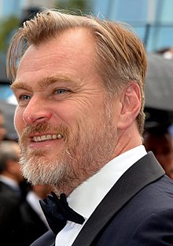
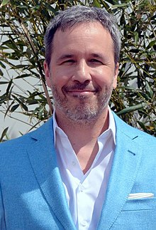

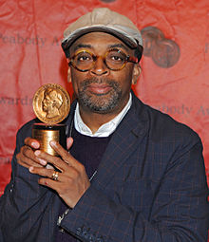


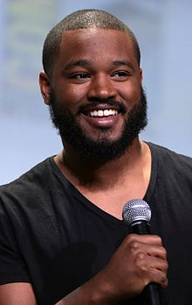
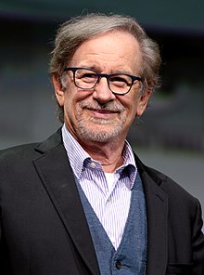
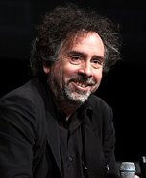

Our final-list
Christopher Nolan
(49, USA)
Denis Villeneuve
(52, Canada)
Robert Zemeckis
(68, USA)
Spike Lee
(63, USA)
Dexter Fletcher
(54, UK)
Jaume Collet-Serra
(46, Spain)
Ryan Coogler
(34, USA)
Steven Spielberg
(73, USA)
Tim Burton
(61, USA)
James Wan
(43, Australia)

Slide 16
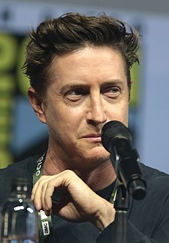

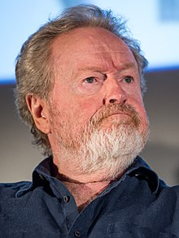

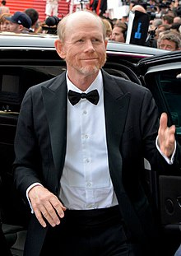
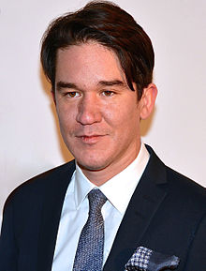
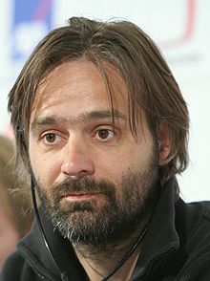

Our final-list
David Gordon Green
(45, USA)
Steven Soderbergh
(57, USA)
Ridley Scott
(82, UK)
Paul Feig
(57, USA)
Ron Howard
(66, USA)
Daniel Espinosa
(43, USA)
Baltasar Kormákur
(54, Iceland)
Mike Flanagan
(42, USA)

Slide 17
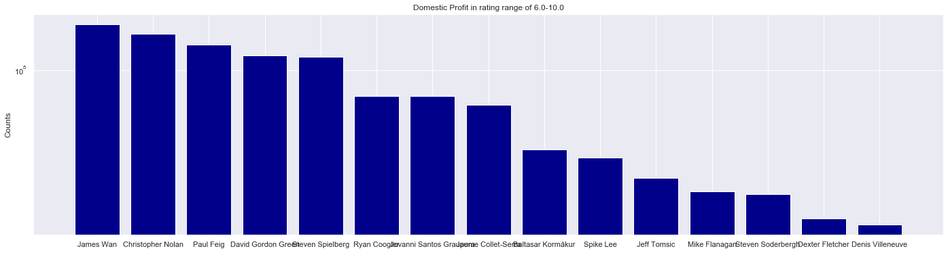
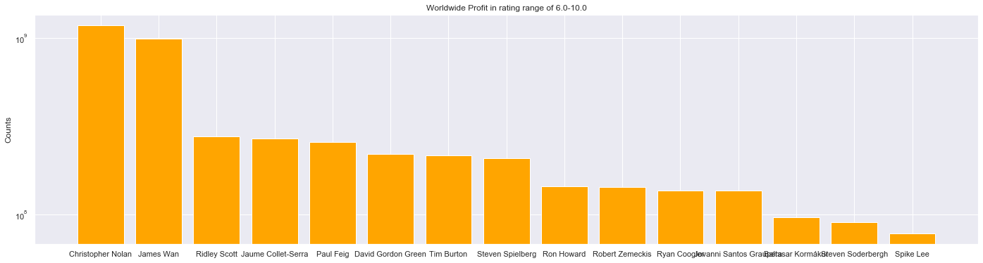
[175061807.0, 155594089.0, 136711718.0, 119926519.0, 117207973.0, 72767581.0, 72767581.0, 65428557.0, 37973011.0, 34275340.0, 26730625.0, 22695246.0, 21848141.0, 16342725.0, 15059398.0]
[1176904017.0, 986894640.0, 277448265.0, 268506138.0, 257132023.0, 220060794.0, 217155210.0, 208346281.0, 144519367.0, 142825099.0, 136567581.0, 136567581.0, 96304046.0, 90296525.0, 78017335.0]

Slide 18
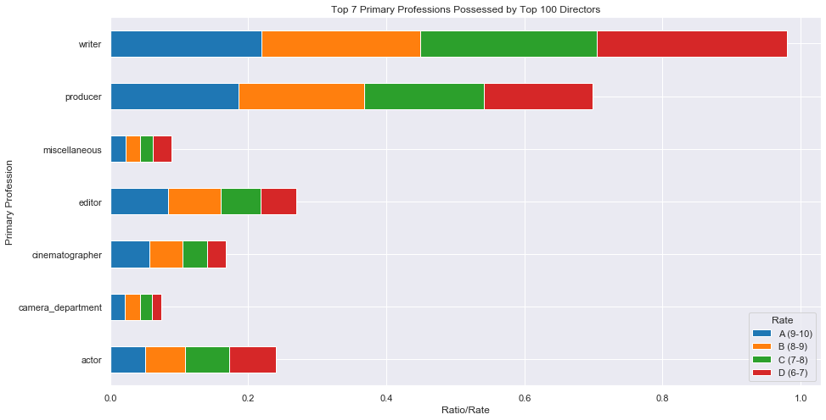
Overall Top 100 Directors & Their Primary Professions (imdb*) over Top 5 imdb* movie genres
No dependency between movie genres and director's primary profession

