Slide 2
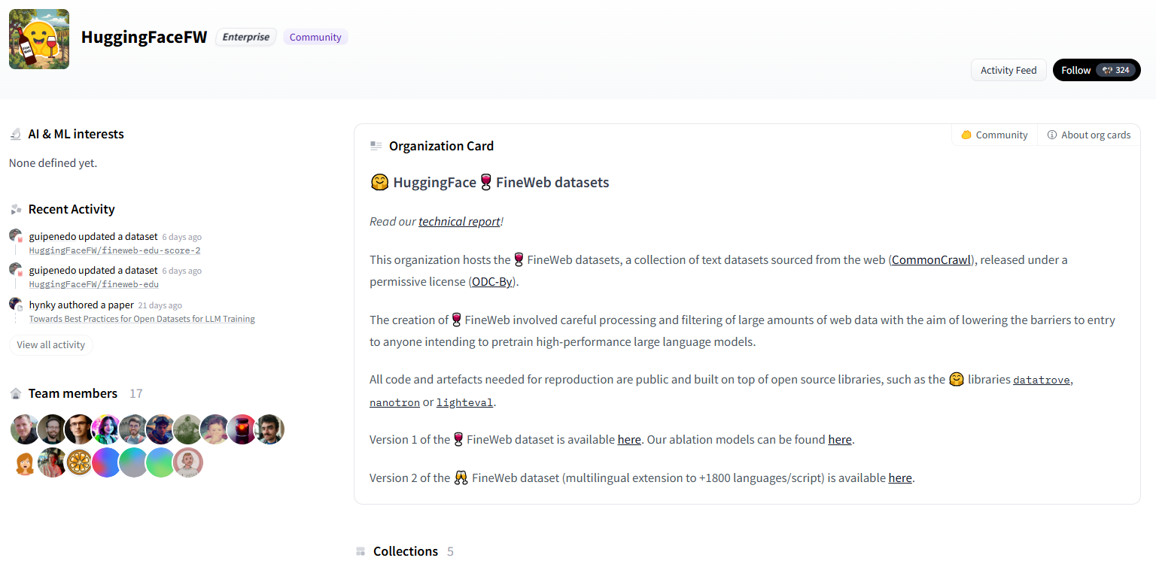
FineWeb Filtered Dataset - Mentioned by Kaparthey

Slide 3
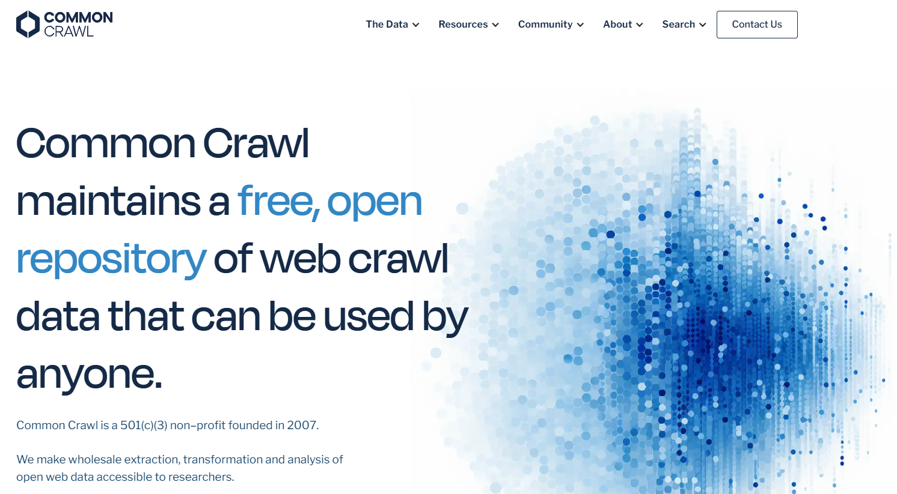
Common Crawl – Mentioned by Kaparthey

Slide 4
Check Tokenization @ TikTokenizer – Presented by Kaparthey
https://youtu.be/7xTGNNLPyMI?si=lzNpt0O518vuzkd7&t=748
https://tiktokenizer.vercel.app/

Slide 5
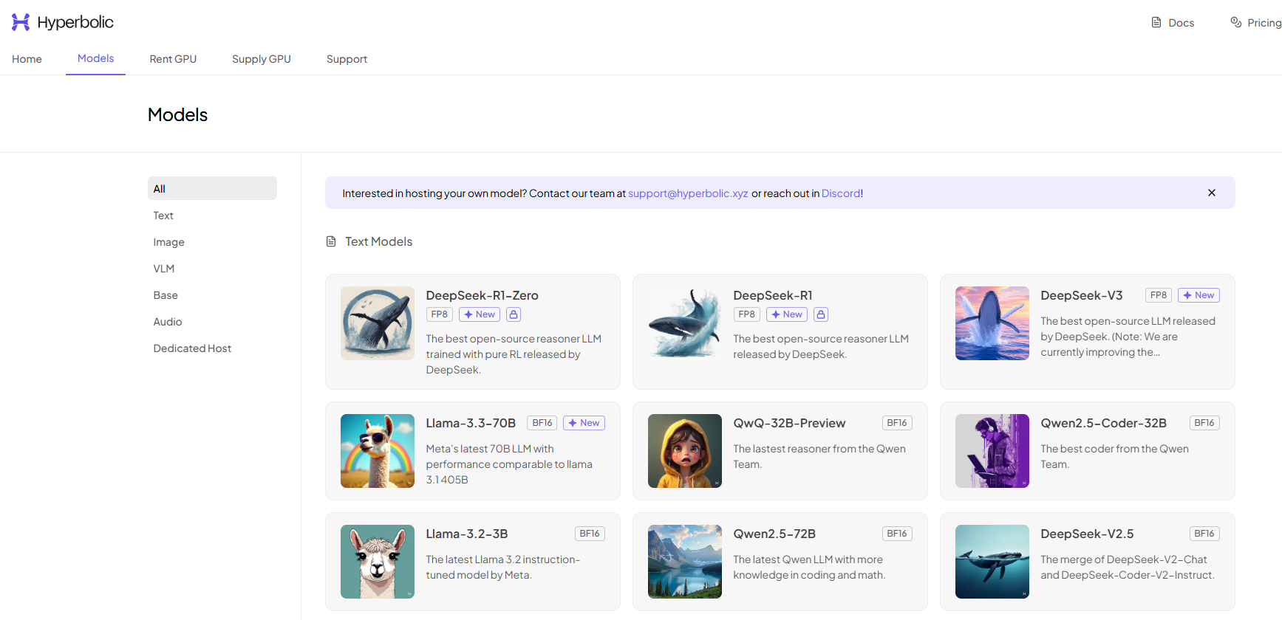
Check Hyperbolic.com – Mentioned by Kaparthey https://youtu.be/7xTGNNLPyMI?si=DhW2m99Og6-PFJlL&t=2848

Slide 6
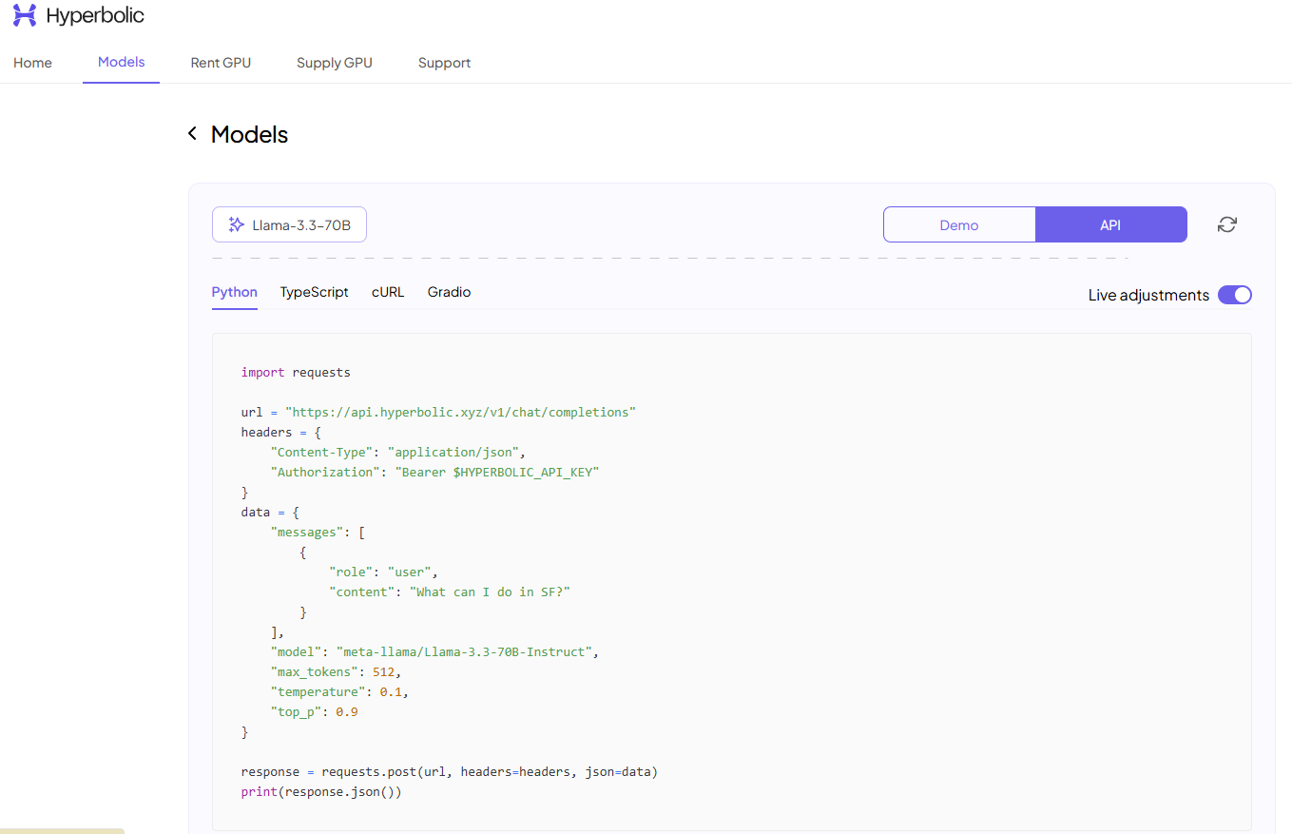
Hyperbolic APIs

Slide 7
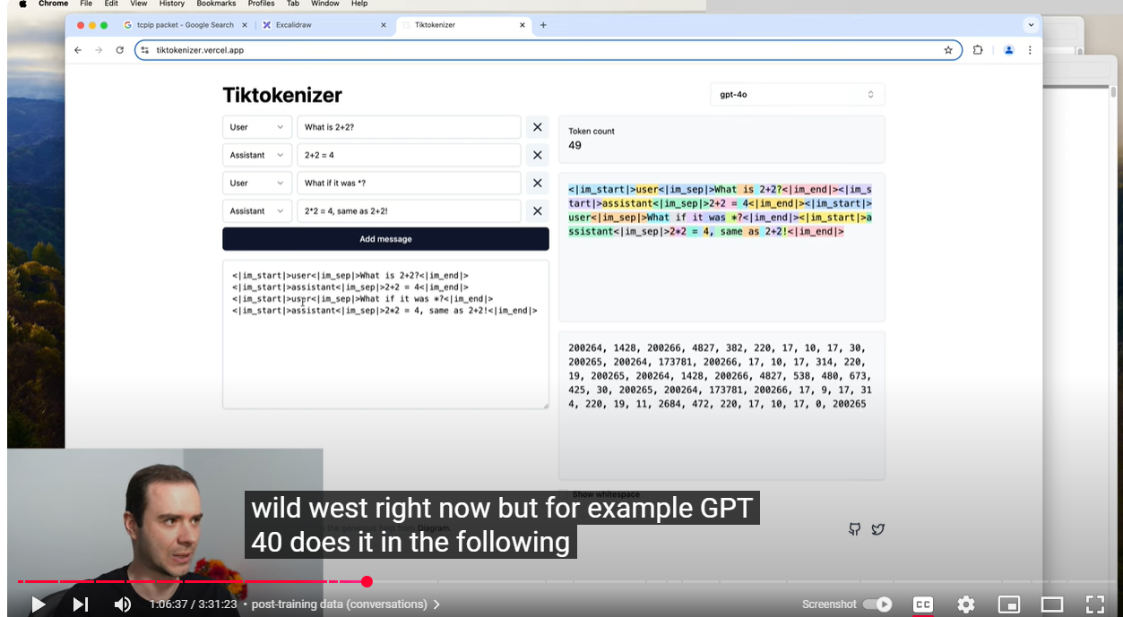
Fine tuning – post-training, user/assistant prompt or dataset for training

Slide 8
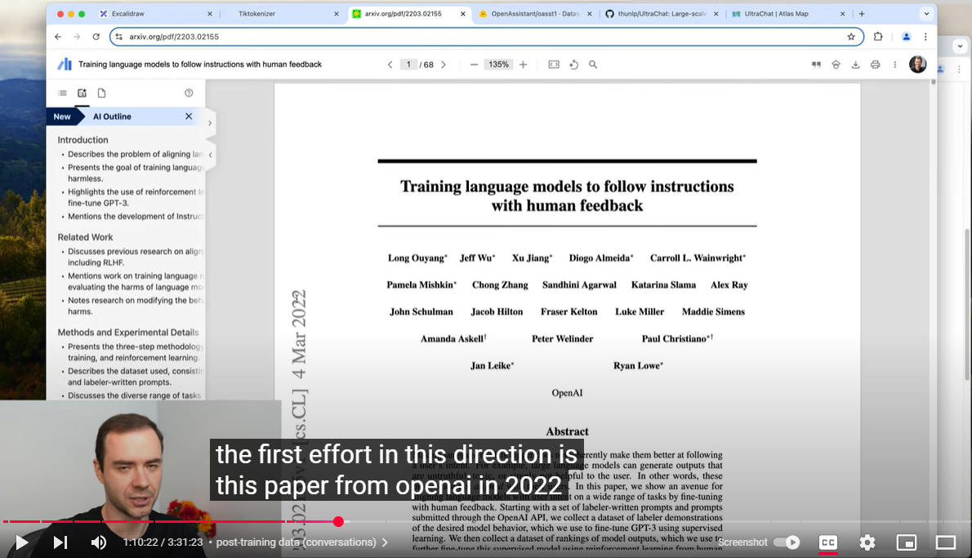
How-to create Finetuning Dataset In this paper, openai talked for the first time how can u take a language model and fine tune it on converstatinos

Slide 9
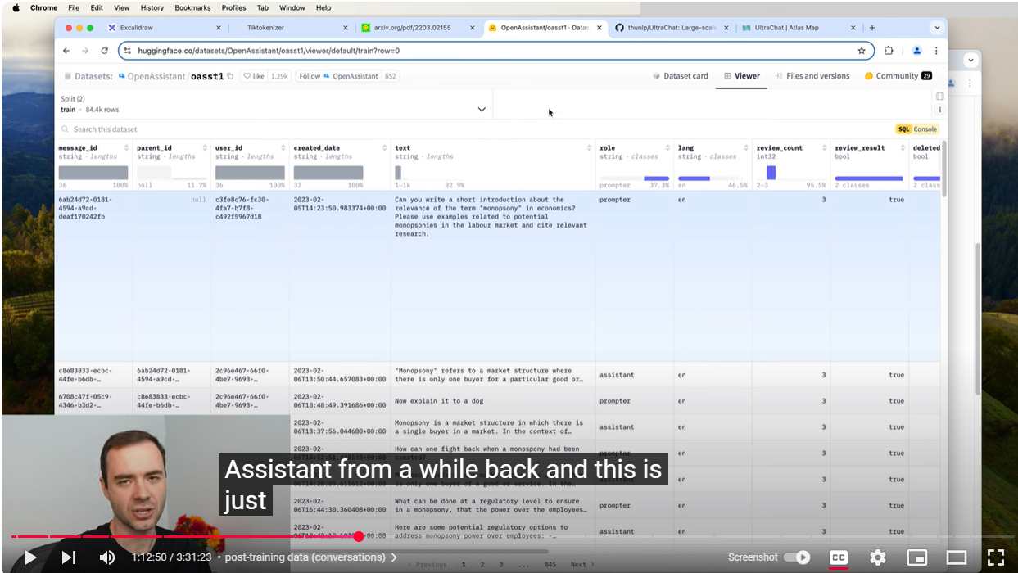
A open source dataset for finetuning conversations – kinda like open ai human labelled closed source dataset.

Slide 10
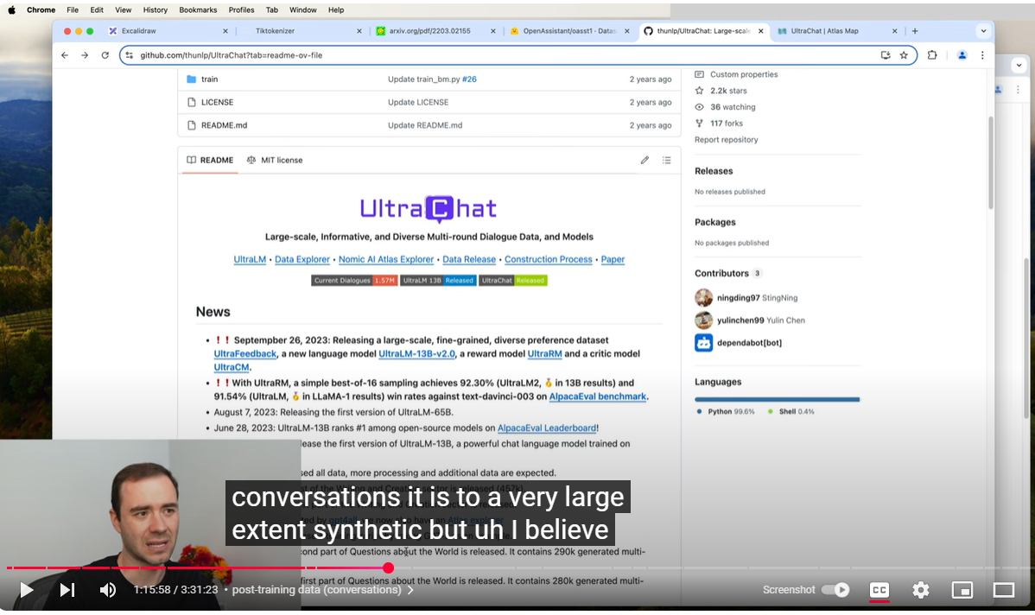
LLM Created Dataset for Fine-Tunning

