Slide 1

307312
Introduction to Probability Distributions

Slide 2
Content
Introduction to Inferential Statistics
Random Variables and Probability Distributions
  Discrete Random Variables
  Continuous Random Variables
The Normal Distribution
The Empirical Rule
The Standard Normal Distribution and the Standard Scores (Z-Scores)
Using the Z-Tables

Slide 3
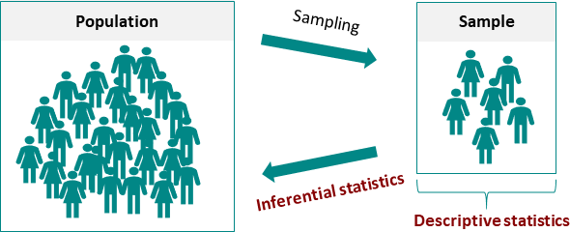
Introduction to Inferential Statistics
Definition: Inferential statistics is the branch of statistics that involves making inferences or predictions about a population based on sample data.
Objective: The main goal of inferential statistics is to draw conclusions, make predictions, or test hypotheses about a population using information obtained from a sample.

Slide 4
Inferential Statistics Uses
Inferential statistics is used in various fields and contexts to make predictions, draw conclusions, and make inferences about populations based on sample data. Here are some common areas and applications where inferential statistics is used:
Scientific Research: Inferential statistics is fundamental in scientific research across disciplines such as biology, physics, chemistry, and environmental science. Researchers use statistical tests to analyze data and draw conclusions about hypotheses.
Business and Economics: Businesses use inferential statistics for market research, sales forecasting, quality control, and decision-making. Econometric models are employed to analyze economic data and make policy recommendations.
Healthcare and Medicine: Medical researchers and healthcare professionals use inferential statistics to study the effectiveness of treatments, analyze patient data, and draw conclusions about disease prevalence. Clinical trials rely heavily on inferential statistics.
Education: In the field of education, inferential statistics are used to assess the effectiveness of teaching methods, evaluate standardized test scores, and make policy decisions about educational programs.
Market Research and Data Analysis: Market researchers use inferential statistics to make predictions about consumer preferences, market trends, and the impact of marketing campaigns.
Finance and Investment: In finance, inferential statistics are used to assess investment risk, analyze stock market data, and estimate future asset prices. Portfolio optimization and risk management rely on statistical modeling.
Criminal Justice and Criminology: Researchers and law enforcement agencies use inferential statistics to analyze crime data, study crime patterns, and evaluate the effectiveness of criminal justice programs.
Sports and Athletics: In sports analytics, inferential statistics are used to analyze player performance, predict game outcomes, and make strategic decisions in sports management.

Slide 5
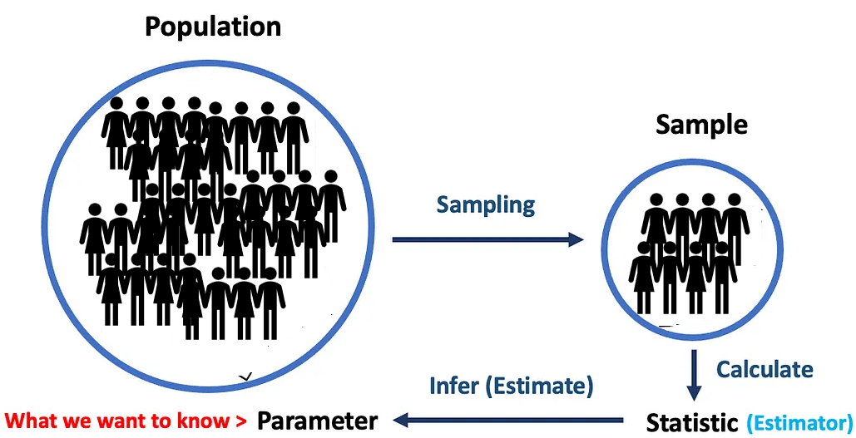
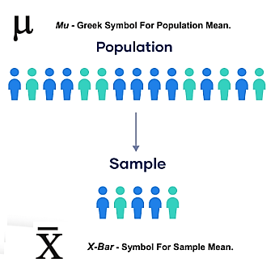
Introduction to Inferential Statistics
Key Concepts:
Population: The entire group of individuals or items of interest that we want to study.
Sample: A subset of the population from which data is collected and analyzed.
Parameter: A numerical characteristic of a population (e.g., mean, proportion).
Statistic: A numerical characteristic of a sample (e.g., sample mean, sample proportion).
https://medium.com/towards-data-science/what-is-p-value-370056b8244d

Slide 6
Types of Inferential Statistics
Estimation
  Point Estimation: Provides a single best guess about a population parameter (e.g., the mean, proportion).
  Interval Estimation (Confidence Intervals): Gives a range of values for a population parameter with a certain level of confidence.
Hypothesis Testing
  A statistical method that uses sample data to evaluate a hypothesis about a population parameter, determining whether there is sufficient evidence to accept or reject a given hypothesis about that population.
Regression Analysis
  Assesses the linear relationship between one continuous dependent variable and one or more independent variables.

Slide 7

Introduction to Random Variables
Understanding the Basics of Probability in Statistics

Slide 8

What is a Random Variable?
A random variable is a variable whose possible values are outcomes of a random process.
A random process is a process or event or where the outcome cannot be predicted with certainty, and each possible outcome has an associated probability.
It can be classified as discrete or continuous depending on the range of values that it assumes.
A discrete random variable assumes a countable number of distinct values, whereas a continuous random variable is characterized by measurable (uncountable) values.
Example: Flipping a coin (discrete), measuring the amount of rain in a day (continuous)

Slide 9


Discrete Random Variables
A Discrete Random Variable is a variable which can take on only a countable number of distinct values like 0, 1, 2, 3, 4, 5…100, 1 million, etc.
Examples of discrete random variables:
  The number of cars that passes through a toll booth everyday in a given day.
  The number of times a coin lands on tails after being flipped 20 times.
  The number of defective widgets in a box of 50 widgets.
  Number of Calls Received by a Call Center.
  Number of Emails Received in a Day

Slide 10
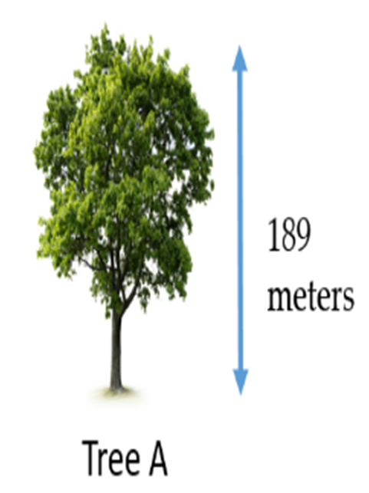

Continuous Random Variables
A Continuous Random Variable is a variable which can take on an infinite number of possible values.
Examples of continuous random variables:
  Business profits.
  The height of a tree.
  The weight of an animal.
  Arrival times of airlines.
  Time required to run a marathon.
  The weight of a chocolate bar on a production line.

Slide 11
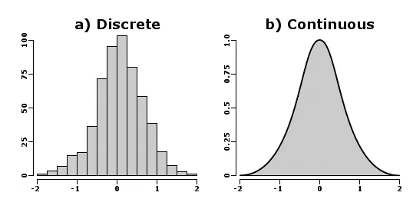
Introduction to Probability Distributions
Discrete and Continuous Probability Distributions

Slide 12
Discrete Probabilities Distributions

Slide 13
Introduction to Probability Distributions
Probability distributions are mathematical functions that describe the likelihood of various outcomes in a statistical experiment.
They provide a mathematical framework for modeling random phenomena.
Discrete vs. Continuous Probability Distributions
Discrete distributions: Outcomes are countable and have finite or countably infinite values.
Continuous distributions: Outcomes are uncountable and have an infinite range of values.
For a probability distribution to be valid, it must satisfy the following two criteria:
  The probability for each outcome must be between 0 and 1.
  The sum of all the probabilities must add up to 1.

Slide 14
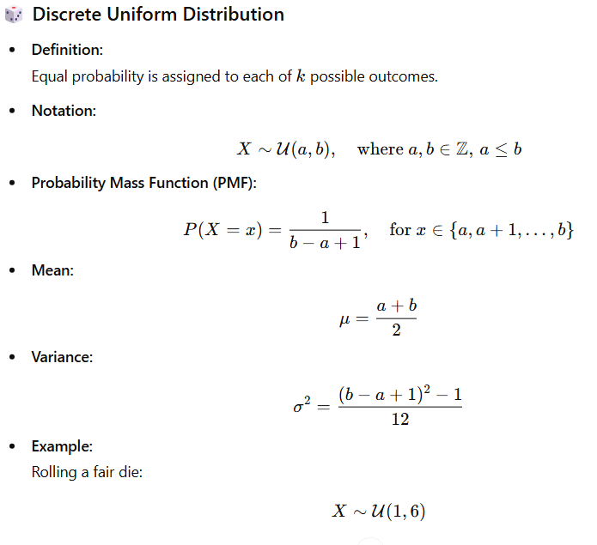
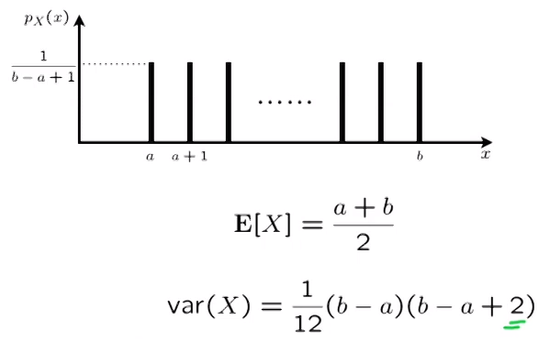
Discrete Probability Distributions
The Discrete Uniform Distribution

Slide 15
Discrete Uniform – PMF Uses
Calculating individual probabilities
Example: For a fair die (U(1,6)), the probability of rolling a 3 is:
P(X = 3) = 1/(6-1+1) = 1/6 ≈ 0.167
Finding probabilities of events
For multiple outcomes: Sum the individual probabilities
Example: Probability of rolling an even number:
P(X ∈ {2,4,6}) = P(X=2) + P(X=4) + P(X=6) = 1/6 + 1/6 + 1/6 = 3/6 = 0.5
Range probabilities
Example: Probability of rolling between 2 and 5 inclusive:
P(2 ≤ X ≤ 5) = (5-2+1)/(6-1+1) = 4/6 = 0.667

Slide 16
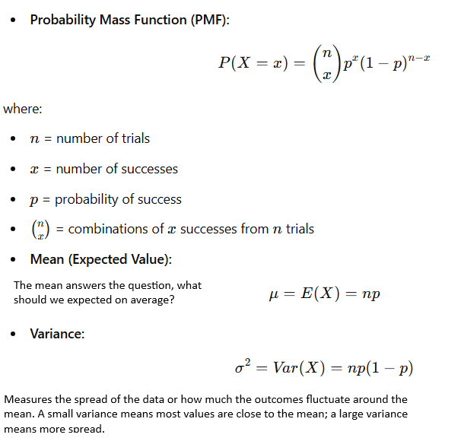

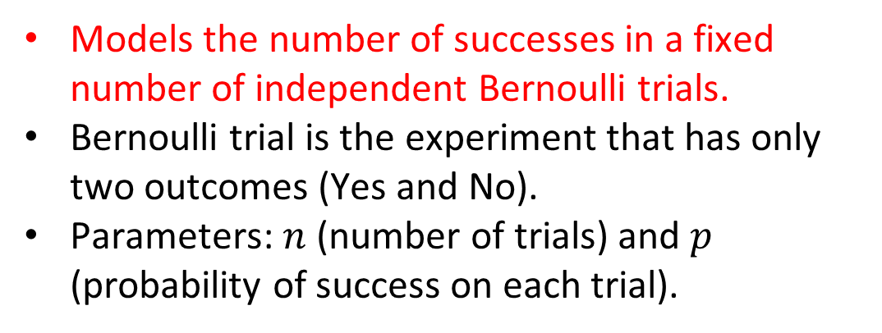
Discrete Probability Distributions
The Binomial Distribution
  Models the number of successes in a fixed number of independent Bernoulli trials.
  Bernoulli trial is the experiment that has only two outcomes (Yes and No).
  Parameters: $n$ (number of trials) and $p$ (probability of success on each trial).
Example: The defect ratio in a car factory is 2% and the factory produces 80 cars in a month,. We can use the binomial distribution to answer questions similar to:
what is the probability that exactly 2 cars are defective?
  what is the probability that less than 2 cars are defective?
  what is the probability that more than 2 cars are defective?
  What is the probability that all cars produced in a month will have no defects?

Slide 17
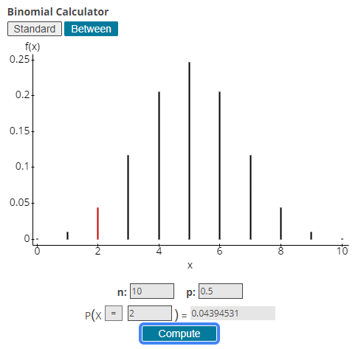

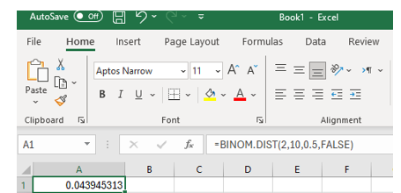

The Binomial Distribution
What is the probability of having 2 Heads ONLY out of 10 trials, knowing that the probability of Head = 50%?
Excel Function
=BINOM.DIST(2,10,0.5,FALSE)
  The larger the number of trials (e.g. ask 100 students) the more the distribution will look like normal distribution.

Slide 18
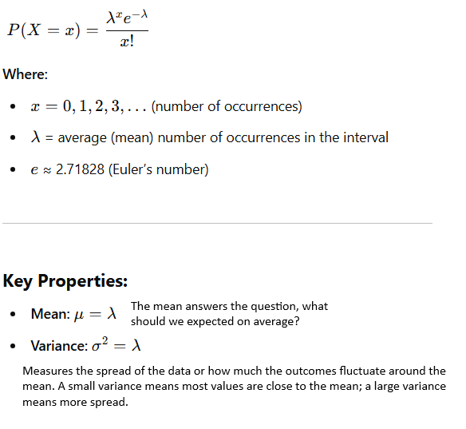

Discrete Probability Distributions
The Poisson Distribution
Poisson Distribution can be used to model the number of times an event occurs within a specified time period or in a given space.
It's particularly useful for estimating the likelihood of rare events over short intervals.
The key feature of the Poisson distribution is that it is defined by just one parameter, λ (lambda), which represents the average rate at which events occur.
Example: Suppose that Zein call center receives 1000 calls/hour on average, and that data center has a capacity of receiving 1100 calls/hours.
Use the Poisson Distribution to find the probability that the number of calls will exceed the call center's capacity, which will require additional temporary staff?

Slide 19
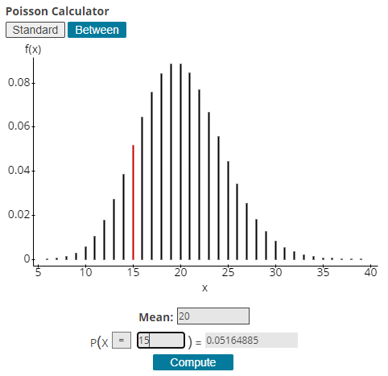
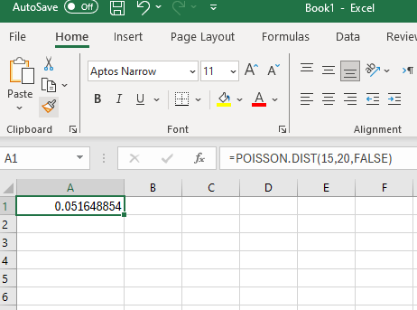


Poisson Distribution
Excel Function
=POISSON.DIST(15,20,FALSE)
  The larger the average rate λ, the more the distribution will look like normal distribution.

Slide 20
Continuous Probabilities Distributions

Slide 21
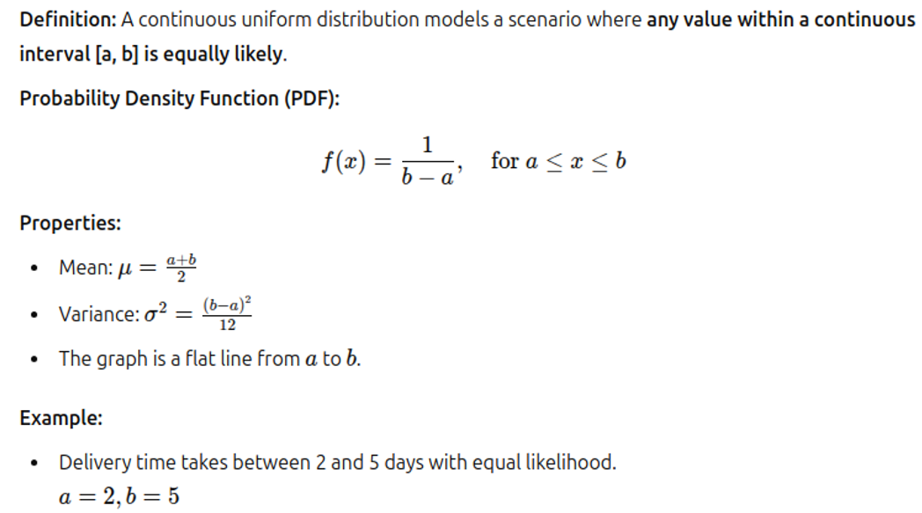
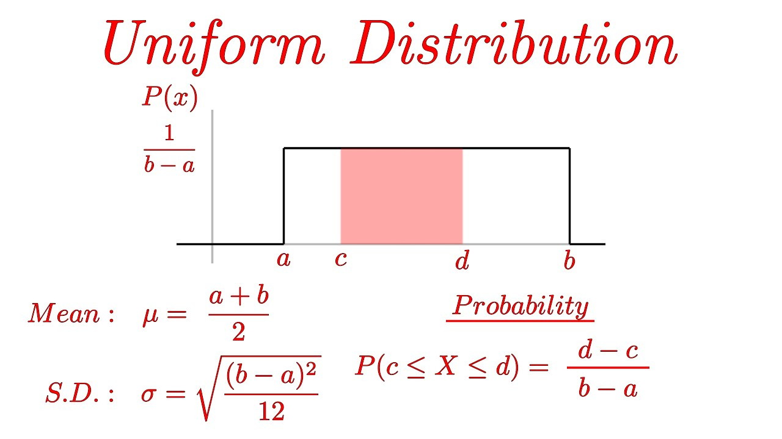
The Continuous Uniform Distribution

Slide 22
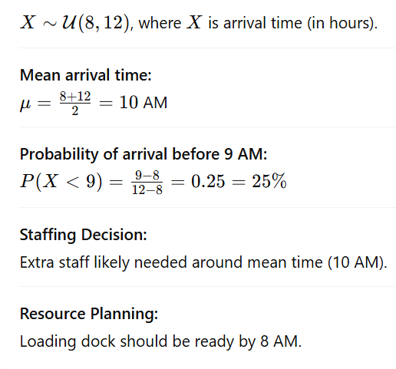
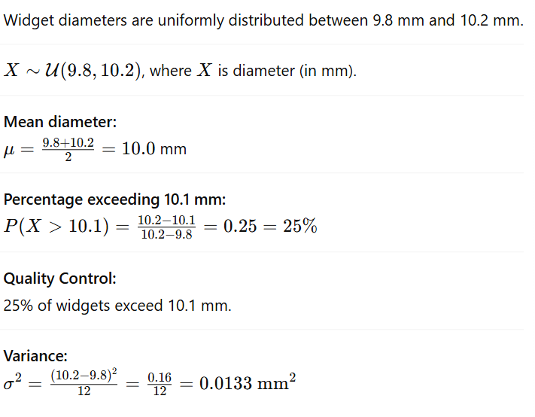
The Continuous Uniform Distribution
Business Cases Studies
Inventory Arrival
A retailer's deliveries arrive uniformly between 8 AM and 12 PM.
Manufacturing
A machine produces widgets with diameters uniformly distributed between 9.8mm and 10.2mm.

Slide 23
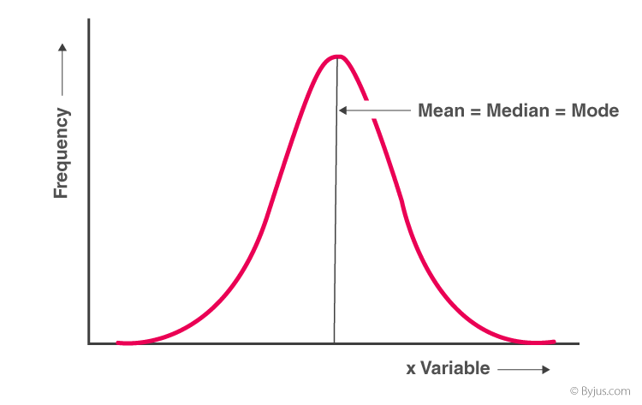
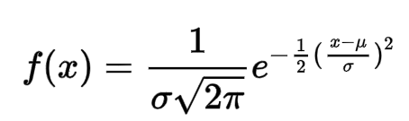
The Normal Distribution
The normal distribution is the most extensively used probability distribution in statistical work.
It is also known as the Gaussian distribution and the Bell Curve.
The x-axis represents the outcomes of the normal process (e.g. students scores, heights, salaries…etc.).
The AREA UNDER THE CURVE represents the probability of the outcome.
The normal distribution has a symmetric distribution where most of the observations cluster around the central peak.
Theoretically, a normal random variable can assume any value between minus infinity and plus infinity.
Normal Distribution Main Features:
  Symmetrically distributed
  Long Tails / Bell Shaped
  Mean/ Mode and Median are the same

Slide 24
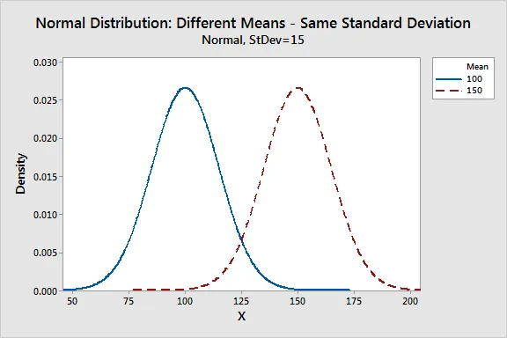
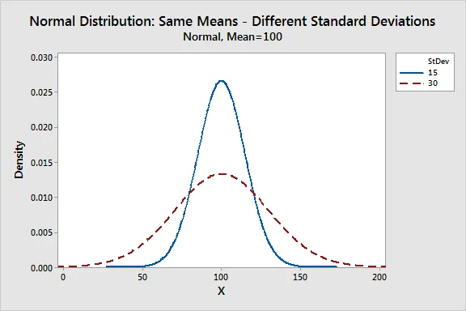
Parameters of the Normal Distribution
The normal distribution is completely described by two parameters, the Mean and the Standard Deviation.
Where X is a continuous random variable (the expected outcome of a continuous random process).
μ = The Mean of the Outcomes of the Random Process.
σ = The Standard Deviation of the Outcomes of the Random Process.
π is approximately 3.14159.
e is approximately 2.71828.

Slide 25
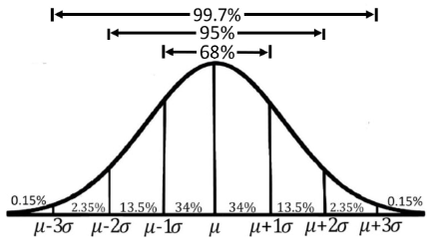
The Empirical Rule for the Normal Distribution
The Empirical Rule describes how data (continuous outcomes) are spread in a normal distribution.
The proportion of the area that falls under the curve between two points on a probability distribution indicates the probability that a value will fall within that interval.
If we know that the data are drawn from a relatively symmetric and bell-shaped distribution - perhaps by a visual inspection of its histogram, then we can make statements about the percentage of observations that fall within certain intervals.
Approximately 68% of data fall within one standard deviation (σ) of the mean (μ).
Around 95% are within two standard deviations.
About 99.7% lie within three standard deviations.

Slide 26
Empirical Rule Example
A large lecture class has 280 students. The professor has announced that the mean score in an exam is 74 with a standard deviation of 8.
Use the Empirical Rule to answer the following:
  Approximately how many students within 58 and 90?
  Approximately how many students scored higher than 90?

Slide 27
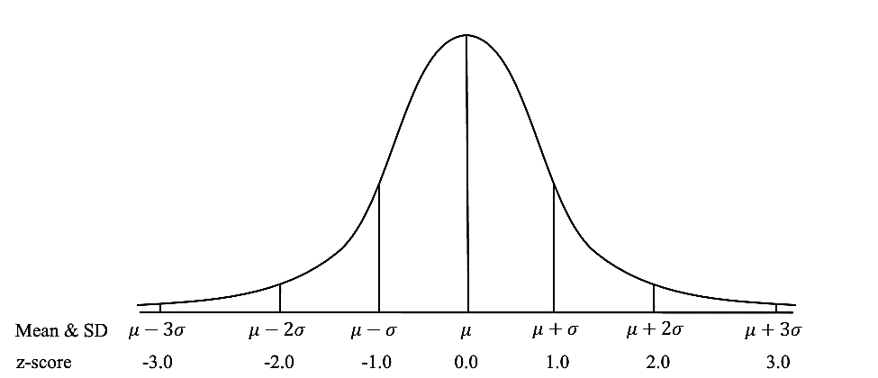
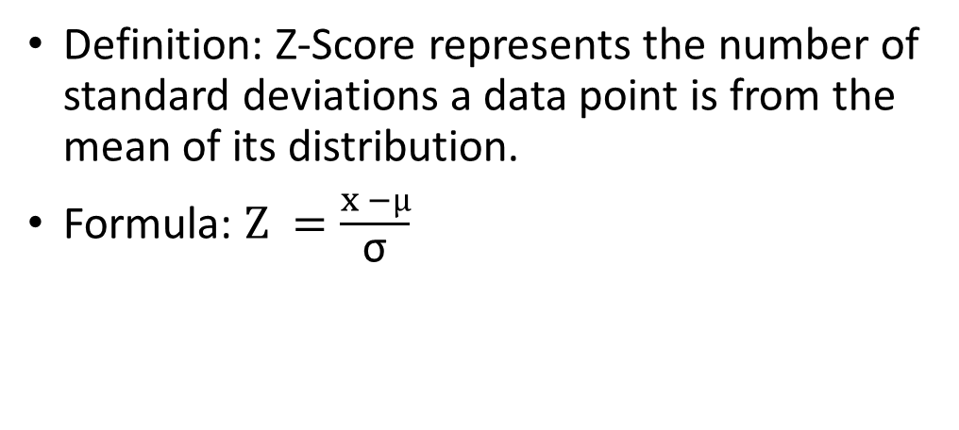
The Z - Score
Definition: Z-Score represents the number of standard deviations a data point is from the mean of its distribution.
Formula: $Z =\frac{x −µ}{\text{σ}}$
Where X is a data point, μ is the mean, and σ is the standard deviation.
Interpretation:
A z-score of 0 corresponds to a data point that is exactly at the mean.
Positive z-scores indicate values above the mean.
Negative z-scores indicate values below the mean.

Slide 28
Back to our Empirical Rule Example
A large lecture class has 280 students. The professor has announced that the mean score in an exam is 74 with a standard deviation of 8.
Use the Empirical Rule to answer the following:
  Approximately how many students within 58 and 90?
  Approximately how many students scored higher than 90?
  Solution for part (a)
  First, we find the z-scores corresponding to 58 and 90.
  Z for 58 = (58 – 74) / 8 = -16/8 = -2, Z for 90 = (58 – 74) / 8 = 16/8 = +2
  Using the empirical rule, we know that 95% of observations falls within 2 standard deviations (each side) from the mean, therefore, the number of students under this criteria = 280 x .95 = 266 students.
  Solution for part (b)
  The score 90 is 2 standard deviations above the mean.
  Therefore, 97.5% of students are below that value and 2.5% are above it.
  Consequently, 2.5/100 * 280 = 7 students are above 90.

Slide 29
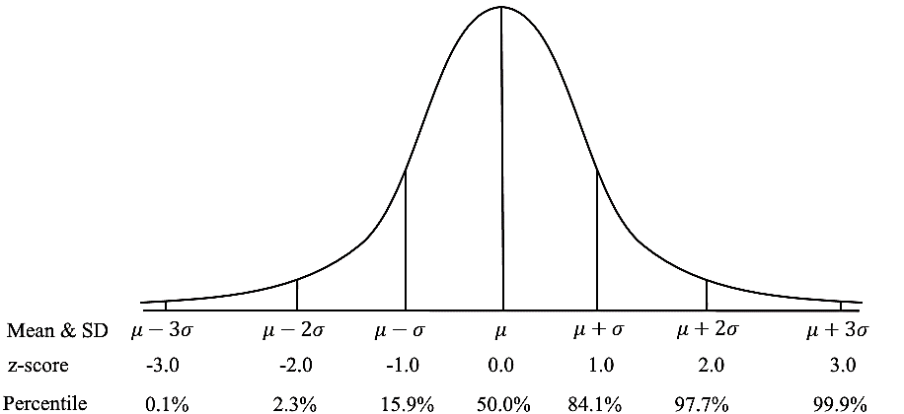
Z-Scores Uses in Statistics
Standardization: Z-scores standardize different distributions to be comparable by converting them to a common scale.
Identification of Outliers: Data points with z-scores less than -2 or greater than 2 are often considered outliers.
Compare values from different populations (e.g. exam results between courses).
Probabilities and Percentiles: Z-scores link data points to their probabilities and percentiles in a normal distribution. E.g., a z-score of 1.96 corresponds to the 97.5th percentile.

Slide 30
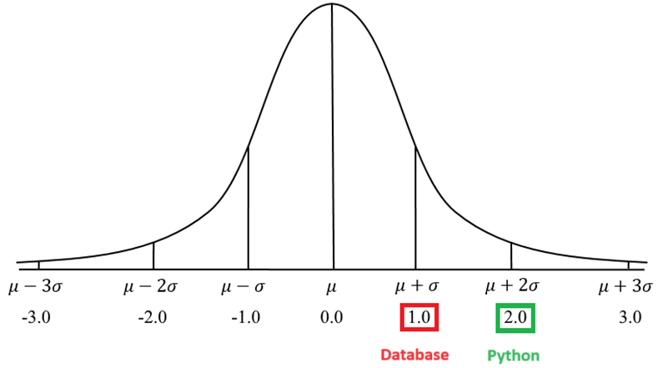
Z-Scores Example – Comparing Values
Khalid achieved 90 in both Python & Database exams. The mean μ for the Python exam was 70 and σ = 10, The μ for the Database exam was 80 and σ = 10.
Use standard scores to determine where did Khalid achieve a better score.
Standard score for the Python Exam: (90−70)/10 =2
Standard score for the Database Exam: (90−80)/10 =1
Khalid's Z-score for the Python exam is 2, which means his score was 2 standard deviations above the mean.
His Z-score for the Database exam is 1, indicating his score was 1 standard deviation above the mean.
Khalid performed better on the Python exam than Database exam since his Z-score is higher for that exam.

Slide 31
How to Find the Right Distribution
Distfit library tests around 90 different distributions automatically.
It's like having a statistician who's willing to try every possible option and tell you which one works best.
from distfit import distfit
import numpy as np
# Let's say you have some data
my_data = np.random.normal(25, 8, 2000) # 2000 data points
# Set up the distribution fitter
fitter = distfit(method='parametric')
# Let it try different distributions and find the best fit
fitter.fit_transform(my_data)
# See what it found
print("Best fit:", fitter.model['name'])
print("Parameters:", fitter.model['params'])
https://medium.com/data-science-collective/how-to-find-the-right-distribution-for-your-data-a-practical-guide-for-non-statistician-with-two-dc2aa0ed707f

Slide 32
Z-Tables

Slide 33
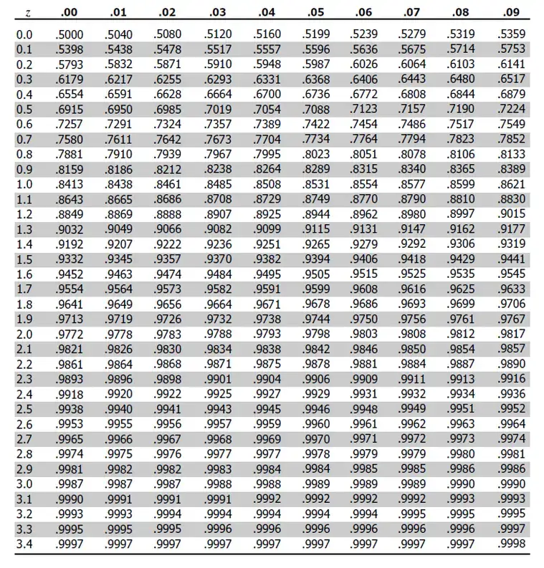
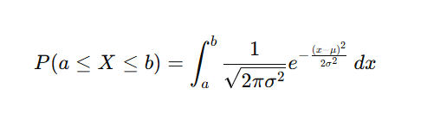
The Z-Tables
The area under the curve in continuous probability distributions represents the probability of outcome occurrence.
The Empirical Rule has pre-defined areas for certain Z-Scores.
What can we do if we need the area between other Z-Scores e.g. +1.25, -2.33?
It will be hard to compute the integral for different intervals:
A simpler solution would be to use a table of pre-computed areas (The Z-Table).
But we need to compute that area ONCE. Therefore, we need to create a Standard Distribution.

Slide 34
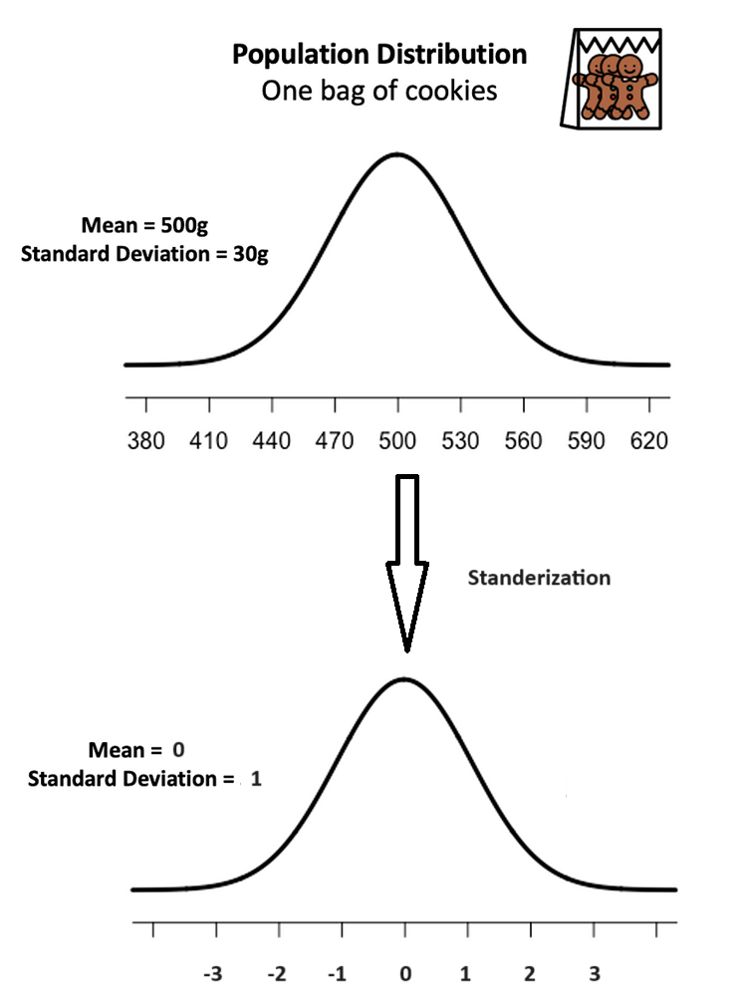
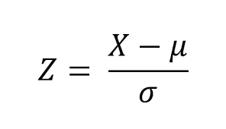
Standard Normal Distribution and Standard Z Scores
The standard normal distribution is a special case of the normal distribution where the mean is zero and the standard deviation is 1.
This distribution is also known as the Z-distribution.
A value on the standard normal distribution is known as a standard score or a Z-score.
A standard score represents the number of standard deviations above or below the mean that a specific observation falls.
For example, a standard score of 1.5 indicates that the observation is 1.5 standard deviations above the mean.
On the other hand, a negative score represents a value below the average.
The mean has a Z-score of 0.
https://medium.com/towards-data-science/what-is-p-value-370056b8244d

Slide 35
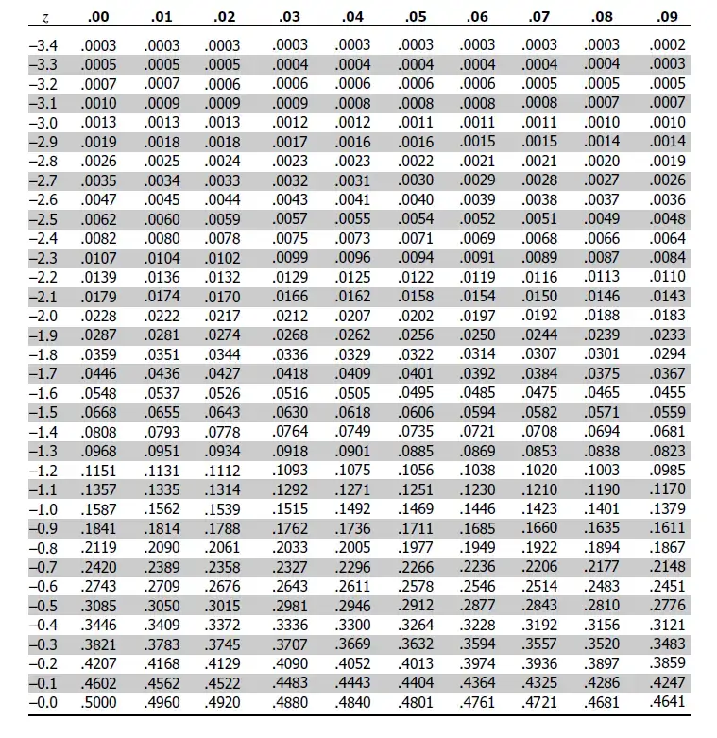
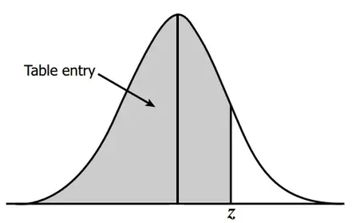
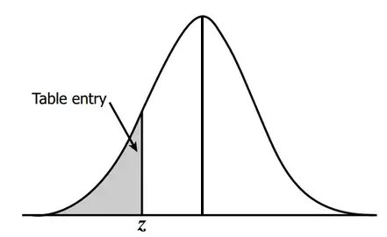
Z-Table for Z Values above 0
Z-Table for Z Values below 0

Slide 36
Z-Tables Example
The average score for the MID exam in Descriptive Statistics course was 70. The standard Deviation for that exam was 6.
Knowing that the exam scores are normally distributed, what is the probability of having a score higher than 75 in that exam?
First, we need to find the standard position (z-score) for the 75 score.
Z score for (75) = (75 – 70) / 6 = 5/6 = .833
Using the z table, the closest value for .833 is: 0.7967 which corresponds to 79.67% of scores are below 75.
To find the probability of having a score over 75, we subtract 79.67% out of the total probability of 100%:
100 – 79.67 = 20.33%

Slide 37
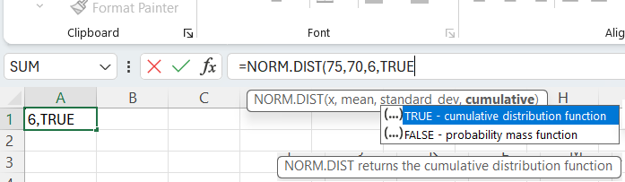
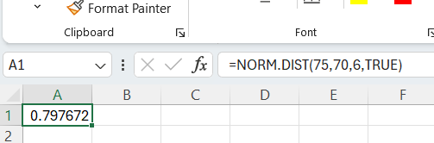
Z-Tables using Excel Functions
The average score for the MID exam in Descriptive Statistics course was 70. The standard Deviation for that exam was 6.
What is the probability of having a score higher than 90 in that exam?
We can use Excel NORM.DIST function. This function expects 4 values, the value we want to find its probability, the mean, the standard deviation and we set cumulative = TRUE.
NORM.DIST(75,70,6,True) = 0.797672
Therefore, the probability of having a score > 75 = 1 - .797672 = .2023% ~ 20%

Slide 38
307312
Introduction to Estimation in Statistics

Slide 39
Content
Introduction to Inferential Statistics
Estimation in Statistics (Point Estimate and Interval Estimate)
The Central Limit Theorem (CLT)
Confidence Intervals – Using Z-Tables
Confidence Intervals – Using T-Tables

Slide 40
Estimation in Statistics
Often in statistics we’re interested in measuring population parameters.
Two of the most common population parameters are:
  Population mean: the mean value of some variable in a population (e.g. the mean height of males in the U.S.)
  Population proportion: the proportion of some variable in a population (e.g. the proportion of residents in a county who support a certain law)
Although we’re interested in measuring these parameters, it’s usually too costly and time-consuming to go around and collect data on every individual in a population in order to calculate the population parameter.
Instead, we typically take a random sample from the overall population and use data from the sample to estimate the population parameter.

Slide 41
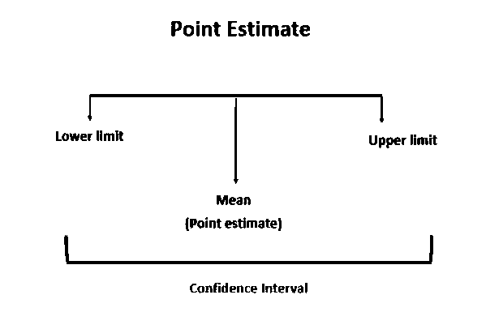
Point vs. Interval
A point estimate is a single value estimate of a parameter. For instance, a sample mean is a point estimate of a population mean.
An interval estimate gives you a range of values where the parameter is expected to lie.
Both types of estimates are important for gathering a clear idea of where a parameter is likely to lie.

Slide 42
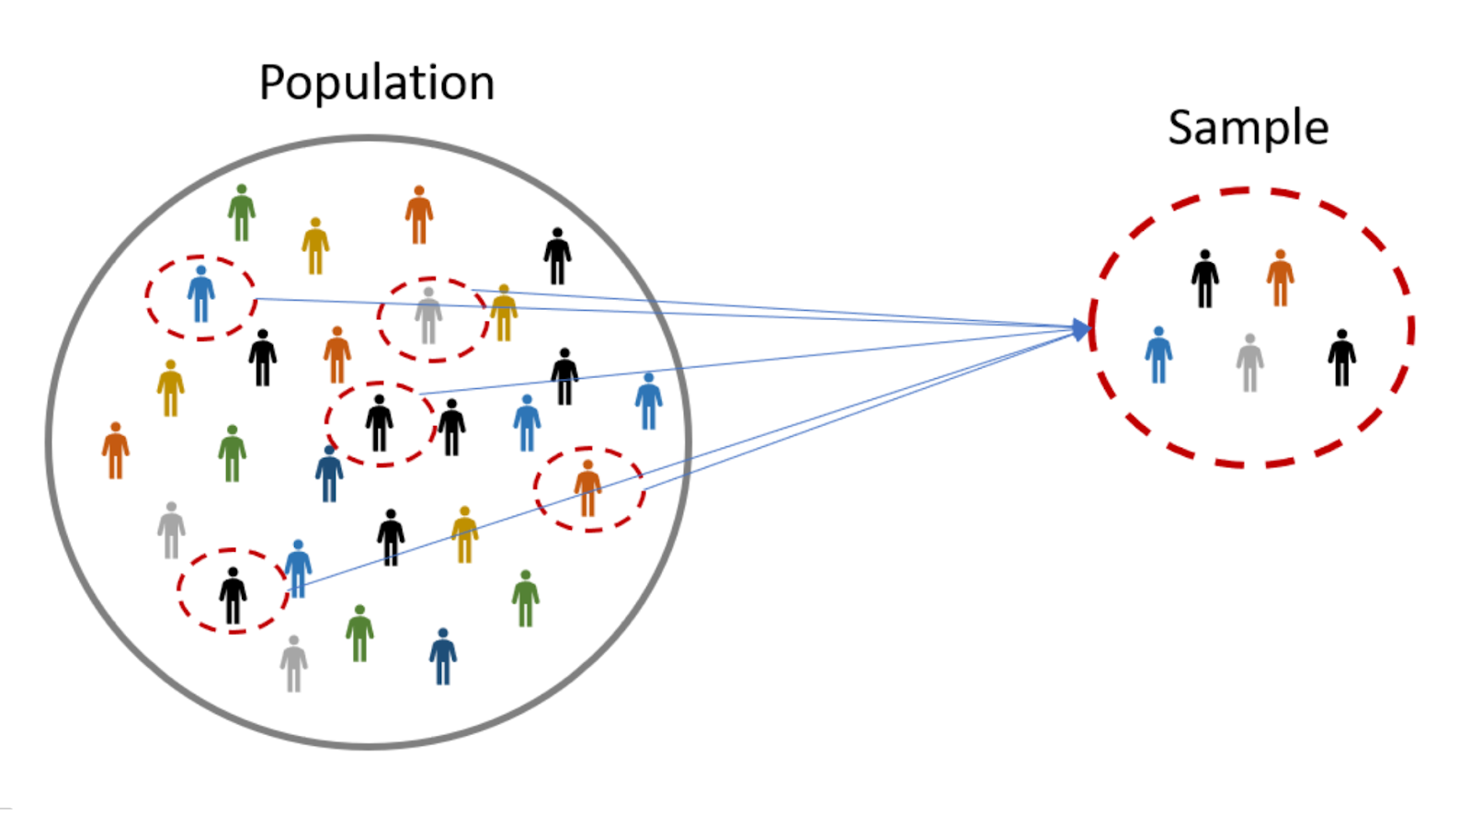
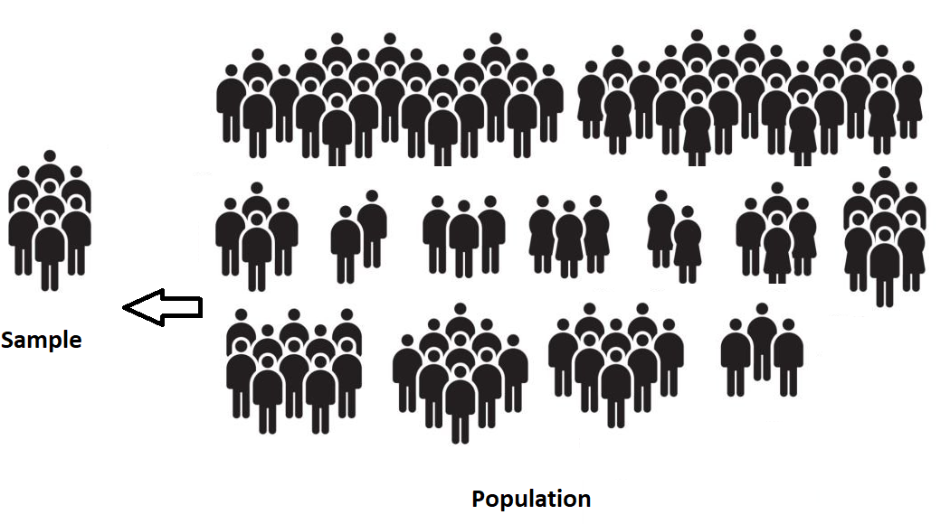
Point Estimates
Suppose we want to estimate the mean weight of a students in the university.
Since there are thousands of students in the university, it would be extremely time-consuming and costly to go around and weigh each individual student.
Instead, we might take a random sample of 50 students and use the mean weight of the students in this sample to estimate the true population mean.
In this case, the mean weight of the sample is called a Point Estimate for the true mean weight of the population.

Slide 43
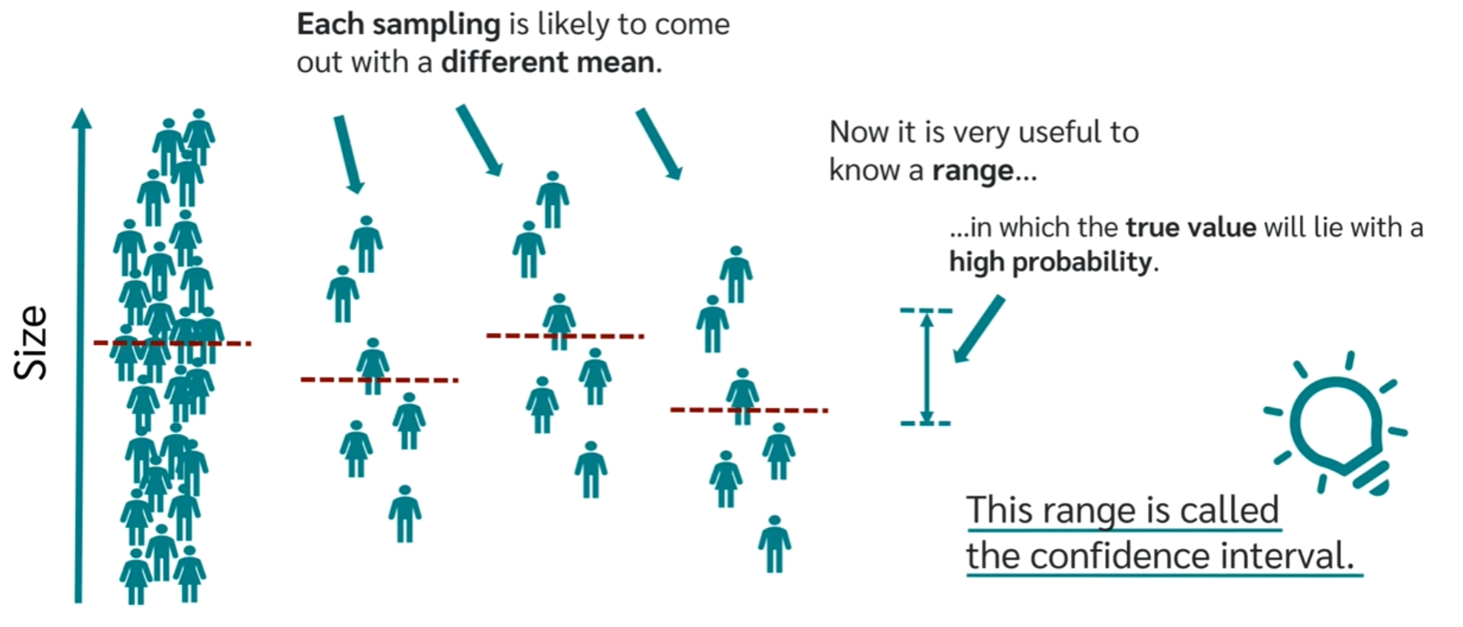
Interval Estimates - Confidence Intervals
The problem with the previous example is that the mean weight of students in the sample is not guaranteed to exactly match the mean weight of students in the whole population.
For example, we might just happen to pick a sample full of low-weight students or perhaps a sample full of heavy students.
To capture this uncertainty, we can create an Interval Estimate or a confidence interval around our point estimate.
The confidence interval gives us a range of values that are likely to contain the true population parameter.

Slide 44
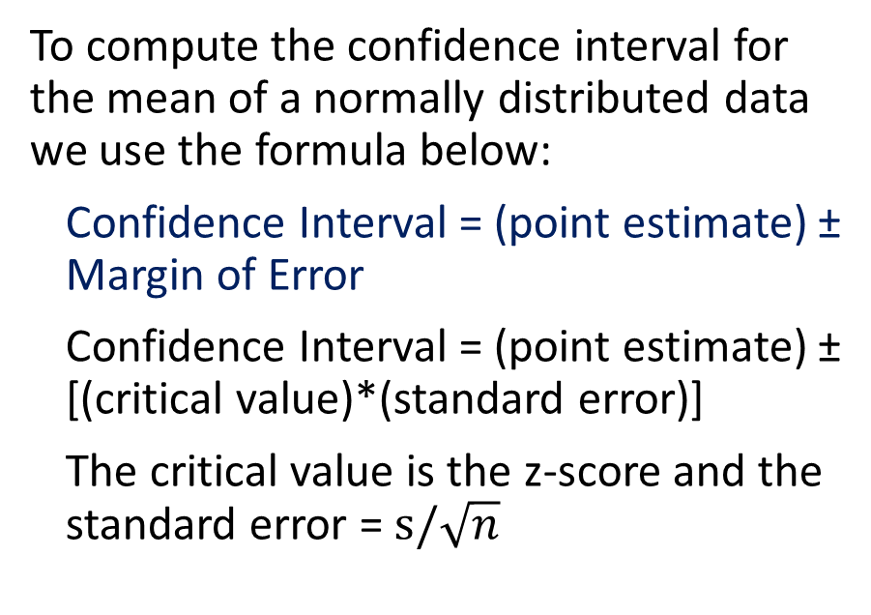
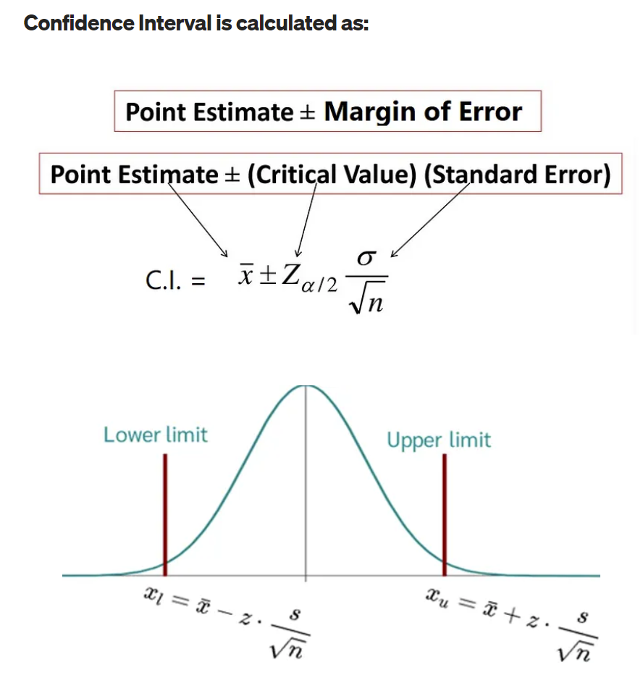
Computing Confidence Intervals
https://medium.com/@ashisharora2204/hypothesis-testing-confidence-interval-level-margin-of-error-39aa7c7ddcd2

Slide 45
The Significance Level Alpha (α) and The Confidence Level
To compute the confidence interval, we need to define the Significance Level Alpha (α) or the Confidence Level.
The two terms are related to each other according to the following equation:
Confidence level= 1 – α
Common values for these notations are listed in the table
Alpha - α | 5% | 1%
Confidence level | 95% | 99%
z-Value | 1.96 | 2.58

Slide 46
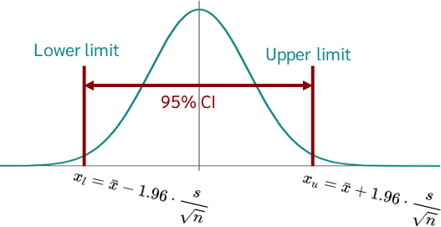
The Significance Level Alpha (α) and The Confidence Level
The confidence level (e.g. 95%) means that if we collected 100 samples and created confidence intervals for each of these samples, we would expect that 95% of these confidence intervals will contain the true population parameter.
It's important to note that this is a theoretical long-term proportion—it's about what we'd expect to happen over many repetitions of the same process, not a guarantee for any individual interval.

Slide 47
Relationship Between Confidence Level and Significance Level in Statistics
The confidence level and the significance level (α) are inverse and complementary concepts in statistical inference and hypothesis testing.
Relationship:
The two are complementary, meaning that if you increase one, you decrease the other, and vice versa.
A higher confidence level corresponds to a lower significance level, while a lower confidence level corresponds to a higher significance level.
Formula:
Confidence Level=1−α
Example:
A 95% confidence level means the significance level is 0.05 (α = 5%).
A 99% confidence level means the significance level is 0.01 (α = 1%).

Slide 48
Where did the Standard Error Come From?
The Central Limit Theorem

Slide 49
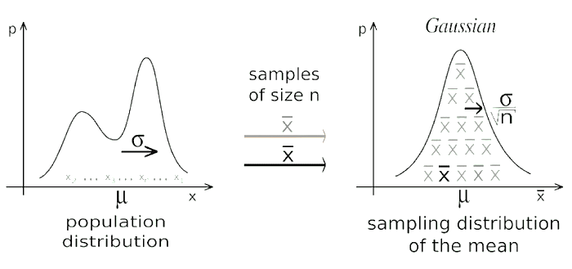
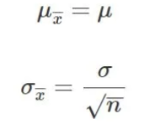

The Central Limit Theorem
The Central Limit Theorem (CLT) states that samples means created from large number of samples will be approximately normally distribution although the distribution we sample from might not be normal.
When we collect large number of samples and we compute the average for each of these samples, we call the generated means as the Sampling Distribution of the means.
The distribution of samples means becomes more normal when the samples size increases.
According to CLT:
1- The mean of the sampling distribution would be equal to the mean of the original distribution.
2- The variance of the sampling distribution of the sample mean would be equal to the variance of the original distribution divided by n, where n is the size of the samples.
Click here for a CLT simulator.

Slide 50
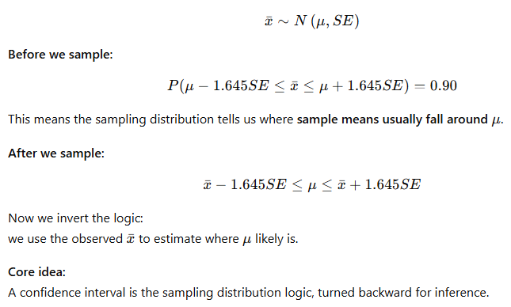
Inference: Turning the Sampling Model Around

Slide 51
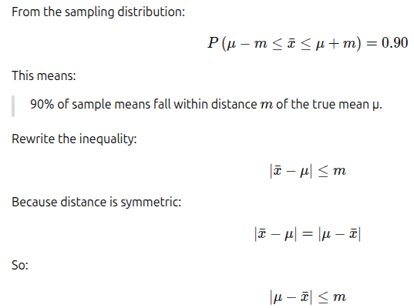
The Symmetry IThe Symmetry Idea Behind Confidence Intervalsdea Behind Confidence Intervals

Slide 52
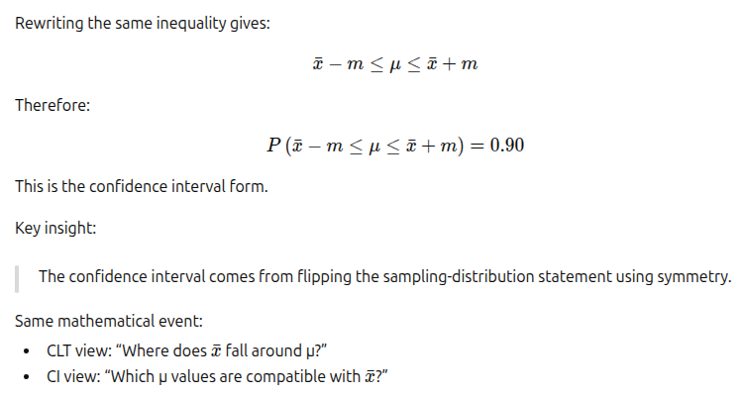
From CLT to Confidence Intervals

Slide 53
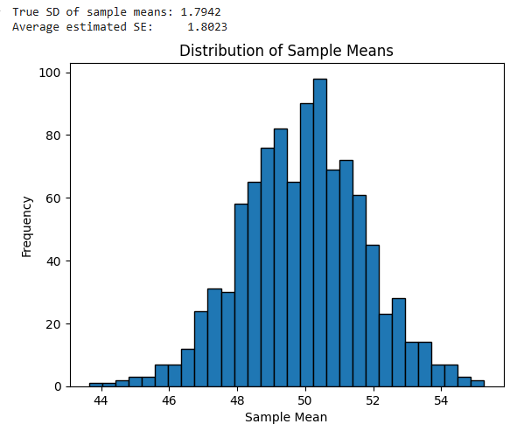
Empirical Proof that Standard Error is an Approximate for the True SD of Sample Means
import numpy as np
import matplotlib.pyplot as plt
# Set population parameters
population = np.random.normal(loc=50, scale=10, size=1000000)
true_sigma = np.std(population)
# Simulation setup
sample_size = 30
num_samples = 1000
sample_means = []
sample_sds = []
for _ in range(num_samples):
sample = np.random.choice(population, sample_size)
sample_means.append(np.mean(sample))
sample_sds.append(np.std(sample, ddof=1))
# Calculate actual SD of sample means
sd_of_sample_means = np.std(sample_means)
# Calculate average standard error estimate
average_se = np.mean([s / np.sqrt(sample_size) for s in sample_sds])
print(f"True SD of sample means: {sd_of_sample_means:.4f}")
print(f"Average estimated SE: {average_se:.4f}")
# Optional: plot histogram
plt.hist(sample_means, bins=30, edgecolor='black')
plt.title('Distribution of Sample Means')
plt.xlabel('Sample Mean')
plt.ylabel('Frequency')
plt.show()

Slide 54
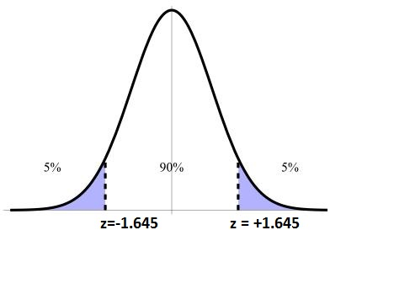

Confidence Intervals Example
Suppose we randomly collected a sample of students with the following information:
  Sample size n = 50
  Sample mean weight x = 73.16 kg
  Population standard deviation s = 8.63
What is the 90% confidence interval for the true population mean weight?
To find the upper bound z-score for the 90% CI, we need to look for area 95% in the z table i.e. 90% + 5% (Look at the Figure)
Therefore, according to the z-table, the upper bound z-score for the 90% Confidence Interval = 1.64 i.e. lower bound is -1.64.
The Margin of Error = 1.64 * (8.63/√50) = ~2
Therefore, the 90% CI = 73.16 ± 2 = [71.16, 75.16]

Slide 55

Confidence Intervals Example
We interpret this 90% confidence interval as follows:
The interval [71.16 kgs to 75.16 kgs] gives us a good estimate of where the mean lies, based on the collective information from our samples.
The 90% means that if we estimate the population parameter and computed the confidence intervals 100 times, we expect that 90% of these intervals will contain our parameter.

Slide 56


Solving Confidence Intervals using Excel Functions
Suppose we randomly collected a sample of students with the following information:
  Sample size n = 50
  Sample mean weight x = 73.16 kg
  Sample standard deviation s = 8.63
What is the 90% confidence interval for the true population mean weight?
We can compute the confidence interval using Excel CONFIDENCE.NORM function.
This function computes the margin of error.
CONFIDENCE.NORM(.1 , 8.63 , 50) = 2.0074 ~ 2
Therefore, the 90% CI = 73.16 ± 2 = [71.16, 75.16]

Slide 57


Transitioning to T-Distribution
The T-distribution, like the normal distribution, is bell-shaped and symmetric but has heavier tails.
This means there is more probability in the tails and less in the center compared to a normal distribution.
The exact shape of the T-distribution depends on the degrees of freedom (df), which are related to the sample size.
Degrees of freedom in the context of the T-distribution refer to the number of independent values in a calculation of a statistic that are free to vary.
For a confidence interval, df is equal to the sample size (n) minus 1 (df = n - 1).
As the sample size increases, the T-distribution approaches the normal Z-distribution.
https://www.scribbr.com/statistics/t-distribution/

Slide 58
When to use T-Distribution
We can use the Z-distribution when the population variance is known or when our data is large enough (n > 30).
However, real-world data often doesn't come with this information.
In practice, the population variance is unknown, and we usually estimate the population variance using the sample variance, which introduces more variability into our statistics.
The T-distribution accommodates this additional uncertainty and is especially useful for small sample sizes.
The T-distribution often serves as a safer alternative because it accounts for the additional uncertainty from estimating the population variance.

Slide 59

The T Table
The first column, denoted "v," lists the degrees of freedom.
Degrees of freedom typically equal the sample size minus one (n-1) and relate to the number of independent values in a set of observations.
The top row lists different significance levels (α), like the probabilities in z-table.
The intersection of a row and column gives the t-value or t score, which is the cutoff point on the t-distribution.
The table lists the areas (probability) on the right side, of the t-scores (opposite to the z-tables), therefore, to find a t scores for confident intervals we split α by 2 and look out the resulting value in the table.
For example, to find the 90% confidence interval for a sample of 20 observations, we find α which is 1 - .9 = .1
We split α by 2 = .1 / 2 = 0.05 and we lookout that value in the table = 1.729

Slide 60


Confidence Intervals Using T-Distribution

Slide 61

Interval Estimates - Confidence Intervals
Suppose we randomly collected a sample of students with the following information:
  Sample size n = 20
  Sample mean weight x = 72.94 kg
  Samples standard deviation s = 8.3946
What is the 90% confidence interval for the true population mean weight?
Confidence Interval 90% → α = 1 - 0.9 = 0.1 → α/2 = 0.05
According to the t-table, the t-score for the 0.05 with df 20 – 1 = 19 → t score = 1.729
The Margin of Error = 1.729 * (8.3946/√20) = 3.25
Therefore, the 90% CI = 72.94 ± 3.25 = [69.69, 76.19]
What is the difference between the 90% Confidence Interval of the Z-Distribution and the 90% Confidence Interval of the T-Distribution?

Slide 62


Solving Confidence Intervals using Excel Functions
Suppose we randomly collected a sample of students with the following information:
  Sample size n = 20
  Sample mean weight x = 72.94 kg
  Samples standard deviation s = 8.3946
What is the 90% confidence interval for the true population mean weight?
We can compute the confidence interval using Excel CONFIDENCE.T function.
This function computes the margin of error.
CONFIDENCE.T(.1 , 8. 39 , 20) = 3.24 ~ 2
Therefore, the 90% CI = 72.94 ± 3.24 = [69.69, 76.19]

Slide 63

Steps to Calculate the Needed Sample Size
Define your research objectives and questions.
Choose a significance level (α) and desired margin of error (E).
Estimate population variability (σ), or use conservative estimates if unknown.
Determine the population size (N).
Select the type of sampling (random or stratified).
Choose the statistical test or analysis that will be applied.
Use a sample size formula or software tool to calculate the required sample size.
Consider practical constraints and adjust for potential non-response.
Conduct the study, analyze data, and interpret results.

Slide 64
307312
Introduction to Hypothesis Testing

Slide 65
Content
Introduction to Hypothesis Testing
  Business Examples
  Significance Level – Alpha
  Computing T-Statistic
  Critical Value Approach vs P-Value Approach
  Type I and Type II Errors
T-Test: Used for normally distributed data when the variance is unknown.
  One-sample t-test: Tests the mean of a single group against a known mean.
  Two-sample t-test: Compares the means of two dependent groups (paired test).
  Two-sample t-test: Compares the means of two independent groups (variance assumed to be equal).
  Two-sample t-test: Compares the means of two independent groups (variance assumed to be not equal).
Proportion Test: Compare sample proportion to a benchmark (e.g., open rate, conversion rate).
ANOVA (Analysis of Variance): Used to compare the means of three or more samples.
  One Way ANOVA
  Two Way ANOVA
Chi-square test: Tests for relationships between categorical variables.

Slide 66
Hypothesis Testing
Hypothesis Testing is a statistical method that uses sample data to evaluate a hypothesis about a population parameter.
A hypothesis is a claim about a population parameter that can be examined.
The purpose of hypothesis testing is to determine whether there is enough evidence in a sample of data to support a particular belief about a population.
Examples of claims that can be checked:
  Testing if a new marketing campaign increases customer engagement.
  Checking whether a redesigned website improves conversion rates.
  Evaluating if a new product packaging affects sales volume.
  Determining if weekend promotions boost in-store foot traffic.
  Assessing whether remote work impacts employee productivity.
  Comparing customer satisfaction between two service locations.
  Testing if a loyalty program increases repeat purchase rates.
  Seeing if a price change affects total revenue.
  Checking whether a new supplier leads to fewer product defects.
  Measuring if training improves sales team performance.

Slide 67
Business Related Examples in Hypothesis Testing
Category | Scenario | Type of Test | Detailed Experiment Design
Marketing | Testing if a new marketing campaign increases customer engagement. | Proportion | Compare engagement rates (clicks, opens) between users exposed to the new vs. old campaign. Randomly assign at least 500 customers to two groups: one receiving the new campaign, one the old. Track engagement (clicks/opens) over a week.
 | Seeing if a promotional email improves open or click-through rates. | Proportion | Compare open/click-through rates between two versions of an email. Send Version A to 1,000 customers and Version B to another 1,000. Ensure equal demographic spread. Compare open and click-through rates.
 | Measuring whether influencer partnerships drive more traffic to the site. | Mean | Compare average daily website visits with and without influencer campaigns. Track daily website traffic for 30 days before and after the influencer campaign. Use rolling averages to minimize noise.
 | Evaluating if social media ads result in more conversions. | Proportion | Compare conversion rates for users who saw the ads vs. those who did not. Randomly expose 5,000 users to social media ads while keeping a matched control group unexposed. Track conversion behavior over 7 days.
Sales & Revenue | Determining if a price change affects total revenue. | Mean | Compare average revenue per user before and after price change. Collect revenue data for 4 weeks before and after price change. Use at least 1,000 transactions in each period to ensure reliability.
 | Testing whether bundling products increases average order value. | Mean | Compare average order value for bundled vs. unbundled products. Assign 500 customers to view bundled product pricing and 500 to unbundled. Track order values across one sales cycle.
 | Assessing if offering free shipping improves purchase completion rates. | Proportion | Compare checkout completion rates with and without free shipping. Split 2,000 checkout users evenly into groups with and without free shipping. Track completion rate within 24 hours.

Slide 68
Category | Scenario | Type of Test | Detailed Experiment Design
Operations | Checking whether a new supplier leads to fewer product defects. | Proportion | Compare defect rates between products from the old vs. new supplier. Collect defect data from 1,000 units produced using the old supplier and 1,000 from the new. Monitor under similar production conditions.
 | Evaluating if a new production method reduces waste or error rates. | Mean | Compare mean waste/error amounts using old vs. new methods. Run the production process using each method for a week, generating at least 500 measurements of waste or errors per method.
 | Determining if delivery time decreases with a new logistics provider. | Mean | Compare average delivery times between the two providers. Record 1,000 delivery times for each provider across the same set of shipping regions and similar order types.
Customer Behavior | Testing if a loyalty program increases repeat purchase rates. | Proportion | Compare proportion of returning customers with and without loyalty program. Track purchase frequency over 3 months for 1,000 loyalty program users and 1,000 non-users, matched by purchase history.
 | Seeing if a new mobile app design boosts daily active users. | Mean | Compare average daily users before and after redesign. Monitor app usage data for 30 days before and after the redesign, using data from at least 5,000 active users.
 | Measuring if customer satisfaction differs after a policy change. | Mean | Compare satisfaction ratings before and after the policy change. Survey at least 500 customers before and after the policy change or use NPS ratings from two equivalent time periods.
Human Resources | Assessing whether remote work impacts employee productivity. | Mean | Compare average productivity scores of remote vs. in-office workers. Randomly select 200 remote and 200 in-office employees with similar roles. Track weekly productivity for 1 month.
 | Measuring if training improves sales team performance. | Mean | Compare average sales figures before and after training. Analyze sales data from 100 employees for the 3 months before and after training. Normalize for seasonal trends.
 | Testing if flexible hours reduce employee turnover. | Proportion | Compare turnover rates between employees with and without flexible hours. Track turnover across 1,000 employees with flexible hours and 1,000 without, matched on role and tenure, over a year.

Slide 69
Key Concepts
Null Hypothesis (H₀): A statement of no effect or no difference (usually we want to test this null state against a difference made by an intervention)
Alternative Hypothesis (H₁ or Ha): What you want to prove – a statement of effect or difference.
Significance Level (α): Probability of rejecting H₀ when it is actually true. Common choices: 0.05, 0.01.
p-value: Probability of observing a result at least as extreme as the one obtained, assuming H₀ is true.
Test Statistic: A value calculated from the sample to decide whether to reject H₀.

Slide 70
The Null and The Alternative Hypothesis
When formulating a hypothesis test, we define two hypotheses: the null hypothesis (𝐻₀) and the alternative hypothesis (𝐻₁ or 𝐻ₐ).
These two hypotheses complement each other—only one of them can be valid.
For example, suppose a company claims that the average delivery time of its orders is 3 days.
To test this claim, the company defines the hypotheses as following:
  The Null hypothesis 𝐻₀: The average delivery time IS EQUAL TO 3 days.
  The Alternative hypothesis 𝐻ₐ: The average delivery time IS NOT 3 days.
Hypotheses are often expressed with symbols like this:
𝐻₀: μ = 3 days
𝐻ₐ: μ ≠ 3 days
Notice that the null hypothesis sets a baseline assuming no difference or effect—in this context, that the mean delivery time is not different from 3 days.
The burden of proof lies with the alternative hypothesis, which must show sufficient evidence that the average delivery time is different from 3 days.

Slide 71
Choosing the Right Test
One-sample z-test or t-test: Compare sample mean to a known value.
Proportion test: Compare sample proportion to a benchmark (e.g., open rate, conversion rate).
Two-sample t-test: Compare means between two groups (e.g., control vs test).
Chi-square test: Compare categorical variables (e.g., customer satisfaction vs region).
ANOVA Test: Compare means between three or more groups.

Slide 72
The Process
Formulate Hypotheses
  Null hypothesis (H₀): A statement of no effect or no difference. It represents the default assumption being tested.
  Alternative hypothesis (Hₐ): The hypothesis you want to provide evidence for, suggesting there is an effect, difference, or relationship in the population.
Choose a Significance Level (α)
  Select the probability of making a Type I error (rejecting H₀ when it is true).
  Common choices: 0.05 (5%) or 0.01 (1%).
Collect and Analyze Data
  Gather sample data relevant to your research question.
  Perform an appropriate statistical analysis (e.g., t-test, chi-square test, ANOVA) depending on your study design.
Calculate the Test Statistic
  Compute the test statistic based on sample data and H₀.
  This quantifies how different the sample is from what is expected under H₀.
Determine the Critical Region
  Identify the rejection region in the probability distribution of the test statistic.
  If the statistic falls within this region, H₀ will be rejected.
Compare the Test Statistic to Critical Values
  If the calculated test statistic falls into the critical region, reject H₀.
  Otherwise, fail to reject H₀.
Calculate the P-Value (Alternative Approach)
  The p-value is the probability of observing a test statistic as extreme as, or more extreme than, the one obtained, assuming H₀ is true.
  Decision rule:
    If p ≤ α → reject H₀
    If p > α → fail to reject H₀
Make a Decision
  Reject H₀: Conclude there is evidence supporting Hₐ.
  Fail to reject H₀: Conclude there is insufficient evidence to support Hₐ.
Interpret Results
  Explain findings in the context of the research question.
  Discuss practical significance and implications of the results.
  Would you like me to also turn this into a step-by-step flowchart or visual diagram for easier understanding?

Slide 73
The Process in Brief
State H₀ and Ha.
Choose α (e.g., 0.05).
Collect data and compute a test statistic.
Compute the p-value.
Compare p-value to α.
Decision: Reject or fail to reject H₀.
Note: We cannot we accept the null hypothesis, we can only reject it or fail to reject it.
The basis for this testing process comes from logic.
For example, if our null hypothesis = All students live in Amman, it will be challenging to check if all students live in Amman.
On the other hand, it will be much easier to find just one student who does not live in Amman and therefore reject the null hypothesis.
Rejecting is much easier that proving or accepting the hypothesis.

Slide 74
More about Hypothesis Testing Core Concepts
Alpha value, The Test Statistic and Critical Values, P-Value, Type I and Type II Errors

Slide 75

The Significance Level α
Before conducting the test, we need to set the significance level α.
The significance level is a measure of the strength of the evidence that must be present in our sample to reject the null hypothesis and conclude that the effect is statistically significant.
Typical significance levels are: α=0.1 (10%), α=0.05 (5%), α=0.01 (1%)
A lower significance level means that the evidence in the data needs to be stronger to reject the null hypothesis.
There is no "correct" significance level - it only states the amount of uncertainty of the conclusion.
A 5% significance level means that we expect to reject a true null hypothesis 5 out of 100 times (Type I Error).

Slide 76
The Test Statistic
The test statistic is the value we compute based on the sample data that we collect.
The test statistic is used to decide the outcome of the hypothesis test.
We standardize test statistic using:
  Z Standard Normal Distribution for large samples or when the variance is known.
  The Student's T-Distribution (T) for small samples and the population variance is unknown.

Slide 77

Computing the Test Statistic Dependence on our Knowledge about Variance

Slide 78

The Critical Value and the p-Value Approach to Hypothesis Testing
To decide whether to reject the null hypothesis, a test statistic is calculated.
The decision is made based on the numerical value of that test statistic.
There are two approaches how to arrive at that decision: The critical value approach and the p-value approach.
The critical value approach
By applying the critical value approach, it is determined, whether the observed test statistic is more extreme than a defined critical value.
Therefore, the observed test statistic (calculated based on sample data) is compared to the critical value (a kind of cutoff value).
If the test statistic is more extreme than the critical value, the null hypothesis is rejected.
If the test statistic is not as extreme as the critical value, the null hypothesis is not rejected.
The critical value is computed based on the given significance level α and the type of probability distribution of the idealized model.
The critical value divides the area under the probability distribution curve in rejection region(s) and non-rejection region.

Slide 79


The Critical Value Approach to Hypothesis Testing
The following three figures show a two tailed test, a left tailed test and a right sided test.
In a two-sided test the null hypothesis is rejected if the test statistic is either too small or too large. Thus, the rejection region for such a test consists of two parts: one on the left and one on the right.
For a left-tailed test the null hypothesis is rejected, if the test statistic is too small. Thus, the rejection region for such a test consists of one part, which is left from the center.
For a right-tailed test the null hypothesis is rejected, if the test statistic is too large. Thus, the rejection region for such a test consists of one part, which is right from the center.
Note: if p≤α , reject $H_{0}$ ; otherwise, if p>α , do not reject $H_{0}$

Slide 80

The p-Value Approach to Hypothesis Testing
The p-value represents:
  The probability of observing the sample data or more extreme values, given that the null hypothesis is true.
  The amount of evidence against the null hypothesis, the smaller (closer to 0) the p-value, the stronger is the evidence against the null hypothesis.
If the p-value (Green Area) is less than or equal to the specified significance level α (Yellow Area) , the null hypothesis is rejected. Otherwise, we fail to reject the null hypothesis.

Slide 81

Type I and Type II Errors
Type I and Type II errors are two potential forms of incorrect conclusions in hypothesis testing.
Type I Error (False Positive): Rejecting $H_{0}$ when it is actually true.
Type II Error (False Negative): Failing to reject $H_{0}$ when it is false.
The acceptable level of Type I error is designated by alpha (α), while the acceptable level of Type II error is designated beta (β).
A Type I error occurs when the null hypothesis is incorrectly rejected when it is actually true.
Conversely, a Type II error happens when the null hypothesis is not rejected when it is in fact false, akin to a false negative, where we fail to detect a true effect or difference.
Consider a pharmaceutical company deciding whether a new drug is effective. A Type I error would occur if the company concludes the drug works when it does not, potentially leading to a costly recall and reputation damage when the truth emerges.
On the other hand, a Type II error would be failing to recognize the drug's efficacy, missing out on the opportunity to bring a beneficial product to market, which can result in lost revenue and competitive disadvantage. The company must balance these risks, often prioritizing the avoidance of one type of error over the other based on the potential costs and impacts associated with each.

Slide 82
Hypothesis Testing Examples

Slide 83

Z Test vs T Test
A z-test is used to test a Null Hypothesis if the popula on variance is known, or if the sample size is larger than 30, for an unknown popula on variance.
A t-test is used when the sample size is less than 30 and the popula on variance is unknown.
In our work, we will focus on T-Tests

Slide 84


One Sample Test – Testing for Two Tails
Scenario: A logistics company believe that its average delivery time is equal to 3 days. The company wants to test this belief.
The company collected a sample data of 40 delivery times to test if there enough evidence (at α = .05) to conclude that the population mean delivery time for the company is equal to 3 days?
H₀: μ = 3
Ha: μ ≠ 3
Using the collected data, the t-statistic will be computed:
If the test statistic is within the rejection region, we reject the null hypothesis, otherwise we fail to reject the null hypothesis noting that the sample data did not show enough evidence against the null hypothesis.

Slide 85

Implement the Test Using Excel Data Analysis Add In
Delivery Times for 40 Days Sample – In Days
1 | 4 | 1 | 4
3 | 3 | 4 | 2
5 | 1 | 6 | 3
3 | 4 | 4 | 3
3 | 2 | 4 | 4
4 | 2 | 1 | 3
2 | 3 | 3 | 3
5 | 4 | 6 | 5
3 | 5 | 2 | 4
6 | 2 | 4 | 5
Test Results
 | Delivery Times
Mean | 3.4
Variance | 1.887179487
Observations | 40
Hypothesized Mean Difference | 0
df | 39
t Stat | 1.841549442
P(T<=t) one-tail | 0.036577924
t Critical one-tail | 1.684875122
P(T<=t) two-tail | 0.073155849
t Critical two-tail | 2.02269092
1
According to the test results, we fail to reject the null hypothesis which states that the mean delivery time is equal to 3 days.
The collected sample data did not provide us with sufficient evidence to conclude that the mean delivery time is different from 3.
We reached this conclusion because the t statistic falls inside the non-rejection region.
We also reached that conclusion because the p-value (0.07315) which is greater than alpha 0.05.
Computing t-statistic manually, t = (3.4 - 3) / (1.37 / √40) ≈ 1.84
2

Slide 86

One Sample – One Tail Test – Upper Tail
Business Context:
A manufacturing company believes that its daily production output is larger than 500 units.
The company collect sample outputs for 30 days.
Hypothesis Formulation:
Null Hypothesis (H₀): μ ≤ 500 (Baseline)
Alternative Hypothesis (H₁): μ > 500 (Output is larger)
This setup calls for a one-tailed (upper-tailed) t-test, as the interest lies specifically in detecting an increase in the mean output.

Slide 87

Implement the Test Using Excel Data Analysis Add In
Collect Daily Output Data
517 | 534
528 | 483
517 | 520
494 | 539
537 | 530
486 | 509
515 | 547
528 | 526
500 | 538
564 | 531
521 | 509
510 | 538
512 | 491
519 | 505
518 | 534
t-Test: Two-Sample Assuming Unequal Variances
 | Daily Output | Dummy
Mean | 520 | 500
Variance | 340.0689655 | 0
Observations | 30 | 4
Hypothesized Mean Difference | 0
df | 29
t Stat | 5.940282826
P(T<=t) one-tail | 9.38286E-07
t Critical one-tail | 1.699127027
P(T<=t) two-tail | 1.87657E-06
t Critical two-tail | 2.045229642
1
T statistic is above the critical value and P-Value is very small < alpha, therefore we reject the null hypothesis
2

Slide 88
Two Sample T-Tests
Two-sample t-test: Compares the means of two dependent groups (Paired t test).
Two-sample t-test: Compares the means of two independent groups (variance assumed to be equal).
Two-sample t-test: Compares the means of two independent groups (variance assumed to be not equal).

Slide 89


Two Samples T-Test – Testing Dependent Groups (Paired T Test)
The dependent samples T-test (or paired samples t-test) is a statistical test that determines whether there is a difference between two dependent groups or samples.
We need the paired t-test whenever we survey the same group or sample at two points in time.
This can be the case, for example, in longitudinal studies with several measurement points (time series analyses) or in intervention studies with experimental designs (before-after measurement).
An example of dependent sampling is when the weight of a group of people is measured at two points in time (before and after going into a diet).
The weight of a person can be measured individually before and after going into the diet, and the difference in the measured values can be calculated in each case.

Slide 90
Two Samples T-Test – Testing Dependent Groups (Paired T Test)
We are interested in the question whether an online statistics learning tutorial helps students improve their grades.
There are three variables of interest in the student's data set (score1, score2 and online.tutorial).
The variables score1 and score2 show the grades (0-100) for two exams on mathematics after attending online training. The higher the value the better the student performed.
The variable online.tutorial is a binary variable, which is 1 if the student completed the online statistics learning tutorial, or 0 otherwise.
The first exam takes place before the students attended the online statistics learning tutorial.
The participation in the online statistics learning tutorial is not mandatory, however the two exams are obligatory for all students.
We want to examine if the group of students, which attended the online statistics learning tutorial, performs better on the second exam compared to the first exam.
Random sample of students who took the online training
` | Score 1 | Score 2
1 | 67 | 71
2 | 62 | 64
3 | 60 | 57
4 | 53 | 52
5 | 75 | 77
6 | 64 | 79
7 | 43 | 48
8 | 74 | 70
9 | 59 | 53
10 | 54 | 58
11 | 66 | 66
12 | 81 | 90
13 | 55 | 57
14 | 64 | 68
15 | 72 | 71
16 | 76 | 78
17 | 75 | 73
18 | 90 | 92
19 | 83 | 90
20 | 64 | 73
21 | 49 | 51
22 | 41 | 51
23 | 75 | 87
24 | 66 | 66
25 | 75 | 74
26 | 49 | 57
27 | 91 | 89
28 | 68 | 69
29 | 72 | 72
30 | 87 | 93
$$H_{0}:{\text{µ}}_{score2}≤{\text{µ}}_{score1}$$ | Null Hypothesis states that there is no effect for the intervention
$$H_{1}:{\text{µ}}_{score2\text{ > }}{\text{µ}}_{score1}$$ | Alternative Hypothesis claims that the intervention caused an effect

Slide 91



Two Samples T-Test – Testing Dependent Groups (Paired T Test)
2
3
1
Based on the sample data and the test statistic, we found that there is a statistically significant difference between the before and after score, the after score (score2) is higher than score1.
This finding is supported by the test statistic and the p-value, therefore we REJECT the null hypothesis, and we conclude that the online tutorial helped students in enhancing their exam performance.

Slide 92

Two Samples T-Test – Testing Independent Groups (Unpaired T Test)
(variance assumed to be equal)
In this section we perform a hypothesis test for the means of two populations.
We examine the mean annual salary (in Euro) of graduates.
The first population consist of male students and the second population of female students.
The standard deviations of the two populations are unknown but assumed to be equal.
The question is, whether there is a difference (at α 5%) in the mean annual salary of graduates related to gender (two tailed test)
 | Male Random Sample | Female Random Sample
1 | $39,647.68 | $29,543.60
2 | $55,726.10 | $30,972.76
3 | $34,717.77 | $33,216.12
4 | $29,999.35 | $24,143.27
5 | $50,763.66 | $40,466.69
6 | $52,433.73 | $29,543.60
7 | $44,385.84 | $47,760.48
8 | $36,599.27 | $45,054.95
9 | $47,842.44 | $42,742.79
10 | $30,854.42 | $42,202.39
11 | $58,614.72 | $40,606.41
12 | $62,887.03 | $29,783.76
13 | $48,288.53 | $46,945.17
14 | $43,191.15 | $29,555.94
15 | $43,756.58 | $45,042.30
16 | $48,453.00 | $29,555.94
17 | $23,090.67 | $45,625.09
18 | $55,660.20 | $28,017.87
19 | $57,527.17 | $35,840.90
20 | $65,776.23 | $33,648.38
21 | $50,011.69 | $46,858.67
22 | $46,213.64 | $42,463.48
23 | $42,211.41 | $33,200.27
24 | $61,384.55 | $28,338.17
25 | $49,780.18 | $26,265.35
26 | $50,474.57 | $34,373.99
27 | $43,281.92 | $37,312.85
28 | $55,484.64 | $37,709.73
29 | $24,409.73 | $35,106.01
30 | $40,489.49 | $37,807.11
$$H_{0}:{\text{µ}}_{male}={\text{µ}}_{female}$$ | Null Hypothesis states that there is no difference
$$H_{1}:{\text{µ}}_{male \text{≠} }{\text{µ}}_{female}$$ | Alternative Hypothesis claims that there is a difference

Slide 93



Two Samples T-Test – Testing Independent Groups (Unpaired T Test)
(variance assumed to be equal)
3
2
1
Based on the sample data and the test statistic, we found that there is a statistically significant difference between male salaries and female salaries.
This finding is supported by the test statistic and the p-value, therefore we REJECT the null hypothesis, and we conclude that the salaries of male graduates and female graduates are not equal.

Slide 94
Two Samples T-Test – Testing Independent Groups (Unpaired T Test)
(variance assumed to be NOT equal)
In this section we perform a hypothesis test for the means of two populations.
To showcase the non-pooled t-test we test a claim that states that the annual salaries for political science female students is higher than the annual salaries of the social science female students.
The standard deviations of the two populations are unknown and assumed to be unequal.
We want to test at α 1%, whether the mean political science salary is higher than the mean salary of the social science (one tail test, upper tail).
 | Political Science Random Sample | Social Science Random Sample
1 | $30,796.16 | $33,641.73
2 | $32,038.41 | $29,635.67
3 | $32,038.41 | $38,738.01
4 | $32,996.39 | $21,453.99
5 | $33,648.38 | $31,484.80
6 | $41,430.16 | $34,287.96
7 | $40,032.78 | $35,583.43
8 | $39,710.80 | $28,672.85
9 | $36,911.26 | $30,062.71
10 | $45,900.13 | $34,420.48
11 | $35,270.19 | $33,641.73
12 | $43,318.41 | $26,291.32
13 | $41,282.13 | $31,151.42
14 | $41,430.16 | $38,738.01
15 | $21,485.62 | $33,565.74
16 | $29,195.50 | $31,484.80
17 | $45,141.81 | $32,194.59
18 | $34,492.08 | $35,746.22
19 | $27,893.26 | $28,281.25
20 | $38,591.54 | $31,405.48
21 | $33,726.58 | $32,194.59
22 | $29,832.22 | $35,987.41
23 | $32,154.94 | $35,583.43
24 | $34,686.49 | $34,227.49
25 | $25,607.82 | $25,758.88
26 | $33,726.58 | $34,373.99
27 | $37,782.86 | $25,658.83
28 | $35,507.83 | $34,201.58
29 | $33,955.21 | $31,151.42
30 | $25,883.03 | $33,641.73
$$H_{0}:{\text{µ}}_{political science}≤{\text{µ}}_{social science}$$ | Null Hypothesis states that the salaries are equal
$$H_{1}:{\text{µ}}_{political science\text{ > }}{\text{µ}}_{social science}$$ | Alternative Hypothesis claims that political science is higher

Slide 95



Two Samples T-Test – Testing Independent Groups (Unpaired T Test)
(variance assumed to be NOT equal)
2
3
1
Based on the sample data and the test statistic, we found that there is no statistically significant difference (at α 1%) between the salaries of political science and social science.
This finding is supported by the test statistic and the p-value, therefore we FAIL TO REJECT the null hypothesis which states that the salaries of political science and social science are equal for female graduates.

Slide 96
Testing Proportions

Slide 97
Introduction to Proportion Tests
A Proportion is a fraction or percentage of a population exhibiting a specific trait (e.g., success/failure).
Proportion tests allow us to infer population parameters from sample data.
Key Differences from t-tests:
Applied to categorical data (e.g., success/failure), not continuous variables.
Uses the normal approximation to the binomial distribution. The central limit theorem says: if the sample size is large enough, the binomial distribution starts to look like a normal distribution.
Therefore, to use the normal distribution as an approximation for the binomial, both of these must be true:
  𝑛.𝑝 ≥ 10
  𝑛.(1−𝑝) ≥ 10
  Where:
    𝑛 = sample size
    𝑝 = hypothesized population proportion (under the null hypothesis)

Slide 98

One-Sample Proportion Test

Slide 99


Example

Slide 100

Two-Samples Proportion Test

Slide 101


Example: Does the New Treatment Work?
This is a one-tailed test for comparing two proportions

Slide 102
Hypothesis Testing for Categorical Data
Chi-Square Tests

Slide 103
Introduction to Chi-Square Tests
Definition: Chi-square tests are statistical methods used to determine whether there's a significant association between categorical variables or whether observed data differs significantly from expected values.
Types of Chi-Square Tests:
  Test of Independence: Determines if two or more categories are independent.
  Goodness of Fit Test: Determines if a sample matches an expected distribution.

Slide 104
Examples
Test of Independence
Marketing: Is customer gender associated with product preference?
HR Analytics: Is employee department linked to job satisfaction level?
Retail: Does store location affect the type of payment method used?
Healthcare Management: Is patient age group related to preferred appointment times?
Customer Service: Is complaint category associated with region?

Slide 105


Chi-Square Steps – Test of Independence
Step-by-Step Process:
  1. Set a contingency table to show the expected frequencies and the observed frequencies.
  2. Calculate the expected frequencies for each cell using the following formula.
  3. Compute Chi-Square statistic using the formula

Slide 106


Chi-Square Steps – Test of Independence
4. Use the Chi-Square distribution to find the Chi-Square statistic and compare it to the critical values at common significance level e.g. (0.05)

Slide 107
Example: Product Preference Across Age Groups
A company wants to determine if there is a significant association between the age group of its customers and their preference for one of two new beverage products.
The marketing team has conducted a survey and collected data from different age groups.
The table below shows the observed frequency table based on the survey:
 | Product A | Product B | Total
Under 30 | 30 | 40 | 70
30 to 50 | 50 | 30 | 80
Over 50 | 20 | 30 | 50
Total | 100 | 100 | 200
Task: Perform a Chi-Square Test of Independence to determine if there's a significant relationship between age group and product preference.

Slide 108
State the Null and the Alternative Hypothesis
For a Chi-Square Test of Independence, the hypotheses are defined in terms of whether the two categorical variables are related.
Null Hypothesis (H₀): There is no association between customer age group and beverage product preference.
Equivalently, product preference is independent of age group.
Alternative Hypothesis (H₁): There is an association between customer age group and beverage product preference.
Equivalently, product preference is not independent of age group.
These hypotheses set up the test to evaluate whether the observed differences in product preference across age groups are due to random variation or reflect a statistically significant relationship.

Slide 109

Steps to Solve in Excel

Slide 110

Calculate Chi-Square Value
Category (Age Group, Product) | Observed (O) | Expected (E) | O−E | (O−E)^2 | E(O−E)^2​
Under 30, Product A | 30 | 35 | -5 | 25 | 25/35≈0.714
Under 30, Product B | 40 | 35 | 5 | 25 | 25/35≈0.714
30 to 50, Product A | 50 | 40 | 10 | 100 | 100/40=2.500
30 to 50, Product B | 30 | 40 | -10 | 100 | 100/40=2.500
Over 50, Product A | 20 | 25 | -5 | 25 | 25/25=1.000
Over 50, Product B | 30 | 25 | 5 | 25 | 25/25=1.000
Total | 200 | 200 |  |  | χ2≈8.428

Slide 111

Steps to Solve in Excel
Interpretation
After calculating the Chi-Square statistic and comparing it with the critical value from a Chi-Square distribution table (or using p-value), you can conclude whether there is a statistically significant association between age group and product preference.

Slide 112

Check the Solution in The Excel File

Slide 113
Hypothesis Testing for More than Two Populations Means
One Way ANOVA

Slide 114
Introduction to One-Way ANOVA
Definition: One-Way ANOVA is a statistical test that compares the means of three or more independent groups to determine if at least one group mean is statistically different from the others.
Purpose: To test for significant differences between the means of multiple groups when you have one categorical independent variable and one continuous dependent variable.
Appropriate Use Cases:
  Comparing customer satisfaction levels across different store locations.
  Examining student performance across different teaching methods.
Key Advantage:
  Allows simultaneous comparison of more than two groups, providing a broader analysis than t-tests.

Slide 115
One Way ANOVA
Hypothesis in One-Way ANOVA:
Null Hypothesis (H0): All group means are equal.
Alternative Hypothesis (H1): At least one group mean is different from the others.
How to Calculate?
Calculate Group Means and Overall Mean
Compute Sum of Squares:
  Total Sum of Squares (SST): Variability of all data points around the overall mean.
  Within-Group Sum of Squares (SSW): Variability within each group.
  Between-Group Sum of Squares (SSB): Variability due to the interaction between the groups.
Calculate Mean Squares:
  Mean Square Between (MSB): SSB divided by the degrees of freedom between groups (k-1).
  Mean Square Within (MSW): SSW divided by the degrees of freedom within groups (N-k).
F-Statistic:
  F = MSB / MSW

Slide 116
ANOVA Example
Scenario: A school tests three different teaching methods to determine which one results in the best performance on a standardized test.
The students are randomly assigned to one of three groups, each receiving instruction through a different method.
Their scores on a standardized test are recorded.
Variables:
  Group: The teaching method group (A, B, C)
  Score: The score each student received on the standardized test.
Student ID | Group | Score
1 | A | 82
2 | A | 88
3 | A | 84
4 | A | 90
5 | A | 85
6 | B | 78
7 | B | 75
8 | B | 80
9 | B | 82
10 | B | 77
11 | C | 90
12 | C | 92
13 | C | 95
14 | C | 91
15 | C | 94

Slide 117

Interpreting Results
F-Statistic and P-Value:
  An F-Statistic higher than the critical value or a P-value less than the alpha level (e.g., 0.05) indicates significant differences between group means.
  In our example, both the F-Statistic and the P-value indicate significant difference between groups means, therefore we reject the null hypothesis.
Post Hoc Tests: If the ANOVA is significant, perform post hoc tests (e.g., Tukey’s HSD) to determine which specific groups differ from each other.

Slide 118
2-Way ANOVA
Case Study: Effect of Teaching Method and Gender on Student Performance
Objective:
A school administrator wants to investigate whether student performance is affected by:
  Teaching method (Traditional vs. Online)
  Student gender (Male vs. Female)
This leads to a 2x2 factorial design:
Factor A: Teaching Method (Traditional, Online)
Factor B: Gender (Male, Female)
Response Variable: Final Exam Score (numerical)

Slide 119
2-Way ANOVA
Gender | Teaching Method | Exam Score
Male | Traditional | 75
Male | Traditional | 78
Female | Traditional | 85
Female | Traditional | 82
Male | Online | 70
Male | Online | 68
Female | Online | 80
Female | Online | 83
 | Traditional |  | Online
 | Male | Female | Male | Female
Score1 | 75 | 85 | 70 | 80
Score2 | 78 | 82 | 68 | 83

Slide 120

How to Select Test Type

Slide 121
307312
Introduction to Linear Regression

Slide 122
Introduction to Regression Analysis
Definition: Regression analysis is a powerful statistical method used for predicting a dependent variable based on one or more independent variables.
Purpose: To understand how the typical value of the dependent variable changes when any one of the independent variables is varied, while the other independent variables are held fixed

Slide 123
Types of Regression
Simple Linear Regression: Involves one independent variable and one dependent variable and the relationship between them is modeled by a linear function.
Multiple Linear Regression (Focus of this presentation): Involves multiple independent variables influencing a single dependent variable.
Other Types: Logistic regression, polynomial regression, Ridge Regression, Lasso Regression etc., used for more specific types of data and relationships.

Slide 124


The Regression Equation

Slide 125

Finding the Best Fit Line
The goal of the linear regression algorithm is to get the best values for B0 and B1 to find the best fit line.
The best fit line is the line that has the least error which means the error between predicted values and actual values should be minimum.
In regression, the difference between the observed value of the dependent variable(Yi) and the predicted value(predicted) is called the residuals.
εi = Y Predicted – Yi
Where Y Predicted = B0 + B1 * Xi
In simple terms, the best fit line is a line that fits the given scatter plot in the best way. Mathematically, the best fit line is obtained by minimizing the Residual Sum of Squares(RSS).

Slide 126


Finding the Best Fit Line

Slide 127
Evaluating the Model
R-squared (The Goodness of Fit): Proportion of variance in the dependent variable that is predictable from the independent variables.
Adjusted R-squared: Modified version of R-squared adjusted for the number of predictors.
F-Statistic: Tests whether at least one predictor variable has a non-zero coefficient.
t-Tests on Coefficients: Each beta coefficient has an associated t-test to determine if the variable is statistically significant.

Slide 128
Linear Regression Example
Scenario: A real estate company wants to predict the selling price of houses based on various features.
Variables:
  Price: Selling price of the house (in thousands of dollars).
  Size: Size of the house in square feet.
  Bedrooms: Number of bedrooms.
  Age: Age of the house in years.
  Location: Categorical variable indicating the neighborhood quality (1 = Low, 2 = Medium, 3 = High).

Slide 129



Simple Linear Regression
2
3
1
House ID | Price | Size
1 | 250 | 1500
2 | 315 | 1800
3 | 270 | 1650
4 | 230 | 1400
5 | 450 | 2000
6 | 190 | 1300
7 | 350 | 1850
8 | 300 | 1600
9 | 280 | 1500
10 | 310 | 1700

Slide 130
Regression Statistics
Multiple R (0.946288):
  This is the correlation coefficient, showing the strength and direction of the linear relationship between the independent variable (Size) and the dependent variable (Price).
  Value close to 1 or -1 indicates a strong linear relationship.
R Square (0.895461):
  The coefficient of determination, indicating how much of the variation in the dependent variable (Price) is explained by the independent variable (Size).
  In this case, ~89.55% of the variance in price is explained by size.
Adjusted R Square (0.882394):
  Adjusted for the number of predictors in the model.
  Useful when comparing models with different numbers of predictors; penalizes for adding non-significant predictors.
Standard Error (24.46997):
  The standard deviation of the residuals. Smaller values indicate better model fit, as residuals are closer to zero.
Observations (10):
  The number of data points used in the regression analysis.

Slide 131
ANOVA (Analysis of Variance):
The ANOVA table tests whether the regression model as a whole is statistically significant.
df (Degrees of Freedom):
  Regression: Number of predictors (1) + Intercept (0) = 1.
  Residual: Total observations (10) - Number of predictors (1) - 1 = 8.
  Total: n−1=9n - 1 = 9n−1=9.
SS (Sum of Squares):
  Regression SS (41032.27): Variation in the dependent variable explained by the model.
  Residual SS (4790.234): Variation not explained by the model (errors).
  Total SS (45822.5): Total variation in the dependent variable.
MS (Mean Square):
  Regression MS (41032.27): Regression SS divided by its df: 41032.27 ÷ 1
  Residual MS (598.7793): Residual SS divided by its df: 4790.234 ÷ 8
F (68.52653):
  The F-statistic, which tests whether the regression model explains a significant proportion of the variation in the dependent variable.
  Larger values indicate the model is a good fit.
Significance F (3.41185E-05):
  The p-value for the F-test. A small value (e.g., <0.05) indicates the model is statistically significant.

Slide 132
Coefficients Table
Intercept (-217.422):
  The value of the dependent variable (Price) when the independent variable (Size) is zero.
Size Coefficient (0.31406):
  The slope of the regression line. For every unit increase in size, the price increases by 0.31406 units.
Standard Error (62.32294 for Intercept, 0.037939 for Size):
  Measures the variability in the coefficient estimates. Smaller values indicate more precise estimates.
  The standard error of a coefficient measures the variability in the estimate of that coefficient if we repeatedly sampled data from the population and fitted the regression model each time.
t Stat (-3.48863 for Intercept, 8.278075 for Size):
  The t-test statistic, used to test whether the coefficient is significantly different from zero.
P-value (0.008215 for Intercept, 3.411E-05 for Size):
  Tests the null hypothesis that the coefficient is zero (no effect).
  A small p-value (<0.05) means the coefficient is statistically significant.
  The smaller the value, the better the predictor – note value like 9.3499E-5 = 9.3 X 10 ^-5 = 0.00000934
Lower 95% and Upper 95%:
  The confidence interval for the coefficient. For example, the coefficient for Size (0.31406) is likely between 0.22657 and 0.40155, with 95% confidence.

Slide 133
Conclusion
The model is statistically significant (Significance F < 0.05), and Size has a significant positive effect on Price (p-value for Size is very small).
The model explains ~89.55% of the variation in Price (R² = 0.895461), which is strong.
The residuals have a standard error of 24.47, indicating the average prediction error.
What Does Standard Error Mean in Regression?
In regression, the standard error (SE) reported in the output refers to the standard deviation of the residuals, also known as the residual standard error (RSE) or simply the "standard error of the regression." It measures how far the observed data points (dependent variable values) are from the predicted values, on average.
In our example, the standard error value indicates that, on average, the predictions made by your regression model are off by 24.47 units (the units of your dependent variable, likely apartment prices).
It tells you how much variability (or error) remains unexplained by your model.

Slide 134


Multiple Linear Regression
2
3
Overall model p-value (significance), small value → good model
1
Smaller P-Value → Best Predictor
House ID | Price | Size | Bedrooms | Age | Location
1 | 250 | 1500 | 3 | 10 | 2
2 | 315 | 1800 | 4 | 15 | 3
3 | 270 | 1650 | 3 | 5 | 3
4 | 230 | 1400 | 2 | 20 | 2
5 | 450 | 2000 | 4 | 2 | 3
6 | 190 | 1300 | 3 | 30 | 1
7 | 350 | 1850 | 4 | 8 | 3
8 | 300 | 1600 | 3 | 12 | 2
9 | 280 | 1500 | 3 | 10 | 2
10 | 310 | 1700 | 3 | 6 | 3
Overall Model Accuracy

Slide 135
Assumptions of Linear Regression
1. Linearity
The relationship between the independent variables (predictors) and the dependent variable (response) should be linear.
This means that the change in the dependent variable is proportional to the change in the independent variable.
Example: If you are predicting house prices (dependent variable) based on the size of the house (independent variable), a linear relationship implies that each additional square foot of the house size increases the price by a constant amount.

Slide 136


Assumptions of Linear Regression
How to Test Linearity: Plot the residuals vs. predicted using a scatter plot, look for a random distribution (no patterns).
To check if the relationship between the independent variable (Size) and the dependent variable (Price) is linear, we look for patterns in the residuals, a random scatter indicates a linear relationship while curves or trends suggest a non-linear relationship.

Slide 137
Assumptions of Linear Regression
2. Independence
Observations should be independent of each other. This means that the residuals (errors) should not be correlated across observations. This assumption is important for the validity of standard statistical tests.
Example: In a study measuring the effect of a new drug on blood pressure, each patient's measurement should be independent. If measurements from the same patient at different times are used, they are not independent.
How to Test: Use the Durbin-Watson test to check for autocorrelation in residuals, particularly for time-series data. This test calculates a test statistic (range 0-4). A value around 2 indicates no autocorrelation, values <2 suggest positive autocorrelation, and >2 indicate negative autocorrelation.

Slide 138
Assumptions of Linear Regression
3. Homoscedasticity
The variance of the error terms (residuals) should be constant across all levels of the independent variables.
If this assumption is violated, it indicates heteroscedasticity, meaning the spread of residuals varies at different levels of the independent variables.
Example: When plotting residuals against fitted values in a regression analysis of apartment prices against apartment size, the spread of residuals should be roughly constant. If residuals spread out more as apartment size increases, this indicates heteroscedasticity.

Slide 139

Assumptions of Linear Regression
How to Test Homoscedasticity : Plot residuals vs. predicted values. The spread of residuals variance should be consistent (no funnel-shaped patterns).
Good Residual Spead
Good Linear Relation
Not a Good Residual Spead
Not a Good Linear Relation
التوزيع العشوائي للنقاط حول الصفر على طول المدى هو التوزيع الأفضل الذي يبين أن الموديل الخطي مناسب
Funnel shape note good
الشكل مثل القمع يبين بأن العلاقة الخطية غير مناسبة

Slide 140
Assumptions of Linear Regression
4. Normal Distribution of Errors
The error terms should be normally distributed. This assumption is especially important for small sample sizes because it affects the validity of confidence intervals and hypothesis tests.
Example: After fitting a regression model predicting apartment price based on apartment size, plotting a histogram or a Q-Q plot of the residuals should show that they follow a normal distribution.
Residuals | Standard Residuals | Rank | Percentiles | Theoritical Residuals
-32.890625 | -1.425656831 | 1 | 0.05 | -1.644853627
-30.78125 | -1.334225158 | 2 | 0.15 | -1.036433389
-13.59375 | -0.589226339 | 3 | 0.25 | -0.67448975
-6.484375 | -0.281067736 | 4 | 0.35 | -0.385320466
-3.671875 | -0.159158839 | 5 | 0.45 | -0.125661347
-0.859375 | -0.037249941 | 6 | 0.55 | 0.125661347
7.734375 | 0.335249469 | 7 | 0.65 | 0.385320466
14.921875 | 0.646794429 | 8 | 0.75 | 0.67448975
26.328125 | 1.141202737 | 9 | 0.85 | 1.036433389
39.296875 | 1.703338209 | 10 | 0.95 | 1.644853627

Slide 141
Assumptions of Linear Regression
5. No Multicollinearity
Independent variables should not be too highly correlated with each other. High correlation between predictors (multicollinearity) can inflate the variances of the coefficient estimates and make the model unstable.
Example: In a regression model predicting salary based on education level and years of experience, if education level and years of experience are highly correlated, it could cause multicollinearity issues. Checking the Variance Inflation Factor (VIF) can help detect this.
How to Test: Calculate Variance Inflation Factor (VIF). VIF values above 10 (or sometimes 5) indicate high multicollinearity. A VIF >10 (or sometimes >5) indicates problematic multicollinearity.

