Slide 1
Style + Substance:
Making smart fibers even smarter

Slide 2
Style + Substance:
Making smart fibers even smarter

Slide 3

Style + Substance:
Making smart fibers even smarter

Slide 4
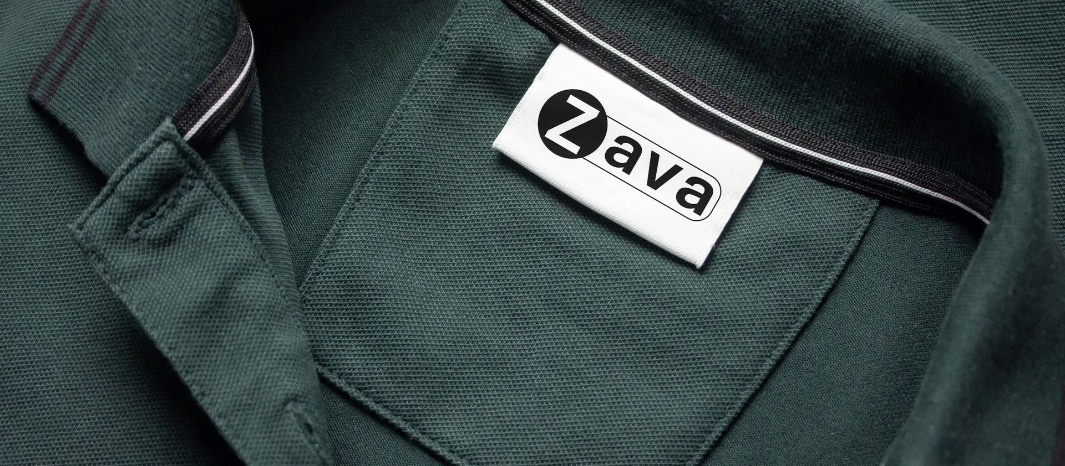
Style + Substance:
Making smart fibers even smarter

Slide 5
Section header 1

Slide 6
Section header 2

Slide 7

Section header 3

Slide 8
Section header 4

Slide 9
Agenda
Example Text
Example Text

Slide 10
Agenda
Example Text
Example Text

Slide 11

Agenda
Example Text
Example Text

Slide 12
pragmatic & bold visual identity
Example Text
Example Text

Slide 13
pragmatic & bold visual identity
Example Text
Example Text

Slide 14
pragmatic & bold visual identity
Example Text
Example Text

Slide 15
pragmatic & bold visual identity
Example Text
Example Text

Slide 16

pragmatic & bold visual identity
Example Text
Example Text

Slide 17

pragmatic & bold visual identity
Example Text
Example Text

Slide 18

pragmatic & bold visual identity
Example Text
Example Text

Slide 19

pragmatic & bold visual identity
Example Text
Example Text

Slide 20

pragmatic & bold visual identity
Example Text
Example Text

Slide 21
pragmatic & bold visual identity

Slide 22
pragmatic & bold visual identity
Header 1
Header 1
Example Text
Example Text
Example Text
Example Text

Slide 23
pragmatic & bold visual identity

Slide 24
pragmatic & bold visual identity
Example Text
Example Text
Example Text
Example Text

Slide 25

pragmatic & bold visual identity
Example Text
Example Text

Slide 26
pragmatic & bold visual identity
Example Text
Example Text

Slide 27
pragmatic & bold visual identity
Example Text
Example Text

Slide 28
pragmatic & bold visual identity
Example Text
Example Text

Slide 29
MARKET SHARE
25%

Slide 30
MARKET SHARE
25%

Slide 31
At Zava, our mission is to transform everyday materials into intelligent, responsive fabrics that enhance human performance, health, and safety. We fuse cutting-edge science with human-centered design to create smart textiles that sense, interpret, and adapt—seamlessly integrating into life, industry, and the future.

Slide 32
– Virginia Postrel
As the structure becomes more complex (multiple cords twisted to form rope, ropes interlaced to form knots), it demonstrates an ‘infinite use of finite means’ and requires a cognitive complexity similar to that required by human language

Slide 33
– Virginia Postrel
As the structure becomes more complex (multiple cords twisted to form rope, ropes interlaced to form knots), it demonstrates an ‘infinite use of finite means’ and requires a cognitive complexity similar to that required by human language

