Slide 1


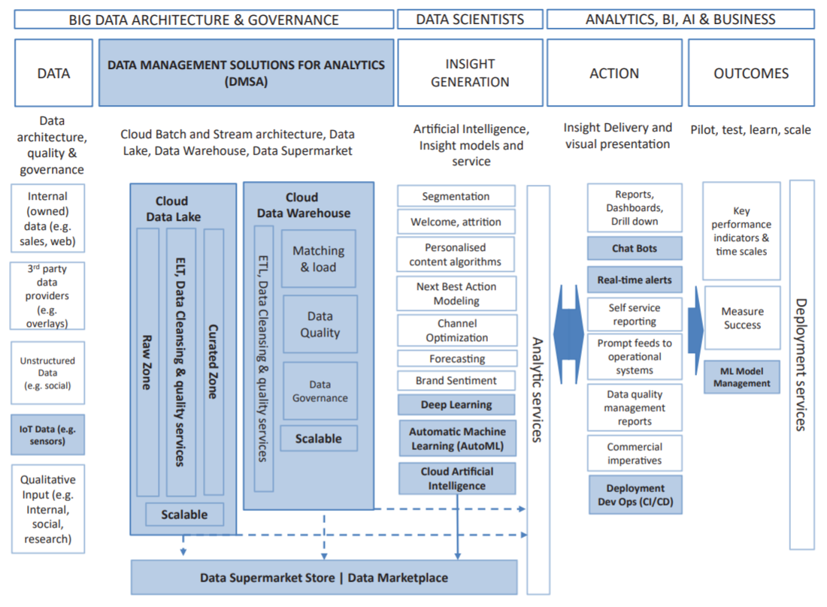
Data and Artificial Intelligence Strategy: A Conceptual Enterprise Big Data Cloud Architecture to Enable Market-Oriented Organisations Caio Moreno [1] ; Ramón Alberto Carrasco [1] ; Enrique Herrera-Viedma [2] [1] Universidad Complutense de Madrid [2] Universidad de Granada
Abstract
Results
Market-Oriented companies are committed to understanding both the needs of their customers, and the capabilities and plans of their competitors through the processes of acquiring and evaluating market information in a systematic and anticipatory manner. On the other hand, most companies in the last years have defined that one of their main strategic objectives for the next years is to become a truly data-driven organisation in the current Big Data context. They are willing to invest heavily in Data and Artificial Intelligence Strategy and build enterprise data platforms that will enable this Market-Oriented vision. In this paper, it is presented an Artificial Intelligence Cloud Architecture capable to help global companies to move from the use of data from descriptive to prescriptive and leveraging existing cloud services to deliver true Market-Oriented in a much shorter time (compared with traditional approaches).
It is proposed a new formal framework for companies that want to adapt to a Big Data MO strategy. For this purpose, the formal framework, presented in this paper, is redefined by adding the necessary components. The new proposed framework can be seen in the figure below.
Objectives
MARKET-ORIENTED (MO) enterprises have as its main objective to perfectly understand the needs of its clients to satisfy them better than the competition and, in this way, to have a competitive advantage over the said competition. In this aspect a key role is played by the data, in such a way that converted into timely knowledge and transmitted to the entire organization to work in coordination, will achieve this common goal.
Precisely, Business Intelligence (BI) is a business philosophy that bases decision-making on data that has been opportunely converted into knowledge process in which, Artificial Intelligence (AI) plays a key role. In this way, there have been authors who have defined a formal framework for the effective implementation of Business Intelligence (BI) in a MO company.
However, the emergence of Big Data has made these models obsolete, and market-oriented companies do not know how to adapt given the wide variety of products and services that composes the so-called Big Data ecosystems.
The main objective of this work, therefore, is to define a formal framework that allows Market Orientation to be effective in the context of Big Data, including the necessary components.
Conclusion
References
In the context that there are many disoriented companies on how to adapt their classic conceptual architectures and take advantage of the great potential of this immense volume of data, this work proposes a conceptual Big Data Science Cloud Architecture, that aims to set the foundational building blocks for a modern MO organisation, capable to support Data and AI use cases and provide the flexibility necessary to add or remove capabilities according to market needs.
Companies that adopt the proposed formal framework will bring
agility and many possibilities to get new marketing insights and to innovate and create new P/S individually adapted to the needs of each of its customers.
To see all the references, please access the full paper published at: http://dx.doi.org/10.9781/ijimai.2019.06.003
Methods
Acknowledgment
To achieve this goal, in the paper section II it is introduced market orientation, and formal architectures to achieve it in a BI framework. In the paper section III a review of this proposed formal frameworks is made, adding the appropriate components that allow carrying out Market Orientation in a Big Data context. Finally, in sequence, some conclusions and future work are presented.
This paper has been elaborated with the financing of FEDER funds in the Spanish National research project TIN2016-75850-R from Spanish Department for Economy and Competitiveness.

