Slide 1
DATABASE MANAGEMENT SYSTEM
MINI PROJECT
2020-2021

Slide 2
TABLE OF CONTENTS
*QUESTION
*SQL QUERY
*OUTPUT SCREENSHOTS
*ER-DIAGRAM (Entity-Relationship Diagram)

Slide 3
PROJECT TITLE :
Grading system for TCE Data Science course Develop a design for grading the students of TCE data science course. Deliverables: 1.E-R Diagram of All entities, relationships and their data structure (student, instructor, examiner, pre-reqs, courses, college …etc) 2.SQL queries to calculate grade, results and display

Slide 4
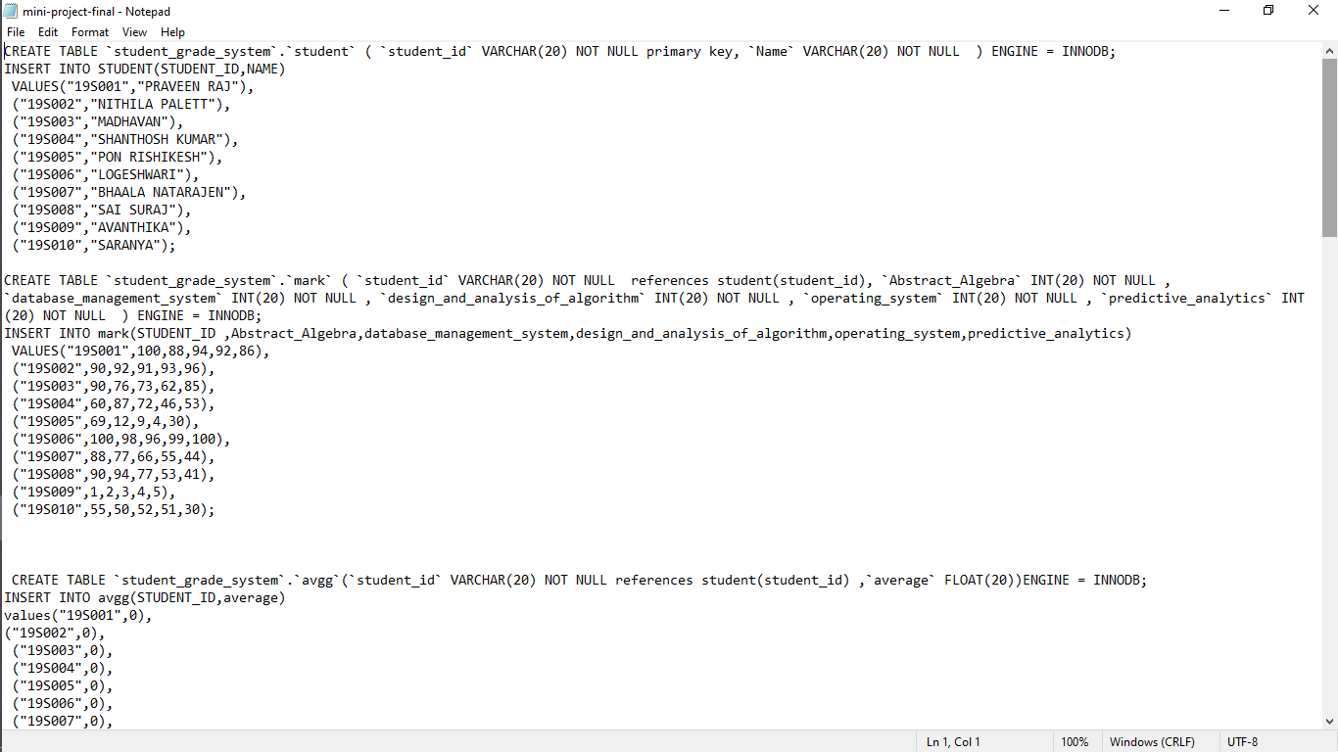
SQL QUERIES:

Slide 5
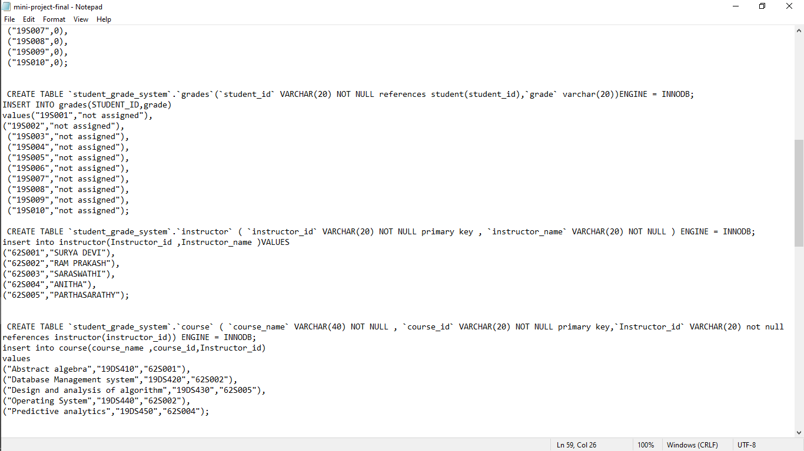

Slide 6
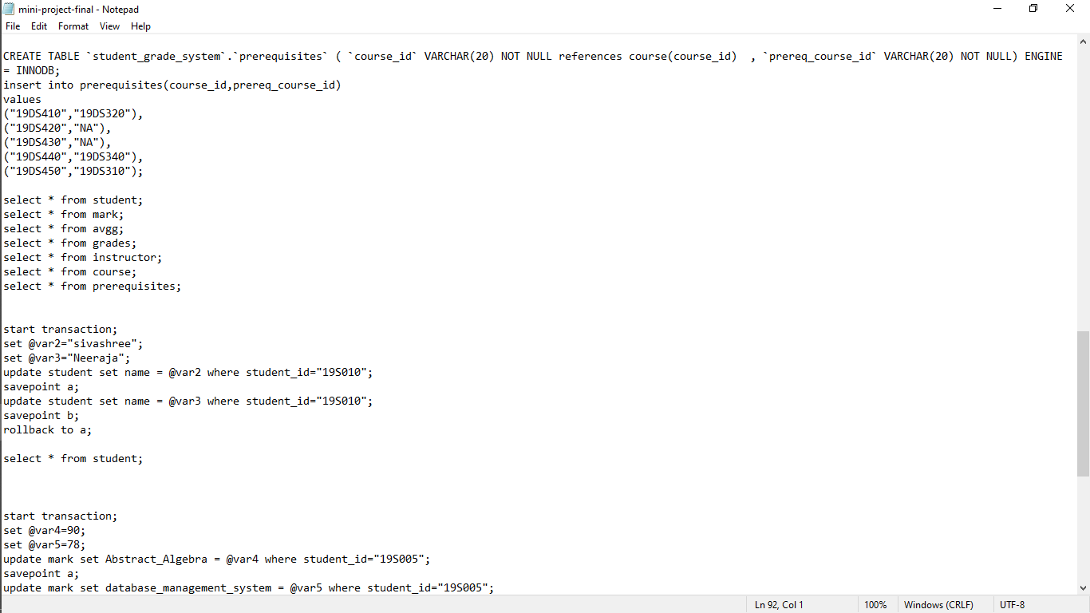

Slide 7
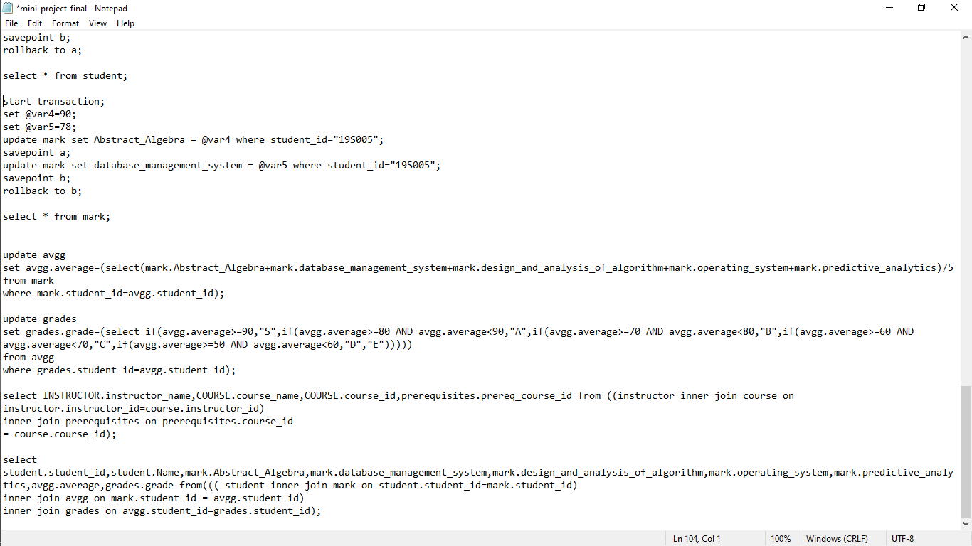

Slide 8
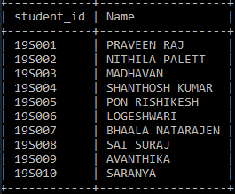
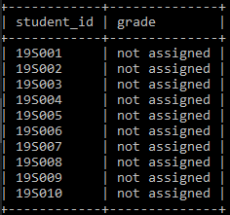
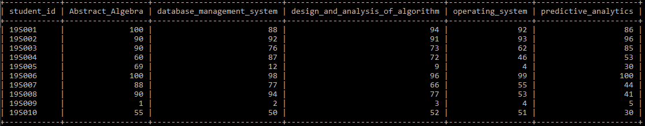
OUTPUT:

Slide 9
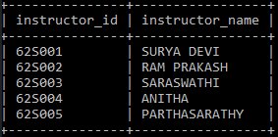
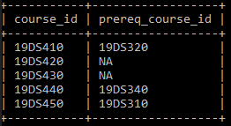
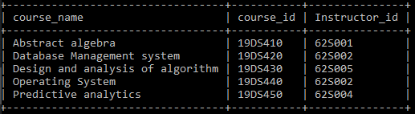
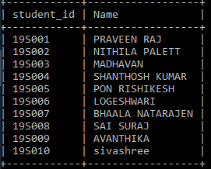

Slide 10
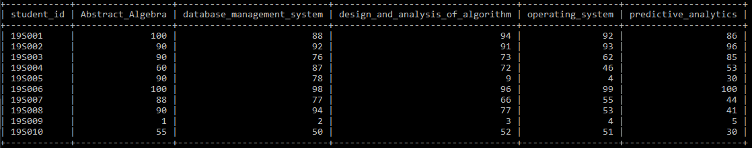
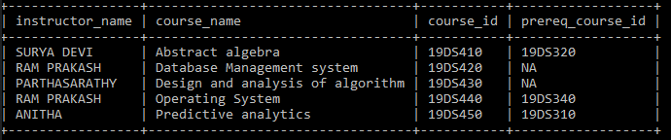

Slide 11
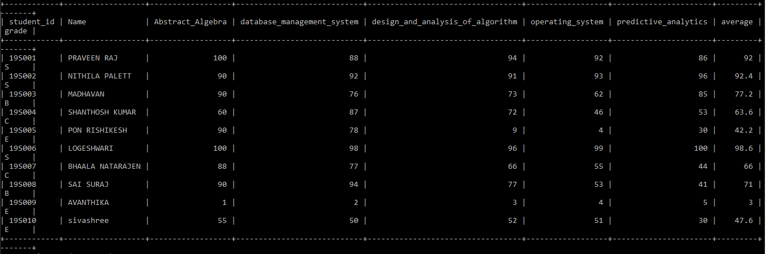

Slide 12
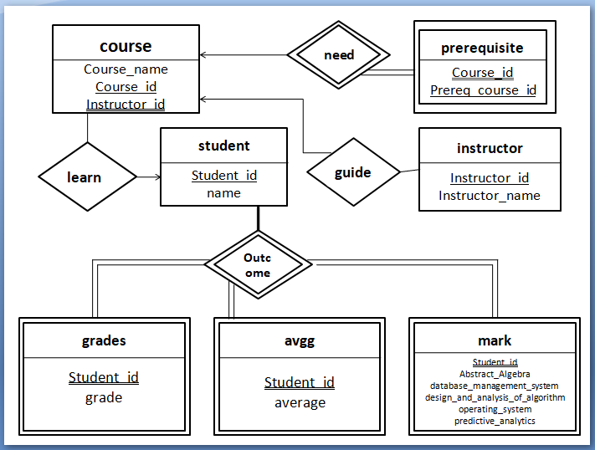
ER DIAGRAM:

Slide 13
THANK YOU…!!!

