Slide 1
Base ABM model

Slide 2
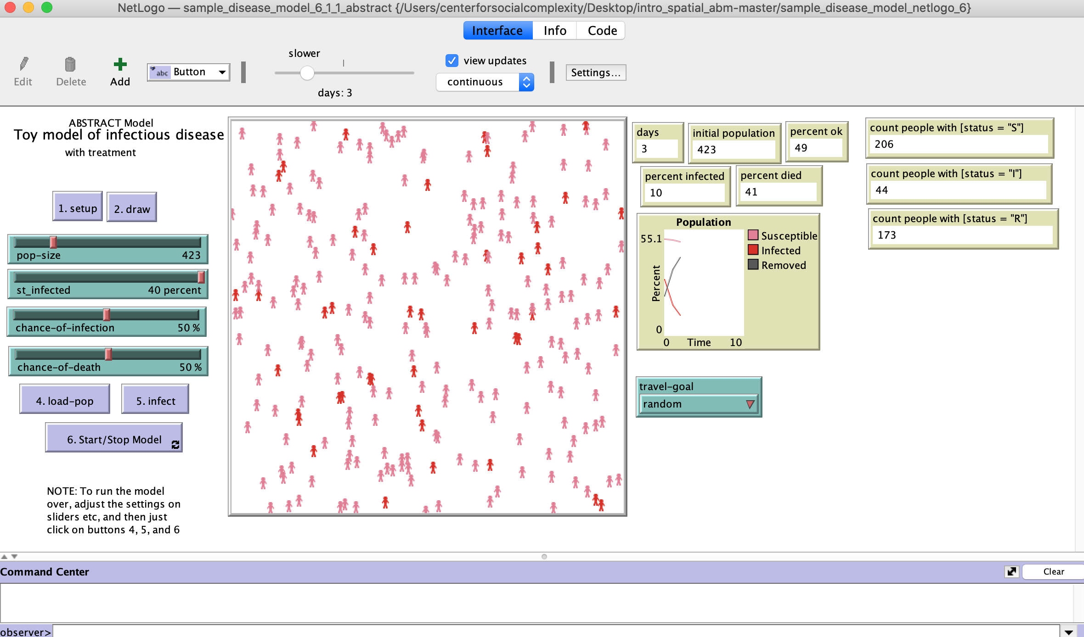

Slide 3
breed [people person]
people-own [status time-infected]
to setup
clear-all
reset-ticks
end
to draw
clear-drawing
reset-ticks
ask patches [set pcolor white]
end

Slide 4
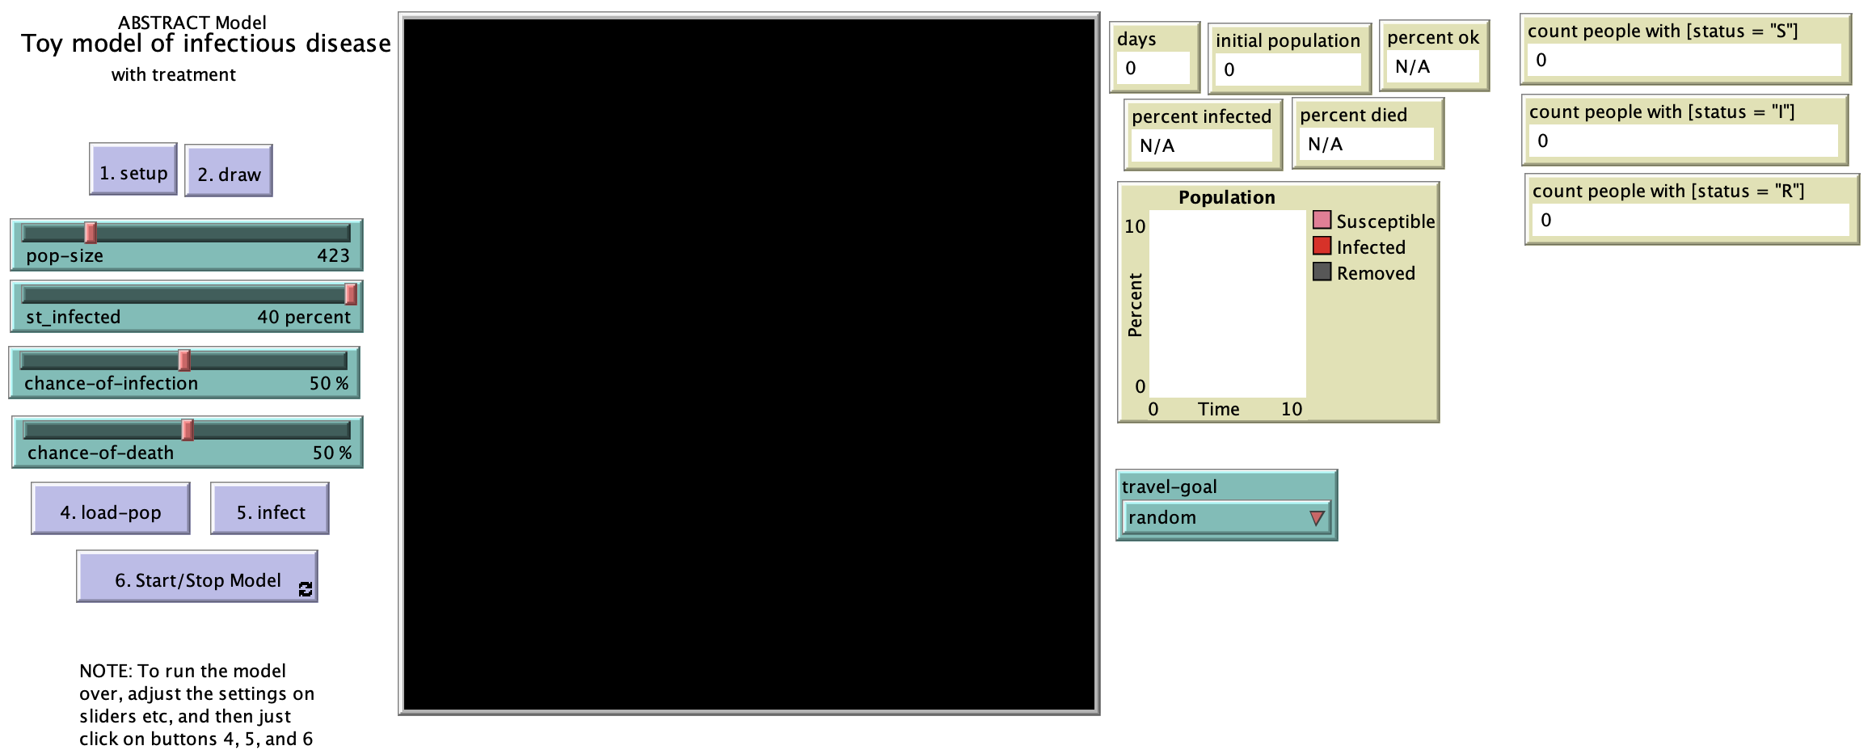

Slide 5
to load-pop
clear-plot
reset-ticks
ask turtles with [breed = people][die]
reset-ticks
create-people pop-size
[set shape "person"
set size 2
set label ""
set status "S"
set color pink
move-to one-of patches]
end

Slide 6
to go
travel
end
to travel
if travel-goal = "random"
[ask people with [status != "R"] [rt random 360 fd 1]]
end

Slide 7
to infect
ask n-of round((st_infected / 100) * count people) people
[set status "I" set color red ]
end
to infect-others
let victims (turtle-set people-here with [status != "R"] people-on neighbors)
ask victims
[if status != "R"
[let chance random 101
if chance > (100 - chance-of-infection)
[set status "I"
set color red]
]]
end

Slide 8
to go
travel
; expose others and possibly infect them
; also chance to die (change status to "R" for remove
ask people with [status = "I"]
[infect-others
let chance random 101
if chance >= (100 - chance-of-death) ; die
[set status "R" set size 0]
if chance < 10 ; get better
[set status "S" set color pink]
]
tick
if not any? people with [status = "S"] [stop] ; everyone is sick or dead
if not any? people with [status = "I"] [stop] ; everyone is either okay or dead
end

Slide 9
Add treatment sites

Slide 10
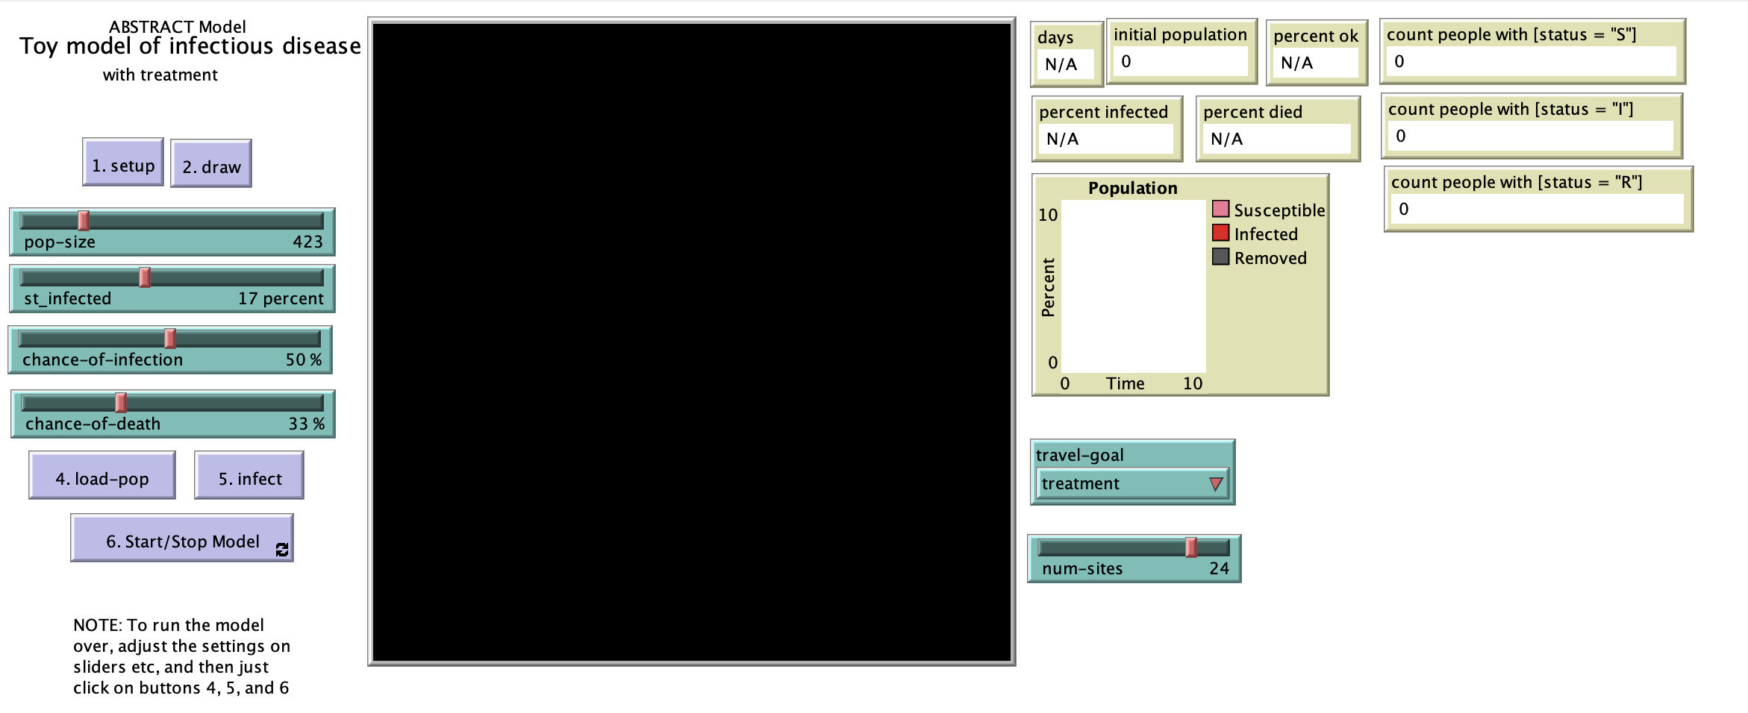

Slide 11
breed [people person]
people-own [status time-infected]
breed [sites site]
sites-own [capacity]
to setup
clear-all
reset-ticks
end
to draw
clear-drawing
reset-ticks
ask patches [set pcolor white]
; add treatment sites
ask n-of num-sites patches [sprout-sites 1]
ask sites [set shape "house" set size 1 set color blue ]
end

Slide 12
to travel
if travel-goal = "random"
[ask people with [status != "R"] [rt random 360 fd 1]]
if travel-goal = "treatment"
[
ask people with [status = "S"]
[rt random 360 fd 1]
ask people with [status = "I"]
[let nearest-treatment min-one-of sites [distance myself]
face nearest-treatment fd 1]
]
end

Slide 13
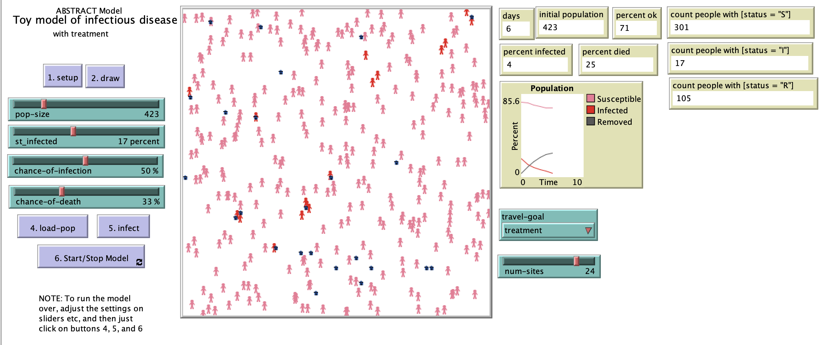

Slide 14
Add GIS and CSV

Slide 15
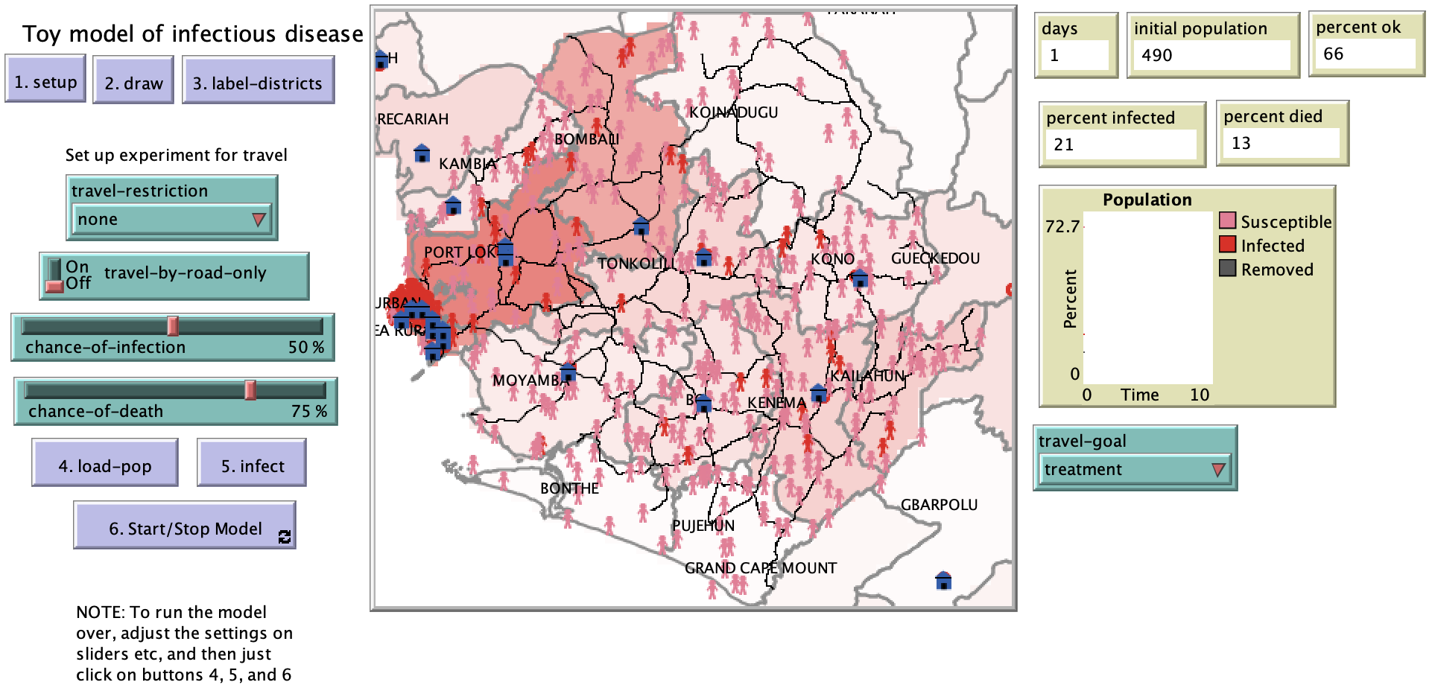

Slide 16
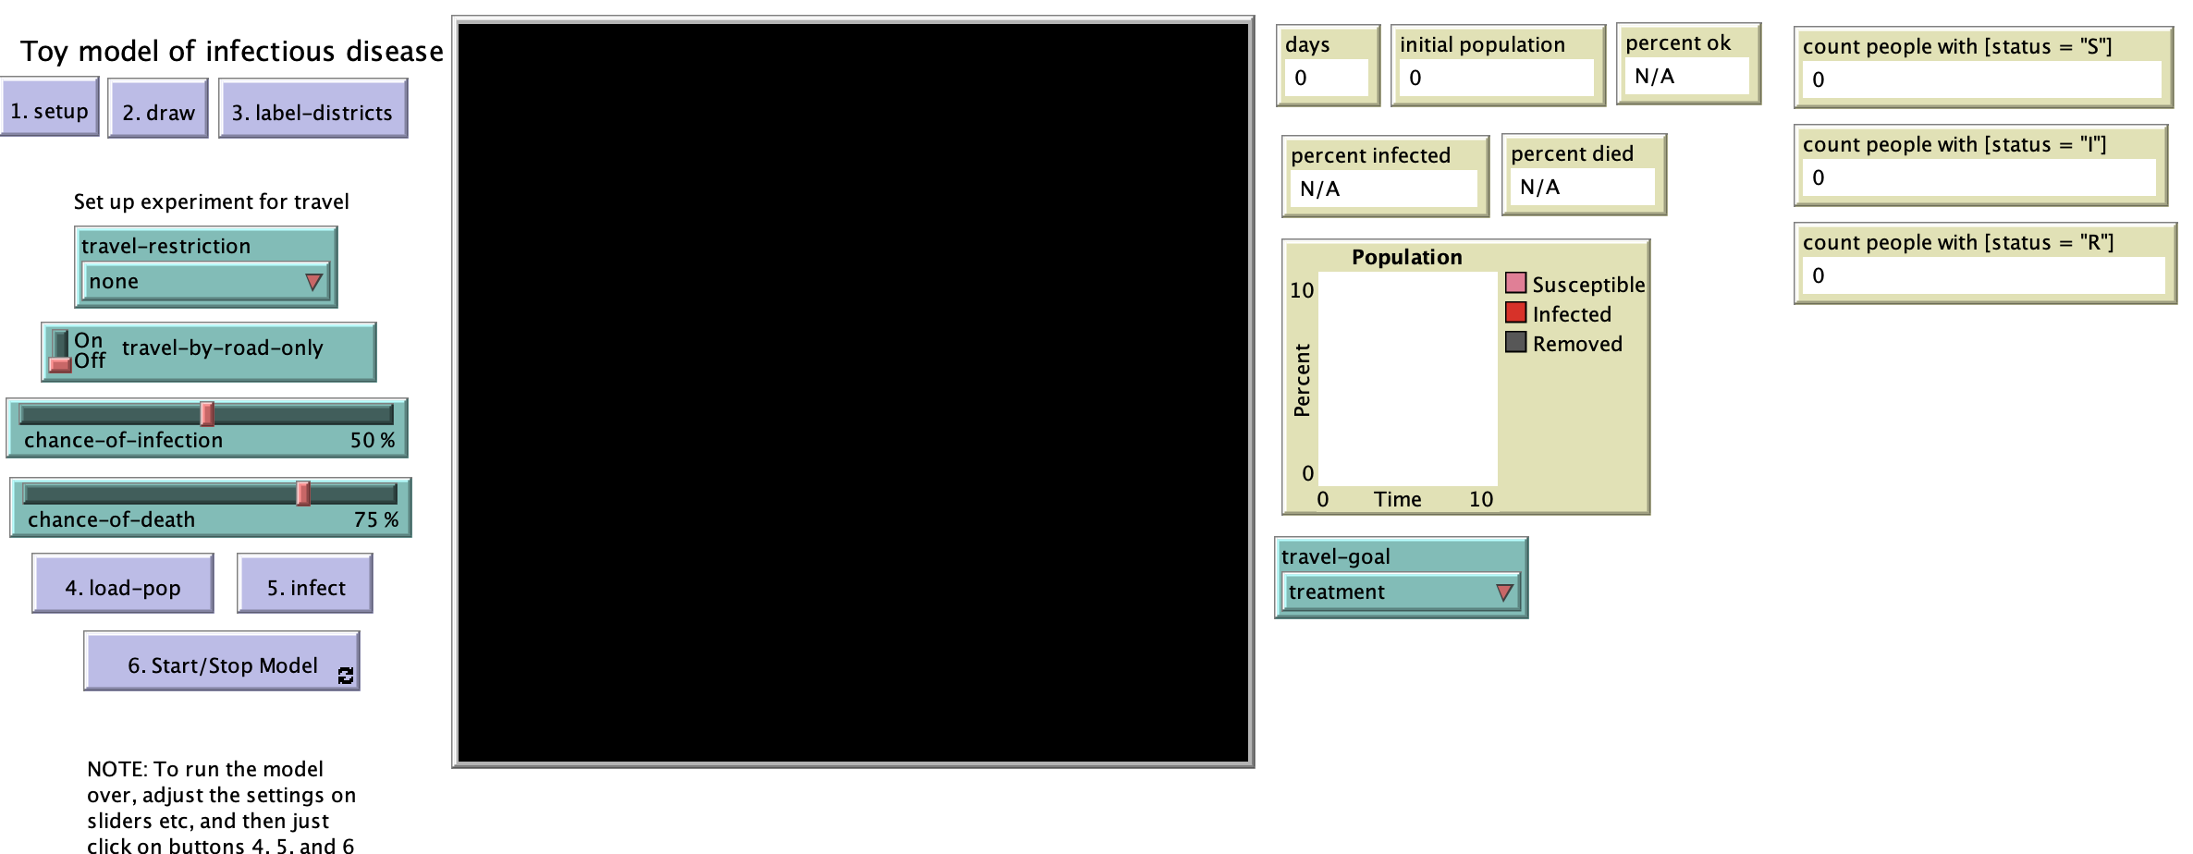

Slide 17
extensions [ gis csv ]
globals [ site-locations roads districts SL]
patches-own [district-name confirmed population road-here]
turtles-own []
breed [people person]
people-own [district status time-infected]
breed [admin-labels admin-label]
admin-labels-own [name]
breed [sites site]
to setup
clear-all
reset-ticks
gis:load-coordinate-system (word "data/projection.prj")
set site-locations gis:load-dataset "data/disease_Treatment_Centers.shp"
set roads gis:load-dataset "data/Sierra Leone_Roads.shp"
set districts gis:load-dataset "data/Cases_at_Admin2_Level.shp"
set SL gis:load-dataset "data/SL_Admin01.shp"
end

Slide 18
to draw
clear-drawing
reset-ticks
gis:set-world-envelope (gis:envelope-union-of ;(gis:envelope-of sites) (gis:envelope-of SL))
ask patches [set pcolor white]
gis:apply-coverage districts "GLOBAL_A_1" district-name
gis:apply-coverage districts "V_ADM2_C_3" confirmed
ask patches
[ifelse (confirmed > 0)
[set pcolor scale-color red confirmed 5000 0]
[set pcolor white]
]
gis:set-drawing-color gray
gis:draw districts 2
gis:set-drawing-color red
gis:draw site-locations 3
gis:set-drawing-color black
gis:draw roads 1
ask patches
[if gis:intersects? roads self
[set road-here 1 ] ]
ask patches
[ if gis:intersects? site-locations self
[sprout-sites 1
[set shape "house" set color blue set size 2]
]
]
end

Slide 19
to label-districts
ask admin-labels [die]
foreach gis:feature-list-of districts
[ ?1 -> let centroid gis:location-of gis:centroid-of ?1
if not empty? centroid
[create-admin-labels 1
[set xcor item 0 centroid
set ycor item 1 centroid
set size 0
set shape "circle"
set color gray
set name gis:property-value ?1 "GLOBAL_A_1"
set label name
set label-color black ]
]
]
end

Slide 20
file-open "data/SL_pop.csv"
if not file-at-end? [let header csv:from-row file-read-line]
while [not file-at-end?]
[let row csv:from-row file-read-line
;let district_name item 0 row
let d_name item 0 row
let district_name upper-case-string d_name ;convert text to uppercase
if district_name = "WESTERN RURAL" [set district_name "WESTERN AREA RURAL"]
if district_name = "WESTERN URBAN" [set district_name "WESTERN AREA URBAN"]
let district_pop item 4 row
let small_pop (district_pop / 10000)
create-people small_pop
[set district district_name
set shape "person"
set size 2
set label ""
set status "S"
set color pink
move-to one-of patches with [district-name = [district] of myself]]]
file-close
end
to load-pop
clear-plot
reset-ticks
ask turtles with [breed = people][die]
reset-ticks

Slide 21
to-report upper-case-string [s]
ifelse empty? s
[report ""]
[ report word (upper-case-char first s)
(upper-case-string butfirst s) ]
end
to-report upper-case-char [c]
let pos position c "abcdefghijklmnopqrstuvwxyz"
ifelse pos = false
[ report c ]
[ report item pos "ABCDEFGHIJKLMNOPQRSTUVWXYZ" ]
end

Slide 22
to infect
foreach gis:feature-list-of districts
[ ?1 -> let d_name gis:property-value ?1 "GLOBAL_A_1"
let infected gis:property-value ?1 "V_ADM2_C_3"
let st_infected round infected / 100 ;for visualization
if st_infected < 0 [set st_infected 1]
if any? people with [district = d_name]
[ask n-of st_infected people with [district = d_name]
[set status "I" set color red ]
]
]
end
to infect-others
let victims (turtle-set people-here with [status != "R"] people-on neighbors)
ask victims
[if status != "R"
[let chance random 101
if chance > (100 - chance-of-infection)
[set status "I"
set color red]
]]
end

Slide 23
to go
travel
; expose others and possibly infect them
; also chance to die (change status to "R" for remove
ask people with [status = "I"]
[infect-others
let chance random 101
if chance >= (100 - chance-of-death) ; die
[set status "R" set size 0]
if chance < 10 ; get better
[set status "S" set color pink]
]
tick
if not any? people with [status = "S"] [stop] ; everyone is sick or dead
if not any? people with [status = "I"] [stop] ; everyone is either okay or dead
end

Slide 24
to travel
if travel-goal = "random"
[ask people with [status != "R"] [check-travel-restriction]];[rt random 360 fd 1]]
if travel-goal = "treatment"
[
ask people with [status = "S"]
[check-travel-restriction]
ask people with [status = "I"]
[let nearest-treatment min-one-of sites [distance myself]
face nearest-treatment fd .5
check-travel-restriction]
]
end

Slide 25
to check-travel-restriction
if travel-restriction = "none" and travel-by-road-only = true
[rt random 360
ifelse not any? neighbors with [road-here = 1]
[move-to min-one-of patches with [road-here = 1] [distance myself]]
[ move-to one-of neighbors with [road-here = 1]]
]
if travel-restriction = "none" and travel-by-road-only = false
[rt random 360
fd 1]
if travel-restriction = "within-districts" and travel-by-road-only = false
[rt random 360
ifelse patch-ahead 1 = nobody
[]
[if [district-name] of patch-ahead 1 = district
[fd 1 ] ]]
if travel-restriction = "within-districts" and travel-by-road-only = true
[rt random 360
ifelse patch-ahead 1 = nobody
[]
[if [district-name] of patch-ahead 1 = district and [road-here] of patch-ahead 1 = 1
[fd 1 ] ]]
end

Slide 26
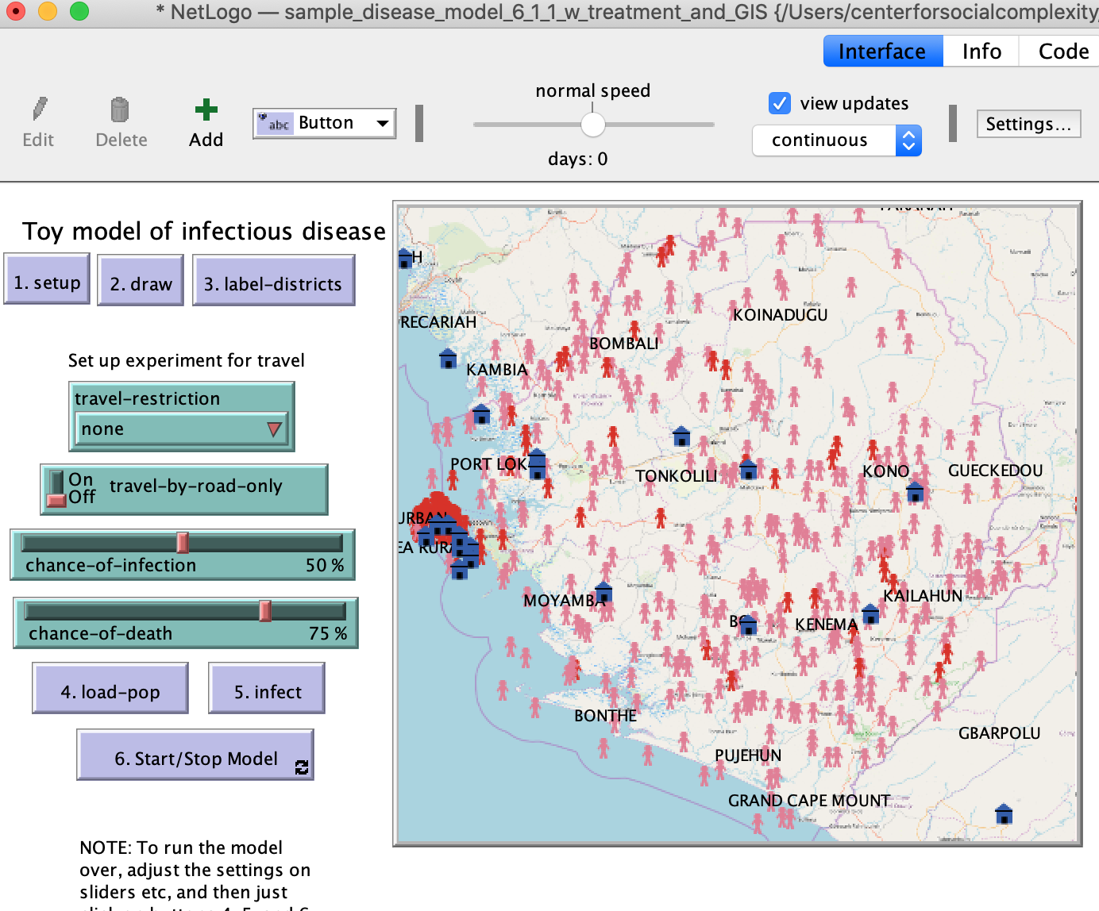
import-drawing "data/map.png"

