Slide 1
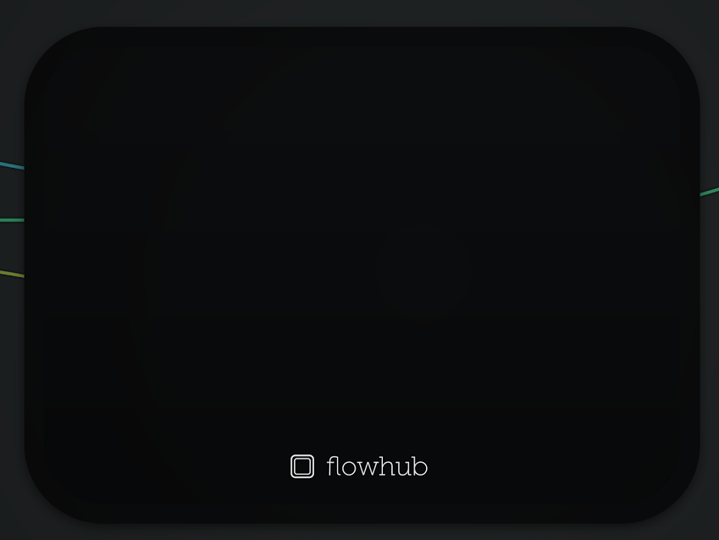
Distributed systems with MsgFlo
Flow-Based Programming over message queues
FOSDEM 2017
Jon Nordby
@jononor

Slide 2
Basic MQTT communication
// Motor.cpp
mqtt.subscribe(“motor/start”, start_motor);
// Button.cpp
mqtt.publish(“motor/start”, button_pressed);
+ Works OK
- Connections hidden in code
- Hardcoded functionality
Notes:
In one device, receive on a certain topic
In another device, send on that topic
hardcoded queues -> hardcoded functionality
Problems:
- reflash needed to change network
- slow to make changes
- low reusability
- connections between devices hidden in code
- hard to get an understanding of the system
“cant see the forest for the trees”

Slide 3
MsgFlo participant
// Motor.cpp
mqtt.subscribe(“motor/start”, start_motor);
mqtt.publish(“msgflo/discover”, motor_info);
// Button.cpp
mqtt.publish(“msgflo/discover”, button_info);
mqtt.publish(“button/pressed”, button_pressed);
+ Devices describe themselves
+ Reusable components
! Something need to connect the topics
Notes:
Participants as "components"
* Receives on a set of topics "inports"
* Sends on another set of topics "outports",
depending only on the device
* Something else has to “bind” the topics together to form a system
* Each device describes itself using a discovery message
* Fully encapsulated: does not know/care where data comes from, nor where it is going to
* Increases composability and reusability
* Increases testability, debuggability

Slide 4
MsgFlo discovery message
{
"component": "fosdem2017/Button",
"role": "button",
"id": "button",
"label": “This is a button, it can be pressed”,
"icon": null,
"outports": [{
"id": "pressed",
"type": "boolean"
"queue": "button/pressed"
}],
"inports": []
}

Slide 5
Bind topics together
# motorcontrol.fbp
button(Button) PRESSED → START motor(Motor)
...
motor RUNNING → RED warninglight(Lamp)
# bind the queues together
$ msgflo-setup motorcontrol.fbp

Slide 6
Foreign participants
# existingdevice.yml
# send MsgFlo discovery message
# on behalf of device
$ msgflo-register-foreign existingdevice.yml
Notes:
Working with existing devices/software
* Send discovery message on behalf of participant
* YAML declaration
* msgflo-register-foreign

Slide 7
Live programming

Slide 8
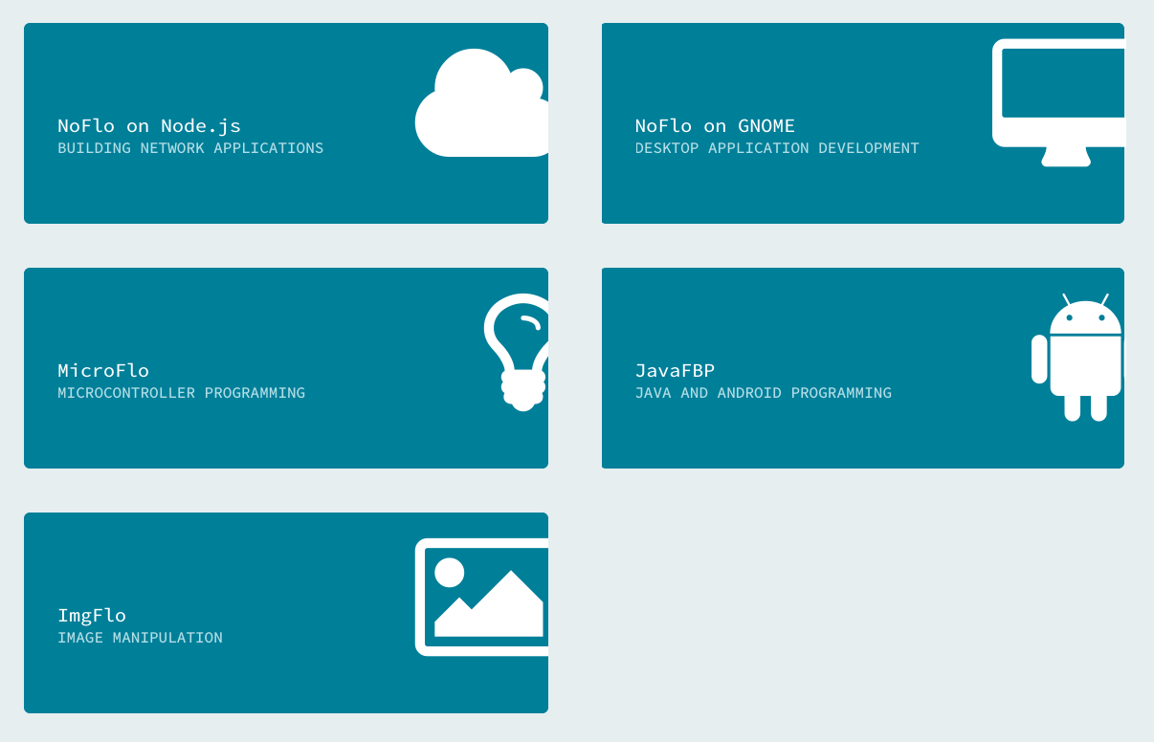
Full stack

Slide 9
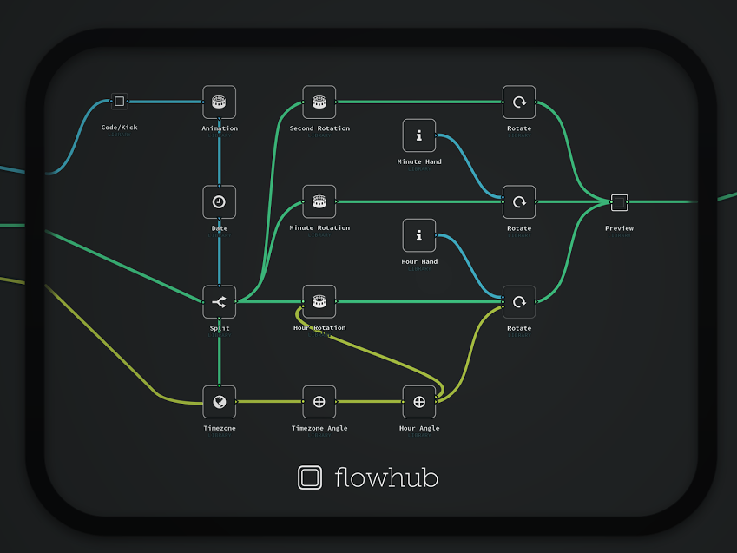
Distributed systems,
not isolated devices!
msgflo.org
@jononor
Notes:
Show

