Slide 1
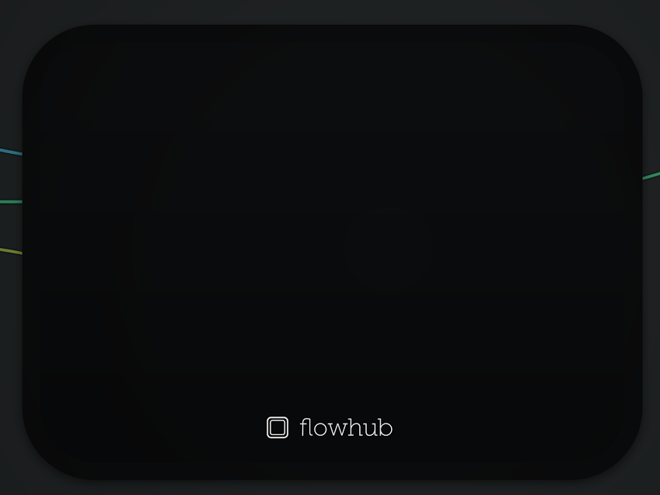
Scalable web services
using message queues
with MsgFlo & GuvScale
Orchestrate 2017
Barcelona
msgflo.org
@flowhub_io
Jon Nordby
@jononor

Slide 2
whoami
Engineer
Electronics → Software
Embedded → Web
Creator
Bicycle mechanic → Digital fabrication
→ Software-Defined Everything
Notes:
In one device, receive on a certain topic
In another device, send on that topic
hardcoded queues -> hardcoded functionality
Problems:
- reflash needed to change network
- slow to make changes
- low reusability
- connections between devices hidden in code
- hard to get an understanding of the system
“cant see the forest for the trees”

Slide 3

Flowhub UG
flowhub.io guvscale.com
msgflo.org noflojs.org microflo.org imgflo.org
Making software systems more understandable through data-driven programming and visual tools.

Slide 4
DevOps?
Everyone is able to
0) understand the system
1) debug problems
2) get changes into production
3) high confidence that change → better
Reality not there yet
- we got to improve tools & practices

Slide 5
This talk
1. Background (The Grid)
2. Message queue basics (RabbitMQ)
3. The MsgFlo way (flow-based-programming)
4. LIVE: Image resizing service
5. Autoscaling workers (GuvScale)
6. LIVE: Enabling GuvScale

Slide 6
Chapter 1:
Background story

Slide 7

TheGrid

Slide 8
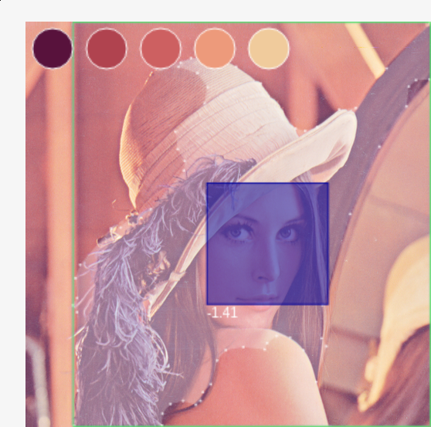
Content analysis
Documents
Video
Image
Text
...

Slide 9
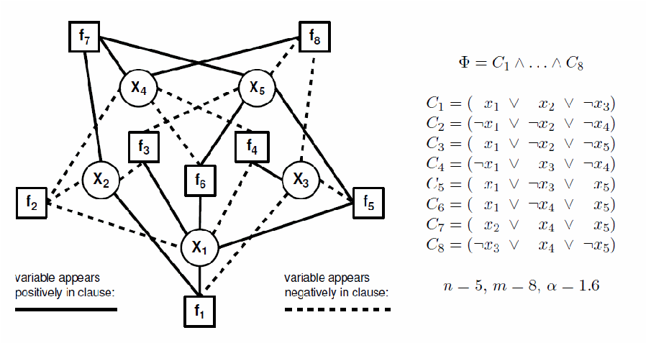
Constraint solving

Slide 10
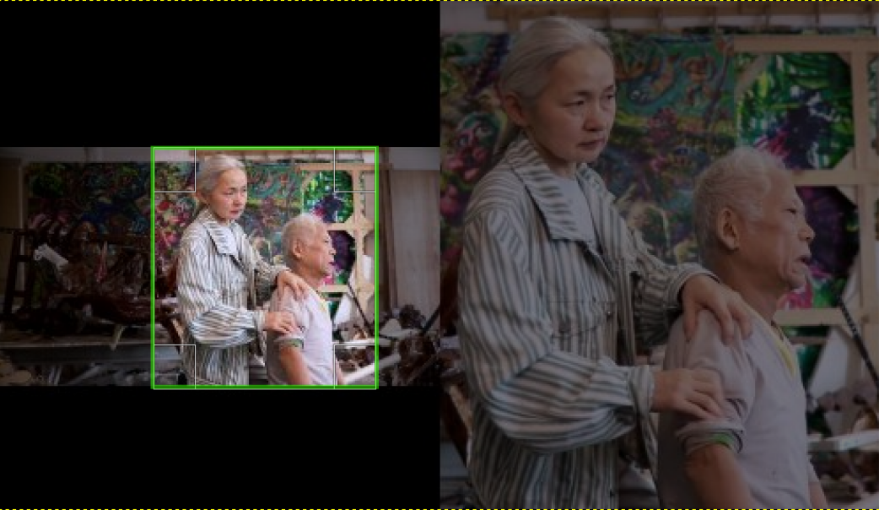
Image processing
https://github.com/imgflo/imgflo-server
Notes:
* MsgFlo programming model and JavaScript participant libraries,
battle-tested in production with AMQP+RabbitMQ.
* MsgFlo with MQTT deployed in Berlin,Oslo hackerspaces
* Live-programming is not so much used yet
* MQTT SSL support not tested! https://github.com/msgflo/msgflo/issues/76
MsgFlo is used
* at c-base hackerspace in Berlin
* at Bitraf hackerspace in Oslo
* At TheGrid (cloud, not IoT).
* In imgflo-server (cloud, not IoT)

Slide 11
Third-party services
Github
Amazon S3
Embed.ly

Slide 12
"A good rule of thumb is to avoid web requests which run longer than 500ms".
Heroku - Worker Dynos, Background Jobs and Queueing
Examples
CPU intensive tasks
External & 3rd-party services

Slide 13
Chapter 2:
Message queues

Slide 14

Message queuing systems
Amazon SDS
Google PubSub
IronMQ
Mosquitto (MQTT)
ZeroMQ
….

Slide 15
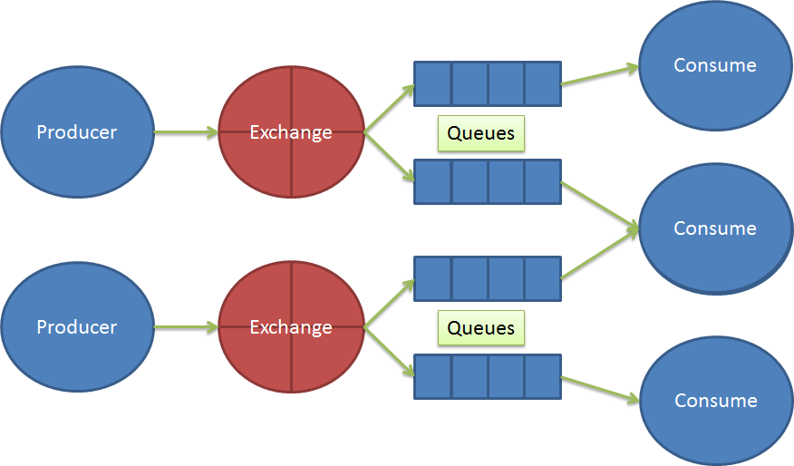
Message queue communication

Slide 16
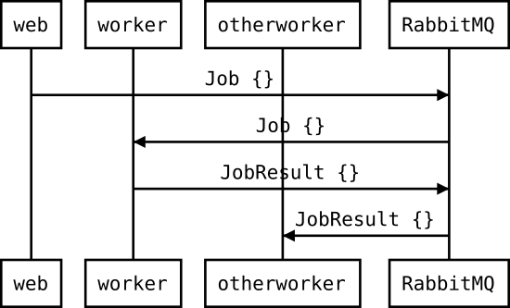
Broker communication model

Slide 17
Basic AMQP communication
// worker.js
amqp.subscribe(“myjobs”, runJob);
// api.js
amqp.publish(“myjobs”, jobData);
+ Works OK
- Connections hidden in code
- Hardcoded functionality
Notes:
In one device, receive on a certain topic
In another device, send on that topic
hardcoded queues -> hardcoded functionality
Problems:
- reflash needed to change network
- slow to make changes
- low reusability
- connections between devices hidden in code
- hard to get an understanding of the system
“cant see the forest for the trees”

Slide 18
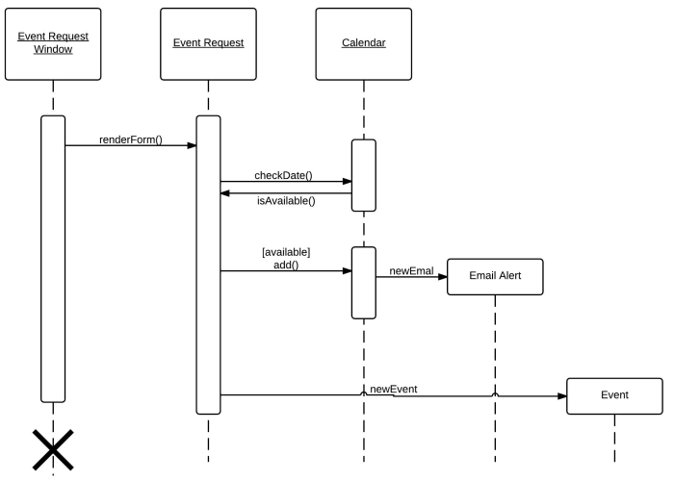
Documentation...
Last updated:
April 1. 2013

Slide 19
Chapter 3:
“the MsgFlo way”

Slide 20
MsgFlo participant
// worker.js
amqp.subscribe(“worker/job”, runJob);
amqp.publish(“msgflo/discover”, workerInfo);
// function runJob
amqp.publish(“worker/result”, res)
// api.js
amqp.publish(“msgflo/discover”, apiInfo);
amqp.publish(“api/newjob”, job);
+ Software describes itself
+ Reusable components
! Something need to connect the topics
Notes:
Participants as "components"
* Receives on a set of topics "inports"
* Sends on another set of topics "outports",
depending only on the device
* Something else has to “bind” the topics together to form a system
* Each device describes itself using a discovery message
* Fully encapsulated: does not know/care where data comes from, nor where it is going to
* Increases composability and reusability
* Increases testability, debuggability

Slide 21
MsgFlo discovery message
{
"component": "ResizeImage",
"role": "resize",
"id": "resize-1",
"label": “This is a button, it can be pressed”,
"icon": null,
"outports": [{
"id": "job",
"type": "boolean"
"queue": "resize/job"
}],
"inports": []
}

Slide 22
Connect workers
# service.fbp
api(HttpApi) NEWJOB → JOB resize(ResizeImage)
...
resize RESULT → JOBDONE api
# bind the queues together
# configures RabbitMQ exchange bindings
$ msgflo-setup service.fbp

Slide 23
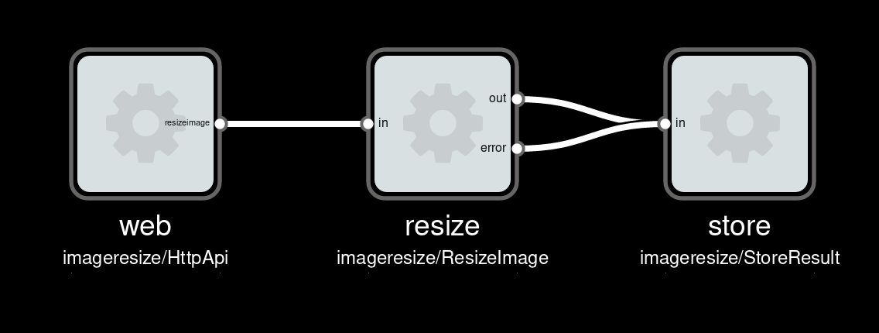

Slide 24
Polyglot
MsgFlo support in $favoritelang ?
= Receive on AMQP queue(s)
+ Send on AMQP exchange(s)
+ MsgFlo discovery message

Slide 25
Convenience libraries
msgflo-nodejs: JavaScript on Node.js
noflo-runtime-msgflo: NoFlo
msgflo-cpp: C++11 on Linux
msgflo-python: Python 2.x
! msgflo-arduino: ESP8266. MQTT-only
msgflo-rust: Rust

Slide 26
Foreign participants
# existingthing.yml
component: c-base/siri
label: c-base siri data rescue probe
inports:
openurl:
queue: siri/open
type: string
# Send MsgFlo discovery message
# on behalf of code
$ msgflo-register-foreign existingthing.yml
Notes:
Working with existing devices/software
* Send discovery message on behalf of participant
* YAML declaration
* msgflo-register-foreign

Slide 27
Message payload agnostic
JSON
Protobuf
XML
Binary
...

Slide 28
Chapter 5:
MsgFlo example
Image resizing service

Slide 29
Chapter 5:
Autoscaling with GuvScale

Slide 30
Conventional autoscaling
System metrics based
No application knowledge
Web frontend (HTTP API) focused
Typically: CPU threshold
Some: Queue-based on/off

Slide 31
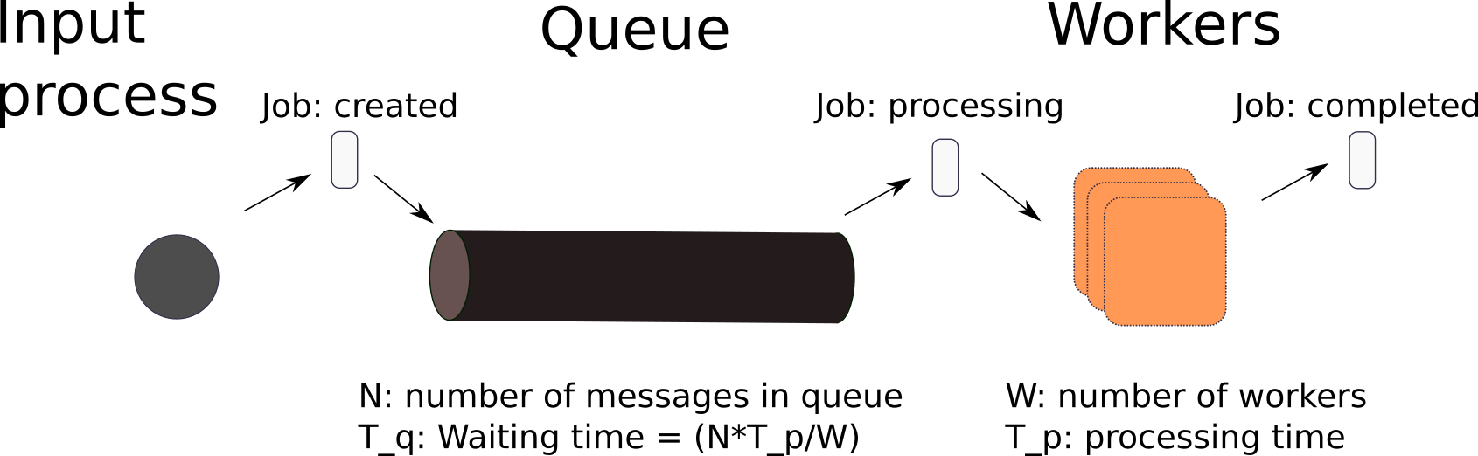
GuvScale
Monitor number of jobs in queue
scale workers to the number needed
to completed within specified deadline
using job processing statistics
Notes:
http://www.jonnor.com/2015/11/guv-automatic-scaling/

Slide 32
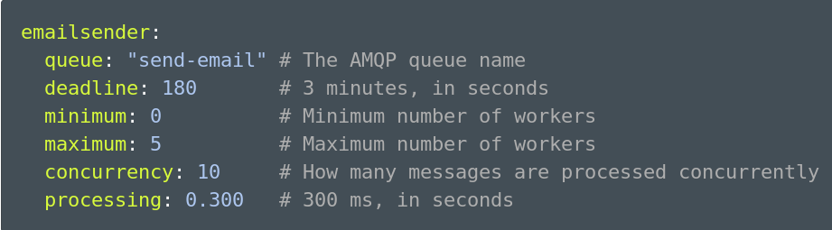
Configuration

Slide 33
Chapter 6:
Using GuvScale

Slide 34
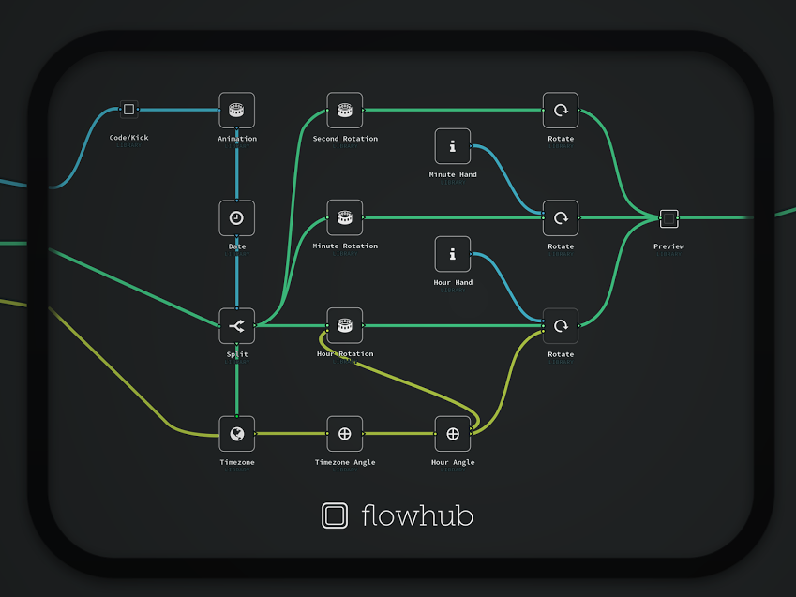
?
msgflo.org
@jononor
Notes:
Show

Slide 35
Participant modelling
best practices
FBP + FSM style
Notes:
* Prefer to have "services" as the core unit. Only ports/topics that affect eachother together.
Avoids dependency on a particular device / implmentation. Encourages thinking about common "interfaces".
Things that are hosted in the same device can be grouped. Naming convention etc
* Dataflow/FBP and (event driven) finite state machines provides best practices
* Source/sink/router components classes. 1->1, 1->N firing/packet patterns
* Always send, proof that state-transition was successful (or not)
* Prefer payloads describing current state fully, instead of events / state changes. Recipient can do transition detection
* Anytime there is a parameter/configuration, expose it.
Never know when you will need it. Much faster to change it live than reflashing!

Slide 36
Component library model
& tools
Notes:
Can declare how to instantiate a participant
- as a commandline string
Used when live-executing new participant
Can generate Heroku Procfile from this,
.fbp graph becomes single-source of information

