Slide 1
Analgesia
Department of Anesthesiology, University of Colorado
By Marnie Biando

Slide 2
Overview
Client: Melanie Donnelly, MD from Department of Anesthesiology
Subject of study: changes to meds during ACL surgeries
”Old” practice: pre-operative nerve block
“New practice: multi-modal analgesics administered intra-operatively
Specific questions to be answered by analysis of data
Notes:
Speak to ACL surgeries and why.
Explain "old" versus "new" practice

Slide 3
Questions
Does the new practice result in an improvement in recovery time?
How often are rescue blocks performed post-operatively?
Are there predictive factors for those we do blocks on postoperatively?
What is the impact of change of practice on postoperative pain, main med consumption, nausea?
Characterize differences in anesthetic pre and post.

Slide 4
analyses
EDA + basic statistics
Central tendencies & descriptive statistics
Deep dive into a “group 1” and ”group 2”
Group 1 = three pre-operative drugs + ketamine
Group 2 = some subset of three pre-operative drugs + ketamine
Notes:
Talk about the different "phases" of analysis

Slide 5
Data cleaning
Modification of data headers for easier R manipulation
Simplification of certain fields:
Surgery types (very long)
Clean up of variables (mostly meds values) that contained a combination of text and numbers
Missing values: fortunately none

Slide 6
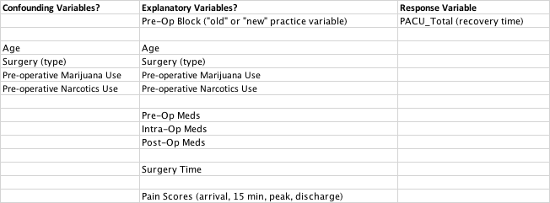
Categorization of variables
After data cleaning, the variables were categorized as ‘explanatory’ or ‘response’ variables. The primary response variable is the recovery time, as this was the variable that the client is most interested in explaining by one or more components of the rest of the data.
A confounding variable is one that “is correlated with both explanatory & response variables.” Confounding variables can introduce unintended bias, influencing the associations between the desired explanatory variables and the response variable.
Notes:
Response vs explanatory
Explain 'confounding' variables

Slide 7
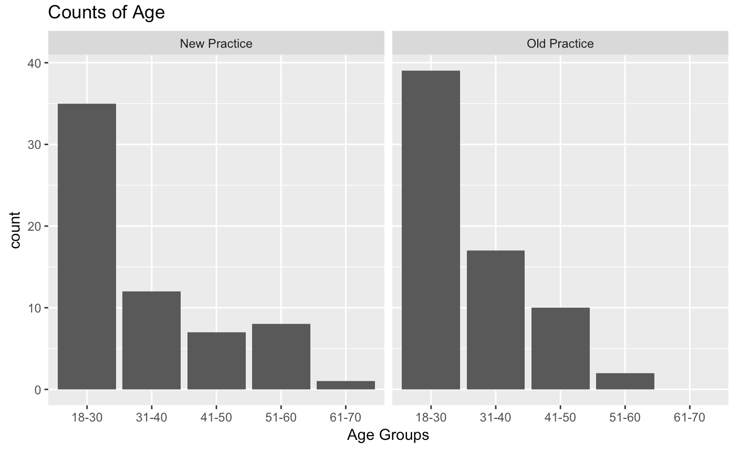
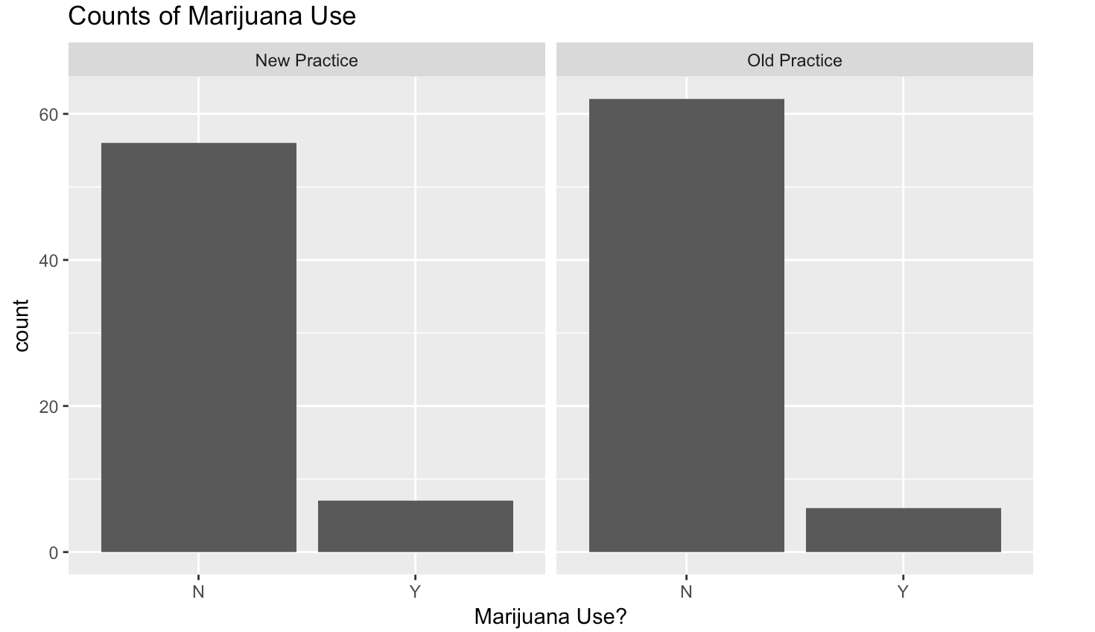
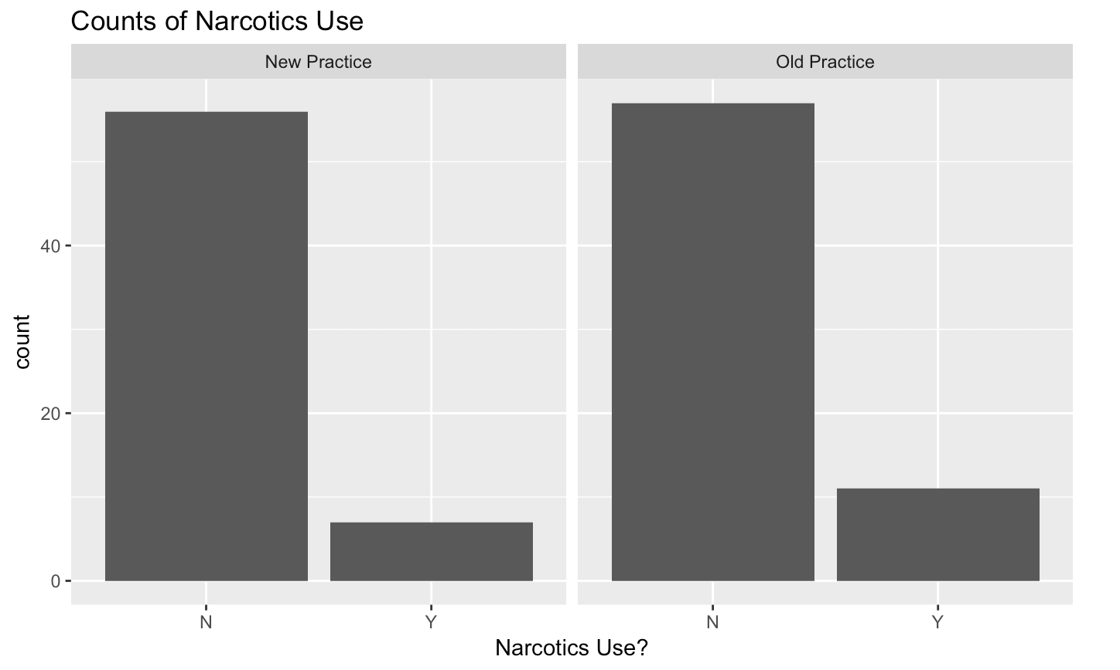
Exploratory Data Analysis
The charts were assembled to provide a visual of tests to verify the existence/absence of confounding variables.
Notes:
EDA slides #1: confounding variables

Slide 8
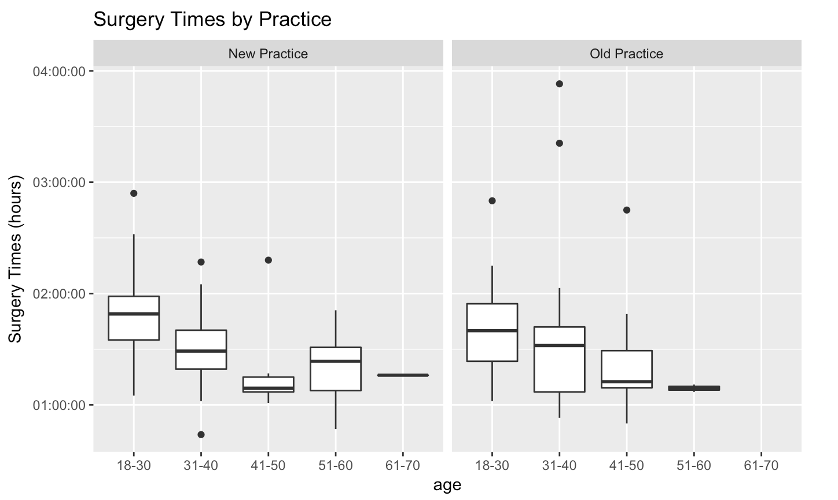
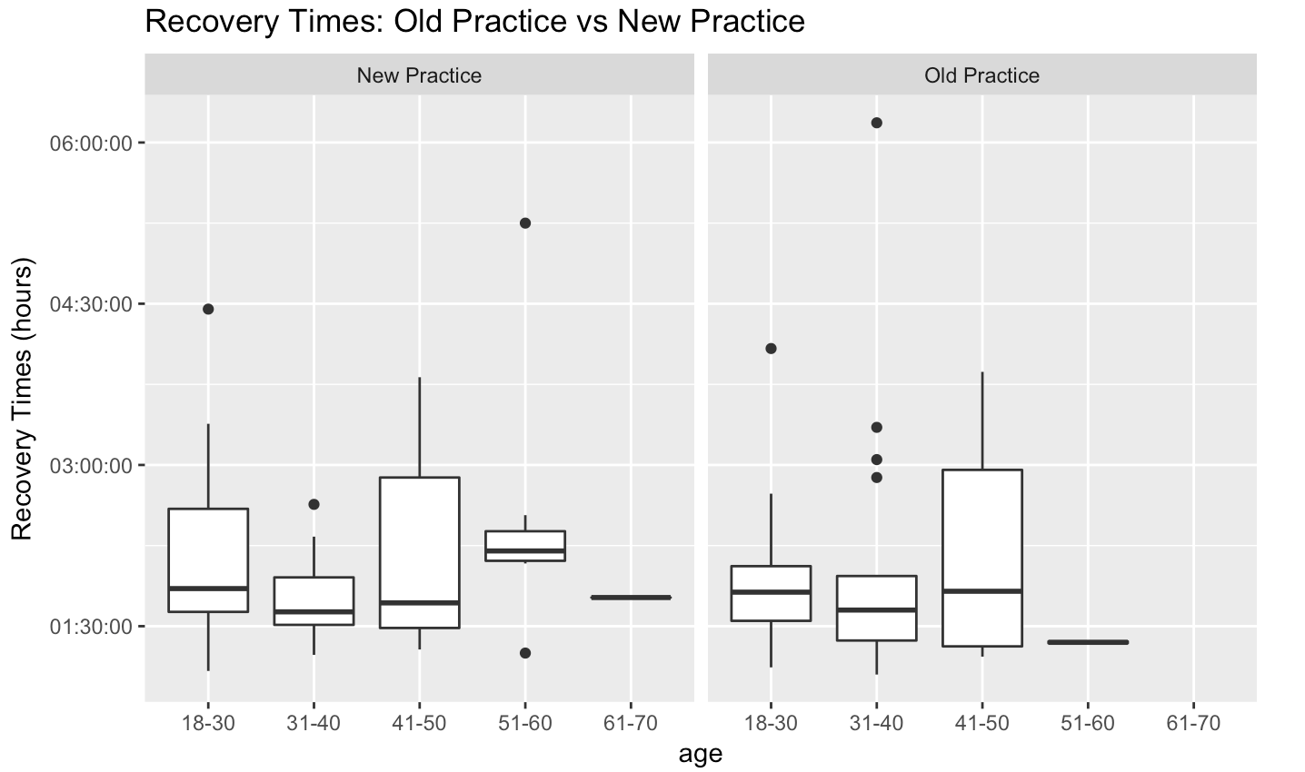
Exploratory Data Analysis
These boxplots for surgery times and recovery times demonstrate that there are definitely outliers in our data, but we will hold off on eliminating any outliers until a later time, after the dataset is reduced based on surgery type (for reasons that will be explained).
Notes:
EDA slide #2: boxplots for outliers
Note: didn't remove any outliers at this time

Slide 9
First Presentation to client
January 22, 2017

Slide 10
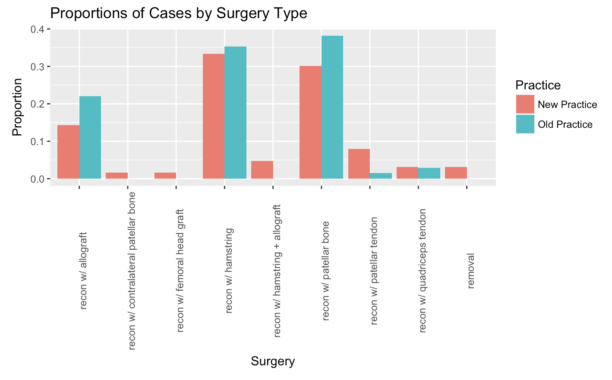
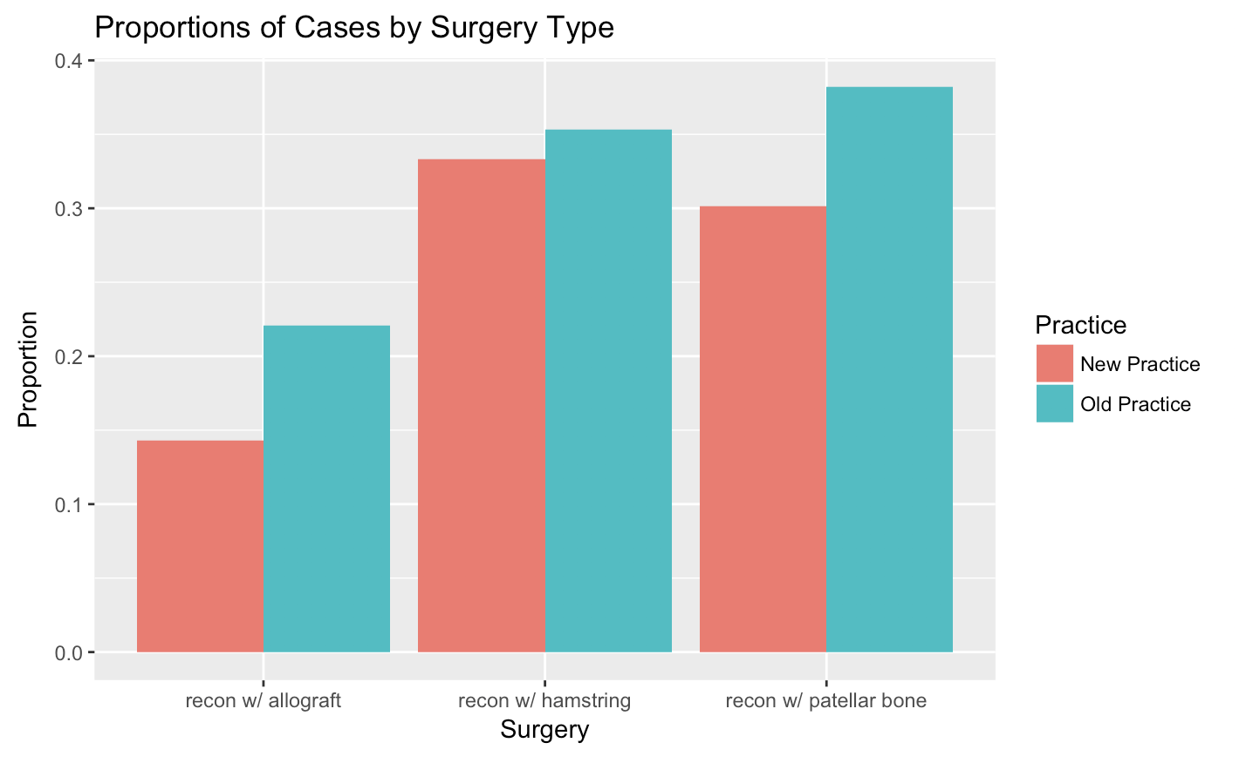
Reducing the dataset
The chart to the left shows that for certain ACL/Knee surgery types, there is not an equal number of cases between the “old” practice and the “new” practice. It was decided that the analysis would be carried out with the three surgery types associated with the most cases (see resulting graph to right).
Notes:
Explain how dataset was reduced and why

Slide 11
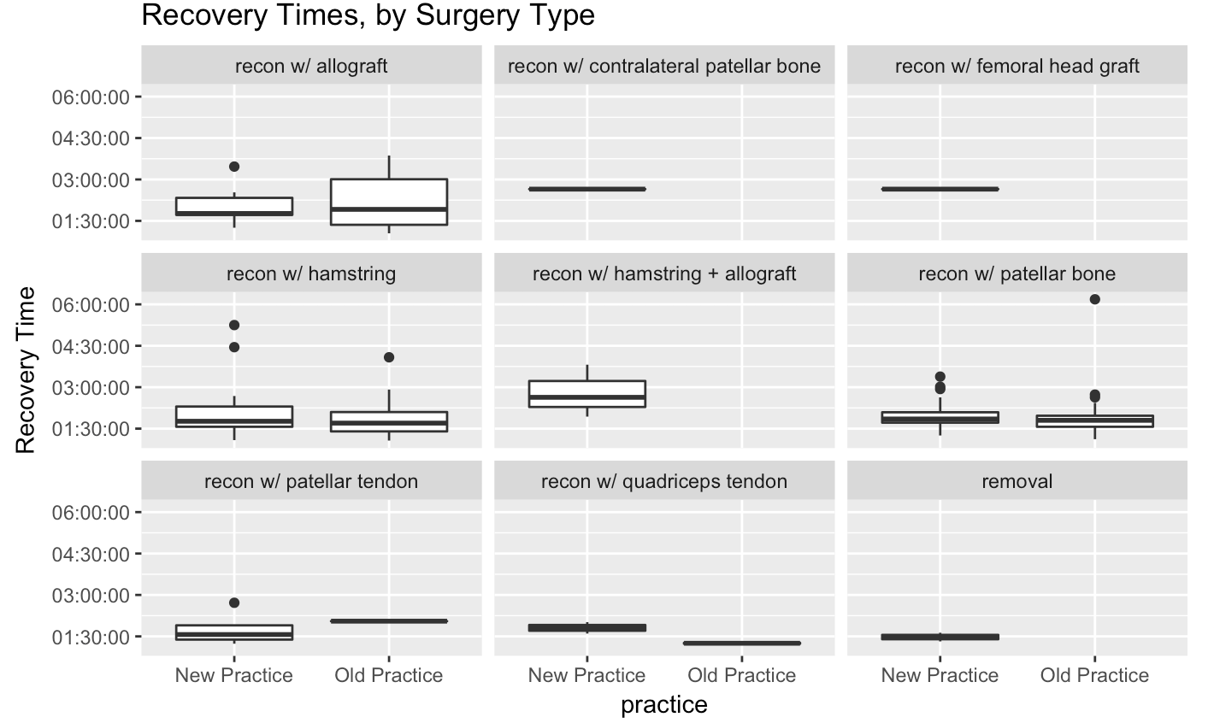
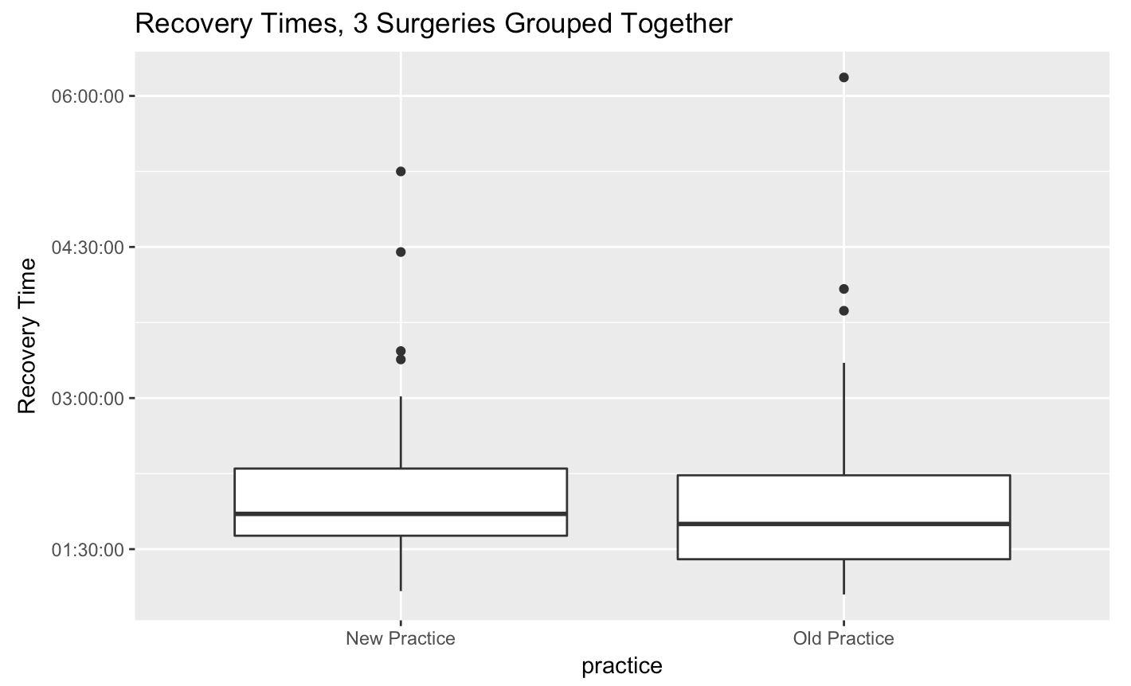
Recovery times: boxplots
Evaluating recovery times by surgery type (left side, below), it appears that there is no support for recovery times being better with the “new” practice when compared to “old” practice cases for the same surgery type. Likewise, comparing the recovery time when grouping by the three surgery types now remaining in our reduced dataset, there is no support again that recovery times have improved with the “new” practice.
Notes:
Additional EDA , based on feedback from class presentation.
Compare recovery time by surgery type versus by old/new practice

Slide 12
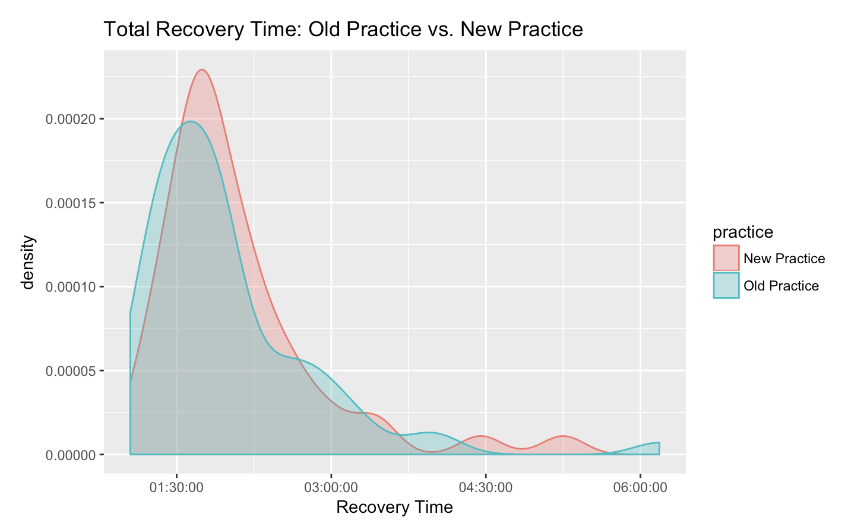
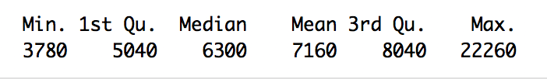
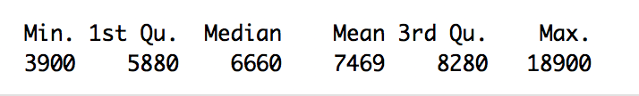
Recovery time: statistical analyses
Recovery time for “old” practice cases
Recovery time for “new” practice cases
Wilcox Rank-Sum to Compare Recovery Times between ”old” and “new” practice cases result in a p-value that is not statistically significant. We cannot reject the null hypothesis that the recovery times are different between “new” and “old” practice.
Notes:
the BIG question: did recovery time improve?
NO. See wilcox-rank sum (is this a valid test given not symmetric about the median)?!

Slide 13
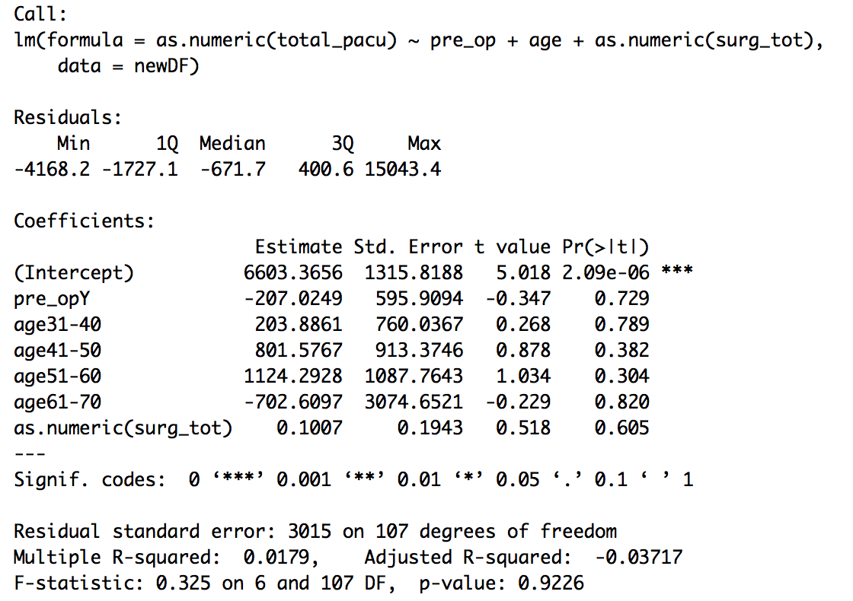
Fitting a linear model
Although we weren’t able to reject the null hypothesis that recovery times between our new practice samples and our old practice samples were significantly different, I thought I would run a linear model with a few select explanatory variables just to see what we would get.
The result: a tiny correlation value (0.0179) and a very high p-value (0.9226). This linear model has no predicting power at all to give us a recovery time based on practice method (new/old) or any other explanatory variables.

Slide 14
Independent analyses
March 2018

Slide 15
Next steps
After the January 22 presentation, the client asked for descriptive and central tendency statistics on certain variables. These are available in the GitHub repository (Analgesia/February) but are not included in this presentation
For the Projects class, I added a few of my own analyses to try and answer a few of the other questions the client asked.
I plan to continue looking into these questions in the next term of the project class.

Slide 16
No improvement in recovery time
Does the new practice result in an improvement in recovery time?
How often are rescue blocks performed post-operatively?
Are there predictive factors for those we do blocks on postoperatively?
What is the impact of change of practice on postoperative pain, main med consumption, nausea?
Characterize differences in anesthetic pre and post.

Slide 17
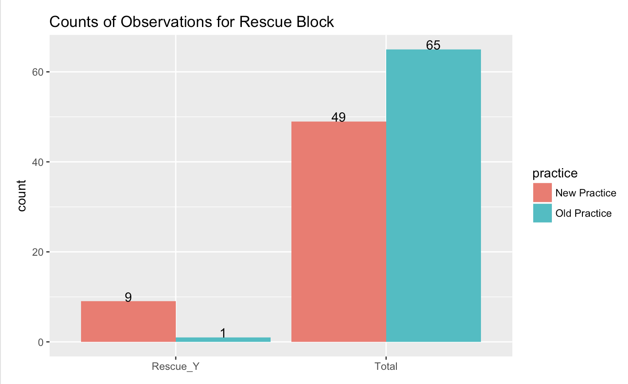
How often do we perform rescue blocks?
Notes:
Moving beyond the dissatisfying results that there is no statistical improvement in recovery time, we will now focus on
Questions 2-5: predictors on cases requiring rescue blocks
Rescue blocks are cases where we have to apply "old" practice AFTER surgery. Our "new" practice failed!

Slide 18
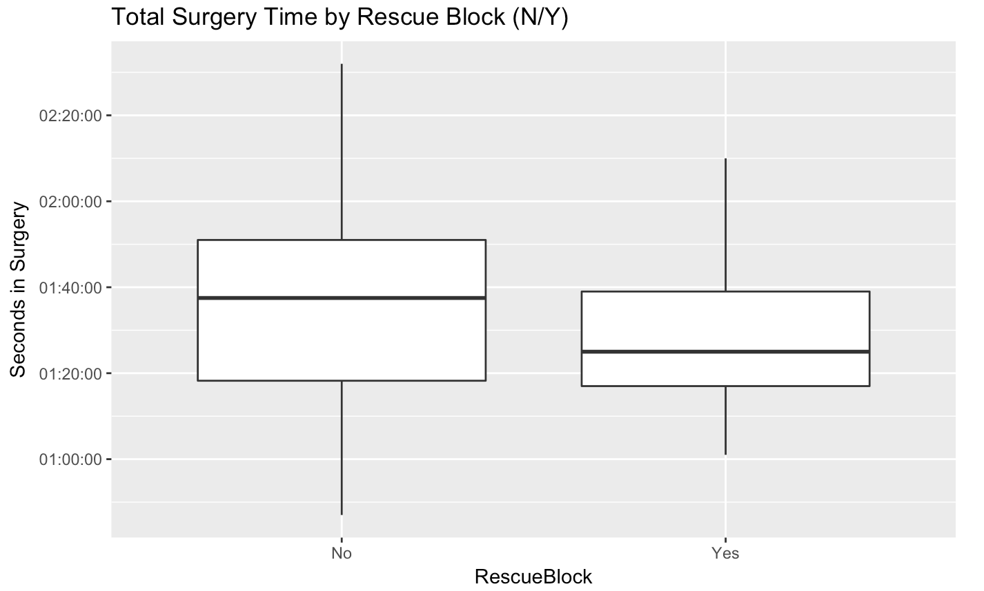
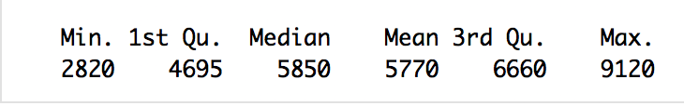

Predictor: surgery time?
Is the amount of time one spends in surgery a predictor of whether one might require a rescue block? From the descriptive statistics presented below, the answer appears to be NO.
Surgery Time (in seconds)
(No Rescue Block) descriptive statistics
Surgery Time (in seconds)
(Yes Rescue Block) descriptive statistics

Slide 19
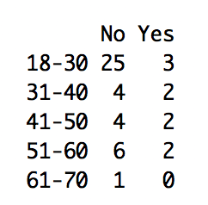
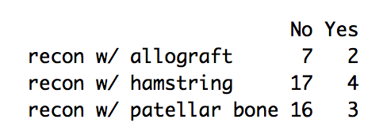
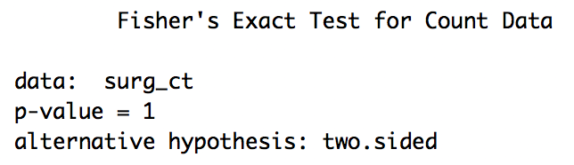
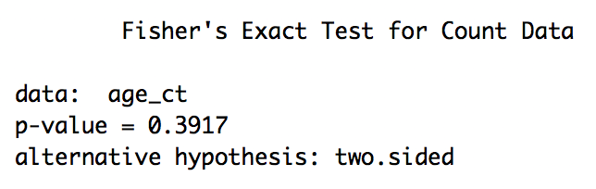
PREDICTOR: Age or surgery type?
Are the amounts of pre-operative meds given to the patient independent of whether one required a rescue block or not? I performed a Fisher’s Exact Count Test on contingency tables for age and surgery type by counts of Rescue Block (y/n) and found there is no association.
Notes:
Review with Pooran:
Are these the right statistical tests?

Slide 20
conclusion
There is no improvement in recovery time (PACU) associated with whether cases follow “new” practice or “old” practice
Attempting a linear model between practice type and recovery time confirmed there is no point in trying to model recovery time as explained by practice type
My attempt to find any predictors on when a rescue block is needed has not turned up anything positive yet: I can rule out age, surgery type, and pre-operative med quantities.
In the next term, I will continue to investigate other possible candidates for predictors on when a rescue block is needed.
I have also provided, per the client’s request, an analysis of the post-operative characteristics of a “group 1” and “group 2” (as identified by the client), and am currently awaiting additional feedback or requests from my client.

