Slide 1
BLG 439E COMPUTER PROJECT I
PROJECT 1 - PRESENTATION

Slide 2
Project : 2-Factor Authentication Mechanism for Smart Phones
Research about Biometric Authentication
Deciding Authentication Method
Software Installation
Developing Application
Application Phases
Test Application

Slide 3
Biometric Authentication Types
Signature Detection
Face Detection
User Motion Detection
Fingerprint Detection
Voice Detection
Retina Detection

Slide 4
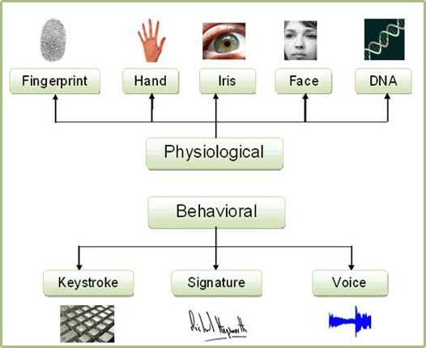
Biometric Authentication Types

Slide 5
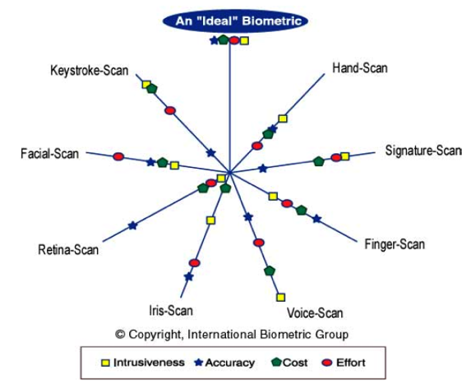
Comparison of Biometrics

Slide 6
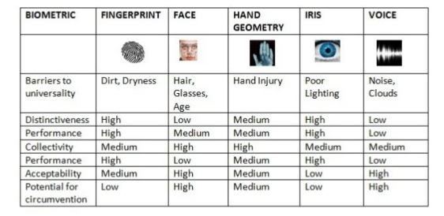
Comparison of Biometrics

Slide 7
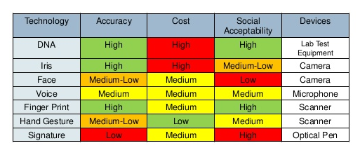
Comparison of Biometrics

Slide 8
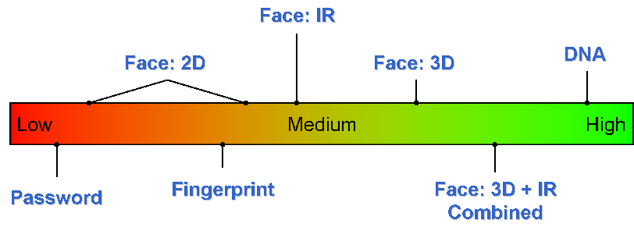
Comparison of Biometrics

Slide 9
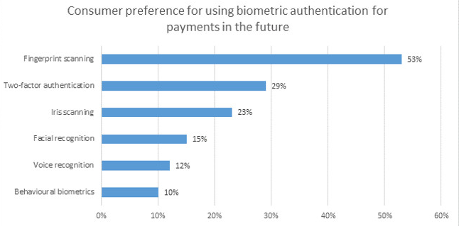
Comparison of Biometrics

Slide 10
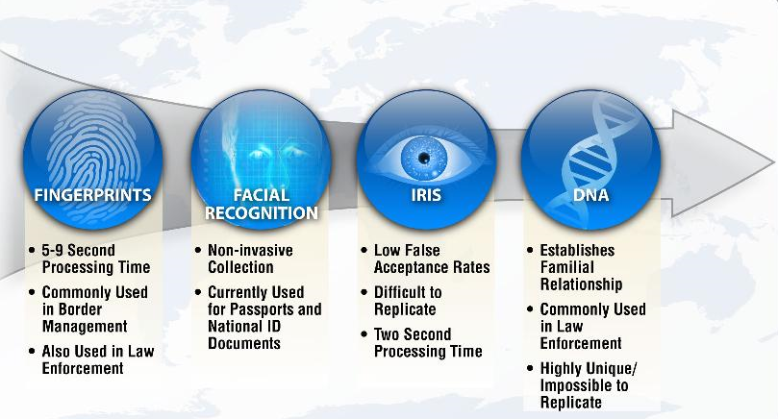
Comparison of Biometrics

Slide 11
Software Installation
Android Studio 2.3.3
JDK 1.8.0
Virtual Device - LG Nexus 5
Real Device – Samsung S7, J2
Fingerprint Authentication Library

Slide 12
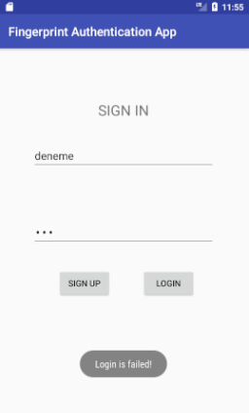
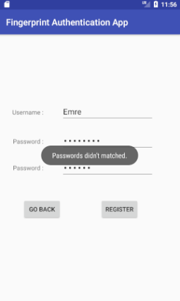
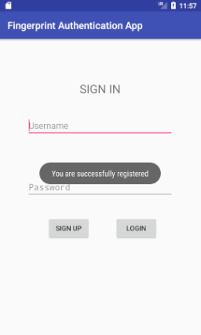
Application Phases and Test

Slide 13
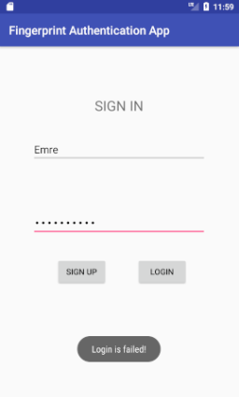
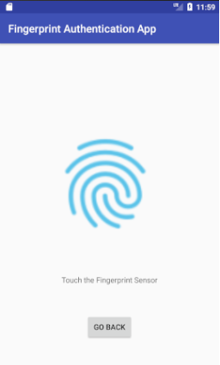
Application Phases and Test

Slide 14
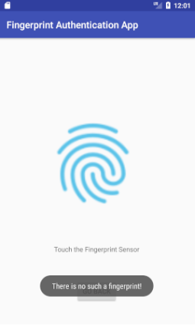
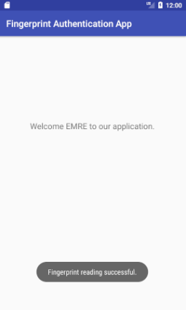
Application Phases and Test

Slide 15
References
1 - http://www.edgefxkits.com/blog/infrared-ir-led-biometric-id-applications/
2 - http://biometrics.pbworks.com/w/page/14811351/Authentication%20technologies
3 - https://www.slideshare.net/sububasistha/a-study-on-biometric-authentication-techniques
4 - https://www.slideshare.net/vasanthvidyakar/skyfi-labs-biometric-authentication-project
5 - https://www.cs.bham.ac.uk/~mdr/teaching/modules03/security/students/SS3/handout/
6 - https://www.nfcworld.com/2016/07/14/346178/europeans-keen-use-biometric-authentication-payments-says-visa/
7 - http://www.cse.wustl.edu/~jain/cse571-11/ftp/biomet/index.html
8 - https://github.com/multidots/android-fingerprint-authentication

Slide 16
Computer Project I
Thanks for Listening

