Slide 1
Cognitive Architectures: A Way Forward for the Psychology of Programming
Michael Hansen
Ph.D Student in Comp/Cog Sci
CREST / Percepts & Concepts Lab
Indiana University Bloomington
Onward! Workshop 2012

Slide 2
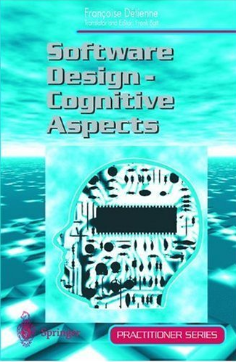
“Many claims are made for the efficacy and utility of new approaches to software engineering – structured methodologies, new programming paradigms, new tools, and so on.
Evidence to support such claims is thin and such evidence, as there is, is largely anecdotal. Of proper scientific evidence there is remarkably little.”
Françoise Détienne
- Frank Bott, 2001

Slide 3
How to Quantify the “Goodness” of a Language Feature?
for x in [10, 20, 30]:
print x
10
20
30
for x in [10, 20, 30]:
for y in [1, 2, 3]:
print x+y
11
12
13
21
22
23
31
32
33

Slide 4
How to Quantify the “Goodness” of a Language Feature?
for x in [10, 20, 30]; y in [1, 2]:
print x+y
?

Slide 5
How to Quantify the “Goodness” of a Language Feature?
for x in [10, 20, 30]; y in [1, 2]:
print x+y
11 11 error!
12 22
21
22
31
32
1st
2nd
3rd
Why?

Slide 6
The Psychology of Programming

Slide 7
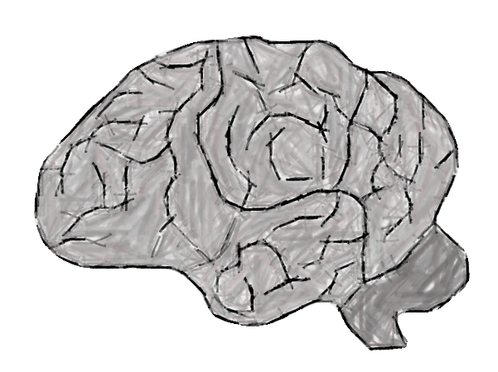
History of the Psychology of Programming
First Period (1960-1979)
Imported theories and methods from Psychology
Short-term memory, descriptive statistics
Correlations between task and language/human factors
Example: comments vs. defects detected
Second Period (1980-present)
Cognitive models
Knowledge, strategies, task, environment/tools
Response times, eye movements, intermediary code
Experts and students

Slide 8
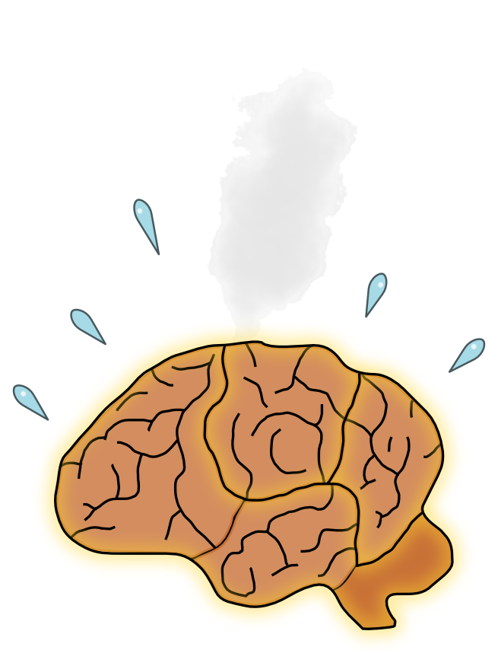
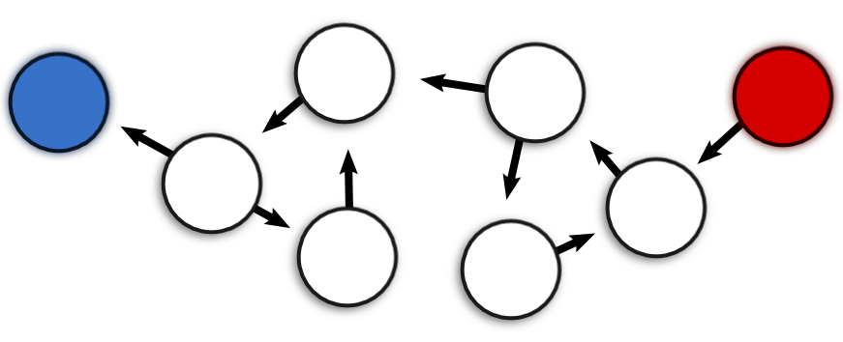
Structural Complexity Metrics & Miller’s Magic Number (7 ± 2)
Lines of code
Coupled with everything!
Cyclomatic Complexity
# of branches
Halstead Volume/Effort
Operators, operands
Object-Oriented metrics
Coupling, cohesion, inheritance

Slide 9
“Furthermore, such [scientific evidence] as there is can be described as ‘black box’, that is, demonstrates a correlation between the use of a certain technique and an improvement in some aspect of the development.
It does not demonstrate how the technique achieves the observed effect.”
- Frank Bott, 2001
Françoise Détienne

Slide 10
History of the Psychology of Programming
First Period (1960-1979)
Imported theories and methods from Psychology
Short-term memory, descriptive statistics
Correlations between task and language/human factors
Example: comments vs. defects detected
Second Period (1980-present)
Cognitive models
Response times, eye movements, intermediary code
Knowledge, strategies, task, environment/tools
Experts and students

Slide 11
Models and Modelers
Elliot Soloway (1984)
Plan analysis, Rules of Discourse
Nancy Pennington (1987)
Text structure, levels of representation
Anneliese von Mayerhauser (1995)
Integrated Metamodel
Françoise Détienne (2001)
Effect of task (read to reuse)
Chris Parnin / Christopher Douce (2008)
Task Memory Model / Stores Model of Code Cognition

Slide 12
Models and Modelers
Elliot Soloway (1984)
Plan analysis, Rules of Discourse
Nancy Pennington (1987)
Text structure, levels of representation
Anneliese von Mayerhauser (1995)
Integrated Metamodel
Françoise Détienne (2001)
Effect of task (read to reuse)
Chris Parnin / Christopher Douce (2008)
Task Memory Model / Stores Model of Code Cognition
Quantitative Predictions?

Slide 13
The Cognitive Complexity Metric

Slide 14
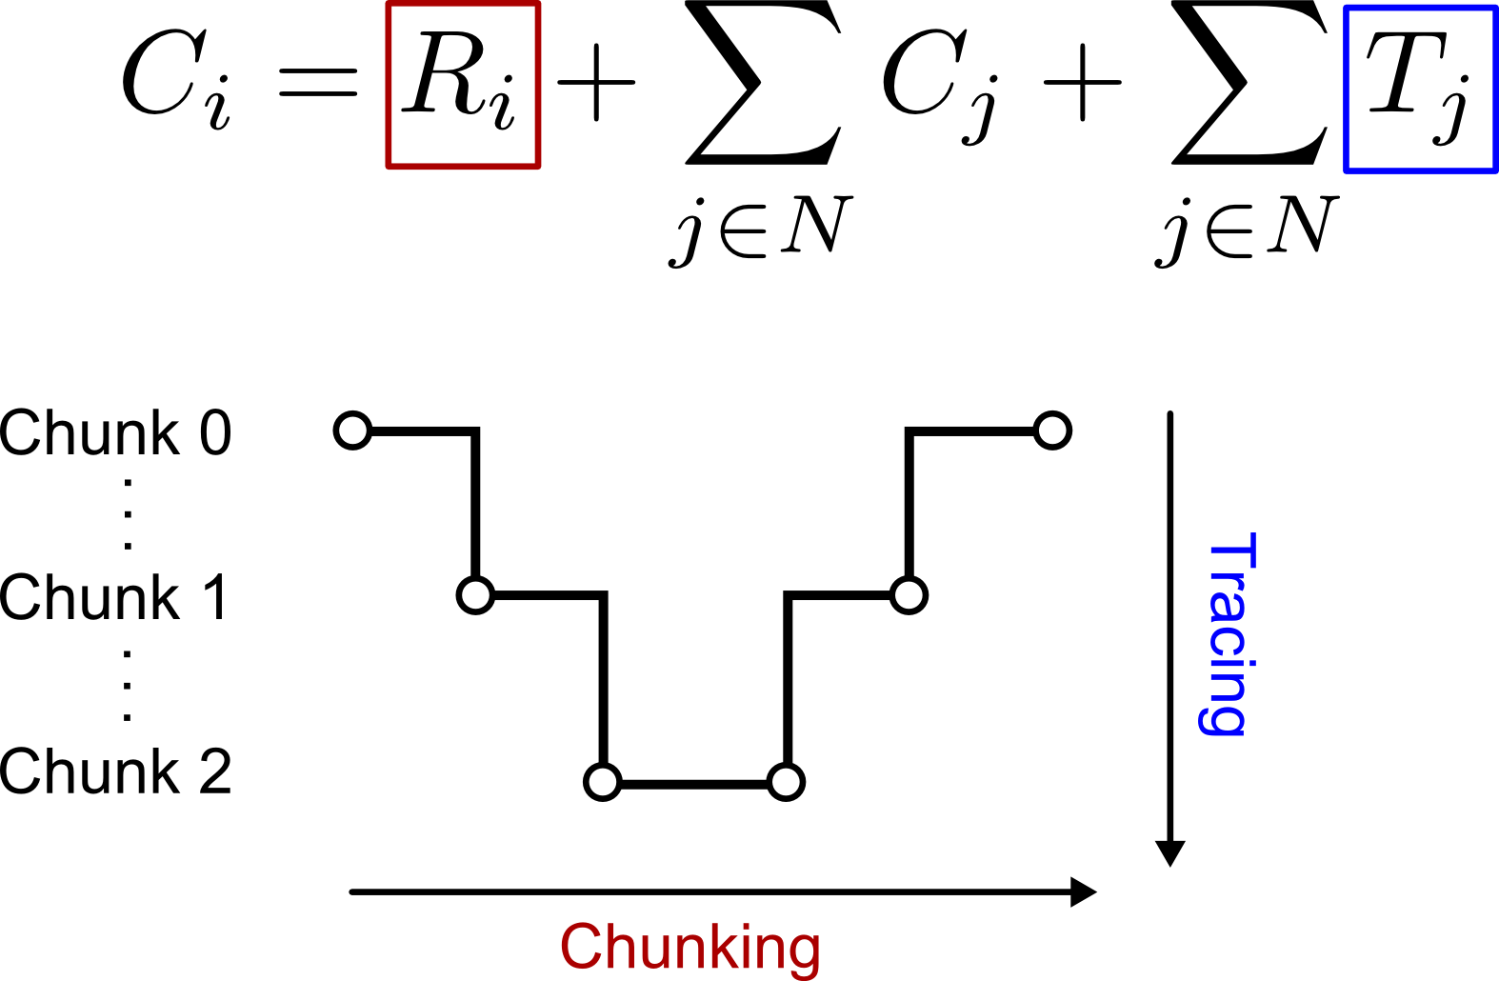
The Cognitive Complexity Metric (Cant et. al, 1995)

Slide 15
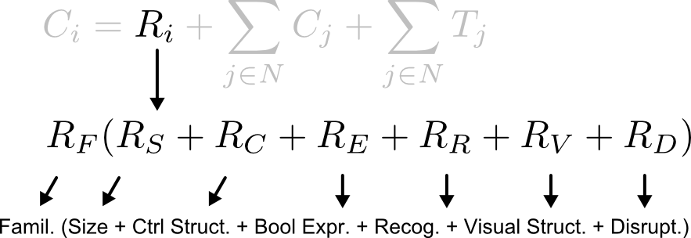
The Cognitive Complexity Metric (Cant, 1995)

Slide 16
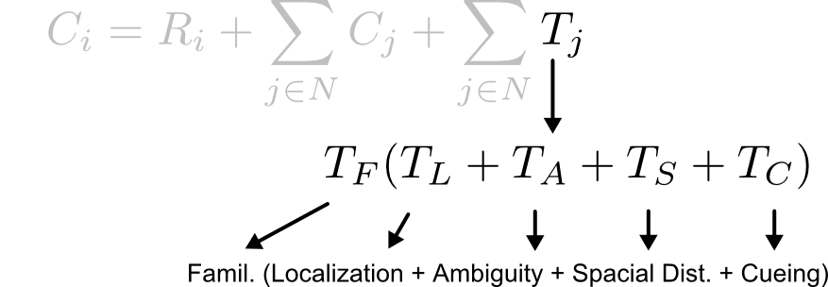
The Cognitive Complexity Metric (Cant, 1995)

Slide 17
Building Up A Representation
Mental
Representation
Code
Feature X
Feature Y

Slide 18
Building Up A Representation
Mental
Representation
Code
All we need are quantitative models of …
The visual system, reading text
Chunking and short/long term memory
Goal-driven behavior
Pattern recognition and learning
Logical reasoning and problem solving
How these fit together!
Feature X
Feature Y

Slide 19
Cognitive Architectures

Slide 20
The ACT-R Cognitive Framework (Anderson, 2007)
“…a specification of the structure of the brain at a level of abstraction that explains how it achieves the function of the mind.”
- How Can the Human Mind Occur in the Physical Universe?
Cognitive Architecture
Software simulation environment
Similar constraints that (supposedly) give rise to the mind
Symbolic and sub-symbolic processes

Slide 21
The ACT-R Cognitive Framework (Anderson, 2007)
“…a specification of the structure of the brain at a level of abstraction that explains how it achieves the function of the mind.”
- How Can the Human Mind Occur in the Physical Universe?
Cognitive Architecture
Software simulation environment
Similar constraints that give rise to the mind
Symbolic and sub-symbolic processes
Massively Parallel Components
Pattern matcher (production system)
Declarative memory (Bayesian activation calculus)
Serial Bottlenecks
Single production at a time (50 ms)
Visual attention
Manual action (keypresses, mouse clicks)

Slide 22
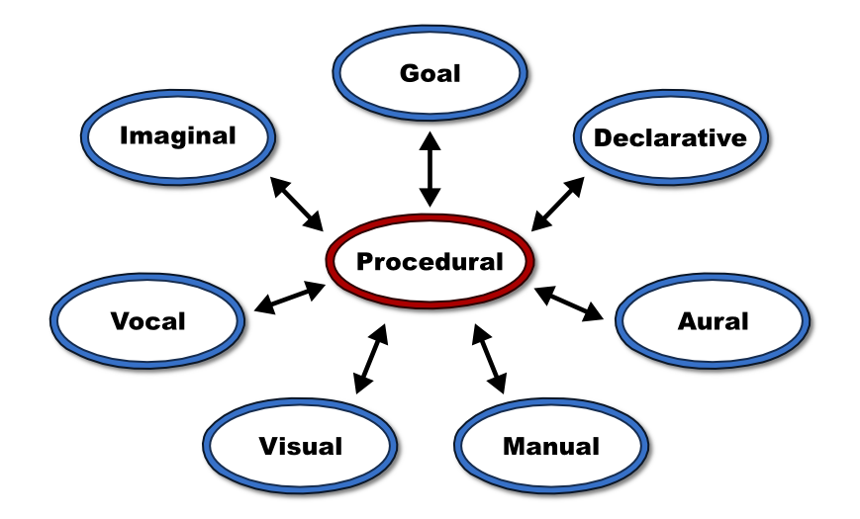
The ACT-R Cognitive Framework (Anderson, 2007)
(p encode-letter
=goal>
isa read-letters
state attend
=visual>
isa text
value =letter1
?imaginal>
buffer empty
==>
=goal>
state wait
+imaginal>
isa array
letter1 =letter1
)
Symbolic + Sub-symbolic Layers

Slide 23
Benefits of a Cognitive Architecture
Bringing together many different psychological theories
Attention, memory, cognition, vision, etc.
Bridging theories
Interaction with real* tools
Models and subjects can use same development environment
Fill in the “cognitive gaps” of a GOMS analysis
Repeatable simulations
Measurements of cognitively relevant dimensions
Make assumptions explicit
Parameters, model code, memory contents are reportable

Slide 24
Where To Go From Here?
Eye-tracking / code comprehension experiments
Participants predict output of simple programs
Novices and experts
Model should predict response time, visual strategy, response
def add_1(num):
added = num + 1
return added
added = 4
add_1(added)
print(added)
What does this program output?

Slide 25
How to Quantify the “Goodness” of a Language Feature?
Use cognitive model simulation to make “objective” judgments
Model response time – how long to complete task?
Visual search strategy – looking at the right things?
Richness of representation – matched the best schema?
Prediction mistakes – consistent errors?
Potential problems
Assumptions/gaps in cognitive architecture
Experimental variables may not provide enough constraints
Approach may not scale to larger programs
What about dramatically new features or paradigms?

Slide 26

Thank You! Questions?

