Slide 1
Java Collections

Slide 2
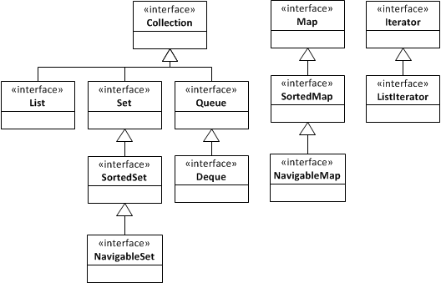
Java Collections
Collections, Iterators, Algorithms

Slide 3
List
List interface
A sequence of elements accessed by index
get(index), set(index, value)
ArrayList (resizable array implementation)
LinkedList (doubly-linked list implementation)

Slide 4
Set
Set interface
A collection that contains no duplicates
add(value), contains(value), remove(value)
HashSet (hash table implementation)
TreeSet (bst implementation)
LinkedHashSet (hash table + linked list impl)

Slide 5
Queue
Queue interface
A collection designed for holding elements prior to processing
add(value), peek(), remove()
ArrayDeque (fifo, resizable array impl)
LinkedList (fifo, linked list implementation)
PriorityQueue (priority queue, binary heap impl)

Slide 6
Deque
Deque interface
A queue that supports efficient insertion and removal at both ends
addFirst(value), addLast(value),
peekFirst(), peekLast(),
removeFirst(), removeLast()
ArrayDeque (resizable array implementation)
LinkedList (linked list implementation)

Slide 7
Stack
Java’s Stack class is deprecated
If you need a stack, use a Deque
push() => Deque.addFirst()
pop() => Deque.removeFirst()
peek() => Deque.peekFirst()

Slide 8
Map
Map interface
A collection that maps keys to values
A set of (key, value) pairs where keys are unique
put(key, value), get(key), contains(key), remove(key)
keySet(), values(), entrySet()
HashMap (hash table implementation)
TreeMap (bst implementation)
LinkedHashMap (hash table + linked list impl)

