Slide 1
Unit Testing & Defensive Programming

Slide 2

F-22 Raptor Fighter

Slide 3
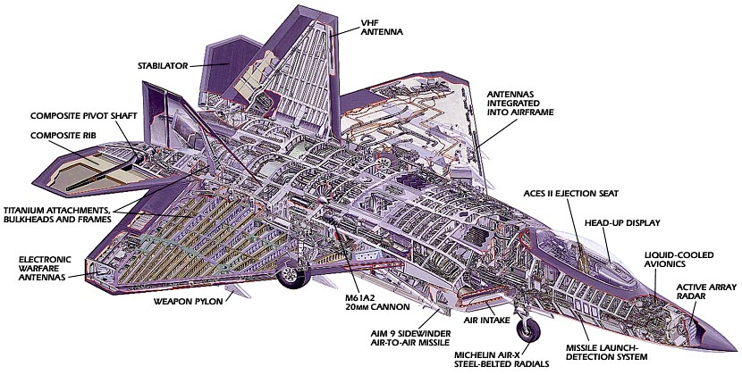
F-22 Raptor Fighter
Manufactured by Lockheed Martin & Boeing
How many parts does the F-22 have?

Slide 4
F-22 Raptor Fighter
What would happen if Lockheed assembled an F-22 with "untested" parts (i.e., parts that were built but never verified)?
It wouldn't work, and in all likelihood you would never be able to make it work
Cheaper and easier to just start over

Slide 5
Managing implementation complexity
Individual parts should be verified before being integrated with other parts
Integrated subsystems should also be verified
If adding a new part breaks the system, the problem must be related to the recently added part
Track down the problem and fix it
This ultimately leads to a complete system that works

Slide 6
2 approaches to programming
Approach #1
"I wrote ALL of the code, but when I tried to compile and run it, nothing seemed to work!“
Approach #2
Write a little code (e.g., a method or small class)
Test it
Write a little more code
Test it
Integrate the two verified pieces of code
Test it
…

Slide 7
Unit testing
Large programs consist of many smaller pieces
Classes, methods, packages, etc.
"Unit" is a generic term for these smaller pieces
Three important types of software testing are:
Unit Testing (test units in isolation)
Integration Testing (test integrated subsystems)
System Testing (test entire system that is fully integrated)
Unit Testing is done to test the smaller pieces in isolation before they are combined with other pieces
Usually done by the developers who write the code

Slide 8
What unit tests do
Unit tests create objects, call methods, and verify that the returned results are correct
Actual results vs. Expected results
Unit tests should be automated so that they can be run frequently (many times a day) to ensure that changes, additions, bug fixes, etc. have not broken the code
Regression testing
Notifies you when changes have introduced bugs, and helps to avoid destabilizing the system

Slide 9
Test driver program
The tests are run by a "test driver", which is a program that just runs all of the unit test cases
It must be easy to add new tests to the test driver
After running the test cases, the test driver either tells you that everything worked, or gives you a list of tests that failed
Little or no manual labor required to run tests and check the results
Tools like Ant or Make are often used to automate the building and running of the test driver (e.g., $ ant test)

Slide 10
JUnit testing framework
JUnit is a “framework” for implementing automated unit tests
JUnit Documentation
Example: Contact Manager unit tests

Slide 11
JUnit testing framework
For every class in the “src” directory, create a corresponding class in the “test” directory
src/shared/model/Contact.java =>
test/shared/model/ContactTest.java
src/server/database/Database.java =>
test/server/database/DatabaseTest.java
src/server/database/Contacts.java =>
test/server/database/ContactsTest.java
src/client/communication/ServerCommunicator.java =>
test/client/communication/ServerCommunicatorTest.java
Import JUnit classes
import org.junit.*;
import static org.junit.Assert.*;

Slide 12
JUnit testing framework
Use JUnit annotations to mark test methods
Annotation | Description
@Test public void method() | The annotation @Test identifies that a method is a test method.
@Before public void method() | Will execute the method before each test. This method can prepare the test environment (e.g. read input data, initialize the class).
@After public void method() | Will execute the method after each test. This method can cleanup the test environment (e.g. delete temporary data, restore defaults).

Slide 13
JUnit testing framework
Use JUnit annotations to mark test methods
Annotation | Description
@BeforeClass public void method() | Will execute the method once, before the start of all tests. This can be used to perform time intensive activities, for example to connect to a database.
@AfterClass public void method() | Will execute the method once, after all tests have finished. This can be used to perform clean-up activities, for example to disconnect from a database.
@Test (expected = Exception.class) | Fails, if the method does not throw the named exception.
@Test(timeout=100) | Fails, if the method takes longer than 100 milliseconds.

Slide 14
JUnit testing framework
Use JUnit assert* methods to implement test cases
JUnit Assert Method Documentation

Slide 15
Running JUnit tests
Run them in Eclipse
Right-Click on any test class, package, folder, or project in the Package Explorer
Select Run As => JUnit Test from the menu
This will run all test methods in the selected class, package, folder, or project

Slide 16
Running JUnit tests
Create a test driver program to run the tests
test/main/UnitTestDriver.java in Contact Manager
package main;
public class UnitTestDriver {
public static void main(String[] args) {
String[] testClasses = new String[] {
"shared.model.ContactTest",
"server.database.DatabaseTest",
"server.database.ContactsTest",
"client.communication.ServerCommunicatorTest"
};
org.junit.runner.JUnitCore.main(testClasses);
}
}

Slide 17
Defensive Programming
Good programming practices that protect you from your own programming mistakes, as well as those of others
Assertions
Parameter Checking

Slide 18
Assertions
As we program, we make many assumptions about the state of the program at each point in the code
A variable's value is in a particular range
A file exists, is writable, is open, etc.
Some data is sorted
A network connection to another machine was successfully opened
…
The correctness of our program depends on the validity of our assumptions
Faulty assumptions result in buggy, unreliable code

Slide 19
Assertions
int binarySearch(int[] data, int searchValue) {
// What assumptions are we making about the parameter values?
…
}
data != null
data is sorted
What happens if these assumptions are wrong?

Slide 20
Assertions
Assertions give us a way to make our assumptions explicit in the code
assert temperature > 32 && temperature < 212;
The parameter to assert is a boolean condition that should be true
assert condition;
If the condition is false, Java throws an AssertionError, which crashes the program
Stack trace tells you where the failed assertion is in the code

Slide 21
Assertions
int binarySearch(int[] data, int searchValue) {
assert data != null;
assert isSorted(data);
…
}
String[] someMethod(int y, int z) {
assert z != 0;
int x = y / z;
assert x > 0 && x < 1024;
return new String[x];
}

Slide 22
Assertions
Assertions are little test cases sprinkled throughout your code that alert you when one of your assumptions is wrong
This is a powerful tool for avoiding and finding bugs
Assertions are usually disabled in released software
In Java, assertions are DISABLED by default
To turn enable them, run the program with the –enableassertions (or -ea) option
java –enableassertions MyApp
java –ea MyApp
In Eclipse, the –enableassertions option can be specified in the VM arguments section of the Run Configuration dialog

Slide 23
Assertions
Alternate form of assert
assert condition : expression;
If condition is false, expression is passed to the constructor of the thrown AssertionError
int binarySearch(int[] data, int searchValue) {
assert data != null : ”binary search data is null”;
assert isSorted(data) : ”binary search data is not sorted”;
…
}
String[] someMethod(int y, int z) {
assert z != 0 : ”invalid z value”;
int x = y / z;
assert x > 0 && x < 1024 : x;
return new String[x];
}

Slide 24
Assertions
If one of my assumptions is wrong, shouldn't I throw an exception?
No. You should fix the bug, not throw an exception.

Slide 25
Parameter Checking
Another important defensive programming technique is "parameter checking"
A method or function should always check its input parameters to ensure that they are valid
If they are invalid, it should indicate that an error has occurred rather than proceeding
This prevents errors from propagating through the code before they are detected
By detecting the error close to the place in the code where it originally occurred, debugging is greatly simplified

Slide 26
Parameter Checking
Two ways to check parameter values
assertions
if statement that throws exception if parameter is invalid
int binarySearch(int[] data, int searchValue) {
assert data != null;
assert isSorted(data);
…
}
int binarySearch(int[] data, int searchValue) {
if (data == null || !isSorted(data)) {
throw new InvalidArgumentException();
}
…
}

Slide 27
Parameter Checking
Should I use assertions or if/throw to check parameters?
If you have control over the calling code, use assertions
If parameter is invalid, you can fix the calling code
If you don't have control over the calling code, throw exceptions
e.g., your product might be a class library that is called by code you don’t control

