Slide 1

A LOOK AT THE VALUATION OF G12 FX Behavioral Equilibrium Exchange Rate Models
Hans Heytens
hansheytens@hotmail.com
0032 469 19 22 26
Thomas Dierckx

Slide 2
HYPERLINK TO PYTHON CODE

Slide 3
GOAL
Use Python for FX-valuation modelling
Construct a long-term equilibrium fair value model to value G12 FX Currency Pairs: G9 + 3 CEE-currencies: eurusd, usdcad, usdjpy, gbpusd, usdsek, usdnok, usdchf, audusd, nzdusd, usdpln, usdhuf, usdczk. Run a in-sample Fixed Effect Panel Regression. Determine currencies with largest deviations in valuation.
Construct an Error Correction Model to estimate the impact of valuation misalignment on future movements in the actual exchange rate.
Perform out-of-sample predictive, recursive panel regression.
Construct a macro trading model based takes long-term positions in currencies only if the currency misalignment versus the fair value estimate is extreme.
PROCESS (PYTHON)

Slide 4
MOTIVATION
We publish our work and learning process because of the protégé effect. Explaining or showing a process to others is the best way to learn for ourselves. We encourage all readers to check our code, logic and search for any pitfalls/errors/mistakes.
INTENDED USE
This notebook is for illustrative and education purposes only. Feel free to use this code for these purposes.
The logic and/or python code might contain errors. All mistakes remain the author's fault. If you find any, let us know so we can rectify
LIMITATIONS AND FUTURE CHALLENGES:
CREDITS
Two papers on exchange rate modelling from investment banks gave us the idea to implement a BEER-model in python ourselves. These papers are:
‘Introducing BEER by Unicredit, a framework for modelling exchange rates’, 3 Sep 2018, Unicredit
‘Merging GSDEER and GSDEEMER:A Global Approach to Equilibrium Exchange Rate Modelling’, May 2005, Goldman Sachs

Slide 5
DATA
I publish my work and learning process because of the protégé effect. I also encourage my readers to check my code, logic and discuss.
Teaching and/or explaining a process to others is the best way to learn for myself.
I encourage my readers to check my code, logic and search for any errors/mistakes.
INTENDED USE
This notebook is for illustrative and education purposes only. Feel free to use this code for these purposes.
The logic and/or python code might contain errors. All mistakes remain the author's fault. If you find any, let me know so I can rectify
LIMITATIONS AND FUTURE CHALLENGES:
Add some more pure eco-indicators on other domains such as US consumer activity, US production (ISM stuff), US Housing…after back-test
Yield curve model needs work as markets often remain volatile first year after yield-curve normalization. Signal might be adjusted to take this into account. This is however overfitting as we noticed this after running the normal model.
Sahm-rule popular rule but international evidence shows weak signal for recessions in other countries. US dynamic labor market, hence maybe better. In any case, we might use better and faster labor indicators: jobless claims, % states with rising unemployment, manufacturing employment,…to be tested…
Keep it simple in this composite eco-model: no multi-variate regressions or machine learning stuff. Just individual models – back-tested – on eco indicators only. Challenge is data going back far enough.
CREDITS
Yield curve diffusion: I first saw yield curve breath as an indicator couple of years ago in a post made by Otavio Costa (Crescat Capital)
Sahm-rule: Claudia Sahm

Slide 6
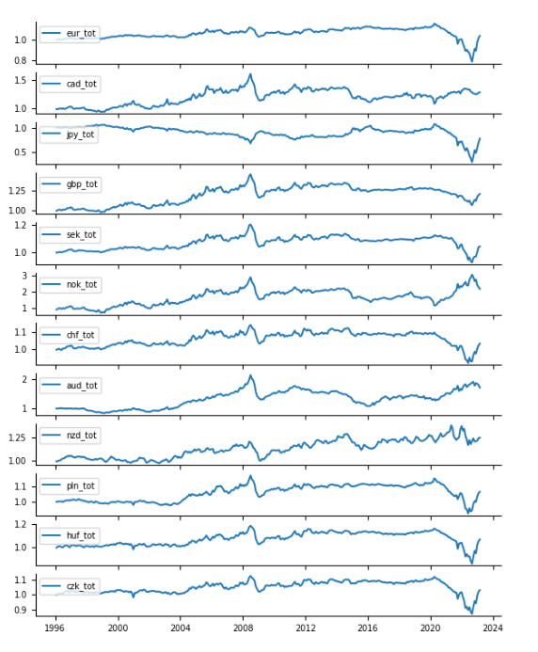
DATA EXPLORATION – Relative Terms of Trade versus United States
Some remarks:
The start of Covid in 2020 together with the commodity bull run led to sudden deterioration in relative tot versus USA for most countries except for some commodity currencies such as: CAD, NOK, AUD & NZD.
The Bloomberg commodity index peaked around May 2022. Since Sep 2022 we notice strong improvement in relative terms of trade versus the USA for most countries since Sep 2022, except for Norway & Australia.

Slide 7
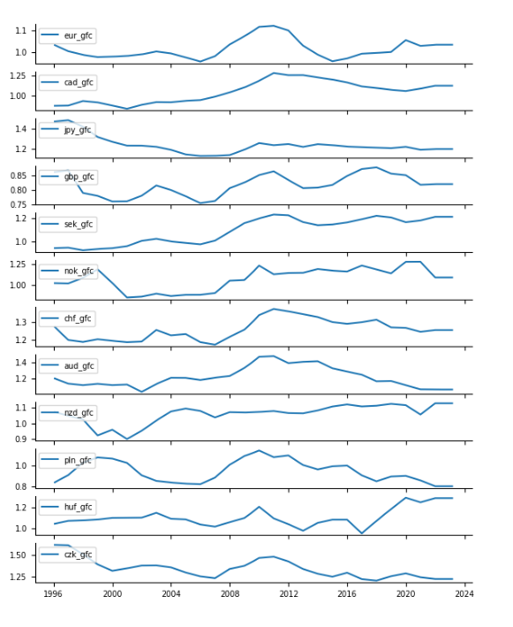
DATA EXPLORATION – Relative Gross Fixed Capital Formation as % GDP versus United States
Some remarks:
Improving versus USA last couple of years:
Sweden, New-Zealand, Hungary
Worsening versus USA last couple of years:
UK, Australia, Poland
Stable versus USA last couple of years:
Euro area, Japan

Slide 8
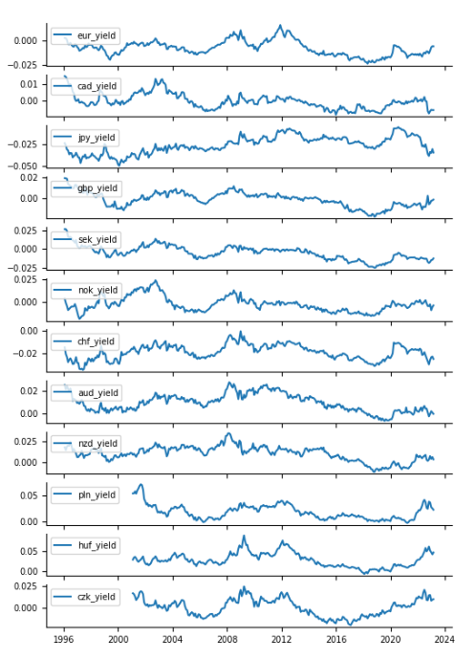
DATA EXPLORATION – 10Y Yield Differential versus United States
Some remarks:
Upward trending yield differentials with USA:
Euro area, UK
Downward trending yield differentials with USA
Canada, Japan Sweden, Switzerland, Australia
Seem to be at turning point:
CEE3 FX: Poland, Hungary, Czech

Slide 9
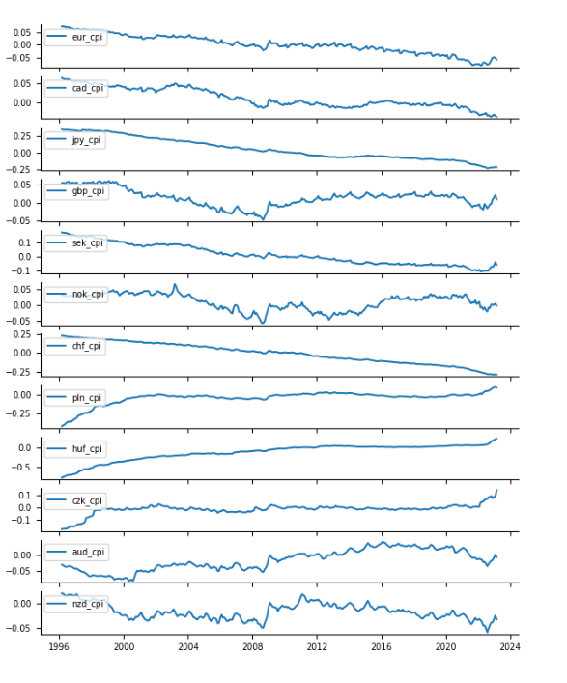
DATA EXPLORATION – Relative CPI-index versus United States
Some remarks:
EUR: relative cpi index long term downtrend versus US, recently: upticks
Currency pairs with structural downtrends in relative CPI index versus USA which could lead to more structural competitiveness versus USA and structural support for the domestic currency in the long run:
Euro Area, Canada, Japan, Sweden (except lately strong upticks), Switzerland
Structural long-term inflators versus USA
Poland, Hungary, Czech

Slide 10
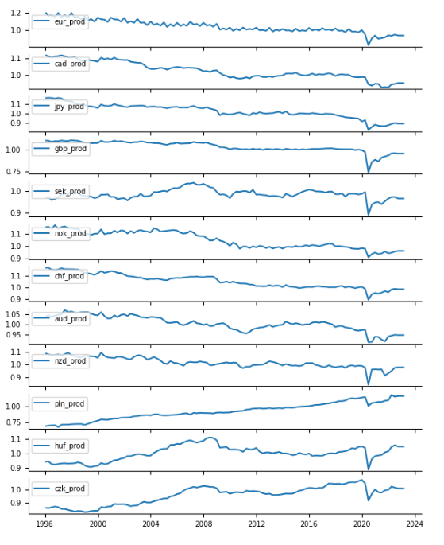
DATA EXPLORATION – Relative labour prodictivity-index versus United States
Some remarks:
Long-term structural downward trends in relative productivity versus USA:
Euro area, Canada, Japan, Norway, Switzerland, Australia,
Hence the word: KING DOLLAR
Structural upward trends:
Poland

Slide 11
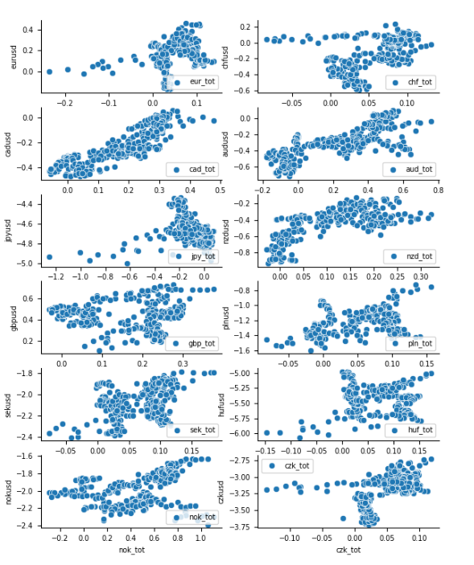
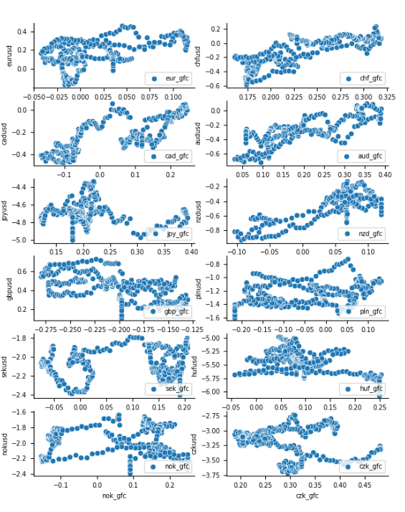
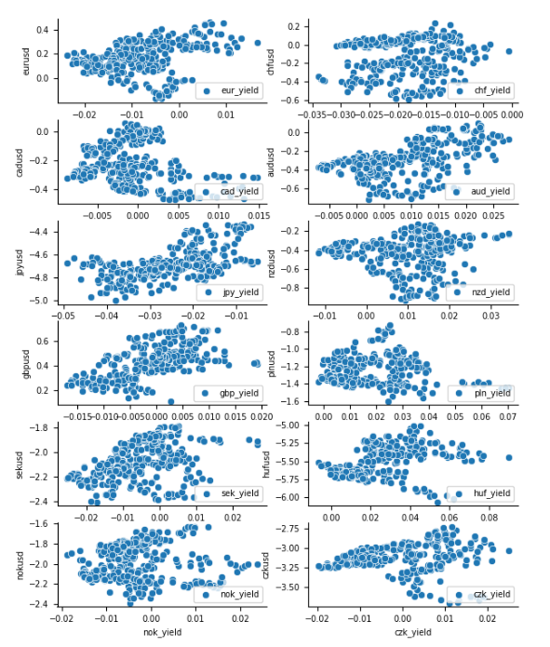
DATA EXPLORATION – scatter plots of response versus feature
Log(fx) versus log(relative terms of trade)
for 12 currencies
(should notice positive correlation on average)
Log(fx) versus log(relative gross fixed capital % gdp)
for 12 currencies
(should notice positive correlation on average)
Log(fx) versus 10y yield differential
for 12 currencies
(should notice positive correlation on average)

Slide 12
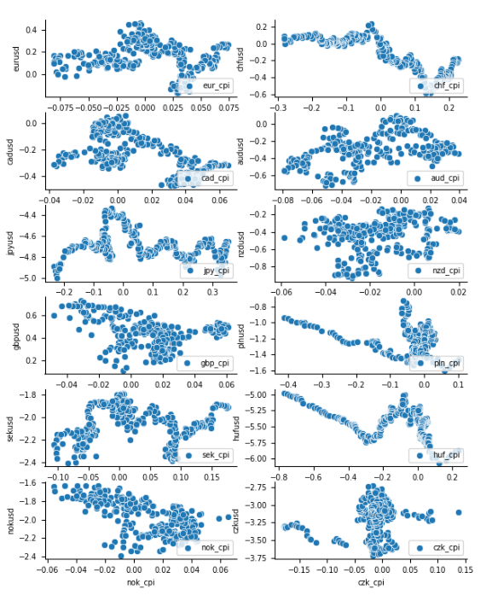
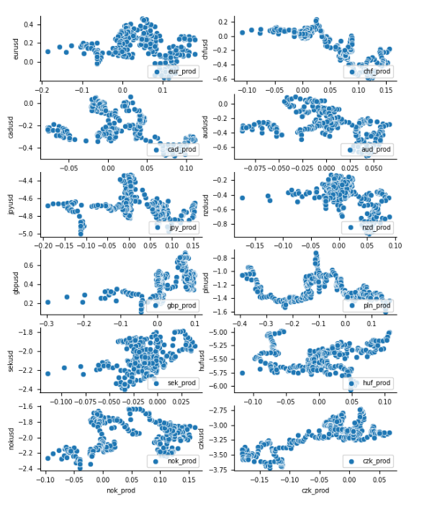
DATA EXPLORATION – scatter plots of response versus feature
Log(fx) versus log(relative CPI-index)
for 12 currencies
(should notice negative correlation on average)
Log(fx) versus log(relative productivity-index)
for 12 currencies
(should notice positive correlation on average)

Slide 13
FIXED EFFECT PANEL REGRESSION THROUGH LSDV (least-square dummy variable regression)
Sample Periods per currency/country
RESPONSE/DEPENDENT/TARGET:
Log of the exchange rate. Exchange rate in format domestic/dollar. Base currency is the domestic country, quoted currency is dollar. Number of units of dollars to one unit of the domestic currency.
Rise in the exchange rate is a rise in the domestic currency versus the dollar.
Data is from Bloomberg.
5 FEATURES/INDEPENDENTS/REGRESSORS/EXPLANATORY VARIABLES
Log of the relative terms of trade. Terms of trade is ratio of export prices to import prices. The relative terms of trade is calculated as ratio of domestic terms of trade to terms of trade of the USA. Terms of trade captures developments in prices of export and import goods. Generally, a rise in the terms of trade would be supportive of a currency as importers demand less foreign FX and foreign demand for domestic currency increases to cover higher export prices. Data is from Citigroup.
Log of relative gross fixed capital formation as % of GDP. Gross fixed capital is a measure for investment appetite in a country. Higher levels should indicate more investment opportunities. On average, this could be supportive of the currency if some of the investments are financed by foreign demand. Data is from IMF.
Yield differential: 10y government yield domestic country minus 10y government yield USA. On average, higher yield differentials should be supportive for the currency with the positive differential. Data is from Bloomberg and IMF.
Log of the relative CPI-index. The inflation differential is a measure of competitiveness. Countries with open economies and lower inflation differentials have cheaper goods and services. On average, this would be supportive of the currency. Data is from IMF.
Log of relative productivity. Balassa-Samuelson effect is the effect where regions with high productivity experience support in their real exchange rates. Productivity here is the labor productivity index as a ratio to the labor productivity in the USA. Data is from OECD.

Slide 14
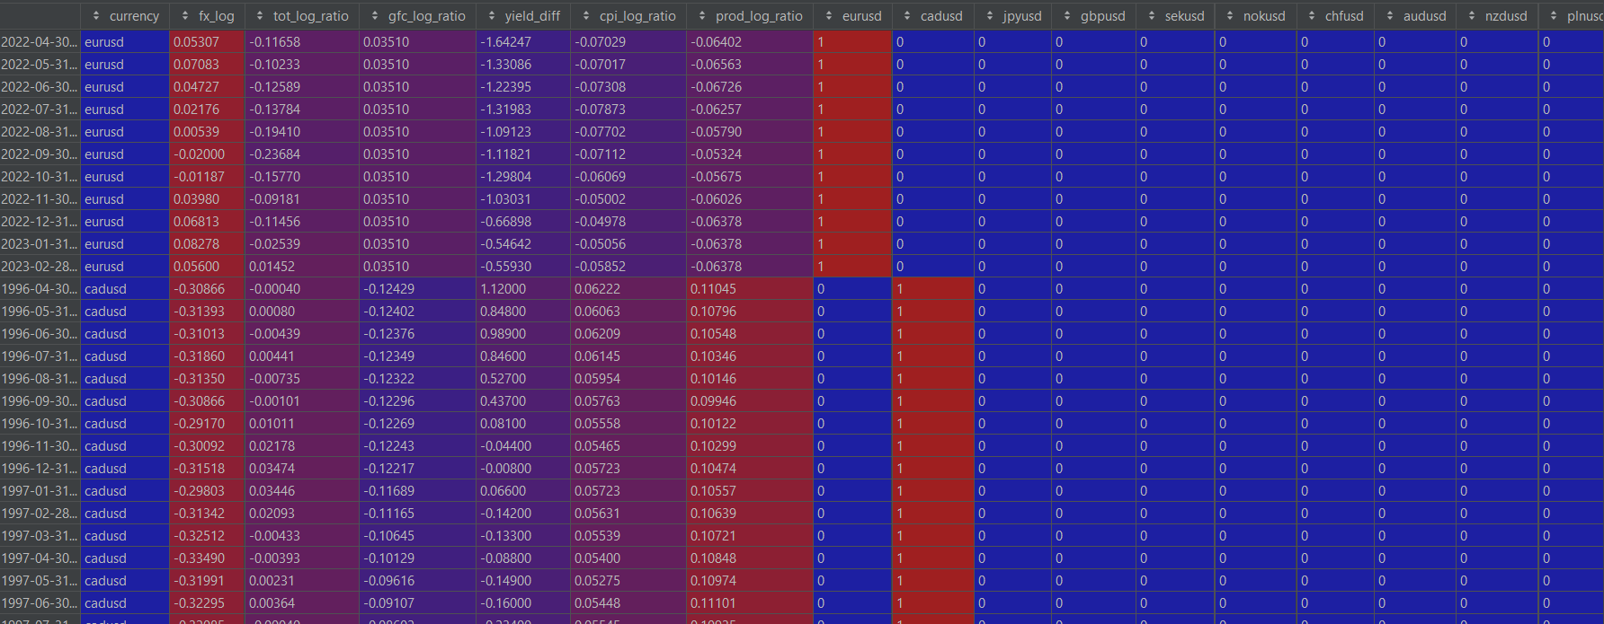
FIXED EFFECT PANEL REGRESSION THROUGH LSDV (least-square dummy variable regression)
Snapshot of our panel data: 3705 monthly observations, 5 features and 12 country/fx dummies.

Slide 15
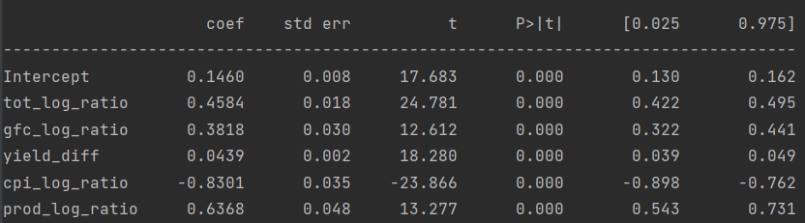
FIXED EFFECT PANEL REGRESSION THROUGH LSDV (least-square dummy variable regression)
Regression of form
Log(fx) = ai + B1log(tot) + B2log(gfc) + B3yield_diff + B4log(cpi) + B5log(prod)
ai = intercept of currency I (each currency/country has its own intercept)
B1, B2, B3, B4, B5 = coefficients
log(tot),….= regressors
Upper intercept is intercept for dummy that was left out being eurusd. There are other intercepts not shown here for each country (these intercepts are equal to euro area intercept + intercept currency)

Slide 16
FX LEVELS VERSUS LONG-TERM FAIR VALUE ACCORDING TO BEER-MODEL
Next slides contain a visual look of the currency pairs versus their long-term fair value according to the beer-model. The currencies are still expressed as units of dollar for one unit of the domestic currency. So, base currency is always the domestic currency, and the quoted currency is always the dollar. Format is domestic/usd.
We quote the currencies that way for ease of interpretation. A high value versus fair value means an overvaluation of the domestic currency (vis-à-vis the dollar) and vice versa. Market conventions can differ. For example: we quote cadusd, but the market normally quotes usdcad. Same for JPY. We quote the currency as jpyusd but the market convention is usdjpy. Etc…

Slide 17
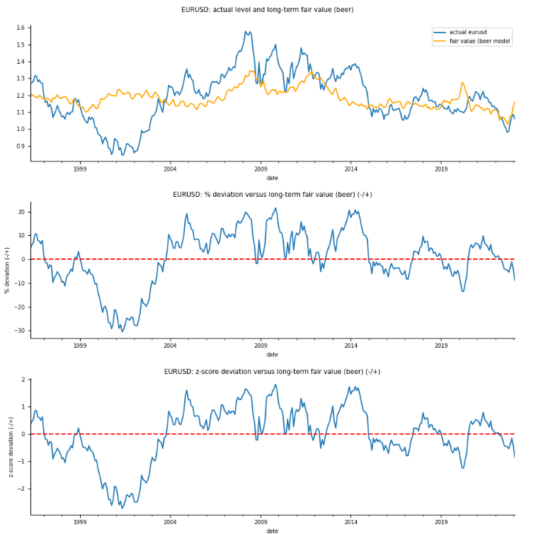
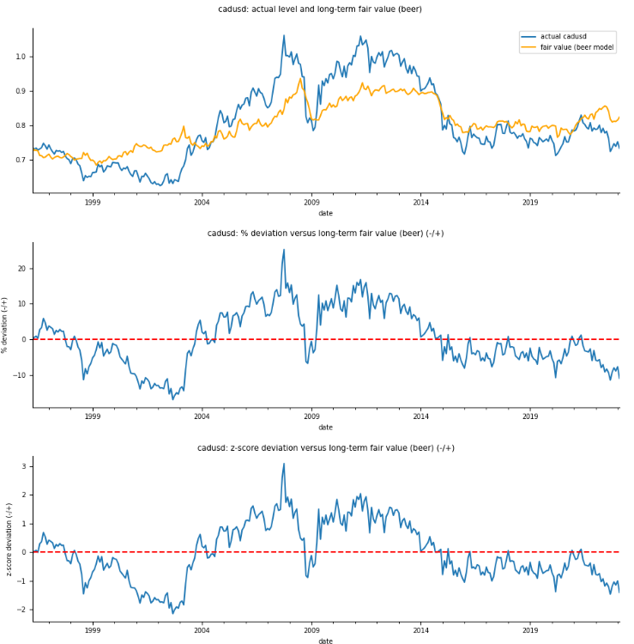
FX LEVELS VERSUS LONG-TERM FAIR VALUE ACCORDING TO BEER-MODEL

Slide 18
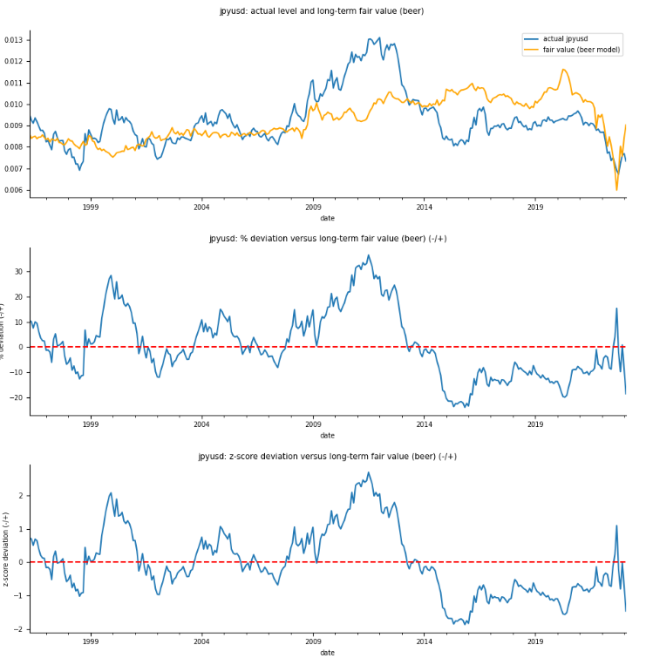
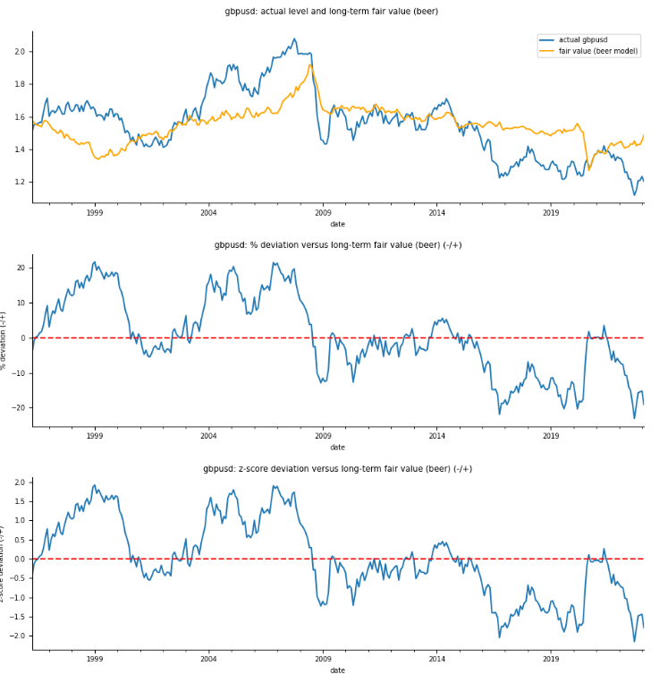
FX LEVELS VERSUS LONG-TERM FAIR VALUE ACCORDING TO BEER-MODEL

Slide 19
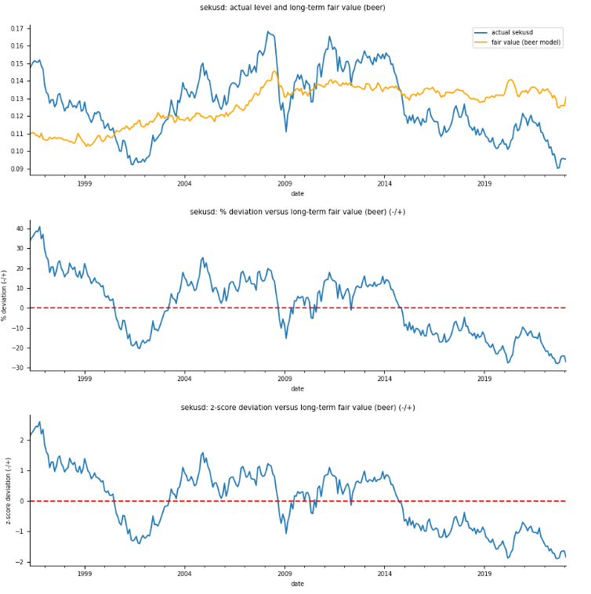
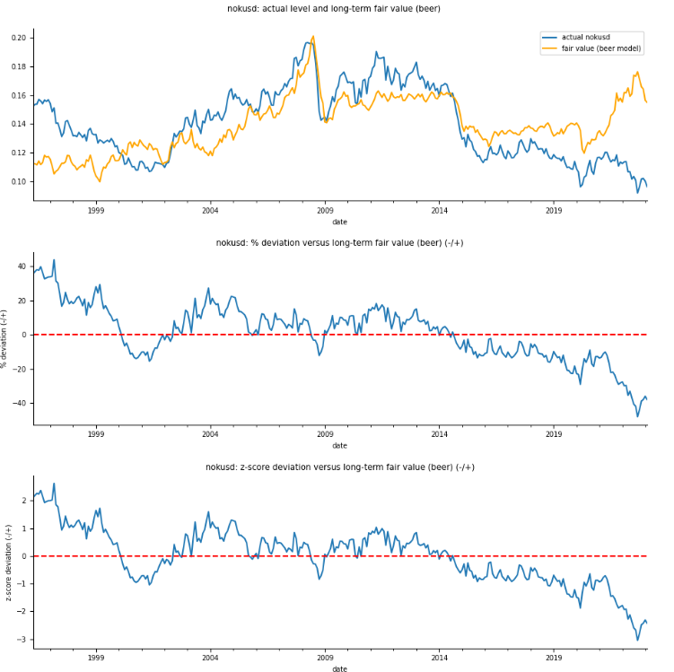
FX LEVELS VERSUS LONG-TERM FAIR VALUE ACCORDING TO BEER-MODEL

Slide 20
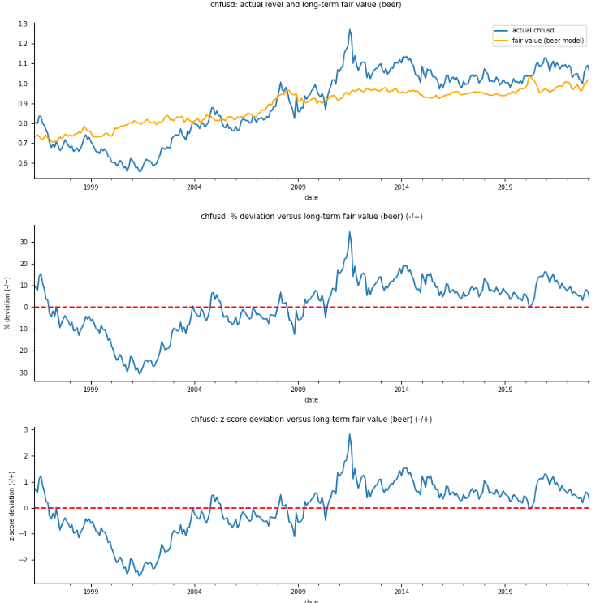
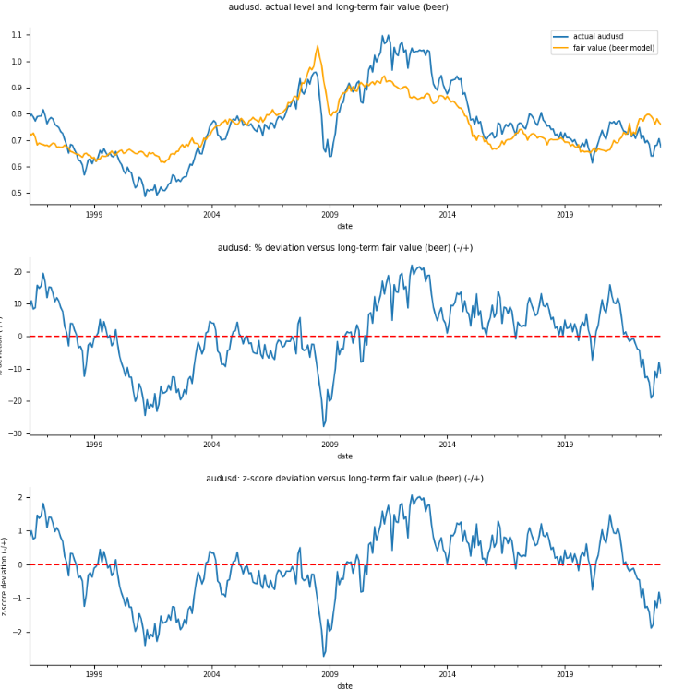
FX LEVELS VERSUS LONG-TERM FAIR VALUE ACCORDING TO BEER-MODEL

Slide 21
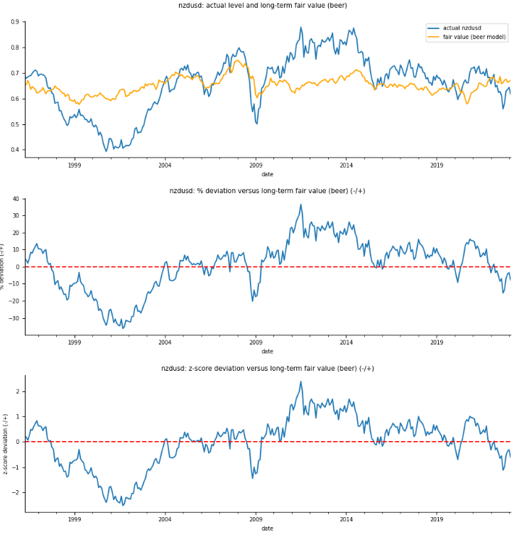
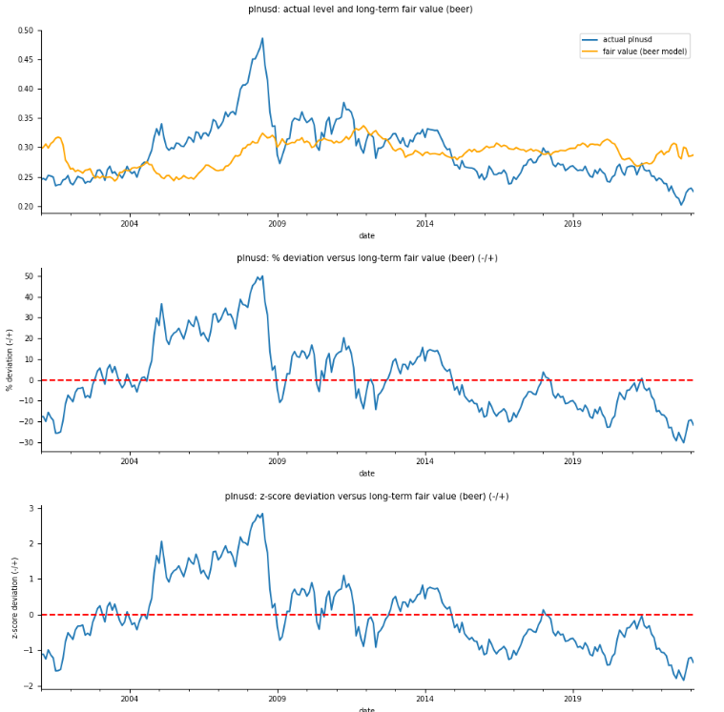
FX LEVELS VERSUS LONG-TERM FAIR VALUE ACCORDING TO BEER-MODEL

Slide 22
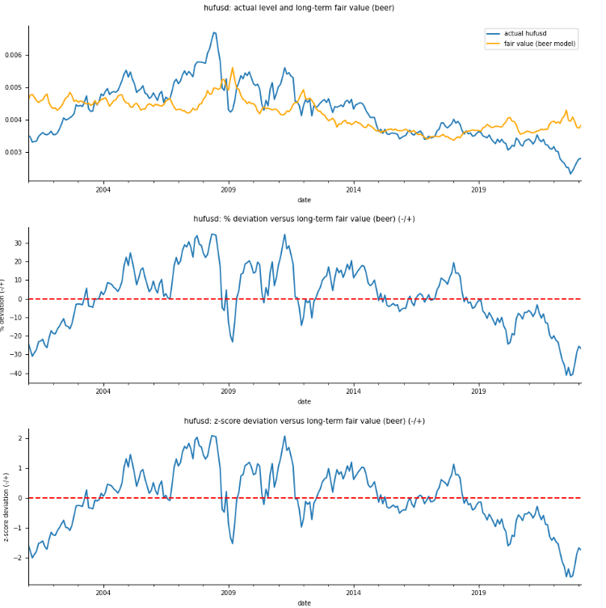
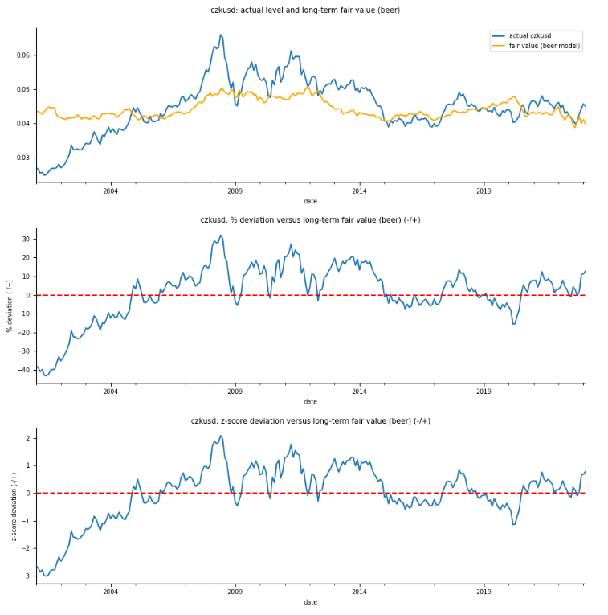
FX LEVELS VERSUS LONG-TERM FAIR VALUE ACCORDING TO BEER-MODEL

