Slide 1

Driver Telematics Analysis
Evan Brydon
Monica Meyer
Matt Shadish
Notes:
Project objective: To establish driver fingerprints

Slide 2
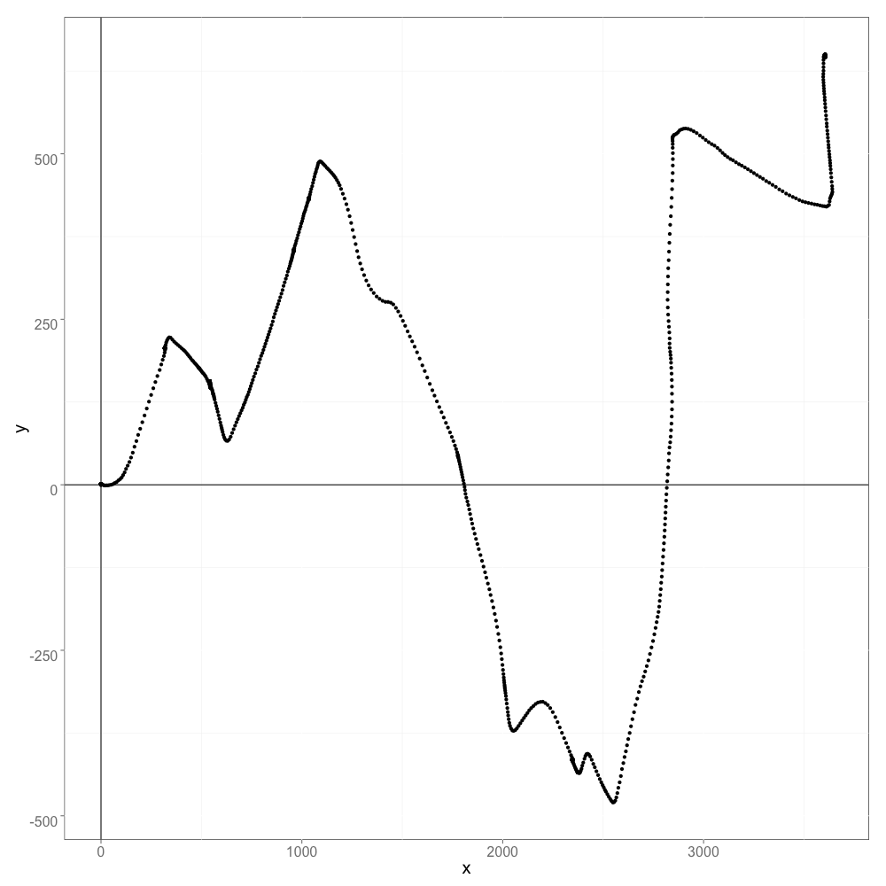
Data
2736 drivers
200 trips/driver
547,200 total trips
X | Y
0.0 | 0.0
15.3 | 4.3
30.4 | 9.6
45.8 | 13.8
55.5 | 23.9

Slide 3
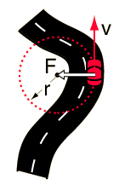
Feature Extraction
32 features for each trip
Standard features:
velocity
acceleration
number of turns taken
Advanced features:
centripetal acceleration
turn angles
Notes:
Each trip -> one observation

Slide 4
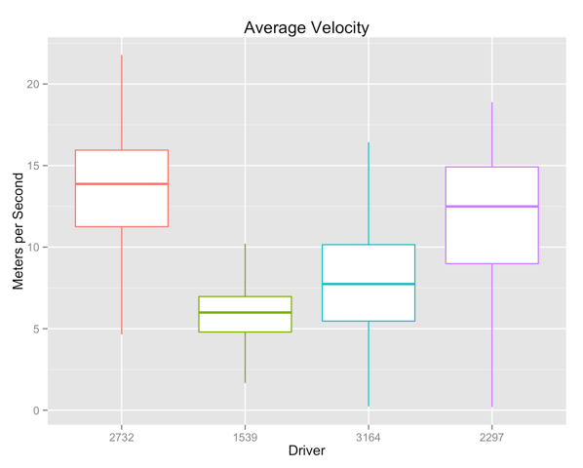
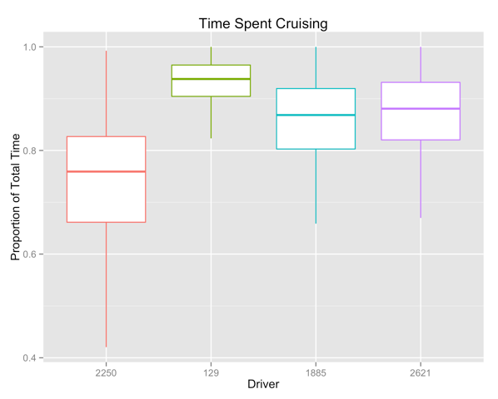
Exploratory Data Analysis
Notes:
RANDOM DRIVERS

Slide 5
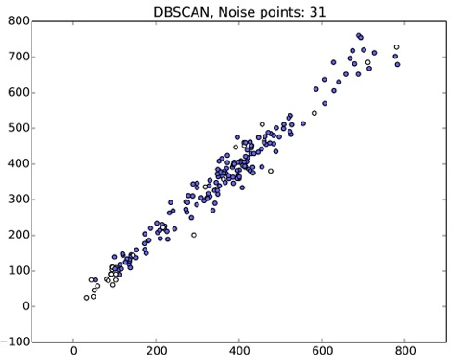
Preliminary Modeling
Unsupervised
Hierarchical clustering
Density based spatial clustering
Identify “noise” points
Notes:
- as a first step, since the data we were given was unlabeled, we thought this might be best solved using unsupervised modeling techniques. - we investigated several clustering algorithms, both hierarchical clustering and density-based spatial clustering, hoping that we could find a dense cluster representing the true driver’s trips with the rest of the trips falling away as noise. - unfortunately, the unsupervised methods didn’t work as well as we hoped, so we decided to find a way to use supervised methods to provide more accurate predictions

Slide 6

Model Building Methodology
Notes:
the basic idea was to take a 'target' driver and label all the driving trips for that driver as positive examples. then, we took a random set of other drivers and labeled those trips as our negative class.

Slide 7

Model Building Methodology
Notes:
the basic idea was to take a 'target' driver and label all the driving trips for that driver as positive examples. then, we took a random set of other drivers and labeled those trips as our negative class.

Slide 8

Model Building Methodology
Notes:
the basic idea was to take a 'target' driver and label all the driving trips for that driver as positive examples. then, we took a random set of other drivers and labeled those trips as our negative class.

Slide 9
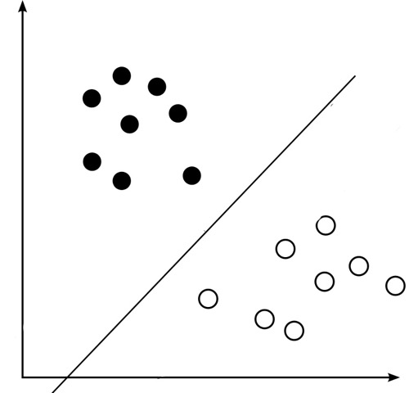
Model Building Methodology
Notes:
- with this new, labeled data, we trained a supervised model, specifically one that produced probability estimates with its predictions.

Slide 10
Model Building Methodology
Notes:
once we had our model, we ran the trips from the original target driver through our model to obtain predictions and their probabilities of indeed belonging to that driver.
- repeated this for every driver. - although there is label noise in the folder of our target driver, the hope is that our supervised model would be able to look past the noise and pick up some main distinguishing features about the target driver. then, by running our original target driver’s trips through this model, we would see which trips do not conform to this original driver fingerprint.

Slide 11
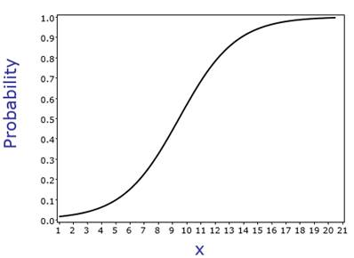
Final Model
Combined probabilities from a Random Forest and Bagged Logistic Regression
Notes:
- in the end, we built both a bagged logistic regression model and a random forest. we then combined the results from these ensembles - Since we were never given the true labels for each trip, it was impossible to perform cross-validation or testing of our results, other than a quick visual inspection. Instead, to determine our model’s performance, we submitted to the Kaggle page, where we were scored based on area under the ROC curve for our predictions.

Slide 12
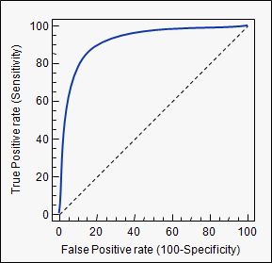
Results
85% area under the ROC Curve
Currently top 25% on the leaderboard
Notes:
Results - Our current model yields an AUC of 85%, which puts us in the top 25% of the Kaggle leaderboard.

Slide 13
Contact Us
github.com/mshadish/kaggle_drivers
eabrydon@usfca.edu
mmeyer6@usfca.edu
mwshadish@usfca.edu
http://www.usfca.edu/artsci/msan/students
Notes:
Contact - If you’re curious to know more about our methods, please come talk to us after the presentations.

