Slide 1
Early Media

Slide 2
What is Early Media?
Early Media is defined when media begins to flow before the call is officially connected. Media channels are set up prior to the call connection. These channels are used to provide the ring tone that the caller hears and are not generated by the caller’s endpoint or other queuing services.

Slide 3
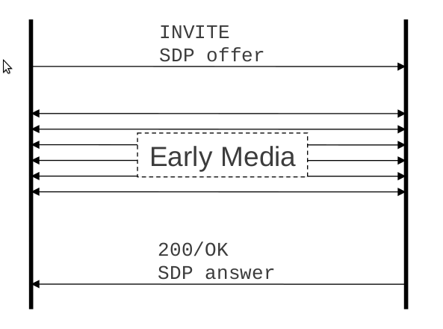
What is Early Media?
Media that flows before the 200/OK response in an INVITE transaction. It can be unidirectional or bidirectional.
Generated by
  Caller
  Callee
  Or both

Slide 4
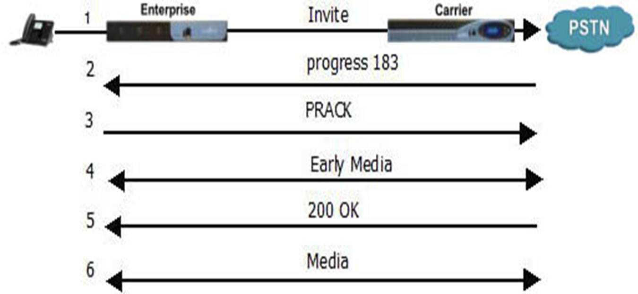

Slide 5
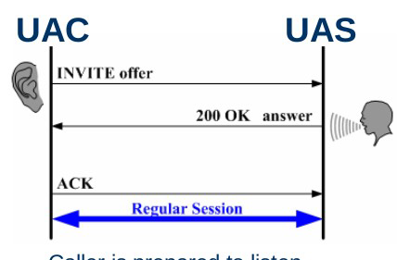
Session Establishment model in SIP
Offer/ Answer model
  SDP messages.
  Offer in INVITE, answer in 200 OK.
  Offer in 200 OK, answer in ACK.
  In PRACK, UPDATE and etc.

Slide 6
Relevance of Early media
Media clipping occurs when the user believes that the media session is already established, but the establishment process has not finished yet, the first few syllables or even the first few words are lost.
Early media help in avoiding Media clipping occurrence.

Slide 7
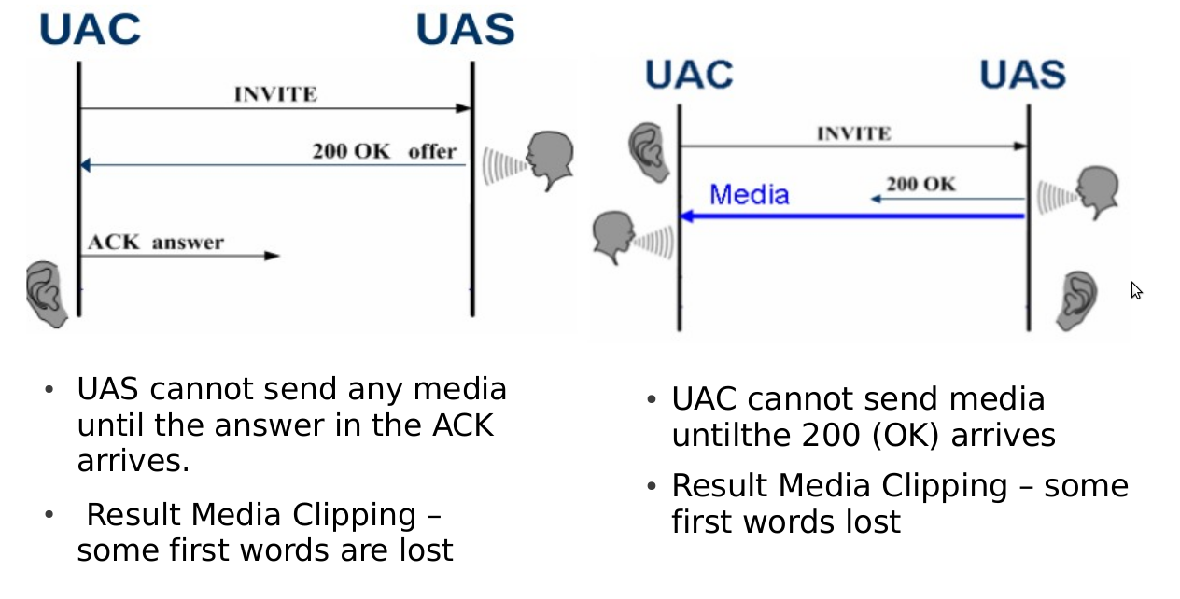
Media Clipping Scenario

Slide 8
Early media model
Gateway model
Application sever model

Slide 9
The Gateway Model
The gateway model consists of managing early media sessions using offer/answer exchanges in reliable provisional responses, PRACKs, and UPDATEs.
If INVITE forks, media clipping may occur.(SIP forking refers to the process of “forking” a single SIP call to multiple SIP endpoints. This is a very powerful feature of SIP. A single call can ring many endpoints at the same time.)

Slide 10
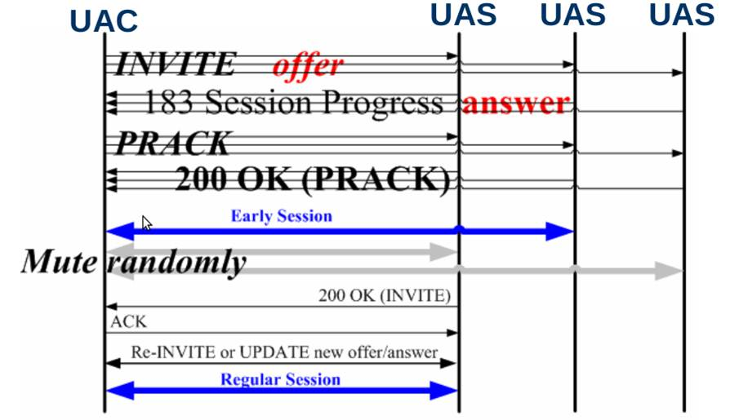
Forking

Slide 11
The Application Server Model
Having the UAS behave as an applicationserver to establish early media sessions with the UAC.
UAC indicates support for early-session option tag
Differentiate offer/answer exchange of early media to regular media.

Slide 12
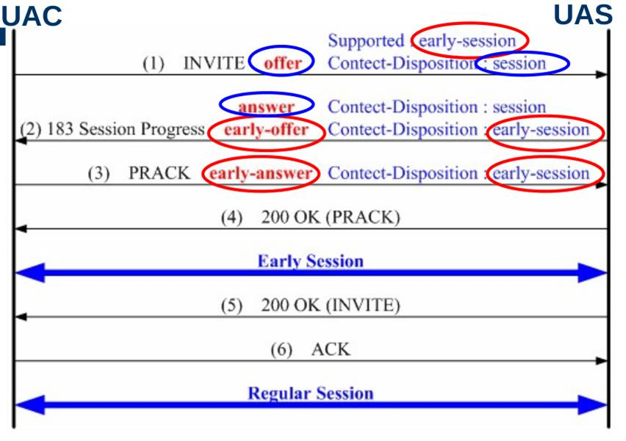
The Application Server Model

Slide 13
Possible Early media
Ringing
Busy
Invalid phone number
Call is being forwarded
Queued
Temporarily unavailable
Request pending
Busy everywhere(When Multiple lines are there)
Does not exist anywhere

Slide 14
Ringing Tone Generation
SIP UAs have different capabilities, different user interfaces.
UAC is supposed to generate ringing tones locally as long as no early media is received from the UAS.
If the UAS generates early media, UAC is supposed to play it instead.
Not easy to decide

Slide 15
Local policy Ringing Tone
Generation
No local ringing without 180 response received.
If 180 (Ringing) received but no incoming media packets, generate local ringing.
If 180 (Ringing) received and incoming mediapackets, play them and do not generate local ringing.
i.e. play incoming media packets and stop local ringing to avoid media clipping, even if the 200(OK) response has not arrived.

Slide 16
Security Considerations
Session description contains the IP address and port number where to receive media.
  Attackers may intrude it.
UAs should encrypt their session descriptions using media-level authentication mechanisms.

Slide 17
Conclusion
The gateway model is acceptable in situations where the UA cannot distinguish between early media and regular media.
The application server model resolves the issues present in the gateway model.

