Slide 1
Advanced LabViEW
http://workshop.frclabviewtutorials.com

Slide 2
Customizing the Dashboard

Slide 3
Customizing the Dashboard
Open Project
Notes:
demo

Slide 4
Customizing the Dashboard
Open Project
Sending data from robot

Slide 5
Customizing the Dashboard
Open Project
Sending data from robot
Smart Dashboard VI’s
Named (case sensitive) values

Slide 6
Sensors

Slide 7
Sensors - Encoder

Slide 8
Sensors - Encoder
Places to use encoders:
When trying to measure rotational speed
Trying to measure rotational distances possibly greater than 8 rotations.
Don’t care about starting position

Slide 9
Sensors - Encoder
Places to use encoders:
When trying to measure rotation speed
Trying to measure rotational distances possibly greater than 8 rotations.
Don’t care about starting position
Examples:
Drive train
Fly Wheel/wheeled shooter
Notes:
Drive-train
likely to travel more than 10 rotations in a given match
Don’t care where the wheels are when starting, and even better – the robots starting position is 0 (good)
Fly Wheel
Don’t care what position it starts in
Likely to rotate more than 10 rotations in a match
Care is primarily about speed

Slide 10
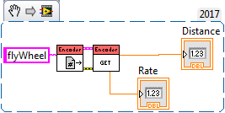
Sensors - Encoder
Reading

Slide 11
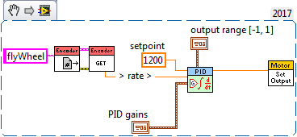
Sensors - Encoder
Control

Slide 12
Sensors - Potentiometer
Notes:
TODO: Code

Slide 13
Sensors - Potentiometer
Places to use potentiometers:
Trying to measure rotational distances less than 8 rotations.
Care about starting position – or absolute positions
Examples:
Arm angles
Elevator positions
Notes:
Arm angles:
Care about absolute position (0 should always mean on the ground regardless of where the arm was when we turn it on).
Same for elevators and similar manipulators

Slide 14
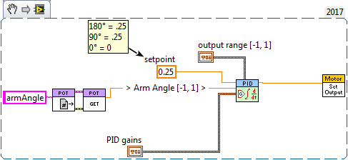
Sensors - Potentiometer
Control

Slide 15
Sensors - Potentiometer
Note:
Easy way to make potentiometer relative to a known point:
https://www.frclabviewtutorials.com/tutorials/sensors/roborio/potentiometer/
Notes:
One disadvantage that potentiometers have when compared to encoders is now you care very much about the position of the potentiometer when mounting/unmounting it.
I’m not going to go into this today, but there is a documented, simple way to apply a known offset when reading potentiometers – you would then update this offset after doing modifications.

Slide 16
Sensors - Gyro

Slide 17
Sensors - Gyro
Places to use a Gyro:
When trying to drive perfectly straight
When trying to turn to specific angles (especially in auto)

Slide 18
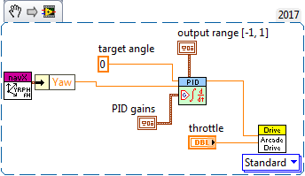
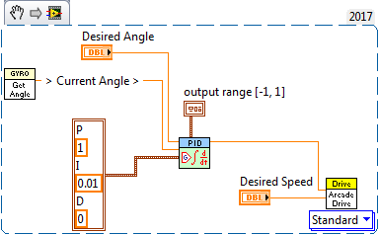
Sensors - Gyro
Control

Slide 19
PID
Proportional
Notes:
https://docs.google.com/viewer?a=v&pid=sites&srcid=aGFyZGluZy5lZHV8dGVhbS0zOTM3fGd4OjUyNzdiNzRkNjkxNjA3MGM
https://www.youtube.com/watch?v=JEpWlTl95Tw
https://www.youtube.com/watch?v=UR0hOmjaHp0
http://robotics.stackexchange.com/questions/167/what-are-good-strategies-for-tuning-pid-loops

Slide 20
PID
Proportional
Constant multiplied by error (offset)
The larger this is, the faster the robot approaches the setpoint (smaller rise time)

Slide 21
PID
Proportional
Constant multiplied by error (offset)
The larger this is, the faster the robot approaches the setpoint (smaller rise time)
Integral
Constant multiplied by integral of all previous error values
The larger this is, the less overshoot and settling time (less bounce)

Slide 22
PID
Proportional
Constant multiplied by error (offset)
The larger this is, the faster the robot approaches the setpoint (smaller rise time)
Integral
Constant multiplied by integral of all previous error values
The larger this is, the less overshoot and settling time (less bounce)
Differential
Used to eliminate steady state error (reducing offset after movement)

Slide 23
PID
Proportional
Constant multiplied by error (offset)
The larger this is, the faster the robot approaches the setpoint (smaller rise time)
Integral
Constant multiplied by integral of all previous error values
The larger this is, the less overshoot and settling time (less bounce)
Differential
Used to eliminate steady state error (reducing offset after movement)

Slide 24
PID
Tuning

Slide 25
PID
Tuning
Several methods available
Ziegler–Nichols*
Tyreus Luyben
Cohen–Coon
Åström-Hägglund
Manual Tuning*
Notes:
http://faculty.mercer.edu/jenkins_he/documents/TuningforPIDControllers.pdf#page=6
https://www.youtube.com/watch?v=JEpWlTl95Tw
https://www.youtube.com/watch?v=UR0hOmjaHp0
http://robotics.stackexchange.com/questions/167/what-are-good-strategies-for-tuning-pid-loops
Ziegler-Nichols: http://robotsforroboticists.com/pid-control/
Manual (page 16): https://docs.google.com/viewer?a=v&pid=sites&srcid=aGFyZGluZy5lZHV8dGVhbS0zOTM3fGd4OjUyNzdiNzRkNjkxNjA3MGM
http://www.ni.com/white-paper/3782/en/

Slide 26
PID
Tuning
Manuel
Raise C_{P} Until robot oscillates about setpoint
Raise C_{D} Until Robot stops bouncing
Raise C_{I} (and change the setpoint) until robot turns and hits the target point
Ziegler-Nichols
Raise C_{P} Until robot oscillates (Value of C_{P} becomes K_{u})
Measure the period of this oscillation (Time to complete 1 cycle becomes T_{U})

Slide 27
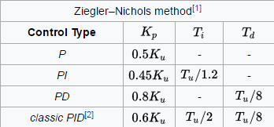
PID
Tuning
Manuel
Raise C_{P} Until robot oscillates about setpoint
Raise C_{D} Until Robot stops bouncing
Raise C_{I} (and change the setpoint) until robot turns and hits the target point
Ziegler-Nichols
Raise C_{P} Until robot oscillates (Value of C_{P} becomes K_{u})
Measure the period of this oscillation (Time to complete 1 cycle becomes T_{U})

Slide 28
PID
Tuning
Manuel
Raise C_{P} Until robot oscillates about setpoint
Raise C_{D} Until Robot stops bouncing
Raise C_{I} (and change the setpoint) until robot turns and hits the target point
Ziegler-Nichols
Raise C_{P} Until robot oscillates (Value of C_{P} becomes K_{u})
Measure the period of this oscillation (Time to complete 1 cycle becomes T_{U})

Slide 29
PID
Demo

Slide 30
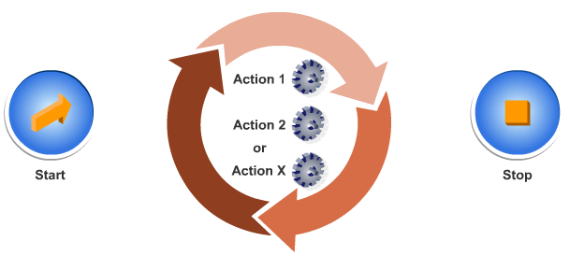
Architectures
State Machine

Slide 31
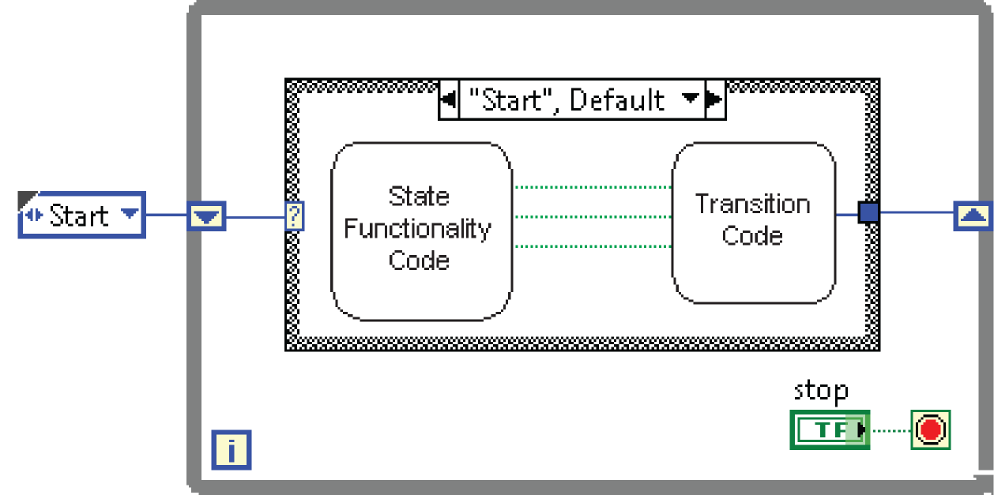
Architectures
State Machine

Slide 32
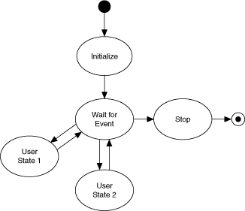
Architectures
State Machine

Slide 33
Architectures
State Machine
Producer-Consumer
Parallel loops
First creating data or instructions
Other handling

Slide 34
Architectures
State Machine
Producer-Consumer
Parallel loops
Use either queue or fgv

Slide 35
Producer Consumer Demo
Notes:
Queue and FGV

Slide 36
Type Def.
Useful for passing data – both controls and indicators
Demo

Slide 37
Type Def.
Useful for passing data – both controls and indicators
Demo
Notes:
typedefs

Slide 38
Questions

