Slide 1
Intro to LabVIEW
http://workshop.frclabviewtutorials.com

Slide 2
Installation
Completely different this year!
(using the new NI Package Manager)
https://docs.wpilib.org/en/latest/docs/getting-started/getting-started-frc-control-system/labview-setup.html

Slide 3
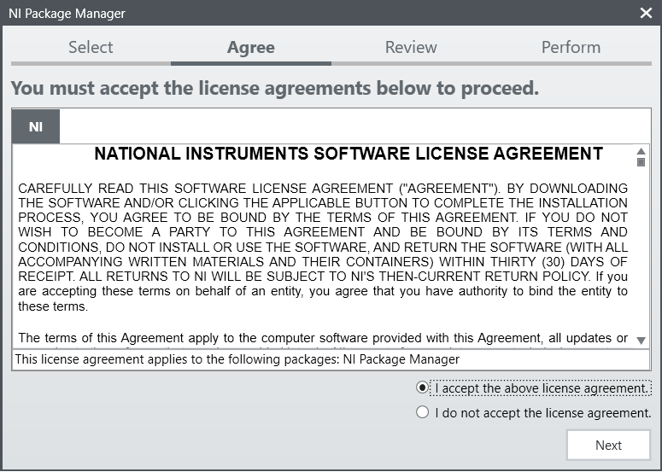

Slide 4
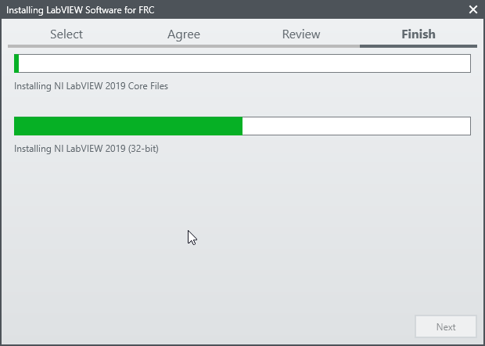

Slide 5
Coding in LabVIEW

Slide 6
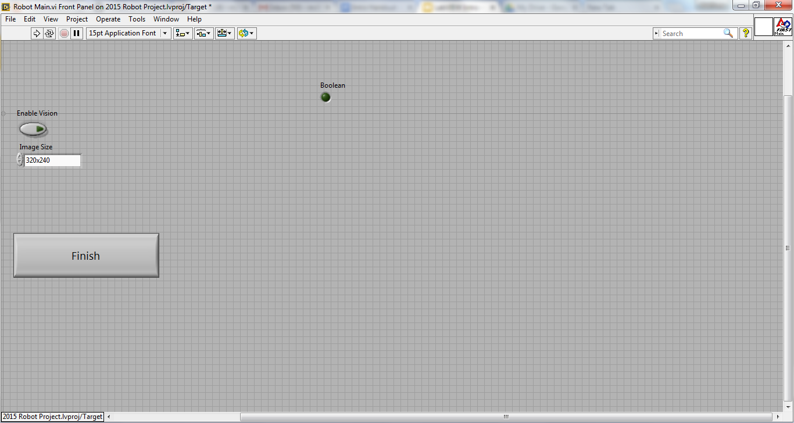
Front Panel
Controls
Indicators

Slide 7
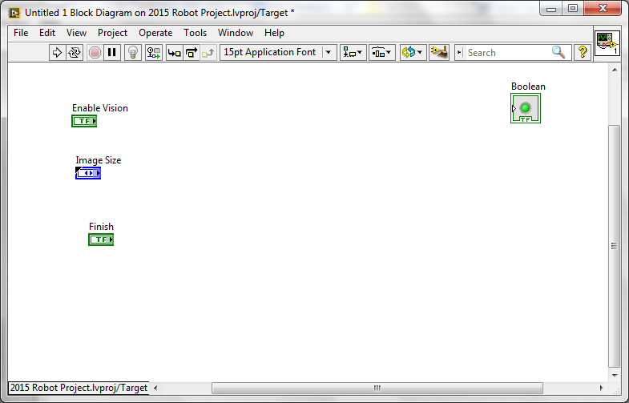
Block Diagram
Terminals
Controls
Indicators

Slide 8
Demo
Adding controls and indicators

Slide 9
Demo
Adding controls and indicators

Slide 10

Data Flow
LabVIEW follows a dataflow model for running Vis
A node executes only when data is available at all of its required input terminals.
A node supplies data to the output terminals only when the node finishes execution.
Notes:
When a node executes, it produces output data and passes the data to the next node in the dataflow path.
The movement of data through the nodes determines the execution order of the VIs and functions on the block diagram.
LabVIEW does NOT use a control flow program execution model like Visual Basic, C++, JAVA, and most other text-based programming languages. In a control flow model, the sequential order of program elements determines the execution order of a program.

Slide 11
Demo - Setting a motor
Read Joystick
Set Drive motors

Slide 12
Demo - Setting a motor
Read Joystick
Set Drive motors

Slide 13
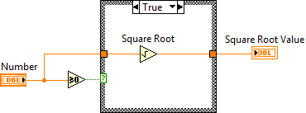
Case Structures
Have two or more sub diagrams or cases.
Use an input value to determine which case to execute.
Execute and display only one case at a time.
Are similar to case statements or if...then...else statements in text-based programming languages.
Notes:
Casestructure.vi and select.vi

Slide 14
Case Structures
Input and Output Tunnels
You can create multiple input and output tunnels.
Input tunnels are available to all cases if needed.
You must define each output tunnel for each case.*

Slide 15
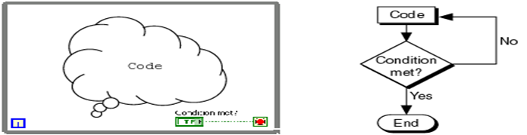
Repetition
While Loop

Slide 16
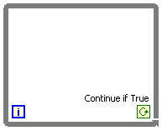
Repetition
While Loop
Iteration terminal
Returns number of times loop has executed.
Is zero-indexed.
Iteration Terminal

Slide 17
Repetition
While Loop
Conditional terminal
Defines when the loop stops.
Has two options.
Stop if True
Continue if True
Iteration Terminal
Conditional Terminal

Slide 18
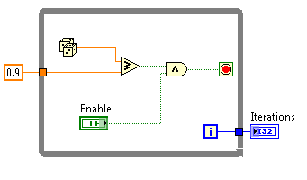
Repetition
While Loop
Tunnels transfer data into and out of structures.

Slide 19
Repetition
While Loop
Tunnels transfer data into and out of structures.
Data pass out of a loop after the loop terminates.

Slide 20
Repetition
While Loop
Tunnels transfer data into and out of structures.
Data pass out of a loop after the loop terminates.
When a tunnel passes data into a loop, the loop executes only after data arrives at the tunnel.

Slide 21
Repetition
While Loop - Demo

Slide 22
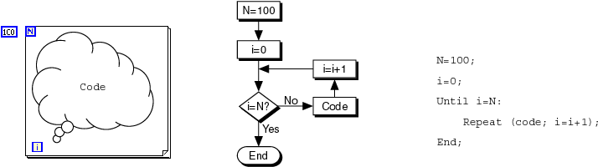
Repetition
While Loop
For Loop

Slide 23
Repetition
While Loop
For Loop
Count Terminal

Slide 24
FRC Arhitecture
Begin

Slide 25
FRC Arhitecture
Begin
Notes:
Show it

Slide 26
FRC Arhitecture
Begin
Create references for all joysticks, motors, and sensors
Runs at power up

Slide 27
FRC Arhitecture
Begin
Teleop

Slide 28
FRC Arhitecture
Begin
Teleop

Slide 29
FRC Arhitecture
Begin
Teleop
Primarily used to read joysticks and set drive motors and actuators
Only runs while Teleop enabled

Slide 30
FRC Arhitecture
Begin
Teleop
Autonomous

Slide 31
FRC Arhitecture
Begin
Teleop
Autonomous

Slide 32
FRC Arhitecture
Begin
Teleop
Autonomous
Runs when Autonomous is enabled

Slide 33
FRC Arhitecture
Begin
Teleop
Autonomous
Timed Tasks

Slide 34
FRC Arhitecture
Begin
Teleop
Autonomous
Timed Tasks

Slide 35
FRC Arhitecture
Begin
Teleop
Autonomous
Timed Tasks
Runs once enabled (during both auto and teleop)

Slide 36
FRC Deploying Code
Run From Main
Notes:
Open Main.vi (from project) – click the run buton

Slide 37
FRC Deploying Code
Run From Main
Deploy
Notes:
Deploying the robot code puts it on the robot – causing it to take effect on next reboot (or after Run as startup)

Slide 38
FRC Deploying Code
Run From Main
Deploy
Run as Startup
Notes:
Run as startup puts the code on the roborio in a temporary location and starts it running (does not persist across reboots).

Slide 39
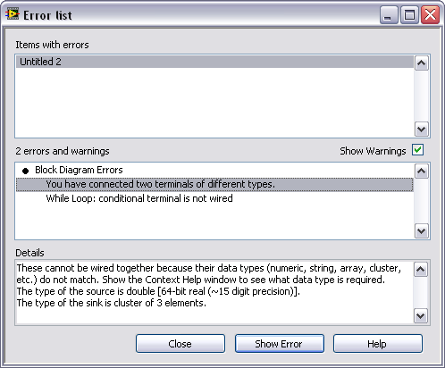
Debugging Techniques
Correcting Broken VI’s

Slide 40
Debugging Techniques
Correcting Broken VI’s
Broken Wires Exist (e.g.)
You wired a Boolean control to a String indicator.
You wired a numeric control to a numeric control.
Notes:
Untitled1.vi

Slide 41
Debugging Techniques
Correcting Broken VI’s
Broken Wires Exist (e.g.)
You wired a Boolean control to a String indicator.
You wired a numeric control to a numeric control.
A required block diagram terminal is unwired.
Notes:
Untitled1.vi

Slide 42
Debugging Techniques
Correcting Broken VI’s
Broken Wires Exist (e.g.)
You wired a Boolean control to a String indicator.
You wired a numeric control to a numeric control.
A required block diagram terminal is unwired.
A subVI is broken
Notes:
Untitled1.vi

Slide 43
Debugging Techniques
Correcting Broken VI’s
Correcting Dataflow
Execution Highlighting
Single-Stepping & Breakpoints
Probes
Notes:
untitled1

Slide 44
Debugging Techniques
Correcting Broken VI’s
Correcting Dataflow
Are there any unwired or hidden subVIs?
Is the default data correct?
Does the VI pass undefined data?
Are numeric representations correct?
Are nodes executed in the correct order?

Slide 45
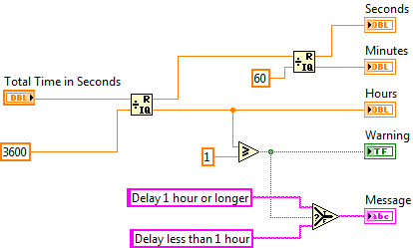
Terminals and LabVIEW datatypes
Notes:
Terminal colors, text, arrow direction, and border thickness all provide visual information about the terminal.
For example, Orange represents floating point numbers. DBL indicates a double-precision floating point number.
Terminals with thick borders with arrows on the right are control terminals. Terminals with thin borders with arrows on the left are indicator terminals.

Slide 46
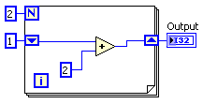
Data Feedback in Loops
Shift Registers
When programming with loops, you often need to know the values of data from previous iterations of the loop.
Shift registers transfer values from one loop iteration to the next.

Slide 47
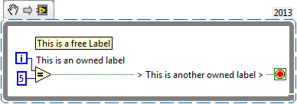
Documentation
Free Labels

Slide 48
Documentation
Free Labels
Describe algorithms.
Have pale yellow backgrounds.
Double-click in any open space to create.

Slide 49
Documentation
Free Labels
Describe algorithms.
Have pale yellow backgrounds.
Double-click in any open space to create.

Slide 50
Documentation
Free Labels
Owned Labels
Explain data contents of wires and objects.
Move with object.
Have transparent backgrounds.
Select Visible Items»Label from the shortcut menu to create.

Slide 51
Documentation
Free Labels
Owned Labels
Explain data contents of wires and objects.
Move with object.
Have transparent backgrounds.
Select Visible Items»Label from the shortcut menu to create.

Slide 52
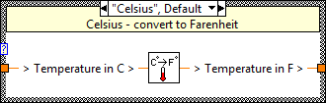
Documentation
Free Labels
Owned Labels
Sub diagram Labels
Case Structures

Slide 53
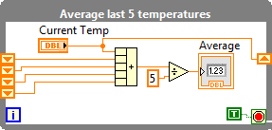
Documentation
Free Labels
Owned Labels
Sub diagram Labels
Case Structures
Loops

Slide 54
Documentation
Free Labels
Owned Labels
Sub diagram Labels
White Papers

Slide 55
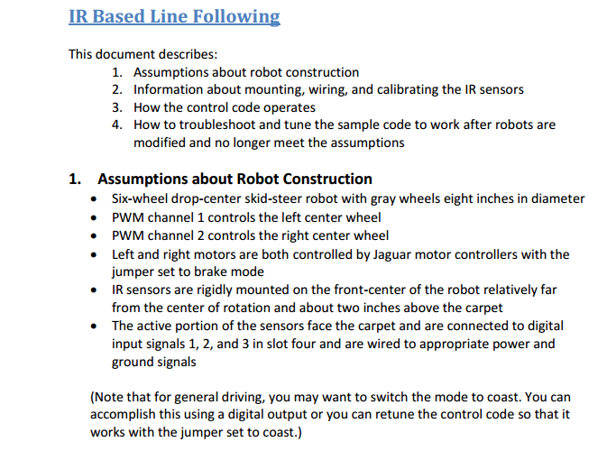
Documentation
Free Labels
Owned Labels
Sub diagram Labels
White Papers

Slide 56
Keyboard Shortcuts
CTRL + u = diagram cleanup
Right Click = palette
CTRL + Space = quick drop
CTRL + e = switch window
CTRL + Shift + e = activate project window
CTRL + r = Run
CTRL + t = split window

