Slide 1
Advanced LabVIEW
frclabviewtutorials.com/workshop

Slide 2
Using an Arduino for sensor input
On the robo-RIO

Slide 3
Using an Arduino for sensor input
Use Arduino to read sensors and stream data over connection to robo-RIO
DIO/AIO
Using Serial bus
Notes:
Connecting DIO or AIO lines to and from an Arduino and the RoboRIO can provide a simple interface – useful for a small finite set of states to communicate (i.e., Breakaway LED status in Recycle Rush – 2 DO for type and 1 AO for height).
Serial bus is a tad harder to code, but allows for infinite states to be communicated (while only consuming one of the serial ports on the RIO).

Slide 4
Using an Arduino for sensor input
DIO/AIO
Code on Arduino to read/write pins
Code on RoboRIO to read/write pins
Code on destination to interpret result

Slide 5
Using an Arduino for sensor input
Using Serial Bus
Code on Arduino to open and transmit to port
Code on RoboRIO to receive from port and interpret
Code on RoboRIO to handle a loss of connection

Slide 6
Using an Arduino for sensor input
Using Serial Bus
Code on Arduino to open and transmit to port - setup
#include <math.h>
// largely from https://www.instructables.com/id/Simple-Arduino-and-HC-SR04-Example/
#define trigPin 13
#define echoPin 12
int order_of_mag;
long duration;
float distance;
String message = "";

Slide 7
Using an Arduino for sensor input
Using Serial Bus
Code on Arduino to open and transmit to port - init
void setup()
{
Serial.begin(9600); // must match baud rate on roboRIO open too.
pinMode(trigPin, OUTPUT);
pinMode(echoPin, INPUT);
order_of_mag = 0;
while(!Serial); // wait for it to be connected
}

Slide 8
Using an Arduino for sensor input
Using Serial Bus
Code on Arduino to open and transmit to port – read sensor
void loop() {
// write a 10 microsecond high pulse to the trigger - make sure it was low for at least 2 before
digitalWrite(trigPin, LOW);
delayMicroseconds(2);
digitalWrite(trigPin, HIGH);
delayMicroseconds(10);
digitalWrite(trigPin, LOW);
// measure time echoPin is HIGH in microS
duration = pulseIn(echoPin, HIGH);

Slide 9
Using an Arduino for sensor input
Using Serial Bus
Code on Arduino to open and transmit to port – scale to cm
// average time to send and receive
distance = (duration/2);
// convert time to cm
// s * ( 343 m/s) = s * 343 m
// distance / 1000 * 353 = d m
// distance * .0353 = d cm
distance = distance * .0353;

Slide 10
Using an Arduino for sensor input
Using Serial Bus
Code on Arduino to open and transmit to port – send
// begin transmission
Serial.print('^’);
// transmit distance
Serial.print(distance);
// end transmission
Serial.println('$’);
// hold up 10 mS - don't need to overflow the buffer.
delay(250);

Slide 11
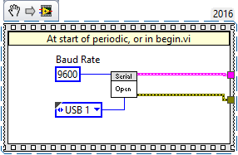
Using an Arduino for sensor input
Using Serial Bus
Code on roboRIO to open port
Notes:
Make sure baud rate matches – select port

Slide 12
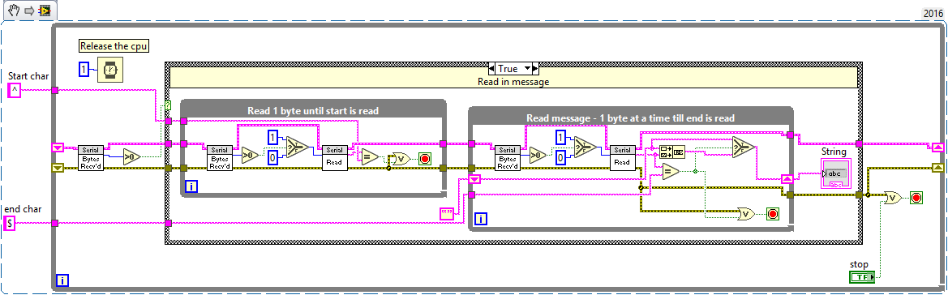
Using an Arduino for sensor input
Using Serial Bus
Code on roboRIO to receive when available
Notes:
Make sure baud rate matches – select port

Slide 13
Using an Arduino for sensor input
Using Serial Bus
Code on roboRIO to receive when available
Notes:
Make sure baud rate matches – select port

Slide 14
Using an Arduino for sensor input
Using Serial Bus
Code on roboRIO to receive when available
Notes:
Make sure baud rate matches – select port

Slide 15
Using an Arduino for sensor input
Using Serial Bus
Code on roboRIO to receive when available
Notes:
Make sure baud rate matches – select port

Slide 16
Using an Arduino for sensor input
Using Serial Bus
Code on roboRIO to receive when available
Notes:
Make sure baud rate matches – select port

Slide 17
Using an Arduino for sensor input
Using Serial Bus
Code on roboRIO to receive when available
Notes:
Make sure baud rate matches – select port

Slide 18
Using an Arduino for sensor input
Using Serial Bus
Code on roboRIO to receive when available
Notes:
Make sure baud rate matches – select port

Slide 19
Using an Arduino for sensor input
Using Serial Bus
Code on roboRIO to receive when available
Notes:
Make sure baud rate matches – select port

Slide 20
Using an Arduino for sensor input
Using Serial Bus
Code on roboRIO to receive when available
Notes:
Make sure baud rate matches – select port

Slide 21

Using an Arduino for sensor input
Using Serial Bus
Code on roboRIO to handle loss of connection
Notes:
Make sure baud rate matches – select port

Slide 22
Using an Arduino for sensor input
Demo

Slide 23
Using an Arduino for sensor input
On the robo-RIO
On the Dashboard

Slide 24
Using and Arduino with the Dashboard
Driver station i/o
Potentiometer for extra input (autonomous selection, shooter speed, etc.)
Buttons/switches for additional control
LEDs for indication
Etc.

Slide 25
Using and Arduino with the Dashboard
Customize the dashboard to read/write to Arduino
Implement own serial interface (like with previous example on RoboRIO) or
Use LINX library (https://www.labviewmakerhub.com/doku.php?id=libraries:linx:start)

Slide 26
Using and Arduino with the Dashboard
Use LINX library
Open connection
Read/write to I/O
Close connection

Slide 27
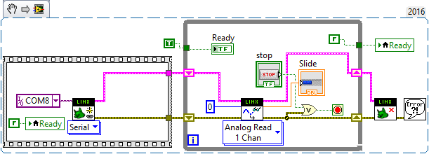
Using and Arduino with the Dashboard
Use LINX library
Open connection
Read/write to I/O
Close connection
Notes:
Works in built exe with/without pressing stop. Need to press stop in dev (will leave the port reserved).

Slide 28
Using and Arduino with the Dashboard
Demo

Slide 29
PID
Proportional
Notes:
https://docs.google.com/viewer?a=v&pid=sites&srcid=aGFyZGluZy5lZHV8dGVhbS0zOTM3fGd4OjUyNzdiNzRkNjkxNjA3MGM
https://www.youtube.com/watch?v=JEpWlTl95Tw
https://www.youtube.com/watch?v=UR0hOmjaHp0
http://robotics.stackexchange.com/questions/167/what-are-good-strategies-for-tuning-pid-loops

Slide 30
PID
Proportional
Constant multiplied by error (offset)
The larger this is, the faster the robot approaches the setpoint (smaller rise time)

Slide 31
PID
Proportional
Constant multiplied by error (offset)
The larger this is, the faster the robot approaches the setpoint (smaller rise time)
Integral
Constant multiplied by integral of all previous error values
The larger this is, the less overshoot and settling time (less bounce)

Slide 32
PID
Proportional
Constant multiplied by error (offset)
The larger this is, the faster the robot approaches the setpoint (smaller rise time)
Integral
Constant multiplied by integral of all previous error values
The larger this is, the less overshoot and settling time (less bounce)
Differential
Used to eliminate steady state error (reducing offset after movement)

Slide 33
PID
Proportional
Constant multiplied by error (offset)
The larger this is, the faster the robot approaches the setpoint (smaller rise time)
Integral
Constant multiplied by integral of all previous error values
The larger this is, the less overshoot and settling time (less bounce)
Differential
Used to eliminate steady state error (reducing offset after movement)

Slide 34
PID
Tuning

Slide 35
PID
Tuning
Several methods available
Ziegler–Nichols*
Tyreus Luyben
Cohen–Coon
Åström-Hägglund
Manual Tuning*
Notes:
http://faculty.mercer.edu/jenkins_he/documents/TuningforPIDControllers.pdf#page=6
https://www.youtube.com/watch?v=JEpWlTl95Tw
https://www.youtube.com/watch?v=UR0hOmjaHp0
http://robotics.stackexchange.com/questions/167/what-are-good-strategies-for-tuning-pid-loops
Ziegler-Nichols: http://robotsforroboticists.com/pid-control/
Manual (page 16): https://docs.google.com/viewer?a=v&pid=sites&srcid=aGFyZGluZy5lZHV8dGVhbS0zOTM3fGd4OjUyNzdiNzRkNjkxNjA3MGM
http://www.ni.com/white-paper/3782/en/

Slide 36
PID
Tuning
Manuel
Raise C_{P} Until robot oscillates about setpoint
Raise C_{D} Until Robot stops bouncing
Raise C_{I} (and change the setpoint) until robot turns and hits the target point
Ziegler-Nichols
Raise C_{P} Until robot oscillates (Value of C_{P} becomes K_{u})
Measure the period of this oscillation (Time to complete 1 cycle becomes T_{U})

Slide 37
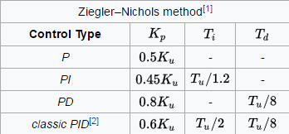
PID
Tuning
Manuel
Raise C_{P} Until robot oscillates about setpoint
Raise C_{D} Until Robot stops bouncing
Raise C_{I} (and change the setpoint) until robot turns and hits the target point
Ziegler-Nichols
Raise C_{P} Until robot oscillates (Value of C_{P} becomes K_{u})
Measure the period of this oscillation (Time to complete 1 cycle becomes T_{U})

Slide 38
PID
Tuning
Manuel
Raise C_{P} Until robot oscillates about setpoint
Raise C_{D} Until Robot stops bouncing
Raise C_{I} (and change the setpoint) until robot turns and hits the target point
Ziegler-Nichols
Raise C_{P} Until robot oscillates (Value of C_{P} becomes K_{u})
Measure the period of this oscillation (Time to complete 1 cycle becomes T_{U})

Slide 39
PID
Demo

Slide 40
Functional Global Variable

Slide 41
Functional Global Variable
Quick Intro
https://frclabviewtutorials.com/fgv/
Notes:
demo

Slide 42
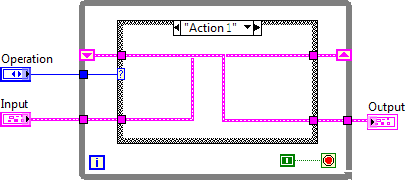
FGV
Functional Global Variable Code

Slide 43
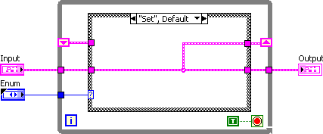
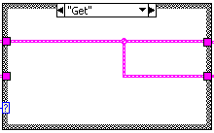
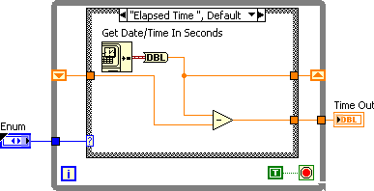
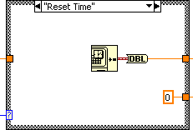
Implementing An FGV

Slide 44
VI Properties
Quick Intro
https://frclabviewtutorials.com/fgv/
SR Flip Flop Demo
Notes:
Demo SR

Slide 45
VI Properties
Quick Intro
https://frclabviewtutorials.com/fgv/
SR Flip Flop Demo
Edge Detector
https://frclabviewtutorials.com/memory-library/
Notes:
Demo edge detetector

Slide 46
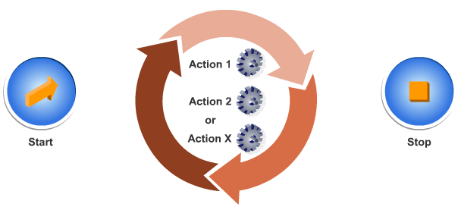
Architectures
State Machine

Slide 47
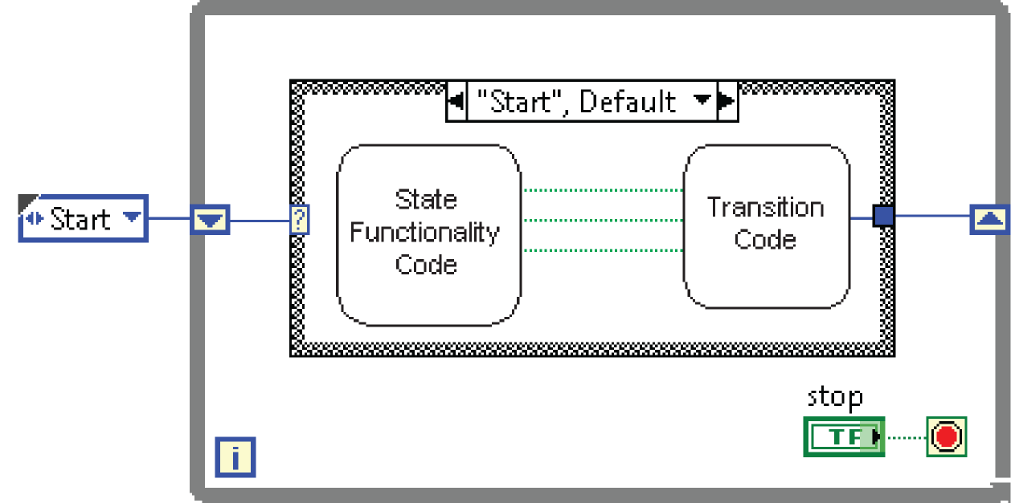
Architectures
State Machine

Slide 48
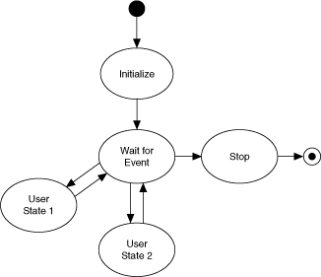
Architectures
State Machine

Slide 49
Architectures
State Machine
Producer-Consumer
Parallel loops
First creating data or instructions
Other handling

Slide 50
Architectures
State Machine
Producer-Consumer
Parallel loops
Use either queue or fgv

Slide 51
Producer Consumer Demo
Notes:
Queue and FGV

Slide 52
Encoders
Wiring (see notes for links)
Rotational Encoders
Fly wheel speed
Drive distance
Linear Encoders
Linear actuator feedback
Etc.
Notes:
https://www.chiefdelphi.com/forums/showthread.php?t=133263
https://www.andymark.com/encoder-p/am-3314.htm
https://www.andymark.com/product-p/am-2992.htm

Slide 53
Encoders – Fly Wheel monitor demo

Slide 54
Type Def.
Useful for passing data – both controls and indicators
Demo

Slide 55
Type Def.
Useful for passing data – both controls and indicators
Demo
Notes:
typedefs

Slide 56
OOP and LVOOP
Object Oriented Programming
Used in C++, C#, Java, Python, etc.
A method of grouping where
An object represents the data
Has attributes and/or properties
Has methods that act on the object and its properties
LVOOP is OOP in LabVIEW

Slide 57
LVOOP
Demos – custom motor control

Slide 58
LVOOP
Demos – custom motor control
Create a class

Slide 59
LVOOP
Demos – custom motor control
Create a class
Create methods

Slide 60
LVOOP
Demos – custom motor control
Create a class
Create methods
Create an object

Slide 61
Questions

