Slide 1
Intro to LabVIEW
frclabviewtutorials.com/workshop

Slide 2
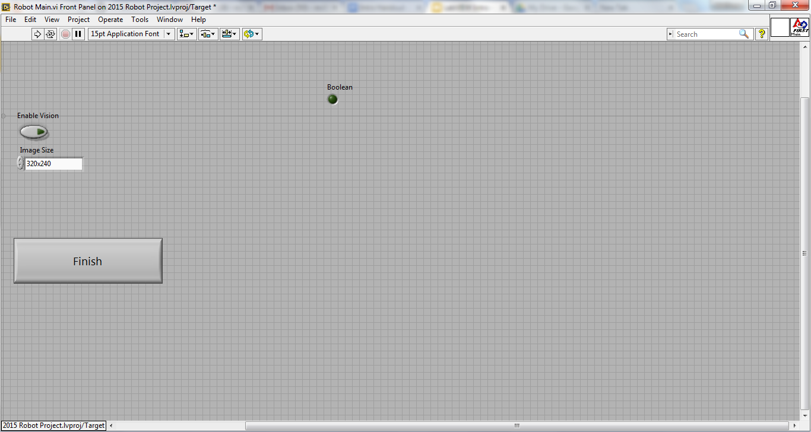
Front Panel
Controls
Indicators

Slide 3
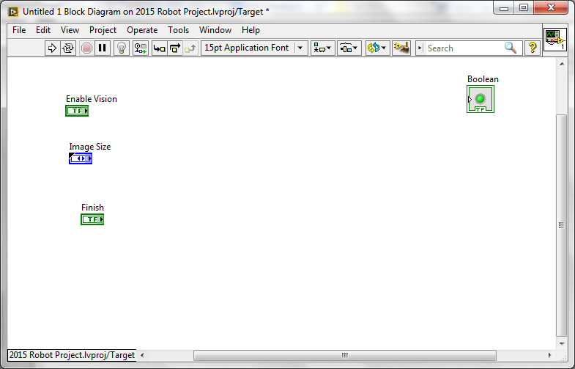
Block Diagram
Terminals
Controls
Indicators

Slide 4
Demo
Adding controls and indicators

Slide 5
Demo
Adding controls and indicators

Slide 6

Data Flow
LabVIEW follows a dataflow model for running Vis
A node executes only when data is available at all of its required input terminals.
A node supplies data to the output terminals only when the node finishes execution.
Notes:
When a node executes, it produces output data and passes the data to the next node in the dataflow path.
The movement of data through the nodes determines the execution order of the VIs and functions on the block diagram.
LabVIEW does NOT use a control flow program execution model like Visual Basic, C++, JAVA, and most other text-based programming languages. In a control flow model, the sequential order of program elements determines the execution order of a program.

Slide 7
Demo - Setting a motor
Read Joystick
Set Drive motors

Slide 8
Demo - Setting a motor
Read Joystick
Set Drive motors

Slide 9
Exercise
Drive a motor.pdf

Slide 10
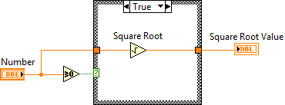
Case Structures
Have two or more sub diagrams or cases.
Use an input value to determine which case to execute.
Execute and display only one case at a time.
Are similar to case statements or if...then...else statements in text-based programming languages.
Notes:
Casestructure.vi and select.vi

Slide 11
Case Structures
Input and Output Tunnels
You can create multiple input and output tunnels.
Input tunnels are available to all cases if needed.
You must define each output tunnel for each case.*

Slide 12
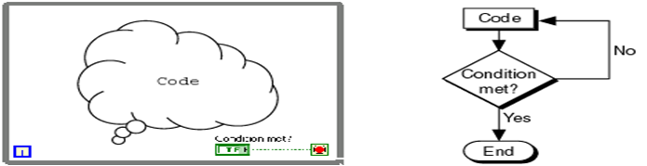
Repetition
While Loop

Slide 13
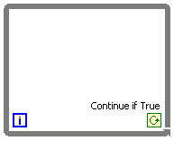
Repetition
While Loop
Iteration terminal
Returns number of times loop has executed.
Is zero-indexed.
Iteration Terminal

Slide 14
Repetition
While Loop
Conditional terminal
Defines when the loop stops.
Has two options.
Stop if True
Continue if True
Iteration Terminal
Conditional Terminal

Slide 15
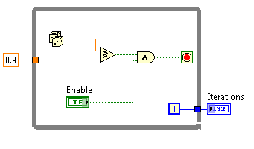
Repetition
While Loop
Tunnels transfer data into and out of structures.

Slide 16
Repetition
While Loop
Tunnels transfer data into and out of structures.
Data pass out of a loop after the loop terminates.

Slide 17
Repetition
While Loop
Tunnels transfer data into and out of structures.
Data pass out of a loop after the loop terminates.
When a tunnel passes data into a loop, the loop executes only after data arrives at the tunnel.

Slide 18
Repetition
While Loop - Demo

Slide 19
Exercise – While Loops
While Loops.pdf
Notes:
pp. 62-75
How many times is the Number of Indicator updated? Why?
Once, because the output tunnel on the While Loop will output only a single value once the While Loop has finished executing.

Slide 20
Exercise – While Loops
How many times is the Number of Iterations indicator updated? Why?
Notes:
pp. 62-75
How many times is the Number of Indicator updated? Why?
Once, because the output tunnel on the While Loop will output only a single value once the While Loop has finished executing.

Slide 21
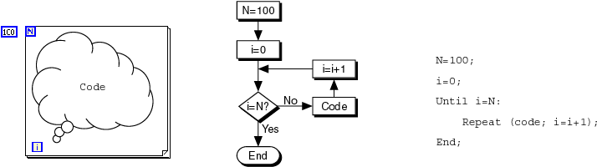
Repetition
While Loop
For Loop

Slide 22
Repetition
While Loop
For Loop
Count Terminal

Slide 23
Repetition
Comparison
Description
For the following scenarios, decide whether to use a While Loop or a For Loop.

Slide 24
Repetition
Comparison
Description
For the following scenarios, decide whether to use a While Loop or a For Loop.
Scenario 1
Acquire sensor data in a loop that runs once per second for 15s (autonomous).
1. If you use a While Loop, what is the condition that you need to stop the loop?
2. If you use a For Loop, how many iterations does the loop need to run?
3. Is it easier to implement a For Loop or a While Loop?

Slide 25
Repetition
Comparison
Description
For the following scenarios, decide whether to use a While Loop or a For Loop.
Scenario 1
Acquire sensor data in a loop that runs once per second for 15s (autonomous).
1. If you use a While Loop, what is the condition that you need to stop the loop?
2. If you use a For Loop, how many iterations does the loop need to run?
3. Is it easier to implement a For Loop or a While Loop?
Scenario 2
Acquire gyro until it reads less than 15°
1. If you use a While Loop, what is the condition that you need to stop the loop?
2. If you use a For Loop, how many iterations does the loop need to run?
3. Is it easier to implement a For Loop or a While Loop?

Slide 26
Repetition
Comparison
Scenario 3
Read both joysticks until they are both negative
1. If you use a While Loop, what is the condition that you need to stop the loop?
2. If you use a For Loop, how many iterations does the loop need to run?
3. Is it easier to implement a For Loop or a While Loop?

Slide 27
Repetition
Comparison
Scenario 3
Read both joysticks until they are both negative
1. If you use a While Loop, what is the condition that you need to stop the loop?
2. If you use a For Loop, how many iterations does the loop need to run?
3. Is it easier to implement a For Loop or a While Loop?
Scenario 4
Control a motor ramp starting at zero, increasing incrementally by 0.01 every second, until the output value reaches 1
1. If you use a While Loop, what is the condition that you need to stop the loop?
2. If you use a For Loop, how many iterations does the loop need to run?
3. Is it easier to implement a For Loop or a While Loop?

Slide 28
FRC Arhitecture
Begin

Slide 29
FRC Arhitecture
Begin
Notes:
Show it

Slide 30
FRC Arhitecture
Begin
Create references for all joysticks, motors, and sensors
Runs at power up

Slide 31
FRC Arhitecture
Begin
Teleop

Slide 32
FRC Arhitecture
Begin
Teleop

Slide 33
FRC Arhitecture
Begin
Teleop
Primarily used to read joysticks and set drive motors and actuators
Only runs while Teleop enabled

Slide 34
FRC Arhitecture
Begin
Teleop
Autonomous

Slide 35
FRC Arhitecture
Begin
Teleop
Autonomous

Slide 36
FRC Arhitecture
Begin
Teleop
Autonomous
Runs when Autonomous is enabled

Slide 37
FRC Arhitecture
Begin
Teleop
Autonomous
Timed Tasks

Slide 38
FRC Arhitecture
Begin
Teleop
Autonomous
Timed Tasks

Slide 39
FRC Arhitecture
Begin
Teleop
Autonomous
Timed Tasks
Runs once enabled (during both auto and teleop)

Slide 40
FRC Deploying Code
Run From Main
Notes:
Open Main.vi (from project) – click the run buton

Slide 41
FRC Deploying Code
Run From Main
Deploy
Notes:
Deploying the robot code puts it on the robot – causing it to take effect on next reboot (or after Run as startup)

Slide 42
FRC Deploying Code
Run From Main
Deploy
Run as Startup
Notes:
Run as startup puts the code on the roborio in a temporary location and starts it running (does not persist across reboots).

Slide 43
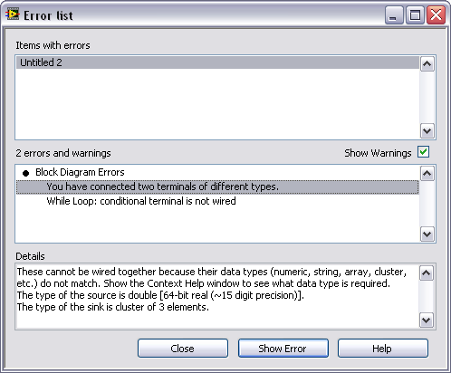
Debugging Techniques
Correcting Broken VI’s

Slide 44
Debugging Techniques
Correcting Broken VI’s
Broken Wires Exist (e.g.)
You wired a Boolean control to a String indicator.
You wired a numeric control to a numeric control.
Notes:
Untitled1.vi

Slide 45
Debugging Techniques
Correcting Broken VI’s
Broken Wires Exist (e.g.)
You wired a Boolean control to a String indicator.
You wired a numeric control to a numeric control.
A required block diagram terminal is unwired.
Notes:
Untitled1.vi

Slide 46
Debugging Techniques
Correcting Broken VI’s
Broken Wires Exist (e.g.)
You wired a Boolean control to a String indicator.
You wired a numeric control to a numeric control.
A required block diagram terminal is unwired.
A subVI is broken
Notes:
Untitled1.vi

Slide 47
Debugging Techniques
Correcting Broken VI’s
Correcting Dataflow
Execution Highlighting
Single-Stepping & Breakpoints
Probes
Notes:
untitled1

Slide 48
Debugging Techniques
Correcting Broken VI’s
Correcting Dataflow
Are there any unwired or hidden subVIs?
Is the default data correct?
Does the VI pass undefined data?
Are numeric representations correct?
Are nodes executed in the correct order?

Slide 49
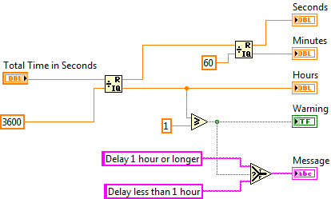
Terminals and LabVIEW datatypes
Notes:
Terminal colors, text, arrow direction, and border thickness all provide visual information about the terminal.
For example, Orange represents floating point numbers. DBL indicates a double-precision floating point number.
Terminals with thick borders with arrows on the right are control terminals. Terminals with thin borders with arrows on the left are indicator terminals.

Slide 50
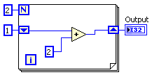
Data Feedback in Loops
Shift Registers
When programming with loops, you often need to know the values of data from previous iterations of the loop.
Shift registers transfer values from one loop iteration to the next.

Slide 51
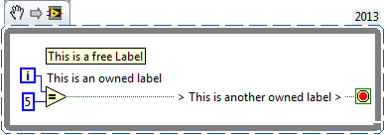
Documentation
Free Labels

Slide 52
Documentation
Free Labels
Describe algorithms.
Have pale yellow backgrounds.
Double-click in any open space to create.

Slide 53
Documentation
Free Labels
Describe algorithms.
Have pale yellow backgrounds.
Double-click in any open space to create.

Slide 54
Documentation
Free Labels
Owned Labels
Explain data contents of wires and objects.
Move with object.
Have transparent backgrounds.
Select Visible Items»Label from the shortcut menu to create.

Slide 55
Documentation
Free Labels
Owned Labels
Explain data contents of wires and objects.
Move with object.
Have transparent backgrounds.
Select Visible Items»Label from the shortcut menu to create.

Slide 56
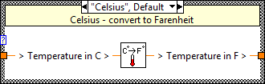
Documentation
Free Labels
Owned Labels
Sub diagram Labels
Case Structures

Slide 57
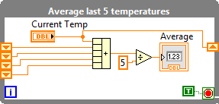
Documentation
Free Labels
Owned Labels
Sub diagram Labels
Case Structures
Loops

Slide 58
Documentation
Free Labels
Owned Labels
Sub diagram Labels
White Papers

Slide 59
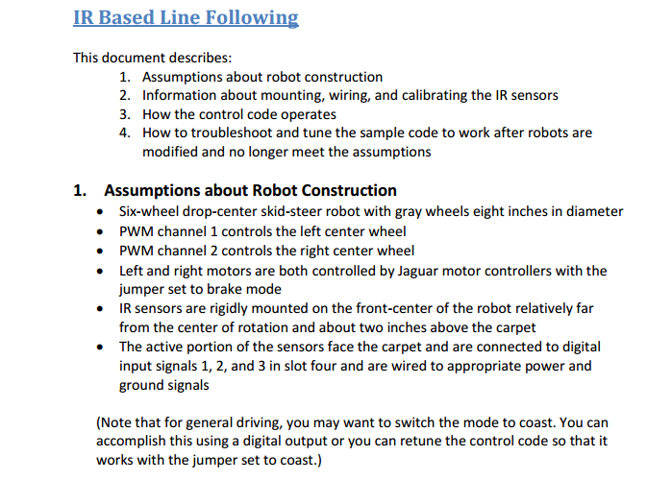
Documentation
Free Labels
Owned Labels
Sub diagram Labels
White Papers

Slide 60
Keyboard Shortcuts
CTRL + u = diagram cleanup
Right Click = palette
CTRL + Space = quick drop
CTRL + e = switch window
CTRL + Shift + e = activate project window
CTRL + r = Run
CTRL + t = split window

