Slide 1
Advanced LabVIEW
http://workshop.frclabviewtutorials.com

Slide 2
Customizing the Dashboard

Slide 3
Customizing the Dashboard
Open Project
Notes:
demo

Slide 4
Customizing the Dashboard
Open Project
Sending data from robot

Slide 5
Customizing the Dashboard
Open Project
Sending data from robot
Smart Dashboard VI’s
Named (case sensitive) values

Slide 6
Customizing the Dashboard
Open Project
Sending data from robot
Smart Dashboard VI’s
Named (case sensitive) values

Slide 7
Customizing the Dashboard
Open Project
Sending data from robot
Sending data to robot

Slide 8
Functional Global Variable

Slide 9
Functional Global Variable
Side note
https://frclabviewtutorials.com/tutorials/fgv/
Notes:
demo

Slide 10
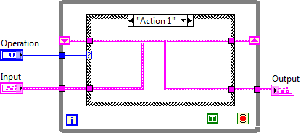
FGV
Functional Global Variable Code

Slide 11
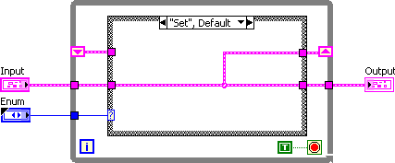
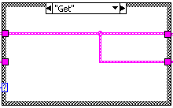
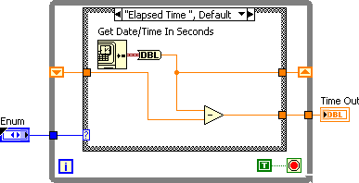
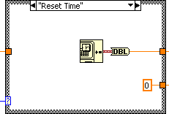
Implementing An FGV

Slide 12
VI Properties
Quick Intro
https://frclabviewtutorials.com/tutorials/fgv/
SR Flip Flop Demo
Notes:
Demo SR

Slide 13
VI Properties
Quick Intro
https://frclabviewtutorials.com/tutorials/fgv/
SR Flip Flop Demo
Edge Detector
https://frclabviewtutorials.com/tutorials/memory-library/
Notes:
Demo edge detetector

Slide 14
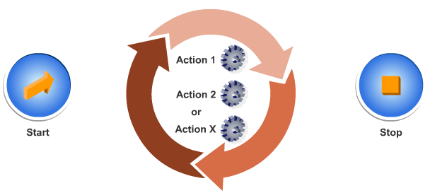
Architectures
State Machine

Slide 15
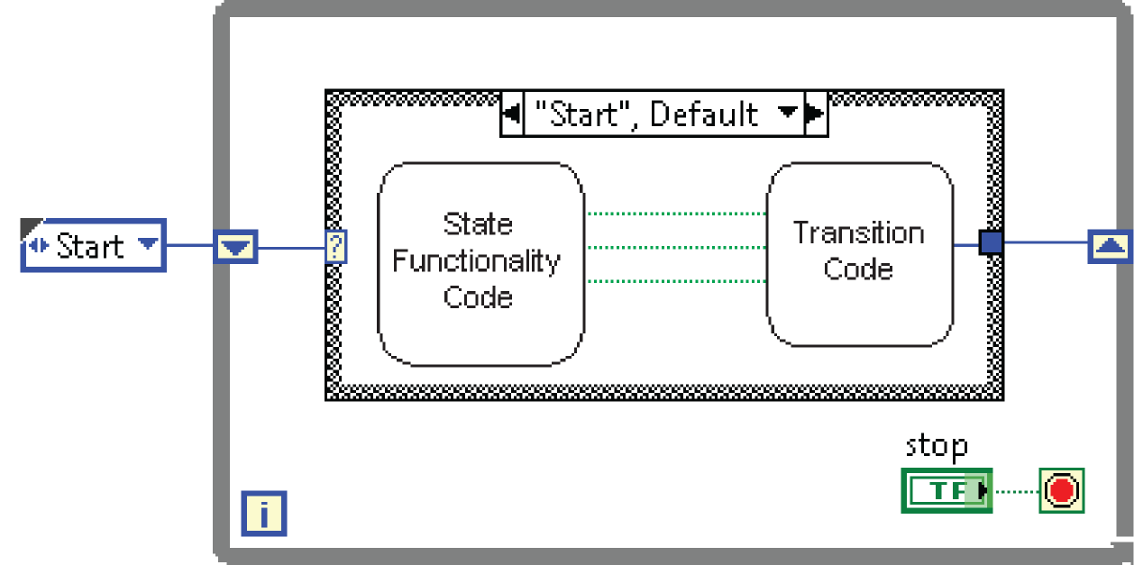
Architectures
State Machine

Slide 16
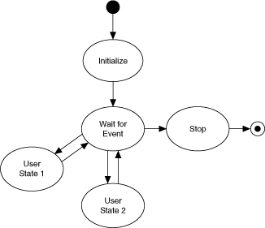
Architectures
State Machine

Slide 17
Architectures
State Machine
Producer-Consumer
Parallel loops
First creating data or instructions
Other handling

Slide 18
Architectures
State Machine
Producer-Consumer
Parallel loops
Use either queue or fgv

Slide 19
Producer Consumer Demo
Notes:
Queue and FGV

Slide 20
Producer Consumer Demo
Use Autonomous and Teleop to (non-concurrently) create data via global variable (or FGV)
Use Periodic tasks to run a state machine controlling the actuator
State-machine is updated by consuming data from global (or FGV)
Notes:
Queue and FGV

Slide 21
Producer Consumer Demo
(side note)
In Computer Science (and CE, but software specifically), there’s a concept call “separation of concerns” (Wikipedia: link)
[Each segment of code should only deal with a single task] (paraphrased)
This might be:
Getting input
Or controlling the shooter
This set-up, allows you to separate the task of deciding what to do base on inputs (/auto) and how to do it(/interacting with the hardware)
Notes:
Queue and FGV

Slide 22
Type Def.
Useful for passing data – both controls and indicators
Demo

Slide 23
Type Def.
Useful for passing data – both controls and indicators
Demo
Notes:
typedefs

Slide 24
PID
Closed loop control through PID
Notes:
To close the feedback loop means to bring information from the output of an action back as an input.

Slide 25
PID
WPI Video:
https://www.youtube.com/watch?list=PL8BLGj0RyhMzNXX9gHBosWPRbqqn0gJUQ&v=UOuRx9Ujsog&feature=emb_logo

Slide 26
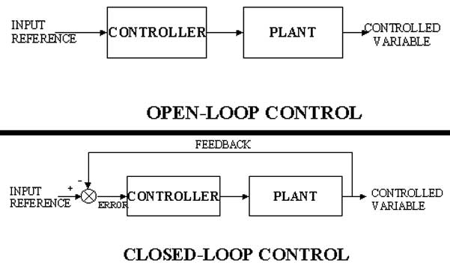
Closed Loop Control
Open Loop:
Notes:
Image from:
https://www.google.com/url?sa=i&source=imgres&cd=&cad=rja&uact=8&ved=2ahUKEwiJubyf2sXfAhVMaq0KHXaFApAQjxx6BAgBEAI&url=http%3A%2F%2Finterviewquestionanswer.com%2Felectrical-engineering%2Fwhat-are-different-types-of-control-systems&psig=AOvVaw0I1yfTz9-ETIWCxb3uyuvJ&ust=1546195772100247

Slide 27
Closed Loop Control
Open Loop:
Joystick
Software
Motor controller
Robot arm
Notes:
Image from:
https://www.google.com/url?sa=i&source=imgres&cd=&cad=rja&uact=8&ved=2ahUKEwiJubyf2sXfAhVMaq0KHXaFApAQjxx6BAgBEAI&url=http%3A%2F%2Finterviewquestionanswer.com%2Felectrical-engineering%2Fwhat-are-different-types-of-control-systems&psig=AOvVaw0I1yfTz9-ETIWCxb3uyuvJ&ust=1546195772100247

Slide 28
Closed Loop Control
Open Loop
Closed Loop
Sensor
Joystick
“Combined”
Software
Motor controller
Robot arm
Notes:
Image from:
https://www.google.com/url?sa=i&source=imgres&cd=&cad=rja&uact=8&ved=2ahUKEwiJubyf2sXfAhVMaq0KHXaFApAQjxx6BAgBEAI&url=http%3A%2F%2Finterviewquestionanswer.com%2Felectrical-engineering%2Fwhat-are-different-types-of-control-systems&psig=AOvVaw0I1yfTz9-ETIWCxb3uyuvJ&ust=1546195772100247

Slide 29
Closed Loop Control
Open Loop
Closed Loop
Example
Notes:
Example:

Slide 30
Closed Loop Control
Open Loop
Closed Loop
Example
Move the arm
Notes:
I want to move the arm

Slide 31
Closed Loop Control
Open Loop
Closed Loop
Example
Move the arm
Tele-op.vi
Notes:
So, I tell Teleop to move the arm

Slide 32
Closed Loop Control
Open Loop
Closed Loop
Example
Move the arm
Tele-op.vi
Motor X = .25
Notes:
It tells the motor (motor X) to set to 25%
Did that move the arm at all? Did it move to the position I wanted ??
I don’t know at this point

Slide 33
Closed Loop Control
Open Loop
Closed Loop
Example
Set Arm Position to 90 °
Tele-op.vi
Motor X = .25
Potentiometer
Notes:
So, let’s put a potentiometer on the arm and change our command to move it to 90 °
Now, Teleop still says to set the motor power to 25%, but the motor will affect the potentiometer. We can then read that potentiometer in Tele-op to know what the arm did.

Slide 34
Closed Loop Control
Open Loop
Closed Loop
Example
(arm position)
Set Arm Position to 90 °
Tele-op.vi
Motor X
Potentiometer
Notes:
Which we would diagram something like this (notice that I removed the value the motor is getting set to because this is now a continuous loop of feedback and the motor value may change over time).

Slide 35
Closed Loop Control - PID
PID stand for:
Proportional
Integral
Derivative
(arm position)
Set Arm Position to 90 °
Tele-op.vi
Motor X
Potentiometer
Notes:
PID is a methodology of closed loop feedback/control that allows for fast response times.

Slide 36
Closed Loop Control - PID
PID stand for:
Proportional
Integral
Derivative
Output = K_{p} E(t) + K_{i} ∫ E’(t) + K_{d} E’(t)
Notes:
From Wikipedia: A PID controller continuously calculates an error value e(t) as the difference between a desired setpoint (SP) and a measured process variable (PV) and applies a correction based on proportional, integral, and derivative terms (denoted P, I, and D respectively), hence the name.

Slide 37
PID
Proportional
Notes:
https://en.wikipedia.org/wiki/PID_controller
https://www.youtube.com/watch?v=JEpWlTl95Tw
https://www.youtube.com/watch?v=UR0hOmjaHp0
http://robotics.stackexchange.com/questions/167/what-are-good-strategies-for-tuning-pid-loops

Slide 38
PID
Proportional
Constant multiplied by error (offset)
The larger this is, the faster the robot approaches the setpoint (smaller rise time)
If too large, the robot will overshoot the target consistently
Notes:
The proportional

Slide 39
PID
Proportional
Constant multiplied by error (offset)
The larger this is, the faster the robot approaches the setpoint (smaller rise time)
Integral
Constant multiplied by integral of all previous error values
Used to eliminate steady state error (reducing offset after movement)
If too large, robot will eventually (> 5s) respond vehemently
Notes:
Note: a small error long enough eventually produces and integral of significant value (exponentially approaching infinity), causing the robot to jump into action and overshoot.

Slide 40
PID
Proportional
Constant multiplied by error (offset)
The larger this is, the faster the robot approaches the setpoint (smaller rise time)
Integral
Constant multiplied by integral of all previous error values
Used to eliminate steady state error (reducing offset after movement)
Differential
The larger this is, the less overshoot and settling time (less bounce)
If too large,
Notes:
Note: sometimes implemented as d(e)/dt or (in WPI) as e(t) – e(t-1)

Slide 41
PID
Tuning

Slide 42
PID
Tuning
Several methods available
Ziegler–Nichols*
Tyreus Luyben
Cohen–Coon
Åström-Hägglund
Manual Tuning*
Notes:
(from WPI):
https://www.youtube.com/watch?list=PL8BLGj0RyhMzNXX9gHBosWPRbqqn0gJUQ&v=UOuRx9Ujsog&feature=emb_logo
(overview of PID):
https://www.youtube.com/watch?v=JEpWlTl95Tw
https://www.youtube.com/watch?v=UR0hOmjaHp0
Manual Tuning (and lots of more info):
http://faculty.mercer.edu/jenkins_he/documents/TuningforPIDControllers.pdf#page=6
http://robotics.stackexchange.com/questions/167/what-are-good-strategies-for-tuning-pid-loops
Ziegler-Nichols: http://robotsforroboticists.com/pid-control/
https://frc-pdr.readthedocs.io/en/latest/control/pid_control.html
http://www.ni.com/white-paper/3782/en/

Slide 43
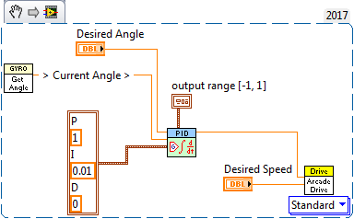
PID
Example code
Notes:
Read the desired angle (a control), and the current angle (from the gyro), bound the output to [-1, 1], us 1 as the the proportional constant and .01 as the integral constant – use the result as the steering on Arcade Drive (in effect, a drive straight).

Slide 44
Questions

