Slide 1
Advanced LabVIEW
http://workshop.frclabviewtutorials.com

Slide 2
Building A Robust Autonomous
If your robot:
Is easy to code for auto
Has the software architected so that auto coding is simple
Has driver’s that are practiced
You have a mountain of potential to do well.
Notes:
TODO: fill this in a little more once we get the game for 2019
Notes:
Every year there has been a way to score points for your alliance by just moving
In the past, auto has been the first or second tie-breaker
A consistent auto is worth more than an if-y end game.
In 2016, (Stronghold) robots got 10 points for crossing a defense and 10 points for scoring in the high goal in auto. A lot of teams that have learned to prioritize Auto got these consistently.
Let’s say for the sake of argument that they were only 90% consistent. 90% x 20 points is an expected 18 points per match.
On the other hand, that year a team could climb in the end game for 15 points. A lot of robots had difficulty getting through the match, onto the tower grounds, and climbing. But even if they were 100% consistent at this, that would only be an expected 15 points per match (which is less than 18).
You might say that’s not a lot less, and it’s not. But in putting in the effort to have a consistent auto and trained drivers, you can be prepared to widen that gap.
Don’t get me wrong, top teams will do both and have better than 90% success at it, but in my experience, a lot of teams that could be competitive are not prioritizing auto enough to compete with the stronger teams.

Slide 3
Ingredients
Quick, effective mechanisms
Easy to edit
Use sensors (closed loop control)
Appropriate sensors to help your robot account for inconsistencies in field, setup, game pieces, battery level, etc.
Notes:
Not going to address mechanisms here, this presentation is focused on the software side of things, but I did feel like we should acknowledge that dependency.
For easy to edit, I’m going to present a way to do a file based autonomous so that you don’t have to redeploy every time you tweak it.
As well as several example sensors and possible ways that they could be beneficial.

Slide 4
Easy to Edit
File Based Auto

Slide 5
File Based Auto
https://www.frclabviewtutorials.com/tutorials/filedAuto/
Objective: Setup a system where I can quickly tweak a setting and re-run auto and see the difference.

Slide 6
File Based Auto
Demo: creating AutoMove control
Notes:
Open project and right click on {Target …} and select New -> Control
We will want to add multiple fields to this control, so first add a cluster
Then to that cluster add a distance angle and time numeric controls.

Slide 7
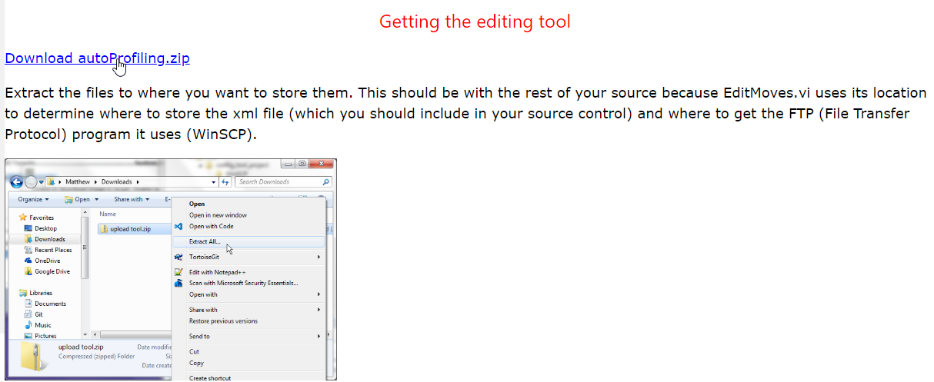
File Based Auto
Get the editing/deploying tool

Slide 8
File Based Auto
Demo: Add EditMoves.vi to my project under “My Computer” and recallMovesOnRobot.vi under “Team Code” and use in auto
Notes:
Back in the project explorer, expand and then right click on “My Computer” and select “Add” -> “File . . .” This will open a file dialogue. Use it to select the EditMoves.vi that you just extracted.
By putting this vi under “My Computer”, you are telling LabVIEW that you want this vi to run locally.
EditMoves.vi is a utility VI that allows for you to put in your own definition of what an autonomous move looks like and build an array of such moves for an auton program. EditMoves will extract xml from the array and store it locally (when save is hit) and put it on the robot for recallMovesOnRobot.vi to load when your autonomous code calls it.
Also add recallMovesOnRobot.vi under the Target (maybe even under “Support Code” or under “Team Code” - it’s up to you).

Slide 9
Ingredients
(NA) Quick, effective mechanisms
(✓) Easy to edit
Use sensors (closed loop control)
Appropriate sensors to help your robot account for inconsistencies in field, setup, game pieces, battery level, etc.
Notes:
Next

Slide 10
PID
Closed loop control through PID
Notes:
To close the feedback loop means to bring information from the output of an action back as an input.

Slide 11
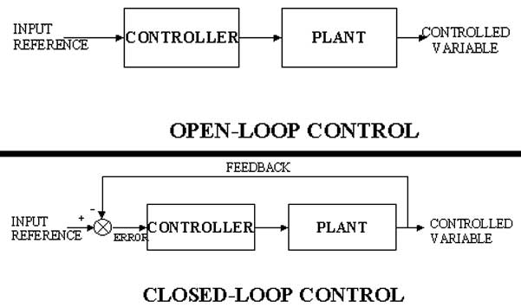
Closed Loop Control
Open Loop:
Notes:
Image from:
https://www.google.com/url?sa=i&source=imgres&cd=&cad=rja&uact=8&ved=2ahUKEwiJubyf2sXfAhVMaq0KHXaFApAQjxx6BAgBEAI&url=http%3A%2F%2Finterviewquestionanswer.com%2Felectrical-engineering%2Fwhat-are-different-types-of-control-systems&psig=AOvVaw0I1yfTz9-ETIWCxb3uyuvJ&ust=1546195772100247

Slide 12
Closed Loop Control
Open Loop
Closed Loop
Notes:
Image from:
https://www.google.com/url?sa=i&source=imgres&cd=&cad=rja&uact=8&ved=2ahUKEwiJubyf2sXfAhVMaq0KHXaFApAQjxx6BAgBEAI&url=http%3A%2F%2Finterviewquestionanswer.com%2Felectrical-engineering%2Fwhat-are-different-types-of-control-systems&psig=AOvVaw0I1yfTz9-ETIWCxb3uyuvJ&ust=1546195772100247

Slide 13
Closed Loop Control
Open Loop
Closed Loop
Example
Notes:
Example:

Slide 14
Closed Loop Control
Open Loop
Closed Loop
Example
Move the arm
Notes:
I want to move the arm

Slide 15
Closed Loop Control
Open Loop
Closed Loop
Example
Move the arm
Tele-op.vi
Notes:
So, I tell Teleop to move the arm

Slide 16
Closed Loop Control
Open Loop
Closed Loop
Example
Move the arm
Tele-op.vi
Motor X = .25
Notes:
It tells the motor (motor X) to set to 25%
Did that move the arm at all? Did it move to the position I wanted ??
I don’t know at this point

Slide 17
Closed Loop Control
Open Loop
Closed Loop
Example
Set Arm Position to 90 °
Tele-op.vi
Motor X = .25
Potentiometer
Notes:
So, let’s put a potentiometer on the arm and change our command to move it to 90 °
Now, Teleop still says to set the motor power to 25%, but the motor will affect the potentiometer. We can then read that potentiometer in Tele-op to know what the arm did.

Slide 18
Closed Loop Control
Open Loop
Closed Loop
Example
(arm position)
Set Arm Position to 90 °
Tele-op.vi
Motor X
Potentiometer
Notes:
Which we would diagram something like this (notice that I removed the value the motor is getting set to because this is now a continuous loop of feedback and the motor value may change over time).

Slide 19
Closed Loop Control - PID
PID stand for:
Proportional
Integral
Derivative
(arm position)
Set Arm Position to 90 °
Tele-op.vi
Motor X
Potentiometer
Notes:
PID is a methodology of closed loop feedback/control that allows for fast response times.

Slide 20
Closed Loop Control - PID
PID stand for:
Proportional
Integral
Derivative
Output = K_{p} E(t) + K_{i} ∫ E’(t) + K_{d} E’(t)
Notes:
From Wikipedia: A PID controller continuously calculates an error value e(t) as the difference between a desired setpoint (SP) and a measured process variable (PV) and applies a correction based on proportional, integral, and derivative terms (denoted P, I, and D respectively), hence the name.

Slide 21
PID
Proportional
Notes:
https://en.wikipedia.org/wiki/PID_controller
https://www.youtube.com/watch?v=JEpWlTl95Tw
https://www.youtube.com/watch?v=UR0hOmjaHp0
http://robotics.stackexchange.com/questions/167/what-are-good-strategies-for-tuning-pid-loops

Slide 22
PID
Proportional
Constant multiplied by error (offset)
The larger this is, the faster the robot approaches the setpoint (smaller rise time)
If too large, the robot will overshoot the target consistently
Notes:
The proportional

Slide 23
PID
Proportional
Constant multiplied by error (offset)
The larger this is, the faster the robot approaches the setpoint (smaller rise time)
If too large, the robot will overshoot the target consistently
Integral
Constant multiplied by integral of all previous error values
The larger this is, the less overshoot and settling time (less bounce)
If too large, the robot will eventually react to any error violently
Notes:
Note: a small error long enough eventually produces and integral of significant value (exponentially approaching infinity), causing the robot to jump into action and overshoot.

Slide 24
PID
Proportional
Constant multiplied by error (offset)
The larger this is, the faster the robot approaches the setpoint (smaller rise time)
Integral
Constant multiplied by integral of all previous error values
Used to eliminate steady state error (reducing offset after movement)
Differential
The larger this is, the less overshoot and settling time (less bounce)

Slide 25
PID
Tuning

Slide 26
PID
Tuning
Several methods available
Ziegler–Nichols*
Tyreus Luyben
Cohen–Coon
Åström-Hägglund
Manual Tuning*
Notes:
http://faculty.mercer.edu/jenkins_he/documents/TuningforPIDControllers.pdf#page=6
https://www.youtube.com/watch?v=JEpWlTl95Tw
https://www.youtube.com/watch?v=UR0hOmjaHp0
http://robotics.stackexchange.com/questions/167/what-are-good-strategies-for-tuning-pid-loops
Ziegler-Nichols: http://robotsforroboticists.com/pid-control/
Manual (page 16): https://docs.google.com/viewer?a=v&pid=sites&srcid=aGFyZGluZy5lZHV8dGVhbS0zOTM3fGd4OjUyNzdiNzRkNjkxNjA3MGM
http://www.ni.com/white-paper/3782/en/

Slide 27
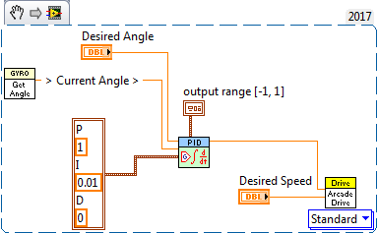
PID
Example code
Notes:
Read the desired angle (a control), and the current angle (from the gyro), bound the output to [-1, 1], us 1 as the the proportional constant and .01 as the integral constant – use the result as the steering on Arcade Drive (in effect, a drive straight).

Slide 28
Ingredients
(NA) Quick, effective mechanisms
(✓) Easy to edit
(✓) Use sensors (closed loop control)
Appropriate sensors to help your robot account for inconsistencies in field, setup, game pieces, battery level, etc.
Notes:
Next, some examples of effective sensors to use.

Slide 29
Sensors

Slide 30
Sensors - Encoder

Slide 31
Sensors - Encoder
Places to use encoders:
When trying to measure rotational speed
Trying to measure rotational distances possibly greater than 8 rotations.
Don’t care about starting position

Slide 32
Sensors - Encoder
Places to use encoders:
When trying to measure rotation speed
Trying to measure rotational distances possibly greater than 8 rotations.
Don’t care about starting position
Examples:
Drive train
Fly Wheel/wheeled shooter
Notes:
Drive-train
likely to travel more than 10 rotations in a given match
Don’t care where the wheels are when starting, and even better – the robots starting position is 0 (good)
Fly Wheel
Don’t care what position it starts in
Likely to rotate more than 10 rotations in a match
Care is primarily about speed

Slide 33
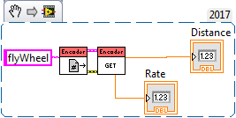
Sensors - Encoder
Reading

Slide 34
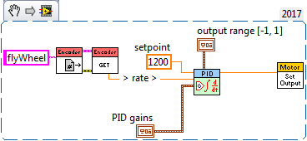
Sensors - Encoder
Control

Slide 35
Sensors - Potentiometer
Notes:
TODO: Code

Slide 36
Sensors - Potentiometer
Places to use potentiometers:
Trying to measure rotational distances less than 8 rotations.
Care about starting position – or absolute positions
Examples:
Arm angles
Elevator positions
Notes:
Arm angles:
Care about absolute position (0 should always mean on the ground regardless of where the arm was when we turn it on).
Same for elevators and similar manipulators

Slide 37
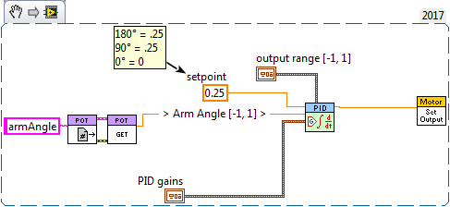
Sensors - Potentiometer
Control

Slide 38
Sensors - Potentiometer
Note:
Easy way to make potentiometer relative to a known point:
https://www.frclabviewtutorials.com/tutorials/sensors/roborio/potentiometer/
Notes:
One disadvantage that potentiometers have when compared to encoders is now you care very much about the position of the potentiometer when mounting/unmounting it.
I’m not going to go into this today, but there is a documented, simple way to apply a known offset when reading potentiometers – you would then update this offset after doing modifications.

Slide 39
Sensors - Gyro

Slide 40
Sensors - Gyro
Places to use a Gyro:
When trying to drive perfectly straight
When trying to turn to specific angles (especially in auto)

Slide 41
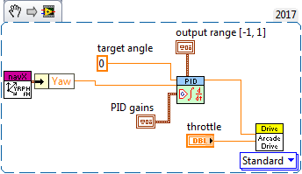
Sensors - Gyro
Control

Slide 42
Sensors - Vision
Demo
Notes:
DistanceToTarget2.vi
Desktop Example

Slide 43
Sensors - Other
https://www.frclabviewtutorials.com/tutorials/sensors/dashboard/arduino/

Slide 44
Demo

Slide 45
Questions

