Slide 1
Advanced LabVIEW
http://workshop.frclabviewtutorials.com

Slide 2
Customizing the Dashboard

Slide 3
Customizing the Dashboard
Open Project
Notes:
demo

Slide 4
Customizing the Dashboard
Open Project
Sending data from robot

Slide 5
Customizing the Dashboard
Open Project
Sending data from robot
Smart Dashboard VI’s
Named (case sensitive) values

Slide 6
Customizing the Dashboard
Open Project
Sending data from robot
Smart Dashboard VI’s
Named (case sensitive) values

Slide 7
Customizing the Dashboard
Open Project
Sending data from robot
Sending data to robot

Slide 8
Functional Global Variable

Slide 9
Functional Global Variable
Side note
https://frclabviewtutorials.com/tutorials/fgv/
Notes:
demo

Slide 10
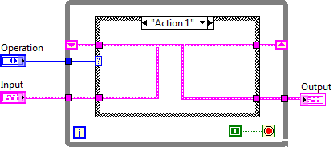
FGV
Functional Global Variable Code

Slide 11
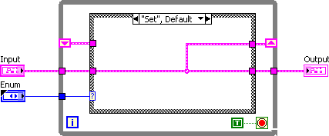
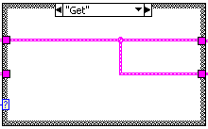
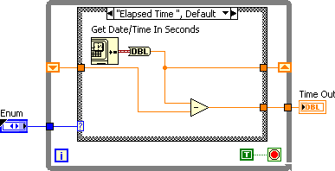
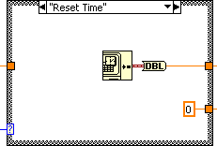
Implementing An FGV

Slide 12
VI Properties
Quick Intro
https://frclabviewtutorials.com/tutorials/fgv/
SR Flip Flop Demo
Notes:
Demo SR

Slide 13
VI Properties
Quick Intro
https://frclabviewtutorials.com/tutorials/fgv/
SR Flip Flop Demo
Edge Detector
https://frclabviewtutorials.com/tutorials/memory-library/
Notes:
Demo edge detetector

Slide 14
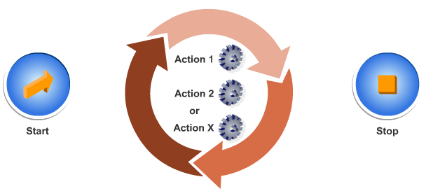
Architectures
State Machine

Slide 15
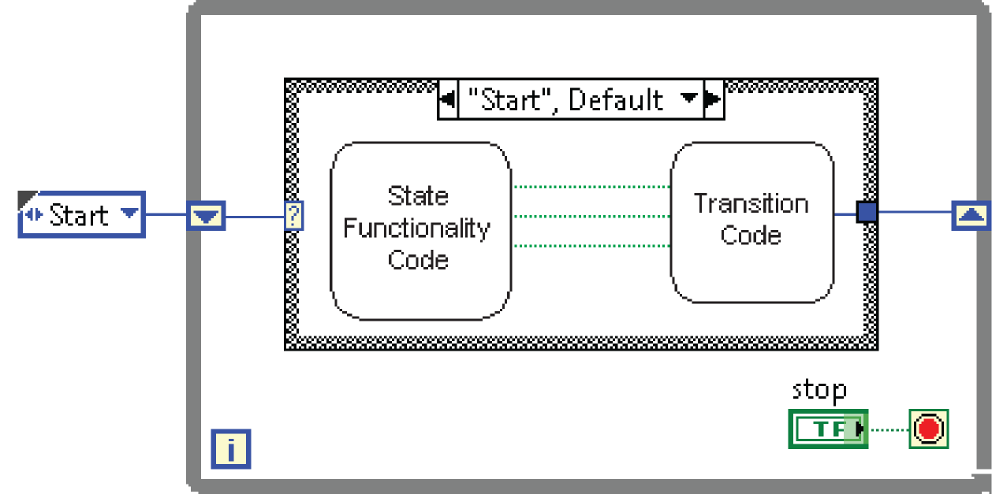
Architectures
State Machine

Slide 16
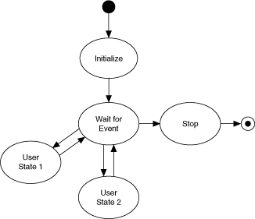
Architectures
State Machine

Slide 17
Architectures
State Machine
Producer-Consumer
Parallel loops
First creating data or instructions
Other handling

Slide 18
Architectures
State Machine
Producer-Consumer
Parallel loops
Use either queue or fgv

Slide 19
Producer Consumer Demo
Notes:
Queue and FGV

Slide 20
Producer Consumer Demo
Use Autonomous and Teleop to (non-concurrently) create data via global variable (or FGV)
Use Periodic tasks to run a state machine controlling the actuator
State-machine is updated by consuming data from global (or FGV)
Notes:
Queue and FGV

Slide 21
Type Def.
Useful for passing data – both controls and indicators
Demo

Slide 22
Type Def.
Useful for passing data – both controls and indicators
Demo
Notes:
typedefs

Slide 23
Questions

