Slide 1
ECE 411 MP3 – Basic Intro to Timing
Fall 2020

Slide 2
Why do we care about timing anyways?
Good Question! Take PHYS 420 for more detail on time.

Slide 3
A Utopia, but for Electrical Engineers
Let’s say one day you were sent to an ideal world.
Unfortunately, you still need to work on your MPs here. But here is a good news: In this world, you don’t need to consider capacitance, inductance or resistance of logic circuits or wires connecting them.
Therefore, a signal will encounter no delay when propagating through logic circuits.

Slide 4
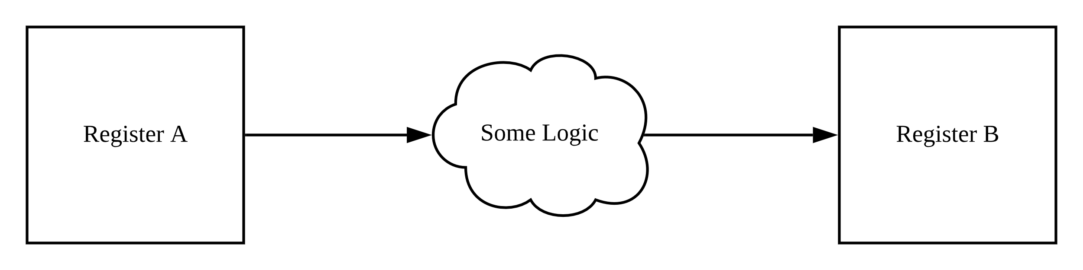
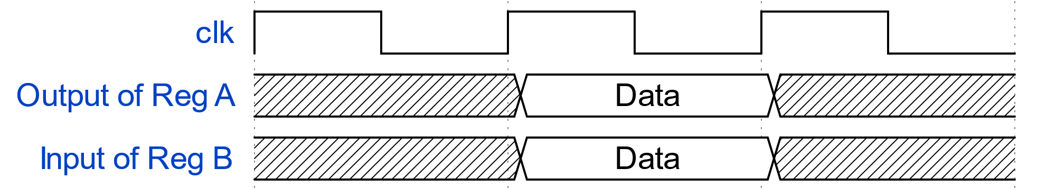
A Utopia, continued…
Considering two Registers, A and B:
Here would be the waveform of the output of Register A and input of Register B in ideal settings.

Slide 5
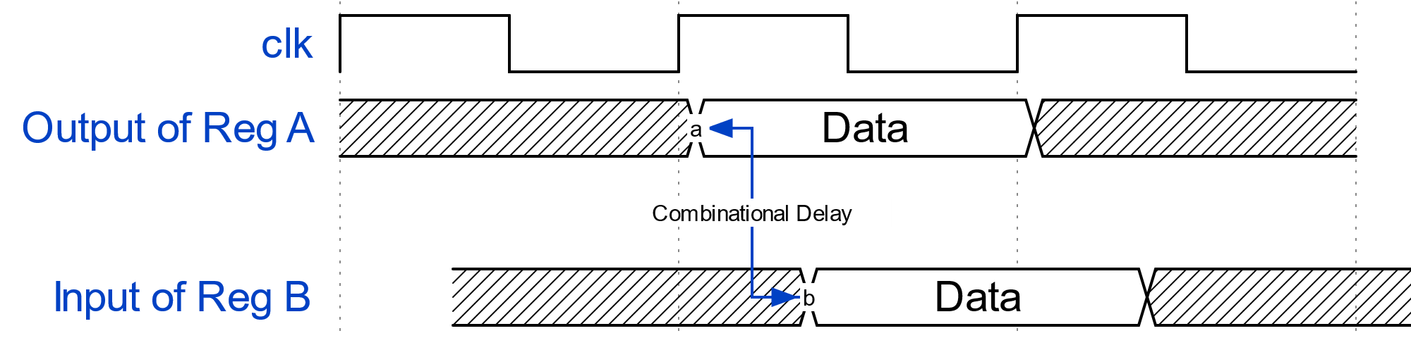
However, Things are different in Real Life
Logical components have capacitance, inductance and resistance.
Wires have resistance, and sometimes inductance and capacitance.
Therefore, there will be a delay when a signal travels from one component to the other. This is called Combinational Delay.

Slide 6
Delays: Propagation and Contamination
In the scope of this course, there are mainly two kinds of delay you need to know.
Propagation Delay: Maximum time for outputs of a combinational circuit to reach a stable new value after inputs changed to a new value.
Contamination Delay: Minimum time for outputs of a combinational circuit to keep the previous value after its inputs have changed.
Keep these in mind ------ they are important!

Slide 7
Let’s look at register timing.
Registers are important! Especially in FPGA.

Slide 8
Setup Time, Hold Time and TCQ
Setup time: For reliable operation of a register, its data input must be stable for some time before the rising clock edge. This is called Setup Time.
Hold time: For reliable operation of a register, its data input must be stable and holds its value for some time after the rising clock edge. This is called Hold Time.
Clock-to-Q Delay (TCQ): Time for the register output to become stable after a clock edge. (All examples here uses rising clock edge.)

Slide 9
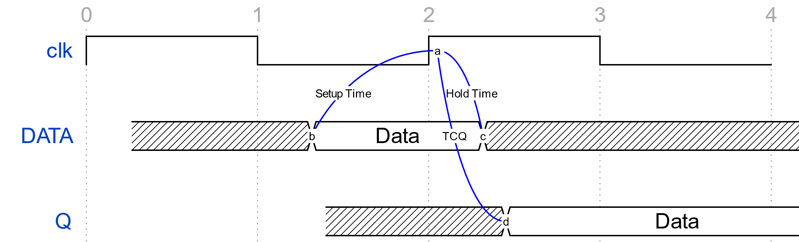
Setup Time, Hold Time and TCQ, continued…

Slide 10
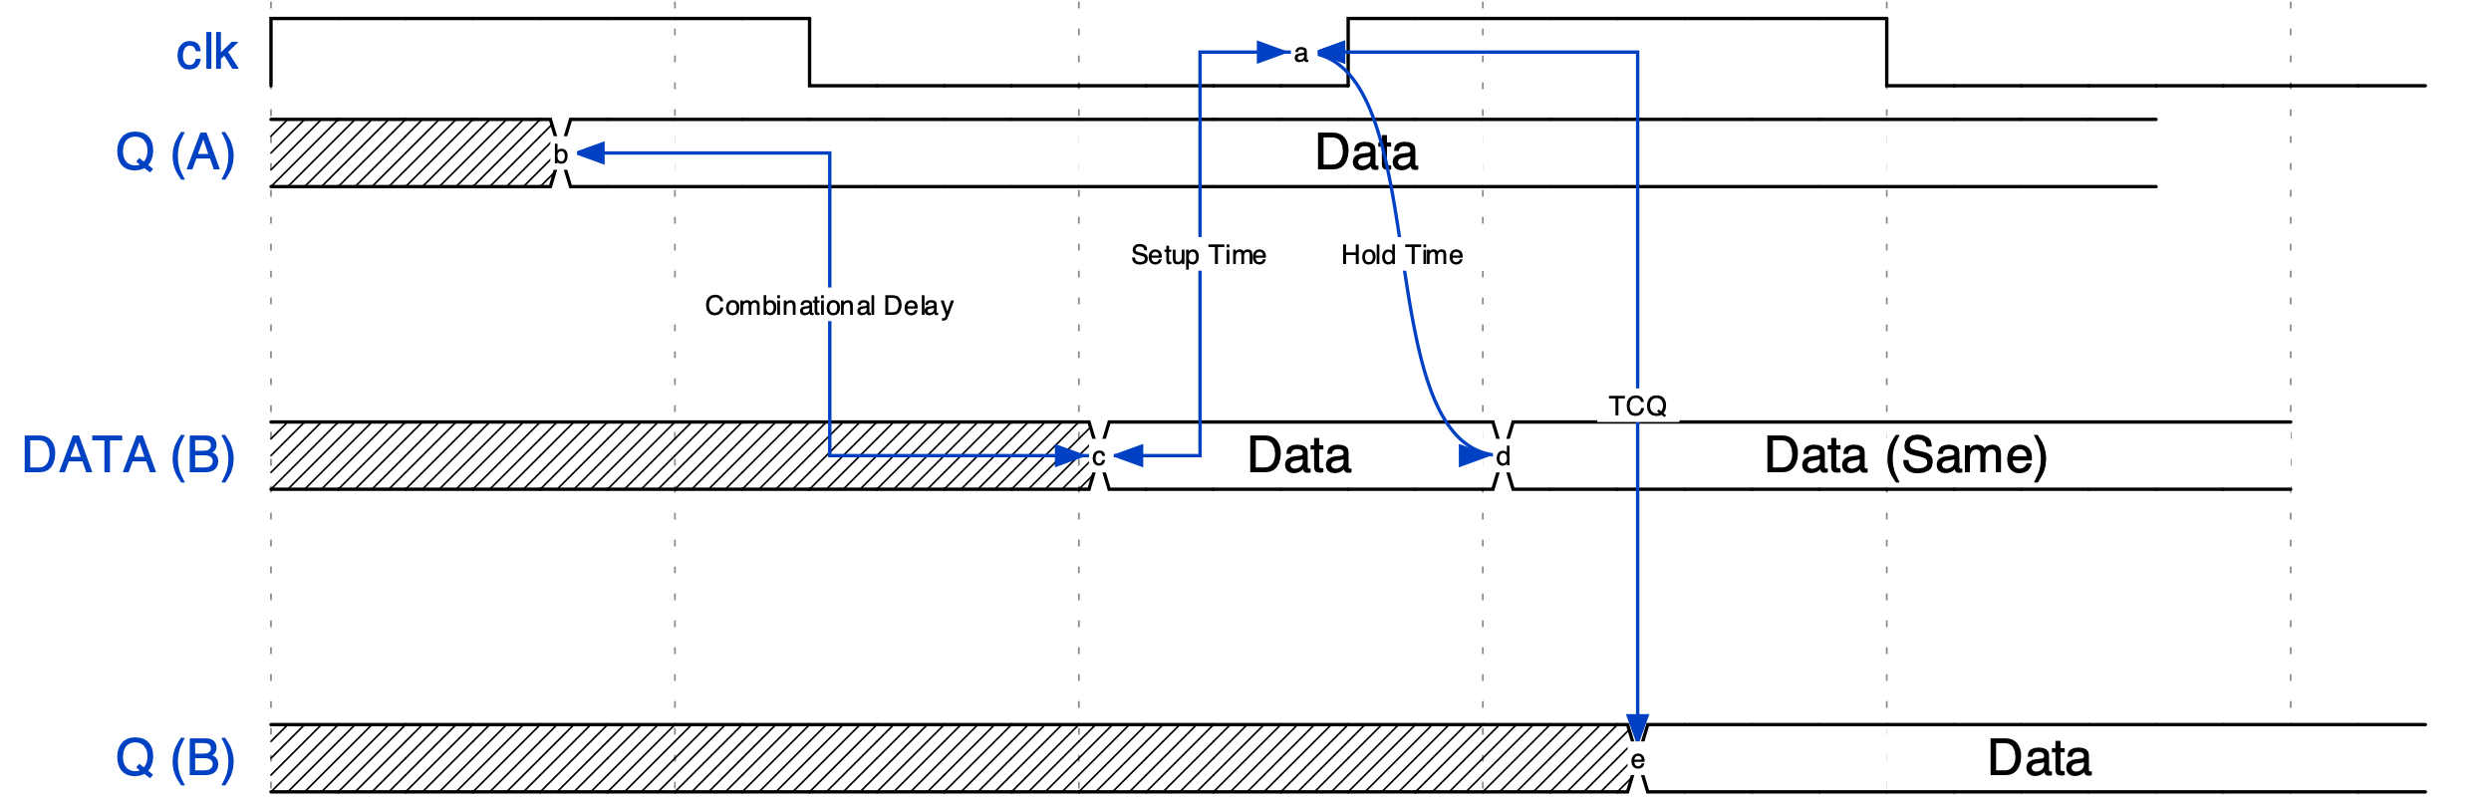
Putting it together: Comb. Delay and Register timing

Slide 11
Cool, but why am I failing timing?
Ask your advisor.

Slide 12
Fmax and Critical Path
As the name indicates, Fmax is the maximum frequency under which your combination logic could function correctly.
Why can’t we just use a clock frequency as high as we want? What will happen?
Since you are in the real world and delays exist. In this case, your design will face unforeseen consequences…

Slide 13
Fmax and Critical Path, continued…
What if the combinational delay is too long?
If we use the same clock frequency, setup and hold time requirement cannot be satisfied. That will cause glitch or metastability in your logic design! Boom, roasted.

Slide 14
Fmax and Critical Path, continued…
Therefore, to ensure correct operation of your logic design, you should lower your clock frequency. In this case, Fmax = 1 / (longest delay)
Imagine several paths like this cause several delays in your design. Naturally, your Fmax depends on the longest combinational path, which is called Critical Path.

Slide 15
What did I fail? – Timing Constraints
In MP1 and 2, our rubric requires your design to achieve certain Fmax.
To let Quartus know that you are trying to achieve the designated frequency for your clk and certain timing requirements (such as delays) for your design, we used timing constraint files to specify these. (.sdc)

Slide 16
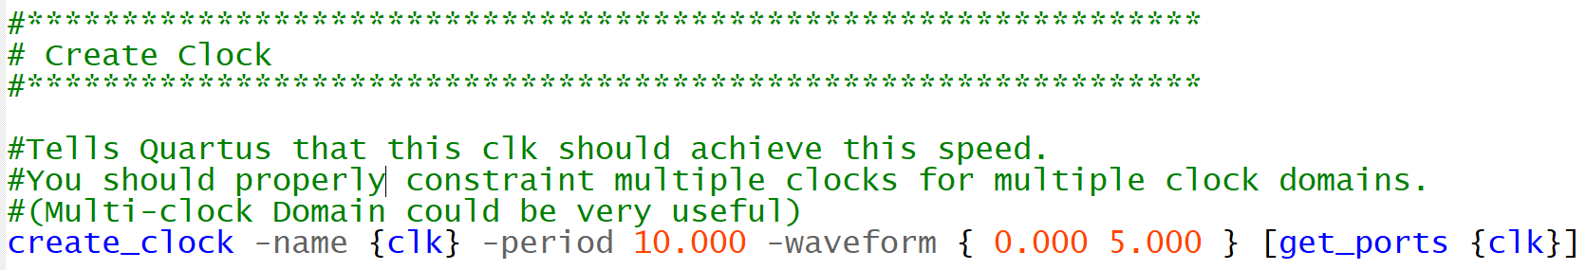
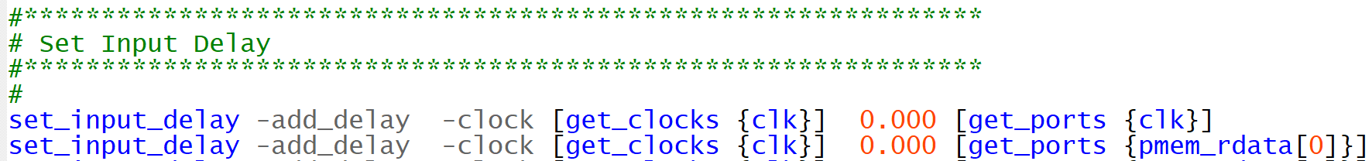
Timing Constraints, continued…

Slide 17
Where went wrong?
Timing Analyzer to your rescue!

Slide 18
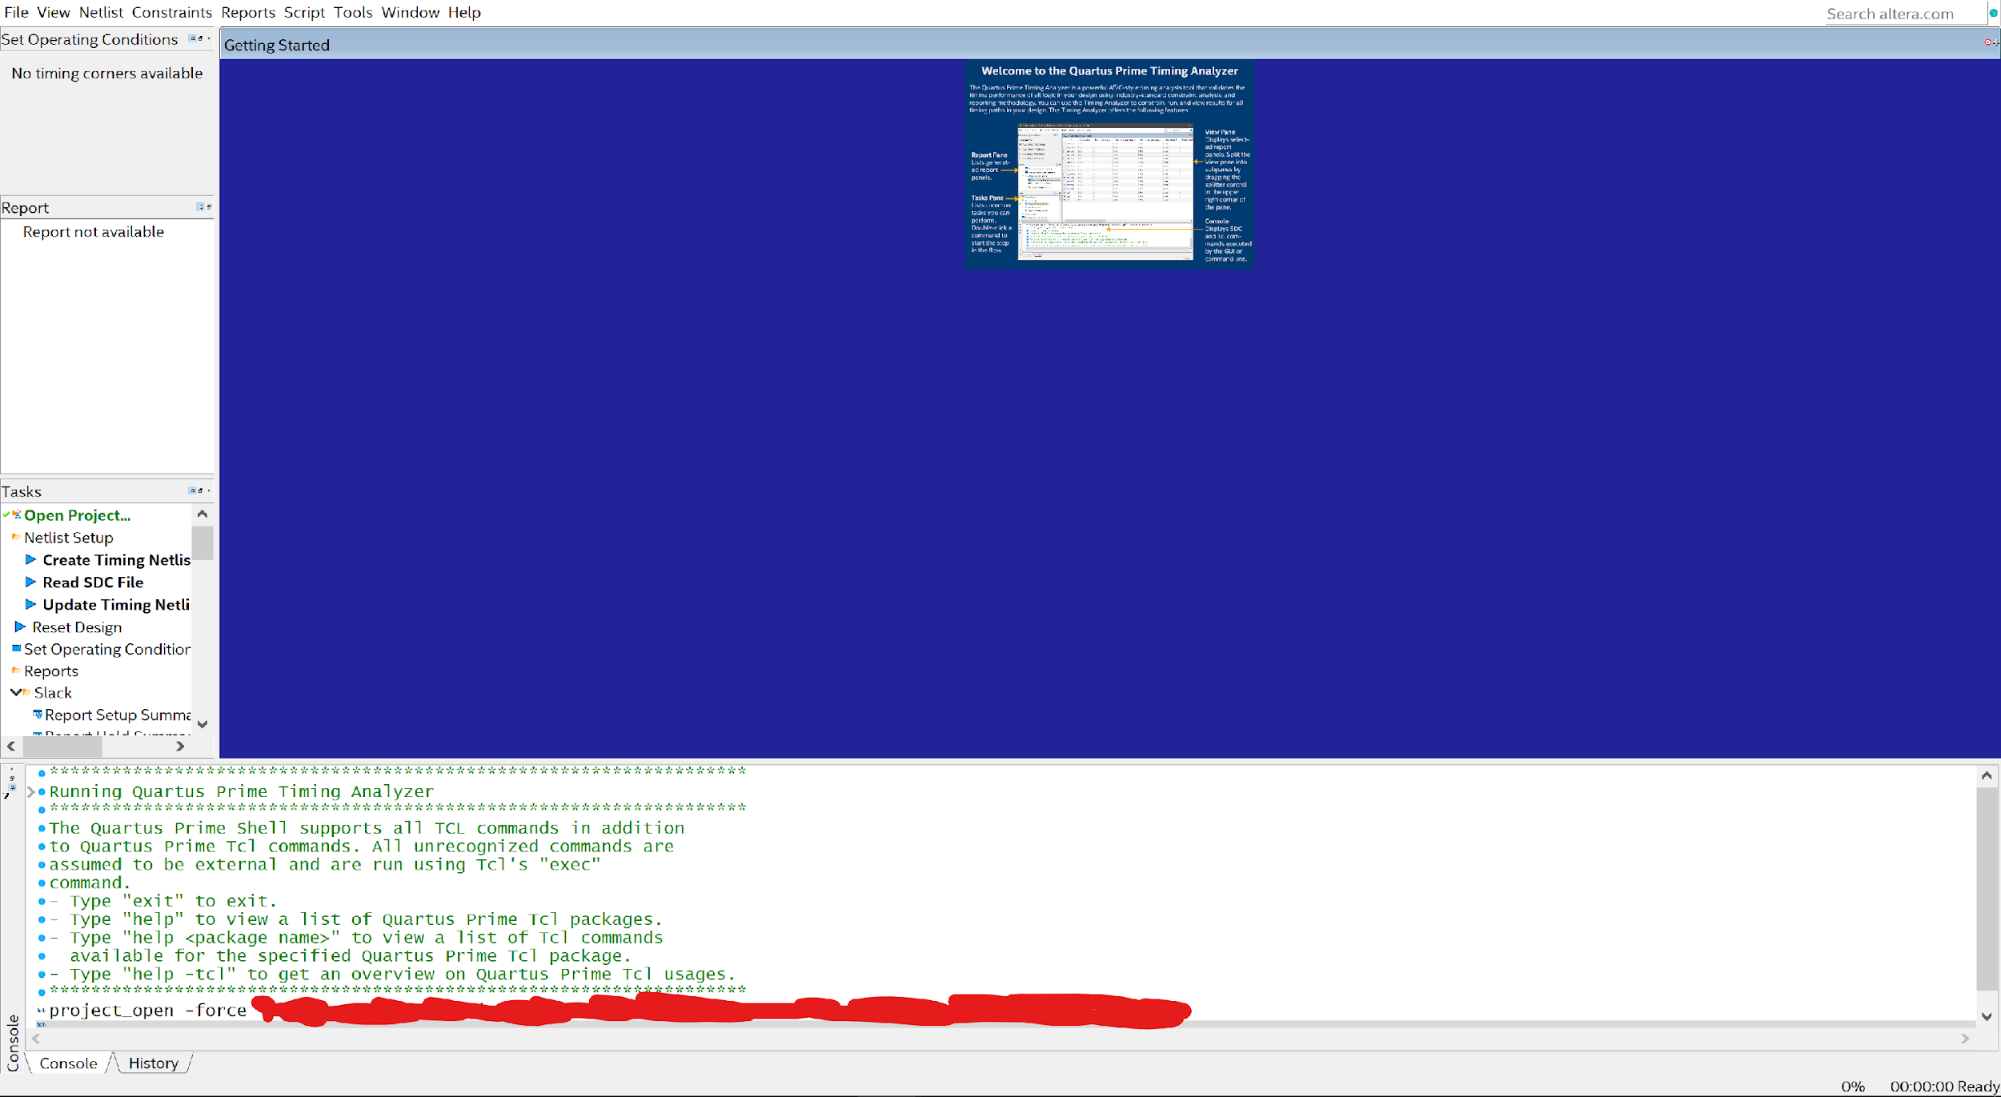
Finding the Critical Path – Timing Analyzer
After a project finishes compiling, open your timing analyzer:

Slide 19
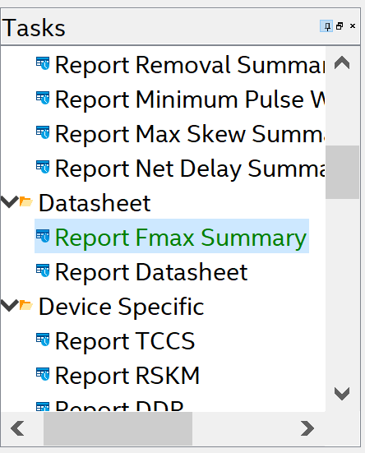
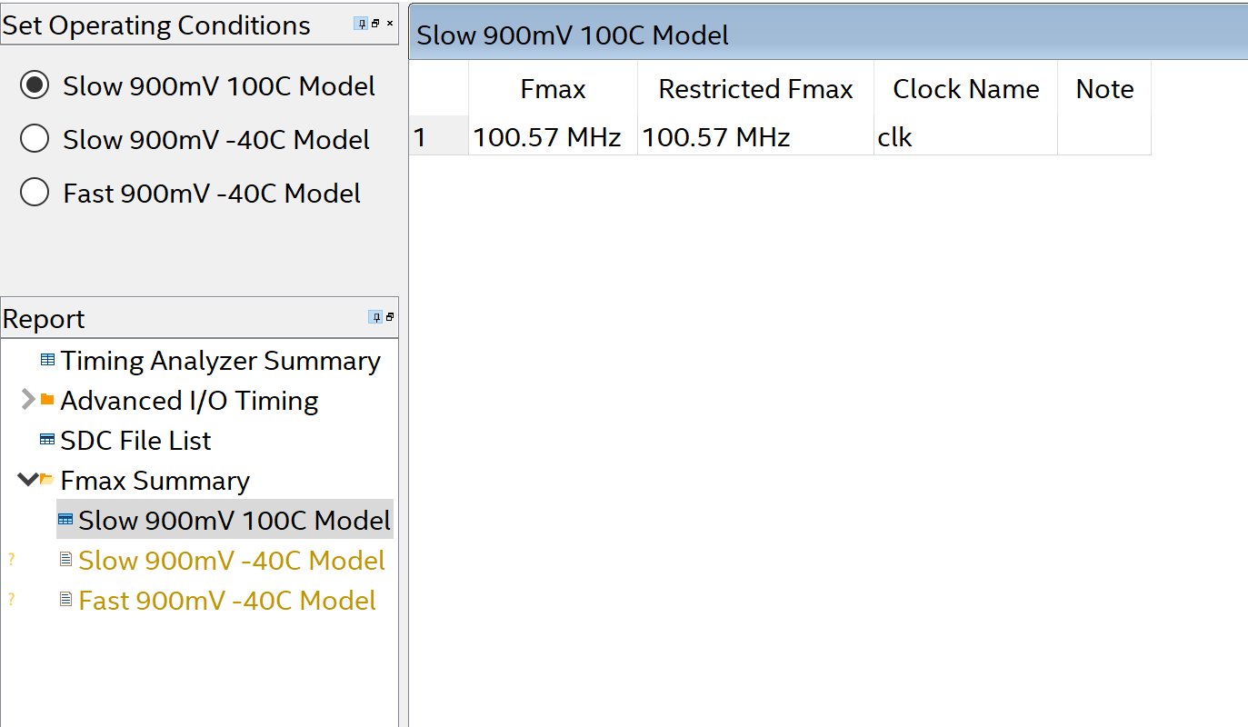
Timing Analyzer, continued…
Goto Datasheet – Report Fmax Summary.
Double Click to start reporting Fmax Summary.

Slide 20
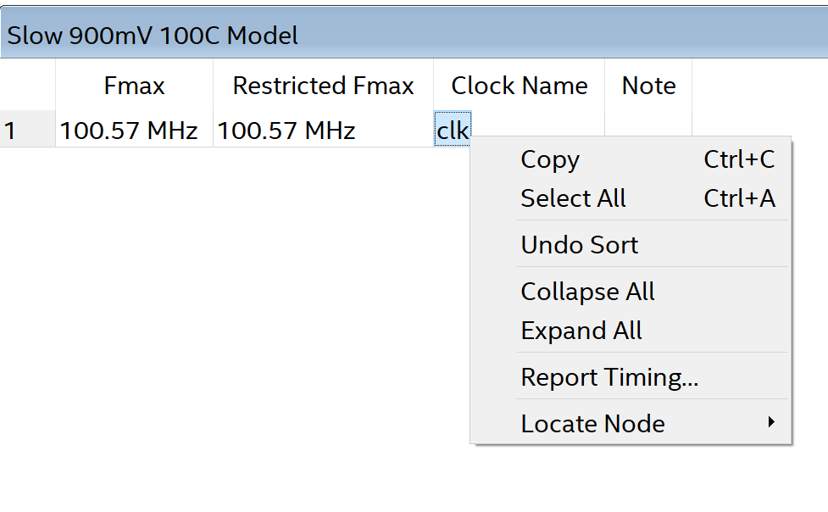
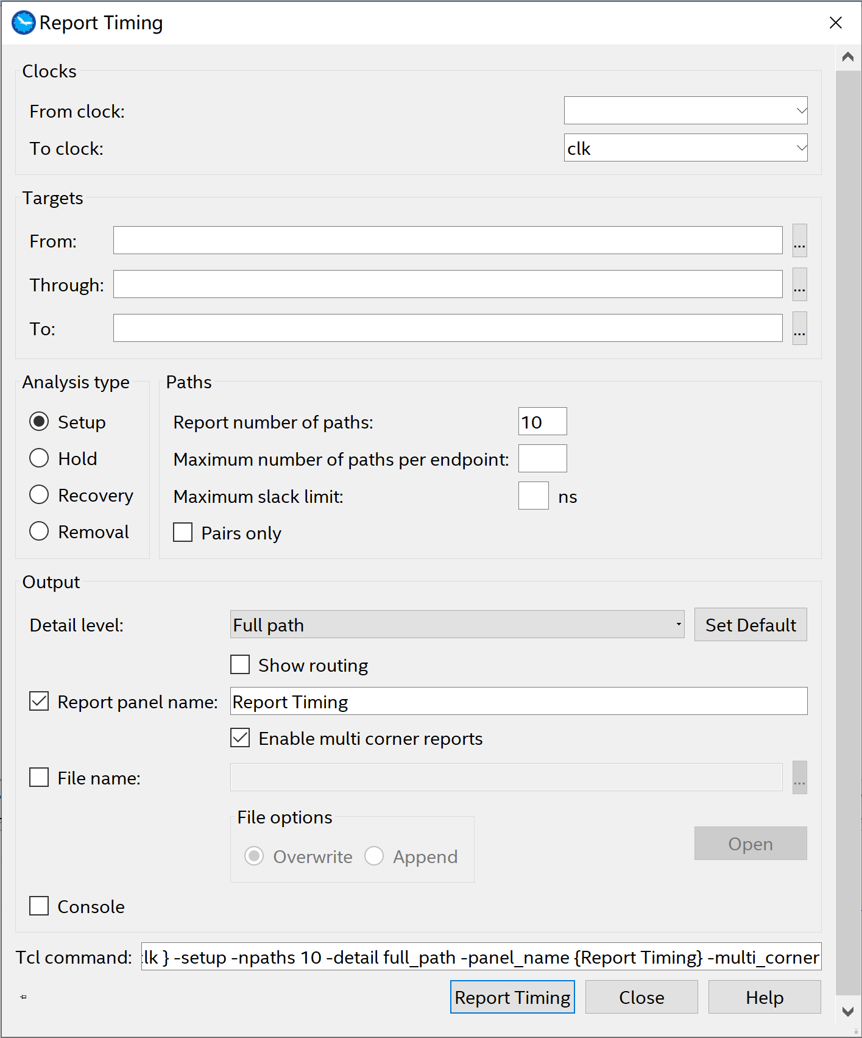
Timing Analyzer, continued…
Right Click on Clock name (clk), choose Report Timing…
Use default settings and click Report Timing

Slide 21
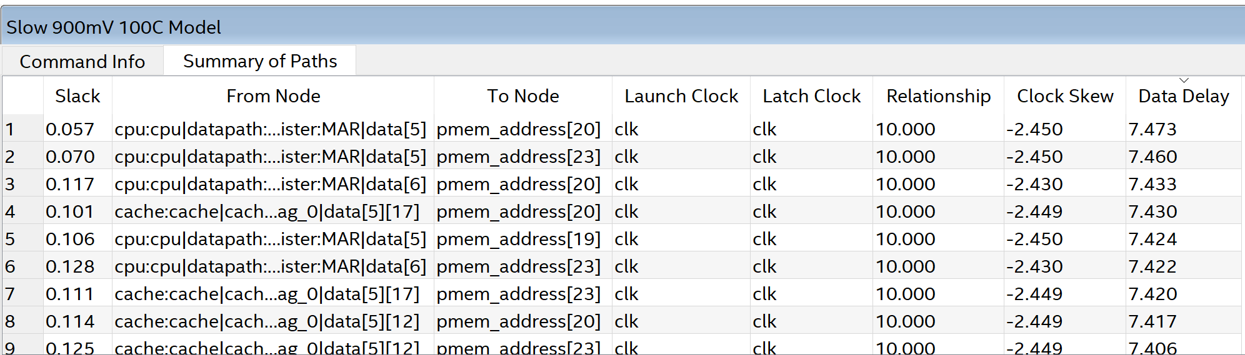
Timing Analyzer, continued…
A list of paths should appear. Choose the one with the smallest slack, since that is the critical path in this clock domain.

Slide 22
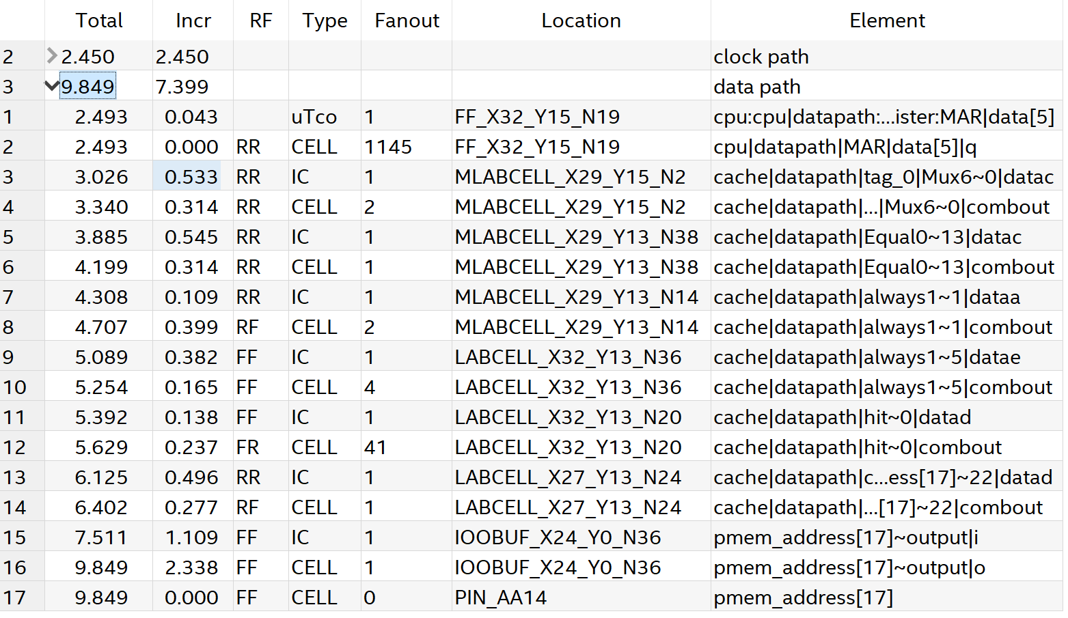
Timing Analyzer, continued…
The critical path contains clock path and data path. Since clock path is not in the scope of the slides, we will focus on data path.

Slide 23
Timing Analyzer, continued…
Fanout: the number of other logic that the register output is connected.
Location:
MLABCELL: Memory Logic Array Block – Logic Cells optimized for storage
LABCELL: Logic Array Block
IOOBUFF: Input/Output – Output Buffer. Used for ESD protection for FPGA pins. Similar goes to IOIBUFF.

Slide 24
Okay, let’s fix this.
Not so hard as you would think.

Slide 25
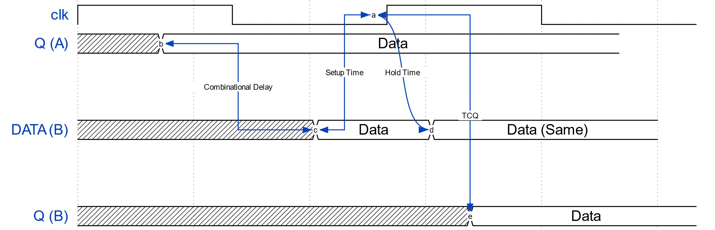
How to optimize Fmax?
Intuitively, since Fmax is inversely related to the length of your critical path, you always want to shorten your critical path by getting rid of unnecessary logic.
However, optimizing combinational logic would sometimes be very difficult. In this case, you might want to think…
In your critical path, your timing constraint requires your end-point register to have the correct input value setup time before the next clock edge. Is this necessary?

Slide 26
How to optimize Fmax, continued…
In MP3, you may have noticed that registering top-level output signals to physical memory would significantly improve timing.
Also, notice that there was a 3ns, non-removable IO Buffer delay for ESD protection.
By registering the output to memory, we essentially “move” this piece of delay to the path the output of the new register and physical memory.
One thing we did here is created a Multicycle Path between a register and physical memory

Slide 27
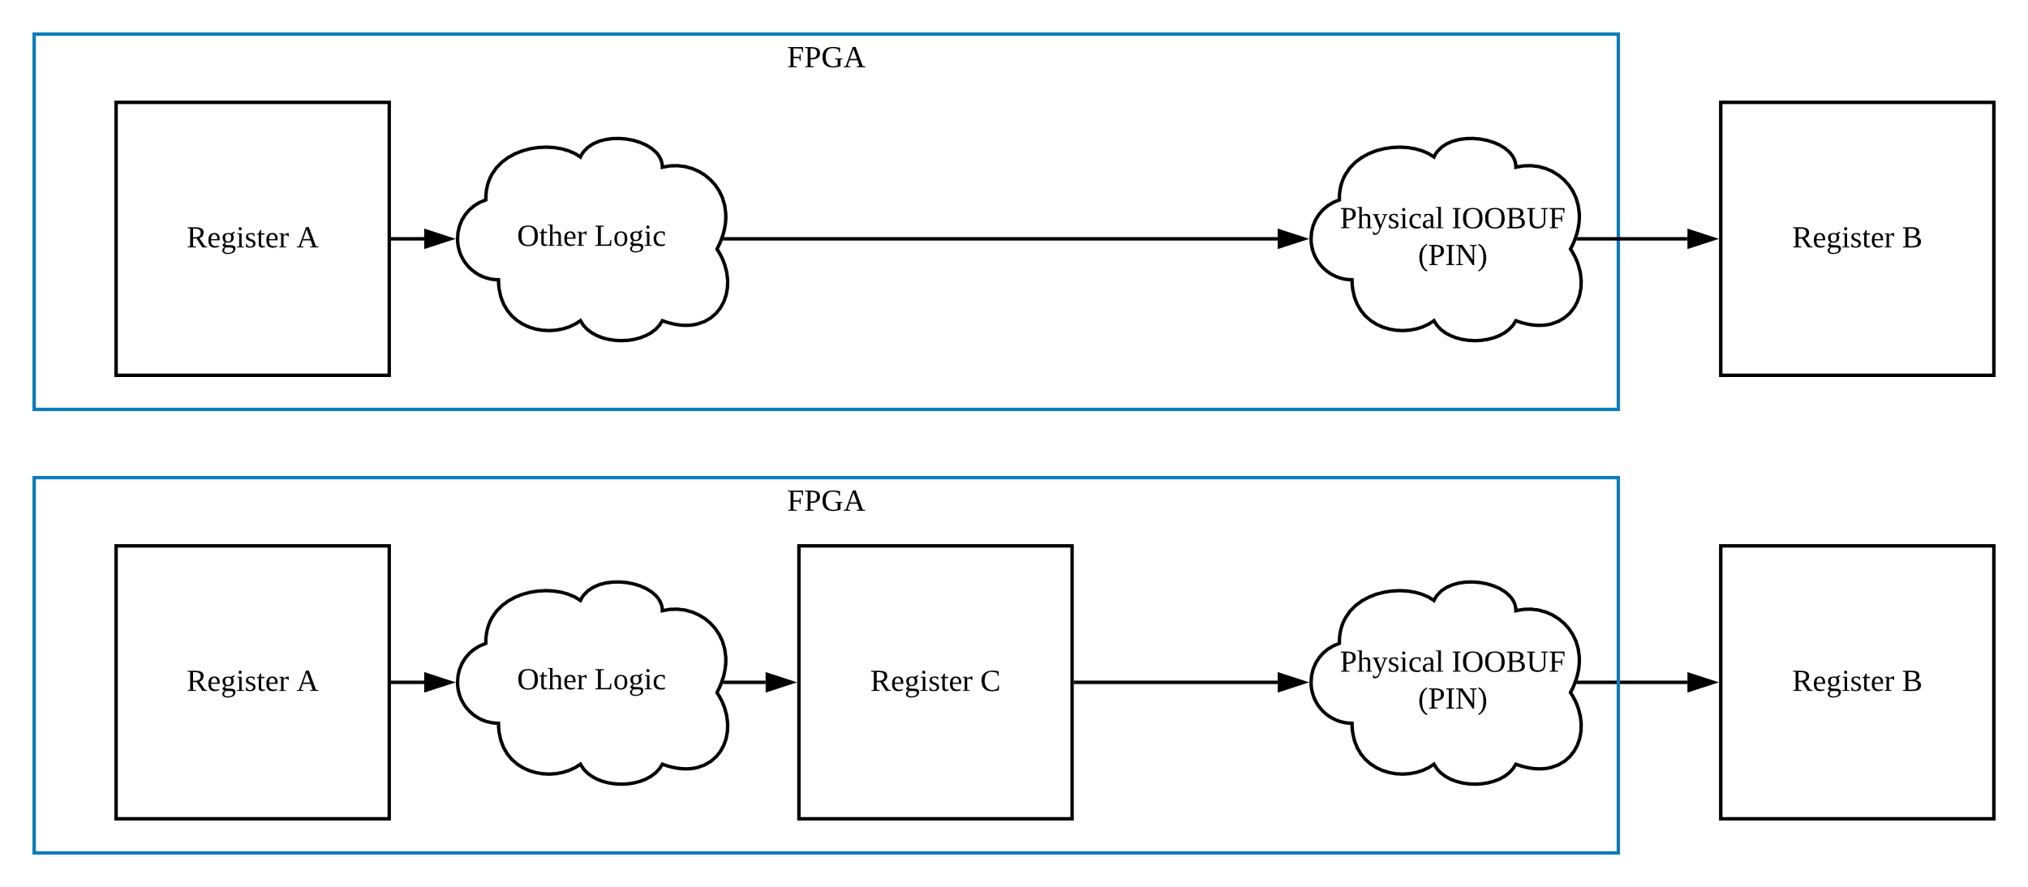
How to optimize Fmax, continued…

Slide 28
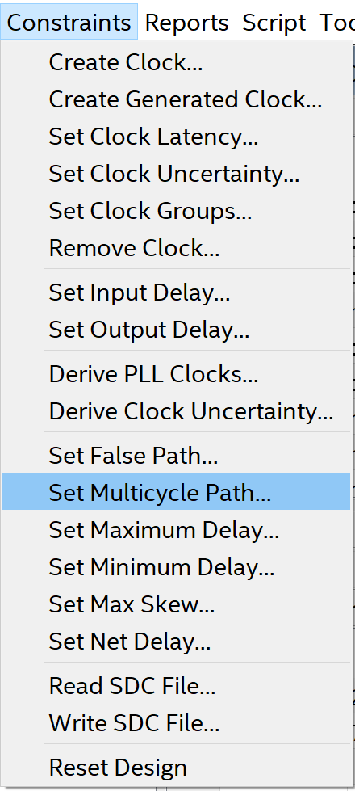
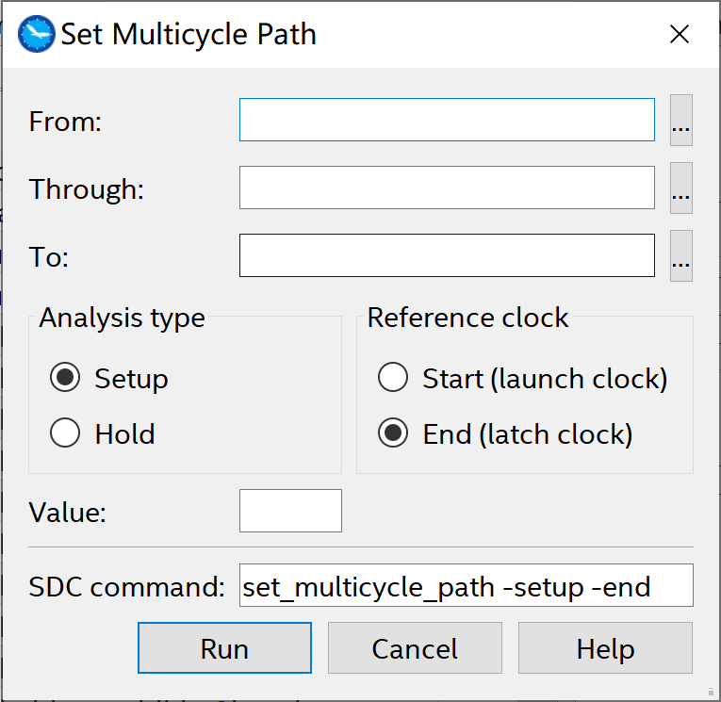
How to optimize Fmax – Multicycle Path
Multicycle Path: A path where data from one register is allowed to take more than one clock cycle to reach to the destination register.
You can set Multicycle Path in Timing Analyzer.

Slide 29
How to optimize Fmax – Pin Delay
Pin Delay: The delay for a signal from some point to appear on an output pin, or in the case of MP3, the output of a module.
Often it can be very useful to place registers on the outputs of your modules (very similar to MAR in MP2), that way there is almost zero combinational logic between the logic of your module and the actual output signal.

Slide 30
Miscellaneous Topics
Why is your fitting process takes a very long time? Quartus could not make your design pass timing constraints during fitting, but it kept on trying because your current Fmax is close to the desired Fmax.
You could adjust how “willing” Quartus is for fitting your design under Project Settings -> Compiler Settings -> Advanced Settings (Fitter) -> Fitter Effort.
Check out Design Space Explorer, which tries to use different seeds for fitting copies of the same project. You could compile multiple copies of your project at the same time, and pick the one with the largest Fmax. (Sounds like a slot machine?)
If you want to learn more on device-level details on timing, ECE 482/483 would be some nice courses on these topics.

Slide 31
Any questions?

Slide 32
References
R.K. Brayton and K. Keytzer, 2004, Retiming, UC Berkeley, Retrieved from https://people.eecs.berkeley.edu/~keutzer/classes/244fa2005/lectures/8-2-retiming-ucb.pdf
2004, L04 – Gates, MIT, Retrieved from http://gick.be/public/school/6004/L04-4up.pdf
1999, Operating Requirements for Altera Devices, Intel, Retrieved from https://www.intel.com/content/dam/www/programmable/us/en/pdfs/literature/ds/dsoprq.pdf
P. Cheung, 2019, Timing Constraints & Timing Analysis, Imperial College London, Retrieved from http://www.ee.ic.ac.uk/pcheung/teaching/ee2_digital/Lecture%208%20-%20Timing%20Constraints.pdf

