Slide 1
Automated Timetable Generator
Muhammad Shaheer Alam 2019369
Muhammad Afzal 2019279
Mohammad Arslan 2019306
Maida Shafaq 2019222
Ramsha Suhail 2019435

Slide 2
Inspiration
GIKI’s amazing system of timetable generation.
Double trouble with multiple revisions coming in.
Confusion amongst faculty, students, and admin.
Software Engineering Project came along the way.

Slide 3
Problem Statement
A web based application to input courses, faculty and lecture halls. A back end which processes the inputs, generates a timetable with relevant constraints and downloads a excel file.

Slide 4
Literature Review
Multiple research papers in the domain, but difference in constraints and algorithms
https://www.scirp.org/journal/paperinformation.aspx?paperid=73004
Git Hub code of similar app: https://github.com/mHuzefa/TimetableGeneratorApp
However used Randomized Brute Force Algorithm

Slide 5
Functional Requirements
Hard Constraints | Soft Constraints
No clashes between teacher, student, classrooms | Have a class before the Lab
Classes, Labs to take place in appropriate classrooms | Minimize idle time for teachers and students
 | One hour in a week where no one has classes

Slide 6
Design and Architecture Intricacies
Use Case Diagram
Logical View – Class Diagram
Development View – Component Diagram
Process View – Sequence & Activity Diagrams
Physical View
UI Design

Slide 7
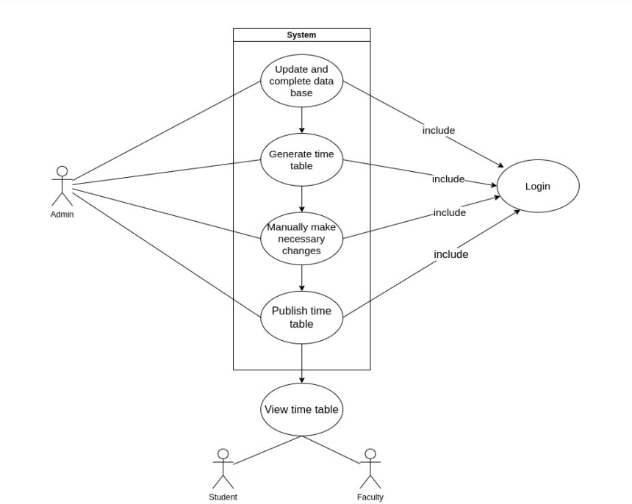
Use Case Diagram

Slide 8
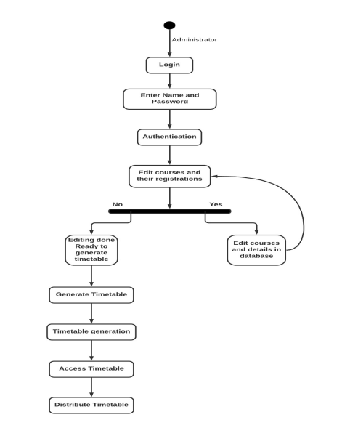
Activity Diagram

Slide 9
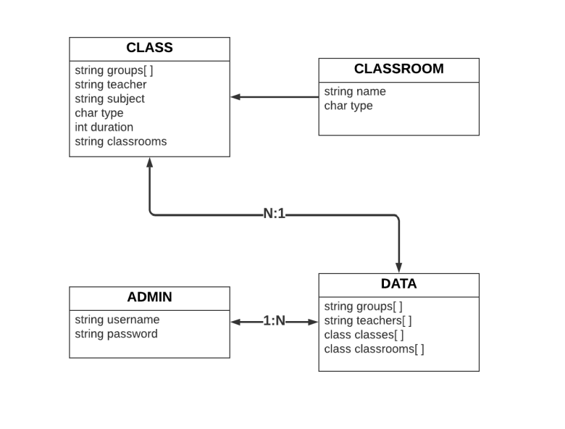
Logical View
Class Diagram

Slide 10
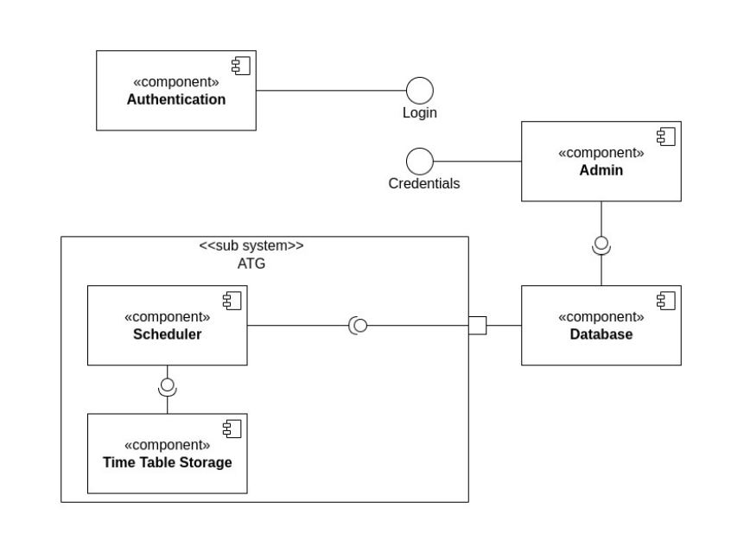
Development View
Component Diagram

Slide 11
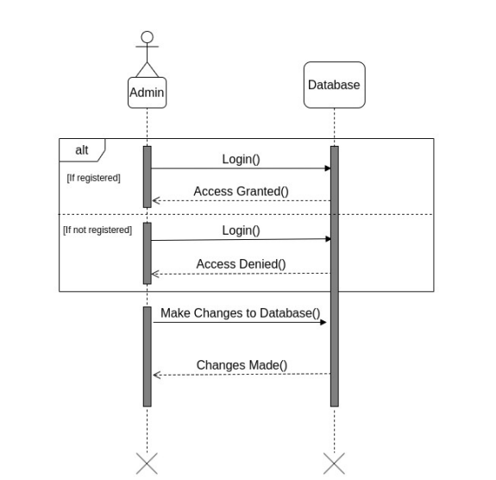
Process View
Sequence Diagram (Making Changes to Database)

Slide 12
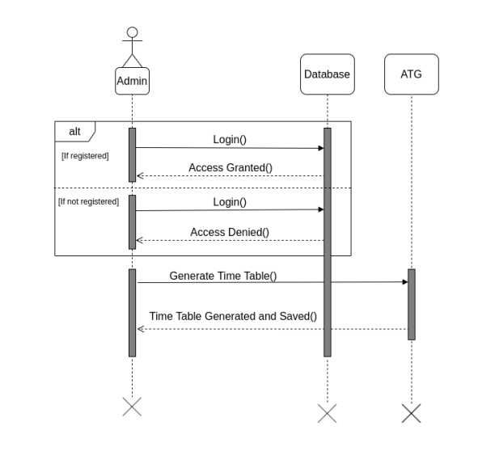
Process View
Sequence Diagram (Generating Timetable)

Slide 13
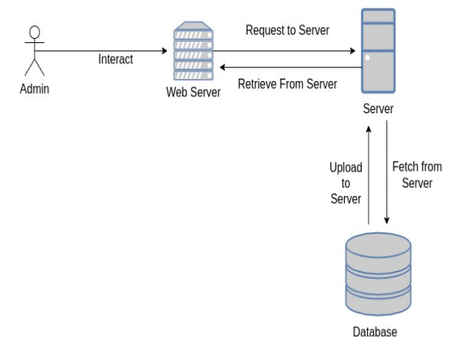
Physical View

Slide 14
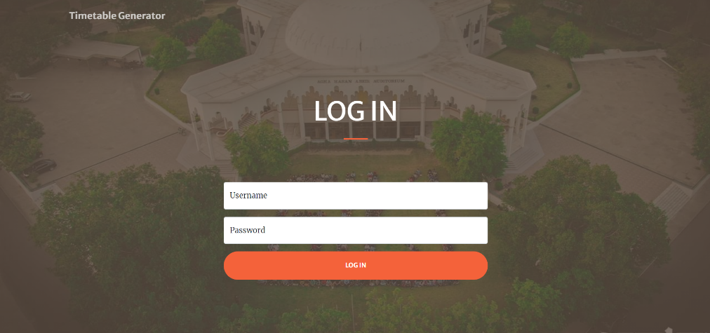
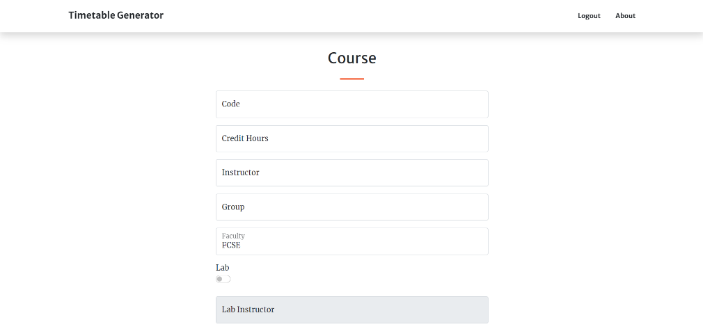
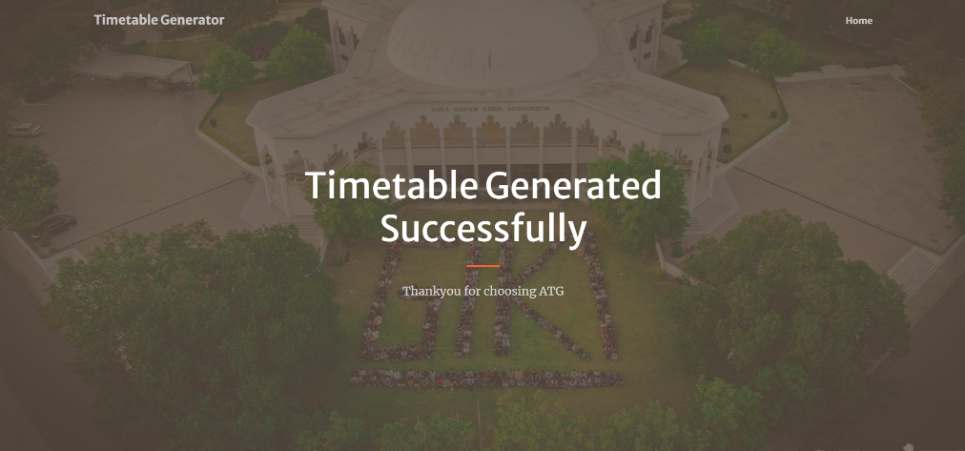
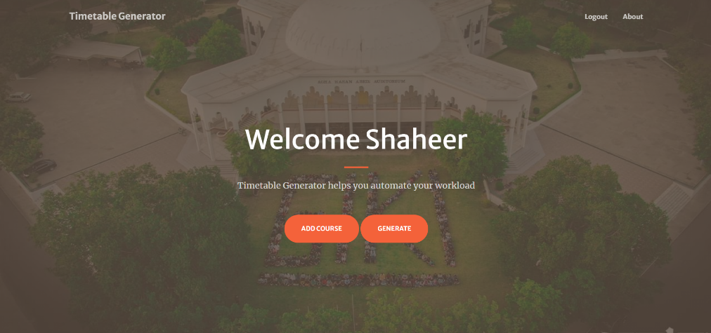
User Interface Designs

Slide 15
Heartiest Thanks to Sir Ahsan!
Open for Questions
Thank You!

