Slide 1

Ramble
CS320
UI Design final project

Slide 2
Introduction
Ramble
Social media app focused on long-form posts
Group
Manan Shahi: Class of 2023, CS major
Ussama Mustafa: Class of 2023, CS & Math major

Slide 3



Domain research
Multitude of social media apps:
Target audience: Really broad
Personal pages / interaction: Twitter, Instagram…
Forums / communities: Reddit, Quora…

Slide 4
Interviewees
Participant 1, College student, freshman
Participant 2, College student, Senior
Participant 3, College student, Senior

Slide 5
Interview Takeaways
Why do people use social media apps or forums?
Entertainment, easy content to consume and defeat boredom
Find interesting topic, learn new information
Create personal page, look at what others are doing
Make online friends, join communities
Have a place to share hobbies, interests

Slide 6
Interview takeaways
What specific UI elements do you look for?
Vibrant colors
No clutter
Content recommendation blocks
Showcasing news / trends
Good sidebars / navbars (YouTube, Twitter…)

Slide 7
Interview takeaways
What do you dislike in social media app designs?
Ads / popups
Censorship and inconsistent bans
Removal of features (See dislikes)
Bad / irrelevant recommendations
Necessity to download app on phone / not being able to view on browser

Slide 8
Interview Takeways
How do you look for specific information on forums?
Google it
Find relevant YouTube videos (video content is easier to grasp)
A google search + ‘reddit’ leads to relevant subreddits

Slide 9


Keywords
Does:
Mindless scrolling
Pass time
Hobbies
Fight boredom

Slide 10
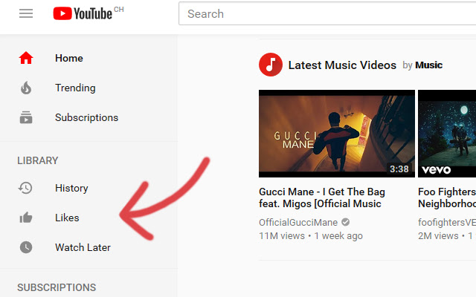
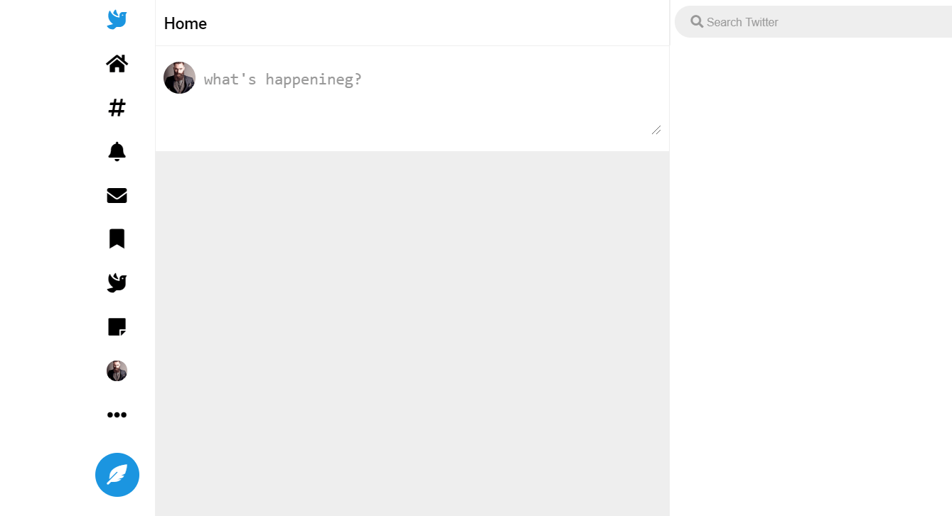
Keywords
Likes:
Bright colors, pretty icons
Interaction with posts (likes, comments …)
Easy access to posts of friends
Useful side bars for navigation

Slide 11

Keywords
Dislikes:
Censorship
Static user experience
Cluttered UI
Ads / pop ups

