Slide 1
IMDB CHALLENGE
By: Sachin, Harsha AND ShAHIQ

Slide 2
Visualizations

Slide 3
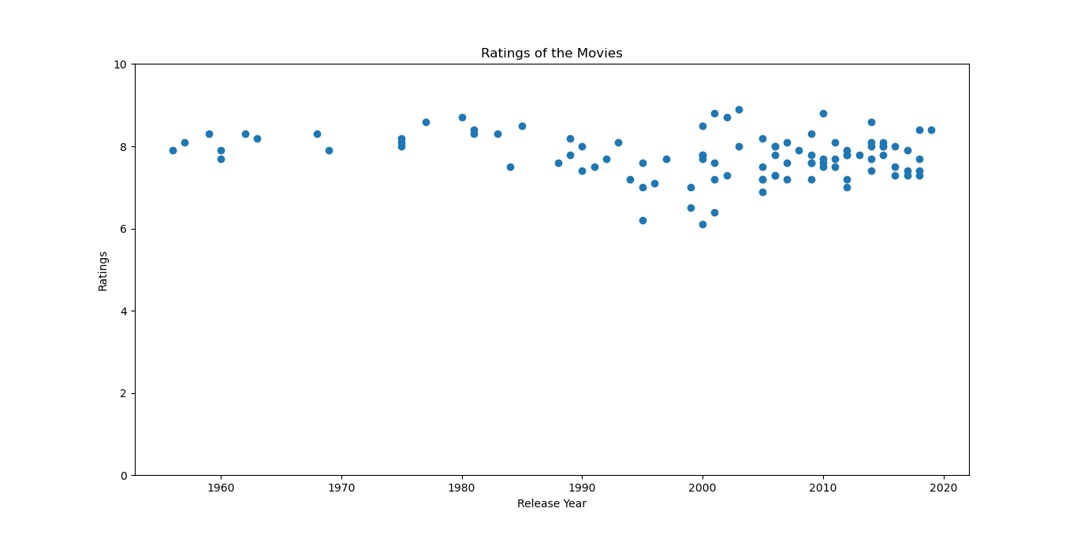
Year of release vs. Rating of Movies

Slide 4
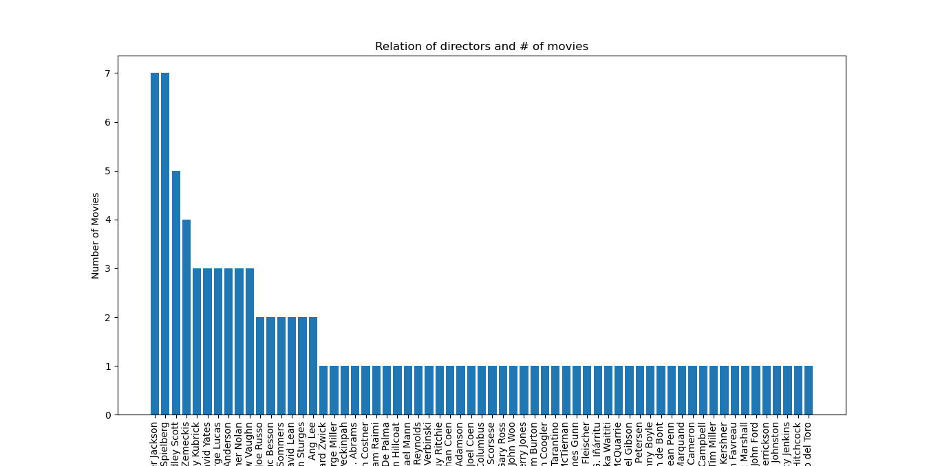
Director vs. # of movies

Slide 5
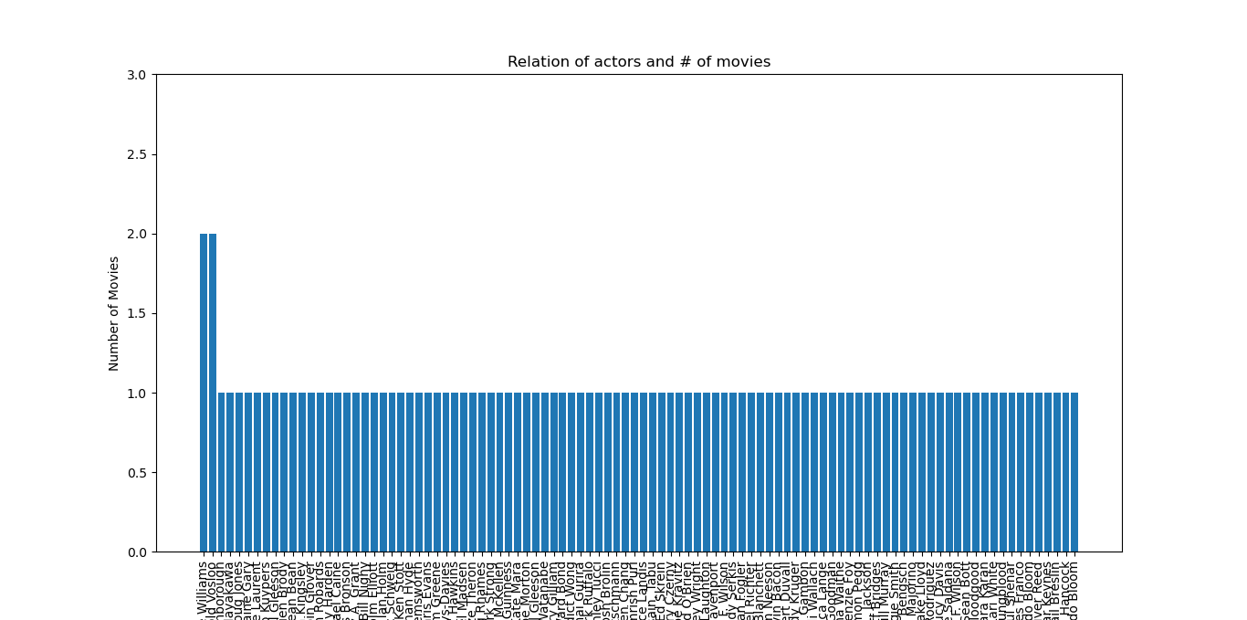
Actor vs. # of movies

Slide 6
THANKYOU ☺

