Slide 1
CS 110 Principles of Web Development
04/18/2022

Slide 2
Puzzle
Using (, ), +, -, *, and /, along with [3, 3, 7, 7] generate an equation that makes 24
For example, 3*3+7/7 is equal to 10.

Slide 3
Get and post methods
A POST, unlike a GET, typically has relevant information in the body of the request.
GET requests a representation of the specified resource.
GET should not be used for operations that cause side-effects, such as using it for taking actions in web applications.
Robots and crawlers can attack
POST submits data to be processed (e.g., from an HTML form) to the identified resource.
A POST, unlike a GET, typically has relevant information in the body of the request.

Slide 4
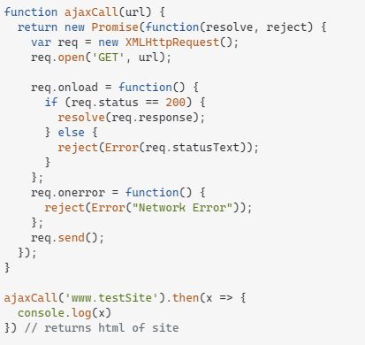
Fetch API / AJAX call
You can request servers inside your JavaScript code without going to the website directly.

Slide 5
Fetch API / AJAX call cont.
Fetch is a JavaScript function that performs AJAX call and has built-in functions such as:
clone() - Creates a clone of a Response object.
error() - Returns a new Response object associated with a network error.
redirect() - Creates a new response with a different URL.
arrayBuffer() - Returns a promise that resolves with an ArrayBuffer.
blob() - Returns a promise that resolves with a Blob.
formData() - Returns a promise that resolves with a FormData object.
json() - Returns a promise that resolves with a JSON object.
text() - Returns a promise that resolves with a USVString (text).

Slide 6
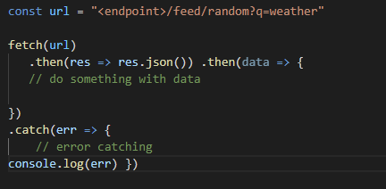
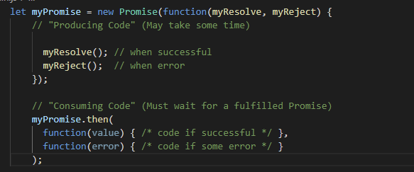
Fetch
Returns a promise.
What is a promise?
Sometimes you don’t have enough information to run a function, so you create a promise that when you gathered the information, you will call that function. ( .then() )
How to generate promise in general:

