Slide 1
E-retail factors for customer activation and retention: A case study from Indian e-commerce customers
Shailja Tiwari
Data science intern
Flip Robo Technology

Slide 2
Problem Statement
Customer satisfaction has emerged as one of the most important factors that guarantee the success of online store; it has been posited as a key stimulant of purchase, repurchase intentions and customer loyalty. A comprehensive review of the literature, theories and models have been carried out to propose the models for customer activation and customer retention. Five major factors that contributed to the success of an e-commerce store have been identified as: service quality, system quality, information quality, trust and net benefit. The research furthermore investigated the factors that influence the online customers repeat purchase intention. The combination of both utilitarian value and hedonistic values are needed to affect the repeat purchase intention (loyalty) positively. The data is collected from the Indian online shoppers. Results indicate the e-retail success factors, which are very much critical for customer satisfaction.
E-retail factors for customer activation and retention: A case study from Indian e-commerce customers

Slide 3
Summary of Analysis :
Survey was done and a dataset was provided containing the details of the participants of a survey, along with their online shopping experiences, preferences, and opinions regarding various e-commerce websites.
The Dataset was first checked for null values, and then the various feature columns were analyzed.
Exploratory Data analysis was conducted to investigate the relationship between the columns, using various visualization techniques.

Slide 4
About the Dataset:
The given dataset consists of 71 columns and 269 rows
'Which of the Indian online retailer would you recommend to a friend?’ is the customer retention because it represents a customer’s loyalty to a website.

Slide 5
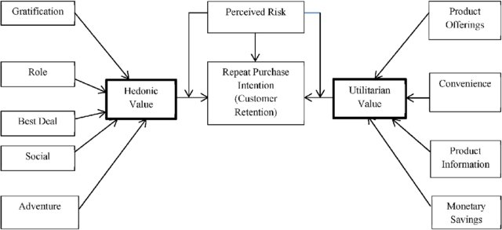
Project design

Slide 6
Experimental analysis
According to studies it is observed that repeat customer purchase resulting from a long standing loyalty positively affects an e-retailer growth and profitability.
The motivation level of a Customer to shop from an e-retail vendor depends on various factors. They can be psychologically categorized into two broad categories:
Hedonistic (b) Utilitarian shopping values.
Hedonistic values represent the excitement, and pleasurable experiences derived from shopping online.
Utilitarian shopping values are those related to the level of fulfillment as a result of being able to achieve the shopping goals.

Slide 7
Aside from Hedonic and Utilitarian values, certain perceived risks also influence the purchase decision of an online customer and therefore, these risks are also a crucial factor in determining the loyalty of a customer to an e-commerce brand.
Because of temporal and spatial separation between the sellers and buyers, online shopping has a more pronounced perception of risk than the traditional physical shopping store.

Slide 8
Exploratory Data Analysis
The individual columns of the dataset were first analyzed to study their composition and then, with reference to the diagram and the theoretical background of the case study, the relationships between various columns were understood through data visualization matplotlib and seaborn and various libraries.

Slide 9
Selecting the target column
If I recommend something to someone I must like it and more likely I will revisit or shop from the same site. Hence taget column must be:
Which of the Indian online retailer would you recommend to a friend?

Slide 10
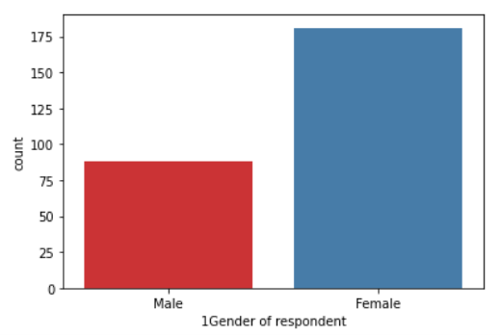
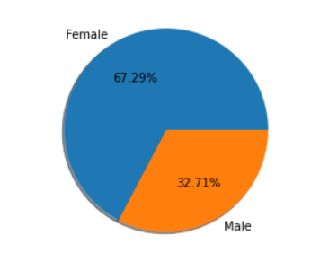
Consumer Distribution
Columns which contained details regarding the demographics of the participants (age, gender, location) were visualized and analyzed.

Slide 11
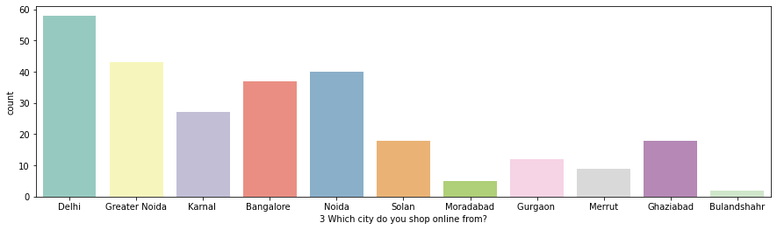
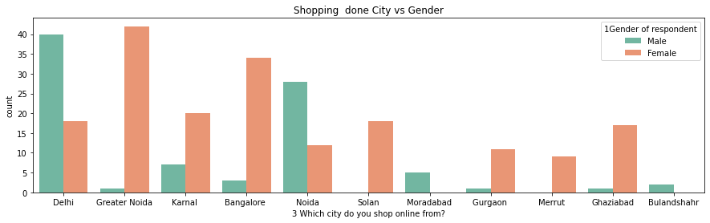

Slide 12
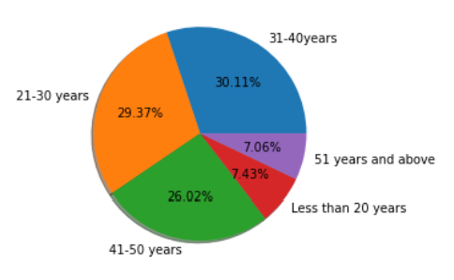
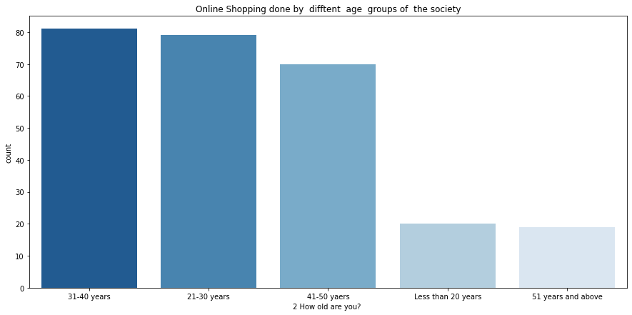

Slide 13
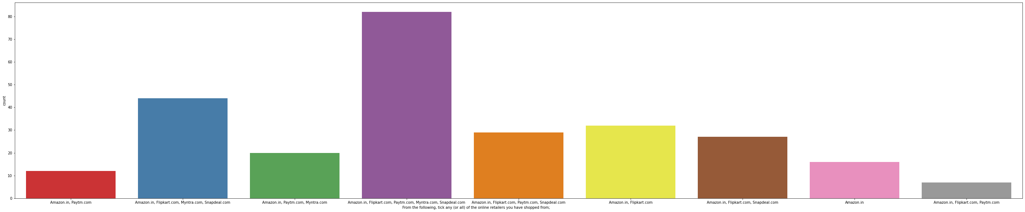
It is observed that Amazon is the most popular E commerce website followed by Flipkart.

Slide 14
Consumer Distribution
Based on the above graphs it is observed that:
Majority of the participants are female, comprising 67.29% of the total participants of the survey.
Most of the participants hail from Delhi, Greater Noida, Noida, and Bangalore.
Majority were Male of those who hailed from Delhi and Noida. While of those who hailed from Greater Noida, Bangalore and Karnal, Ghaziabad and Solan the majority were Female.
The age distribution of the majority of the participants lies in the range of 21-40 years, with 59.48% of the total participants falling within that age range, while 26.02% of the participants belong to the age range of 41-50 years.

Slide 15
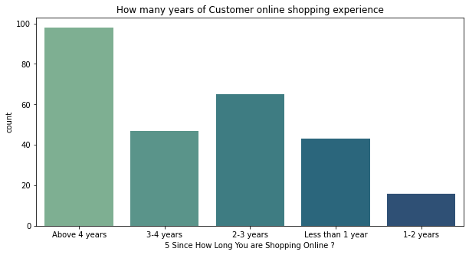
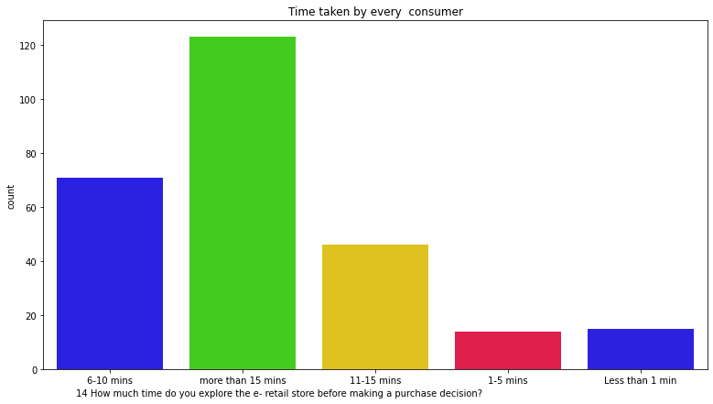
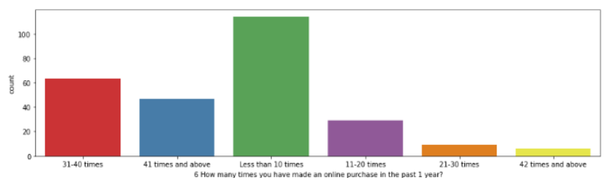
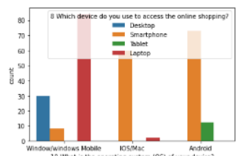
Online shopping Timeline

Slide 16
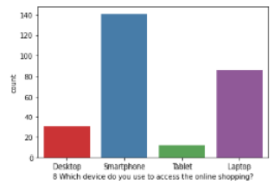
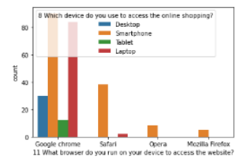

Slide 17
Online shopping Timeline
Majority of the consumers have been shopping for over 4 years and have made less than 10 purchases in the last 1 year.
Smartphone and mobile internet are the most popular means of accessing ecommerce websites, with most common screen size being 5.5 inches or greater.
Windows operating system is the most popular on Laptop/Desktop devices while android is the most popular OS on smartphone devices followed by iOS.
Google Chrome is the most popular web Browser, especially on portable devices, followed by Safari.
Search Engine is the most common means of arriving at the E commerce websites, followed by Application and Direct URL.
Most consumers spend over 15 mins browsing an e-commerce website before making a purchase decision.

Slide 18
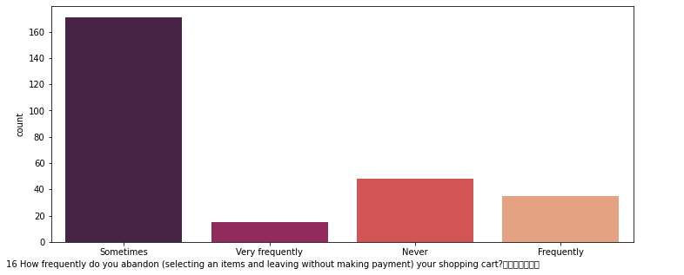
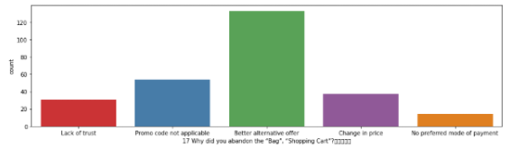
Consumer Hesitation
Various factors/reasons which contributed to consumers’ hesitation to complete a purchase online were analyzed from the data provided under the columns of the dataframe.

Slide 19
Consumer Hesitation
Based on the above graphs it is observed that:
Consumers sometimes abandon items in shopping cart.
Finding a better alternative offer is the most common reason behind why consumers abandon items on a particular e commerce website.

Slide 20
Consumer Thoughts on Website and it’s Features
Analyzing the opinions of the participants on the various features of the e-commerce websites reveals that majority of the consumers strongly agree that:
The content on the website must be easy to read and understand
Information on similar product to the one highlighted is important for product comparison
There should be Responsiveness, availability of several communication channels (email, online rep, twitter, phone etc.)
Online shopping gives monetary benefit and discounts
Enjoyment is derived from shopping online
Shopping online is convenient and flexible
Return and replacement policy of the e-tailer is important for purchase decision
The Convenience of patronizing the online retailer
Shopping on the website gives you the sense of adventure
Shopping on your preferred e-tailer enhances your social status
You feel gratification shopping on your favorite e-tailer
Shopping on the website helps you fulfill certain roles
Getting value for money spent is important

Slide 21
Convenient Payment methods should be available.
There is trust in the online retail store fulfilling its part of the transaction at the stipulated time
There should be Empathy (readiness to assist with queries) towards the customers
Online retail store should be able to guarantee the privacy of the customer
Complete information on listed seller and product being offered is important for purchase decision
All relevant information on listed products must be stated clearly
Navigation in website should be easy
Loading and processing should be quick
Interface of the website must be user friendly
Gaining access to loyalty programs is a benefit of shopping online
Displaying quality Information on the website improves satisfaction of customers
User derive satisfaction while shopping on a good quality website or application
Net Benefit is derived from shopping online can lead to users satisfaction
User satisfaction cannot exist without trust
E commerce websites must Offer a wide variety of listed product in several category
There should be Provision of complete and relevant product information
Monetary savings must be considerable

Slide 22
Consumer Ecommerce Website preferences and opinions
Analyzing the Preferences and opinions of the participants regarding the e-commerce websites reveals that:
Amazon.in, Flipkart.com, Paytm.com, Myntra.com, Snapdeal.com are the most popular e-commerce websites.
Amazon.in, Flipkart.com, Paytm.com, Myntra.com, Snapdeal.com are the easiest to use websites and applications
Amazon.in and Flipkart.com have the most visually appealing web-page layout.
Amazon.in and Flipkart.com have the widest variety of products on offer.
Amazon.in and Flipkart.com have the most complete, relevant description information of products.
Amazon.in, and Paytm.com have the fastest loading speed while Flipkart is regarded by very few as being quick to load

Slide 23
Consumer Ecommerce Website preferences and opinions
Amazon.com, Flipkart.com, Paytm.com are considered quick to complete purchases.
Amazon.in, Flipkart.com are regarded by most to have several payment options available
Amazon.in is regarded to offer speedy order delivery by most.
Amazon.in offers the most Privacy for customers’ information.
Amazon.in , followed by Flipkart.com, Paytm.com, Myntra.com, Snapdeal.com provide the best security for customer financial information.
Amazon.in is perceived to be the most trustworthy website by the majority of participants.
Amazon.in, Flipkart.com, Myntra.com, Snapdeal have the highest presence of online assistance through multi-channel.
Most people face longer time to get logged in during promotion, sales period on Amazon.in and Flipkart followed by Paytm and Myntra.

Slide 24
Consumer Ecommerce Website preferences and opinions
Amazon.in, Flipkart.com take the longest time displaying graphics and photos during promotion, sales period.
Most people face Late declaration of price on Myntra and Paytm during promotion, sales period.
Myntra and Paytm take the longest page loading time during promotion, sales period.
Snapdeal.com and Amazon.in have the most limited modes of payment on most products during promotion, sales period.
Paytm.com and Snapdeal.com have Longer delivery periods compared to others.
Amazon.in and Paytm.com have had recent changes in website/Application design, as observed by the consumers.

Slide 25
Analyzing Relationship between Customer retention and Perceived Risks
Columns that represent abandoning shopping carts on e commerce websites, reasons behind abandoning shopping carts,Longer delivery period,Website disruption,Customer Data security,Trustworthiness etc. represent perceived risks
While the Column representing the recommended e commerce brands represents customer loyalty / retention.
The relationships between the columns representing the perceived risks and the column representing Customer retention were visualized and observations were made.

Slide 26
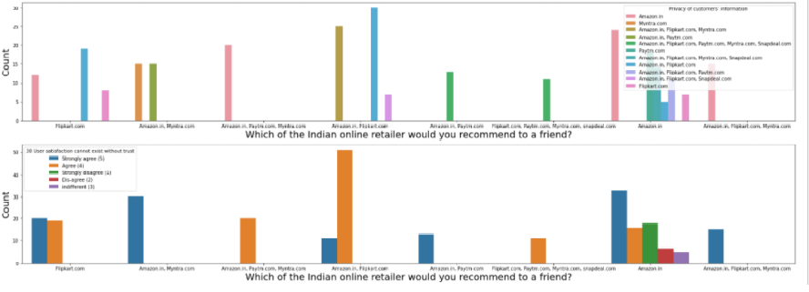
Relationship between Customer retention and Perceived Risks

Slide 27
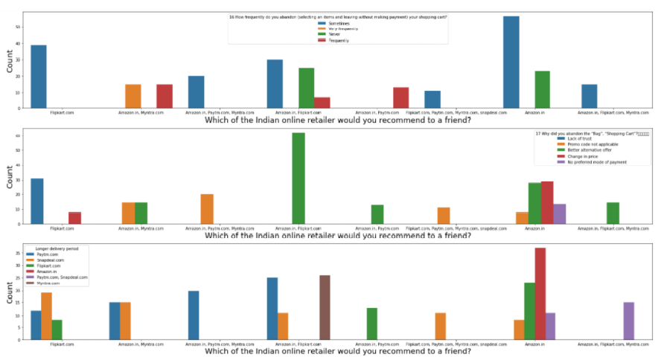
Relationship between Customer retention and Perceived Risks

Slide 28
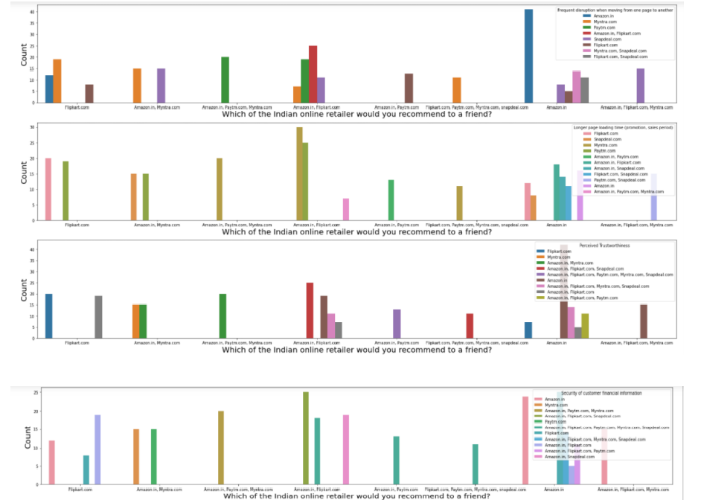
Relationship between Customer retention and Perceived Risks

Slide 29
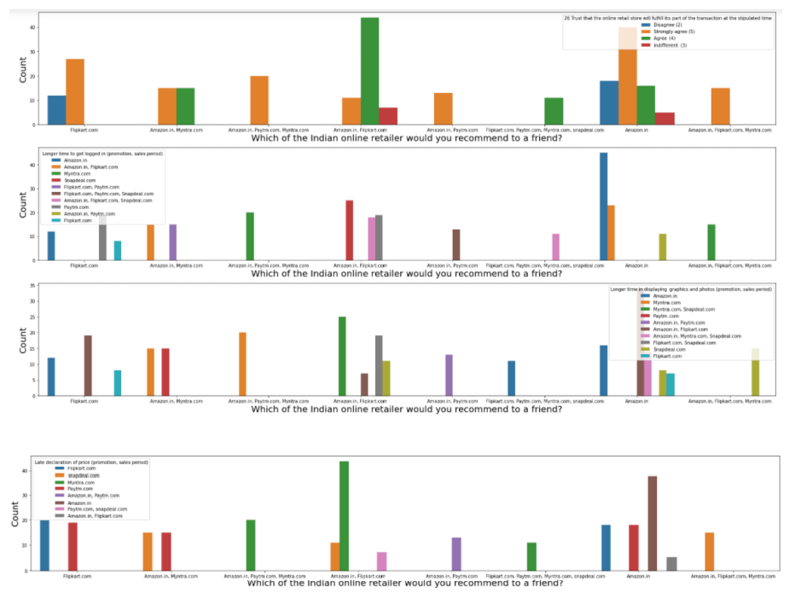
Relationship between Customer retention and Perceived Risks

Slide 30
Relationship between Customer retention and Perceived Risks
From the graphs above the following observations are made:
Customers sometimes abandon their shopping carts on Amazon and Flipkart implying there is a low level of perceived risk for those websites. While some people frequently abandon their shopping carts on Amazon.in and Myntra.com and Paytm.com, which may indicate a higher level of perceived risk on those websites.
Customers usually abandon their shopping carts on Amazon and Flipkart when they find a better alternative offer which implies that there is a greater importance for utilitarian value, While on Flipkart alone they mostly abandon due to lack of trust and on amazon alone, they abandon either due to Promo code not being applicable or Change in price.
Customers face longest delivery Periods when they purchase on Amazon.in, followed by flipkart.com and paytm, however Amazon.in is still the most preferred shopping website.
It is observed that those who prefer Flipkart.com , Paytm.com, Myntra.com and Snapdeal.com to Amazon.in do so because they face frequent disruption when moving from page to page on Amazon.in

Slide 31
Customers face the longest time to get logged in on Amazon.in and Flipkart.com the most and yet, recommend those 2 websites the most.
Customers prefer Amazon.in and Flipkart.com To Myntra.com and Snapdeal.com because Myntra and Snapdeal take longer to display graphics and photos during promotion and sales period.
Customers prefer Amazon.in and Flipkart.com To Myntra.com and Snapdeal.com because Myntra and Snapdeal take too long to declare prices during promotion and sales period.
Those who prefer Amazon.in and Flipkart.com face longer page loading time during promotion and sales period on snapdeal.com and myntra.com
Amazon.in has the highest trustworthiness as perceived by most consumers.
Amazon.in, Flipkart.com, Paytm.com have the highest security for customer financial information.
Amazon.in, Flipkart.com, Paytm.com maintain the greatest privacy for customer information.
Customers who believe that user satisfaction can’t exist without trust recommend Amazon.in and Flipkart.com
Those customers who recommend Amazon.in and Flipkart.com the most trust that online retail stores will fulfill their part of the transaction at the stipulated time.

Slide 32
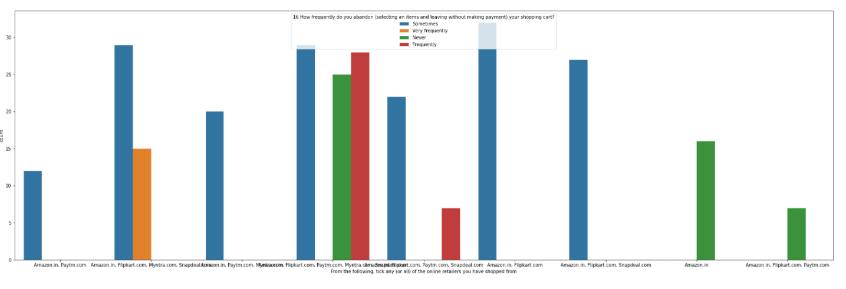
Calculated Risk on E Commerce Websites
The relations between perceived risks and online e-commerce websites were visualized and observations were made.

Slide 33
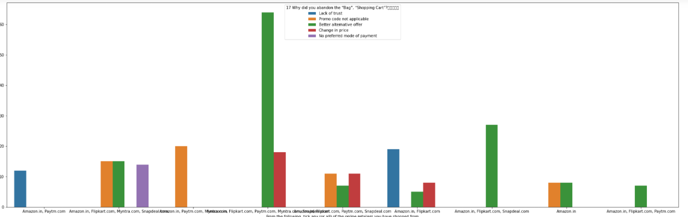
Most customers abandon their shopping carts on Amazon and Flipkart because of change in price or when they find a better deal elsewhere, whereas on Paytm , Myntra , Snapdeal etc. the reasons are varied but largely are due to lack of trust or absence of preferred mode of payment.

Slide 34
Conclusion.
From the above Exploratory Data Analysis, it is determined that for any website to retain customers, for the growth of its customer-base and to build and maintain a successful business, it is important that the E-tailers focus on enhancing customer experience in shopping on their websites, while ensuring that all of their particular hedonic and utilitarian needs are satisfied, while taking steps to minimise the perceived risks.
Offering a huge variety of products, impeccable website design, user friendly interface, a huge variety of safe and convenient payment options, offering strong data security and privacy, helpful, empathetic support staff and impeccable customer service, optimized website processes that universally load in optimal time on all types of platforms and systems, faster delivery etc. are vital to ensure customer loyalty to the brand of the e-tailer Experienced customers, give great importance to their experiences of previous purchases, which in turn speeds up the process of attaining their shopping goals.

Slide 35
Repeat customer rate. Repeat customer rate is the backbone of customer retention. ...
Purchase frequency.
Average Order Value.
Use customer accounts.
Improve your customer support.
Start a customer loyalty program.
Send engaging emails to customers.
Offer a discount or credit to return.

