Slide 1


COLLEGE HOSTEL BOOKING SYSTEM
SUPERVISOR Mr.A.Malarmannan,M.E., AP/CSE.
PRESENTED BY
2303811710422141– SHAJATHI BEE M

Slide 2

PRESENTATION OVERVIEW
Objective
Project Introduction
Problem Statement
Methodologies (Programming concepts relevant to problem statement)
Architecture of the proposed system
List of Modules
7. Merits
8. Results and Discussion
9. Queries

Slide 3
OBJECTIVE
The objective of the Room Booking Application is to provide an efficient, user-friendly desktop solution for managing room bookings.
The application allows users to:
Register for an account and log in securely using a username and password.
View available rooms and their booking status (whether they are available or already booked).
Book available rooms and provide special requests if necessary.
Manage room availability by updating the status of rooms once they are booked.
Exit the application in a controlled manner.

Slide 4
PROJECT INTRODUCTION
The Room Booking Application is a simple, interactive desktop-based application that allows users to register, log in, view available rooms, and book rooms.
The app is designed using Java AWT for the graphical user interface (GUI), providing a clean, user-friendly experience.
It allows users to manage room bookings in a hotel or similar setting by interacting with different panels that cater to registration, login, room booking, and viewing room availability..

Slide 5
PROBLEM STATEMENT
The problem addressed by this application is the management and booking of available rooms in a facility, such as a hotel. In the traditional setup, users may have to manually check room availability and rely on human agents to reserve rooms.
This software aims to streamline the booking process by offering:
User-friendly registration and login features.
Easy navigation for checking room availability.
Seamless booking of rooms based on availability.

Slide 6
Methodologies (Programming concepts relevant to problem statement)
DATA STRUCTURES:
ArrayList: To store the list of rooms and bookings.
HashMap: To map student IDs to their bookings or to store room availability based on room IDs.
PriorityQueue: To handle prioritization of booking requests, e.g., prioritizing students based on booking date or special needs.
CLASS:
We will define several classes such as Room, Booking, Student, Room- Manager, etc. to represent different entities in the system. Each class will have attributes and methods related to its role in the system.

Slide 7
Methodologies (Programming concepts relevant to problem statement)
CONTROL FLOW:
Implement the logic for booking rooms, checking availability, and updating sta- tuses.
Conditional statements (if-else) to check for availability, handle booking con- formation.
Loops to iterate through available rooms, view bookings, and process requests.
SYNCHRONIZATION :
To handle concurrent access to the booking system, use synchronization (e.g.,
synchronized methods or blocks) to ensure that only one student can book

Slide 8
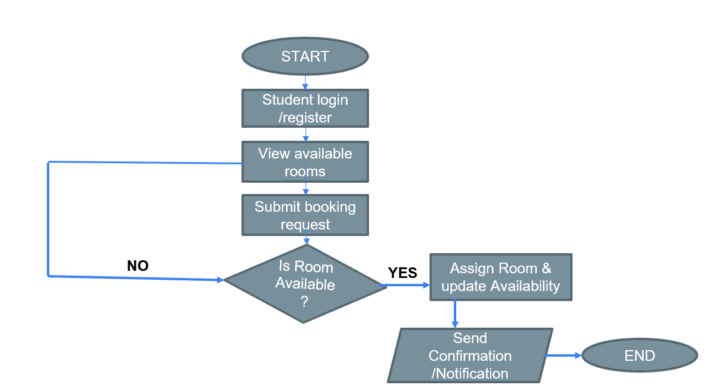
Architecture of the proposed system

Slide 9
MODULE DESCRIPTION
User Interface Module
Provides an intuitive and interactive platform for students to view available rooms, submit booking requests, and manage account details. Built with Java Swing or JavaFX, it allows users to search for rooms, apply filters based on preferences (e.g., room type, capacity), and securely register/login to make bookings.
Real-Time Availability Module
Ensures that room availability is updated dynamically. Using multi-threading and the Observer Design Pattern, it continuously monitors and reflects changes in room status, ensuring that users always see up-to-date information and preventing double bookings.
Booking Management Module
Handles booking requests, processes them based on room availability, and ensures fair distribution using a priority queue. It includes features for confirming bookings, updating room status, and controlling concurrency to prevent simultaneous bookings of the same room.
Notification and Confirmation Module
Just displays a statement if the room booking is successful.
However the complete the module will be implemented completely in the future by working on sending an message directly to student as mail.

Slide 10
MERITS
Ease of Use: The app is designed with a simple and intuitive interface, making it accessible even to users with minimal technical knowledge.
Efficiency: Users can quickly register, log in, and book rooms with minimal clicks.
Modular Design: The system is divided into several modules that handle specific tasks, making it easy to maintain and update.
Real-Time Feedback: The app provides real-time feedback through dialog boxes, ensuring that users are informed about the success or failure of their actions.
Availability Management: The system efficiently tracks room availability and ensures that rooms are only booked once.

Slide 11
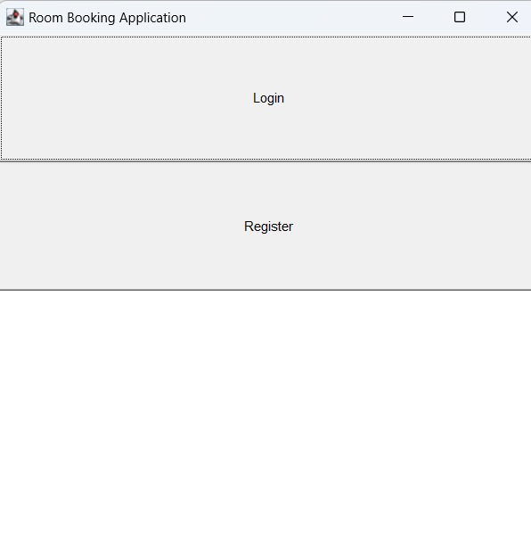
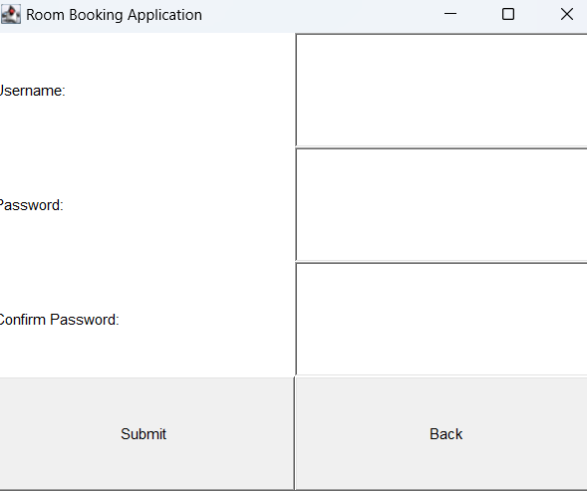
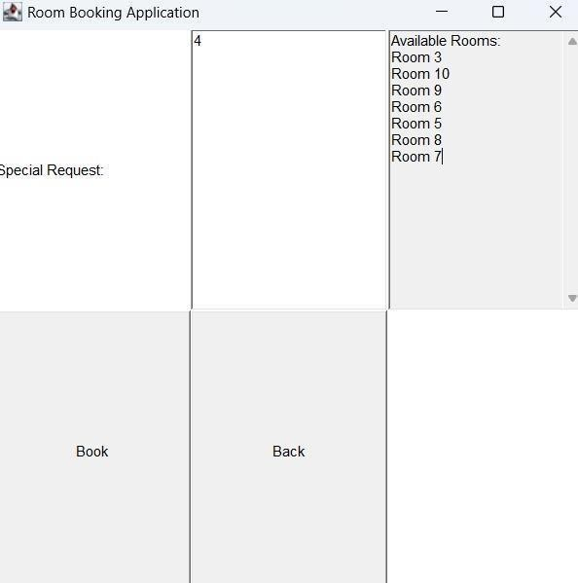
RESULT AND DISCUSSION

Slide 12
ANY QUERIES ?

Slide 13
THANK YOU

