Slide 1
NLP · BERT · AI
Crisis Signal Detector
Leveraging BERT for Real-time Mental Health Monitoring
An End-to-End NLP Solution — from Fine-tuning to Cloud Deployment
🔗 Live Demo: huggingface.co/spaces/mshakeelrasheed/crisis-signal-detector

Slide 2
Project Overview & The Problem
⚡
🛡️
🤝
Scale Problem
AI First Line of Defense
Human-AI Collaboration
Humans cannot manually monitor millions of social media posts, helpline messages, or forum threads in real time.
Automated detection flags high-risk text instantly — providing a 24/7 safety net that no human team could sustain alone.
The system doesn't replace counselors. It triages and prioritizes, so human experts focus where they matter most.
"The system provides an automated first line of defense to flag text indicating a high risk of self-harm."

Slide 3
Dataset & Training Strategy
230K+
10K
⚠️ The Constraint
Google Colab RAM could not handle the full 230K dataset without crashing the session. Strategic downsampling to 10,000 high-quality, representative rows was the engineering solution.
Total Source Records
Training Sample Used
Training Pipeline
1. Load & inspect 230K+ raw records
2. Strategic downsample → 10,000 balanced rows
3. Tokenize with bert-base-uncased (max 128 tokens)
4. Fine-tune BERT classifier on Google Colab (GPU)
5. Tune prediction threshold → 40% sensitivity
6. Export weights (.safetensors) & deploy to HF Spaces

Slide 4
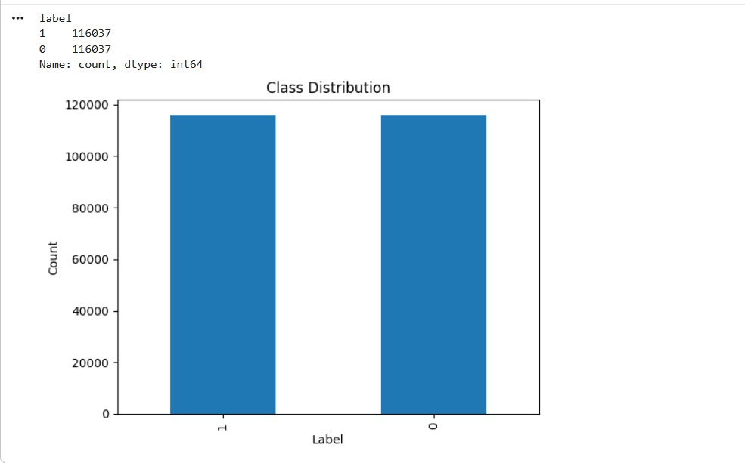
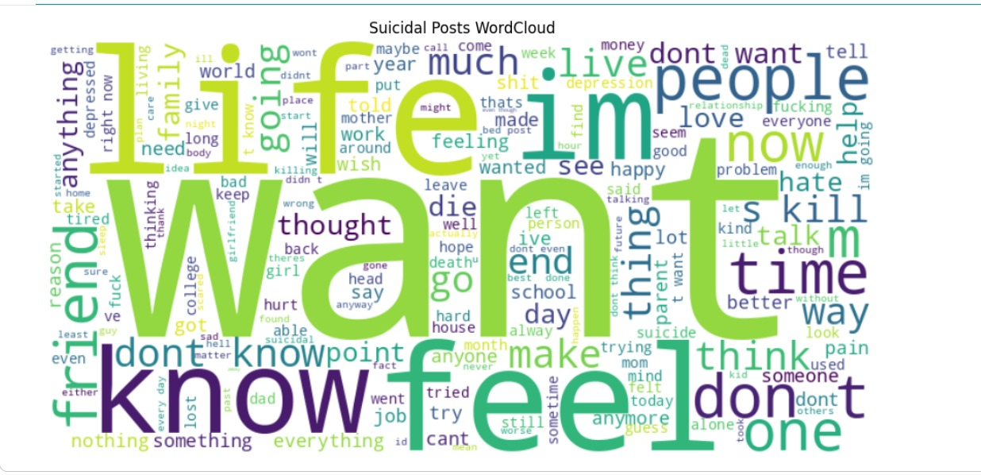
Data Visualization
Class Distribution (Full Dataset)
Suicidal Posts — Word Cloud
✅ Perfectly balanced — 116,037 rows each class. Prevents model bias.
Emotional pain, isolation, and urgency dominate — exactly what BERT learns to detect.

Slide 5
Tech Stack
🧠
BERT
🔥
PyTorch
🤗
Hugging Face
bert-base-uncased
Deep Learning Framework
Transformers + Spaces
Bidirectional Transformer that understands full sentence context, not just keywords.
Powers the fine-tuning process and model weight management.
Model hub for SafeTensors storage and free cloud deployment endpoint.
🖥️
Streamlit
🐳
Docker
Web UI Framework
Containerization
Builds the interactive dashboard with real-time input, predictions, and confidence charts.
Packages app + dependencies into a portable image for reliable cloud execution.

Slide 6
Challenges Faced
01
Hardware Limitations
Google Colab's RAM crashed repeatedly during full-dataset training. Solution: strategic downsampling to 10K rows — sufficient for strong model performance.
02
Deployment Logistics
The model weights file exceeded 400MB. The Docker image had to be carefully structured so the Dockerfile copied model.safetensors to the same directory as app.py.
03
Docker Pathing
Default Docker templates only copy src/ and requirements.txt. The container acted like a strict bouncer — ignoring the weights file entirely until path rules were fixed.
04
Edge Cases — Short Sentences
"I wanna die." returned only 59.6% confidence — a near coin-flip. Length bias in training data meant the model struggled with blunt, short crisis signals.

Slide 7
Architecture & Custom Threshold
Raw Text
Input
Tokenizer
(max 128)
BERT
Encoder
Linear
Classifier
40%
Threshold
✅ SAFE
🚨 CRISIS
Why 40% Instead of the Standard 50%?
🎯 False Negative Risk: Missing a real crisis is far more dangerous than a false alarm. The threshold is tuned toward caution.
⚖️ At 40%, any text the model is even 40% confident about gets flagged — erring on the side of safety, not precision.
📊 This is a deliberate engineering tradeoff: higher recall at the cost of slightly lower precision.

Slide 8
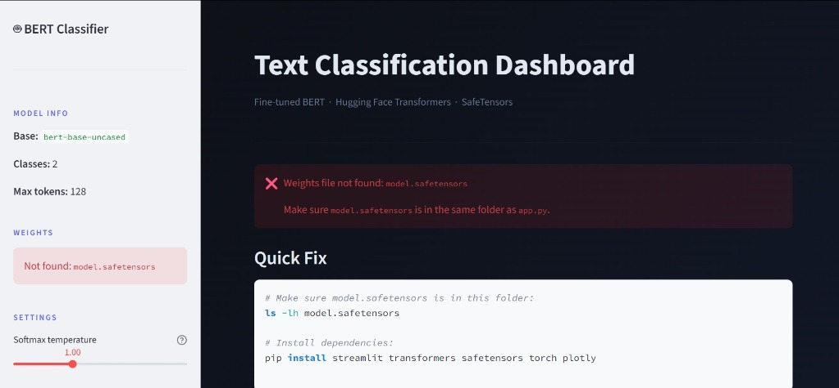
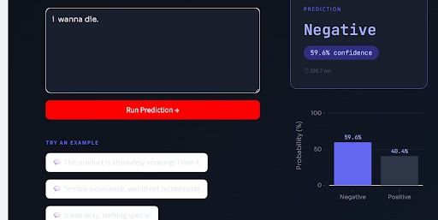
Live Dashboard Demo
App Dashboard — Model Info & Error Handling
Prediction Output — Confidence Score & Probability Chart
Real-time predictions
Confidence % score
Probability bar chart
Under 300ms response

Slide 9
Advantages & Future Work
Current Advantages
Future Roadmap
⚡
< 300ms
🌍
Multilingual Support
Response time — fast enough for real-time deployment at scale.
Extend to Urdu, Arabic, and other languages to reach underserved communities.
☁️
Cloud Native
📱
Social Media API Integration
Docker + HF Spaces means zero setup for end users.
Connect directly to Twitter/Reddit streams for automated real-time scanning.
⚖️
Balanced Data
📈
Full Dataset Training
Perfectly equal class distribution eliminates model bias.
Train on all 230K+ rows using cloud GPUs (Colab Pro / AWS) for higher accuracy.
🎯
Tuned Threshold
🔔
Alert & Escalation System
40% sensitivity prioritizes catching crises over false negatives.
Notify counselors or moderators automatically when crisis signals are detected.

Slide 10
Conclusion
"AI can be more than just a tool — it can be a lifesaver."
✅ Fine-tuned BERT model trained on 230K+ real mental health records
✅ Perfectly balanced dataset ensures unbiased, fair predictions
✅ Custom 40% threshold prioritizes human safety over false negatives
✅ Deployed on Hugging Face Spaces — accessible to anyone, instantly
✅ Real-time response under 300ms with confidence visualization
🔗 Try it live: huggingface.co/spaces/mshakeelrasheed/crisis-signal-detector
Q & A

