Slide 1

APPLICATION OF MACHINE LEARNING IN SMART MANUFACTURING
Md Shams Reza(190103056)
BTP Supervisor: Dr. Biranchi Panda
Department of Mechanical Engineering
Indian Institute of Technology Guwahati
ME 499 BTP Phase II Presentation,
1st May 2022, IIT Guwahati, Guwahati, India

Slide 2
Plan of Presentation
Introduction
Literature Review
Motivation and Objective of the Work
Numerical Formulation / Experimental Details
Results
Result 1
Result 2
Result 2
Conclusions
Future Work/Phase II work

Slide 3
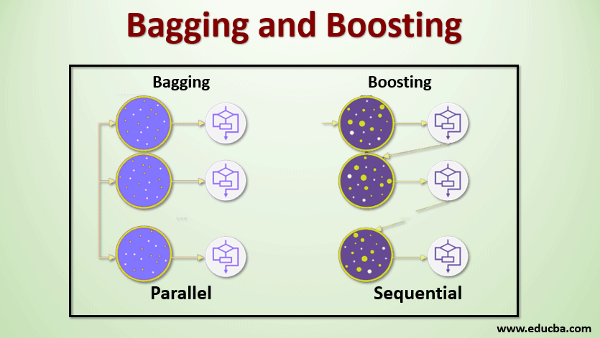
Introduction
Random forest:It is supervised machine learning technique. It is used to solve for regression and classification of problems. It consists of many decision trees. It builds decision trees on different samples and takes their majority vote or classification and average in case of regression.
Supervised learning : where a computer algorithm is trained on input data that has been labeled for a particular output.
Ensemble learning : simply combination of multiple model.
it has two types: Bagging and
Boosting.
Bagging: It creates a different
training subset from sample
training data with replacement &
the final output is based
on majority voting. For example,
Random Forest

Slide 4
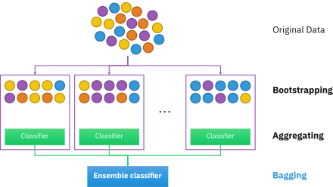
Literature Review
This step of row sampling with replacement is called bootstrap.
This step which involves combining all the results and generating output
based on majority voting is known
as aggregation.
Steps involved in random forest algorithm: Step 1: In Random Forest n number of random records are taken from the dataset having k number of records. Step 2: Individual decision trees are constructed for each sample. Step 3: Each decision tree will generate an output. Step 4: Final output is considered based on Majority Voting or Averaging for Classification and regression respectively.

Slide 5
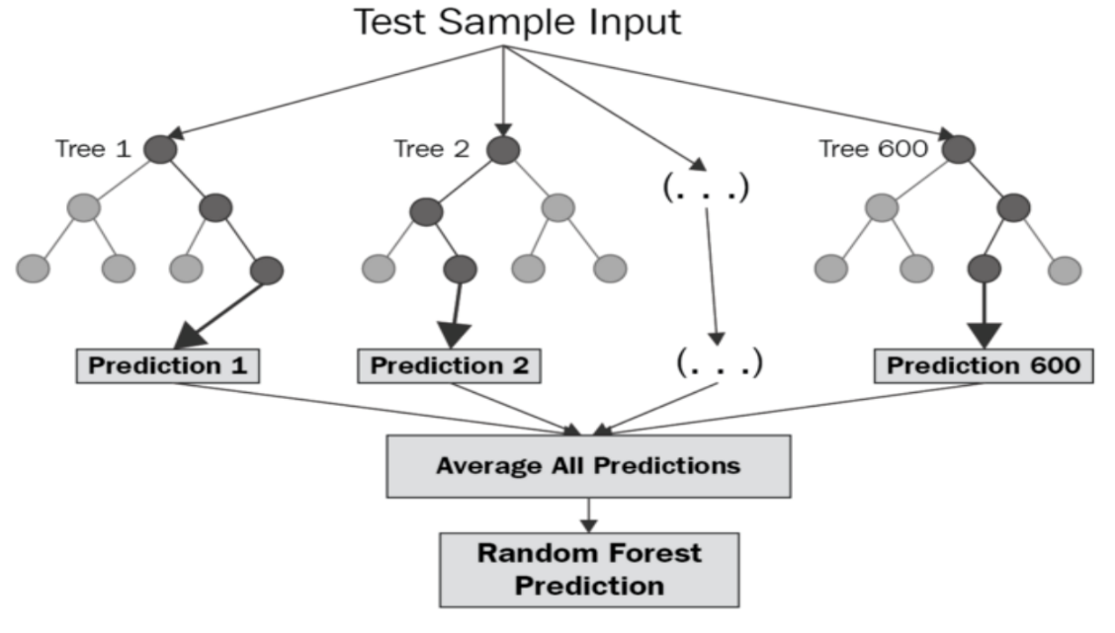
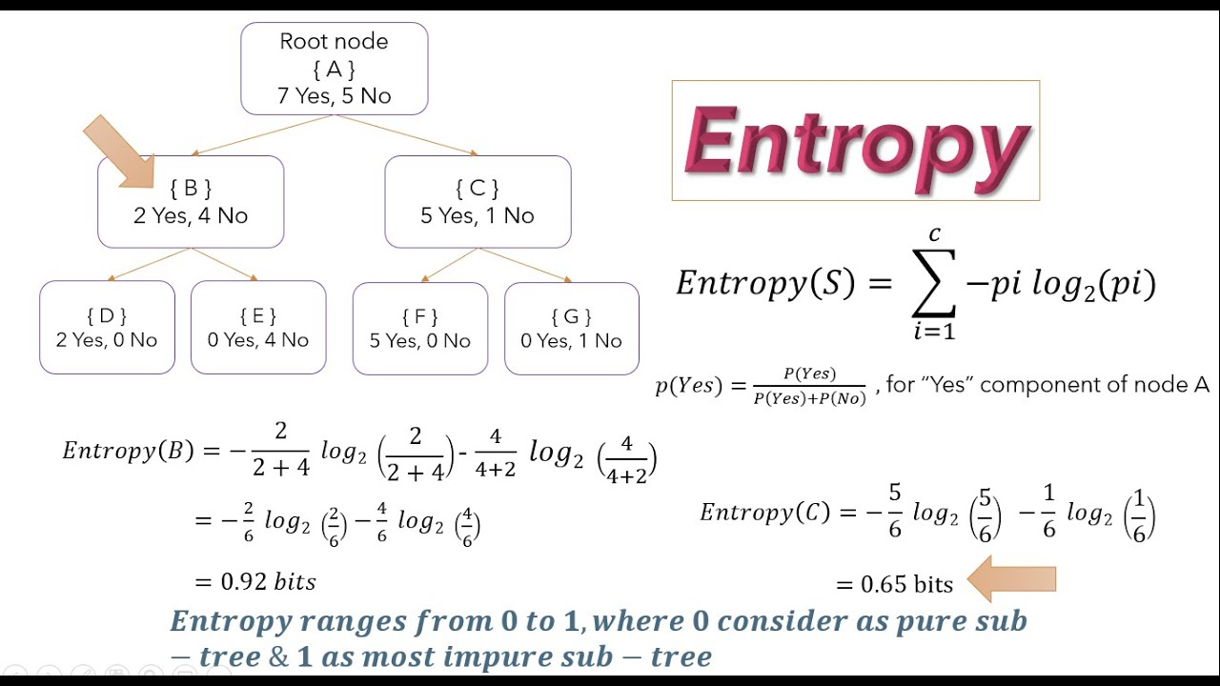
As previously discussed step
are shown in figure>>>>>>
While making
decision tree
some important
terms are
entropy and
Gini- impurity

Slide 6
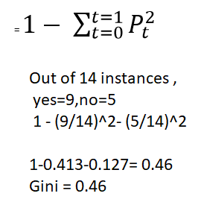
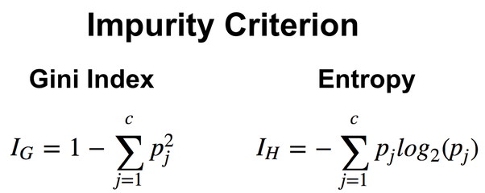
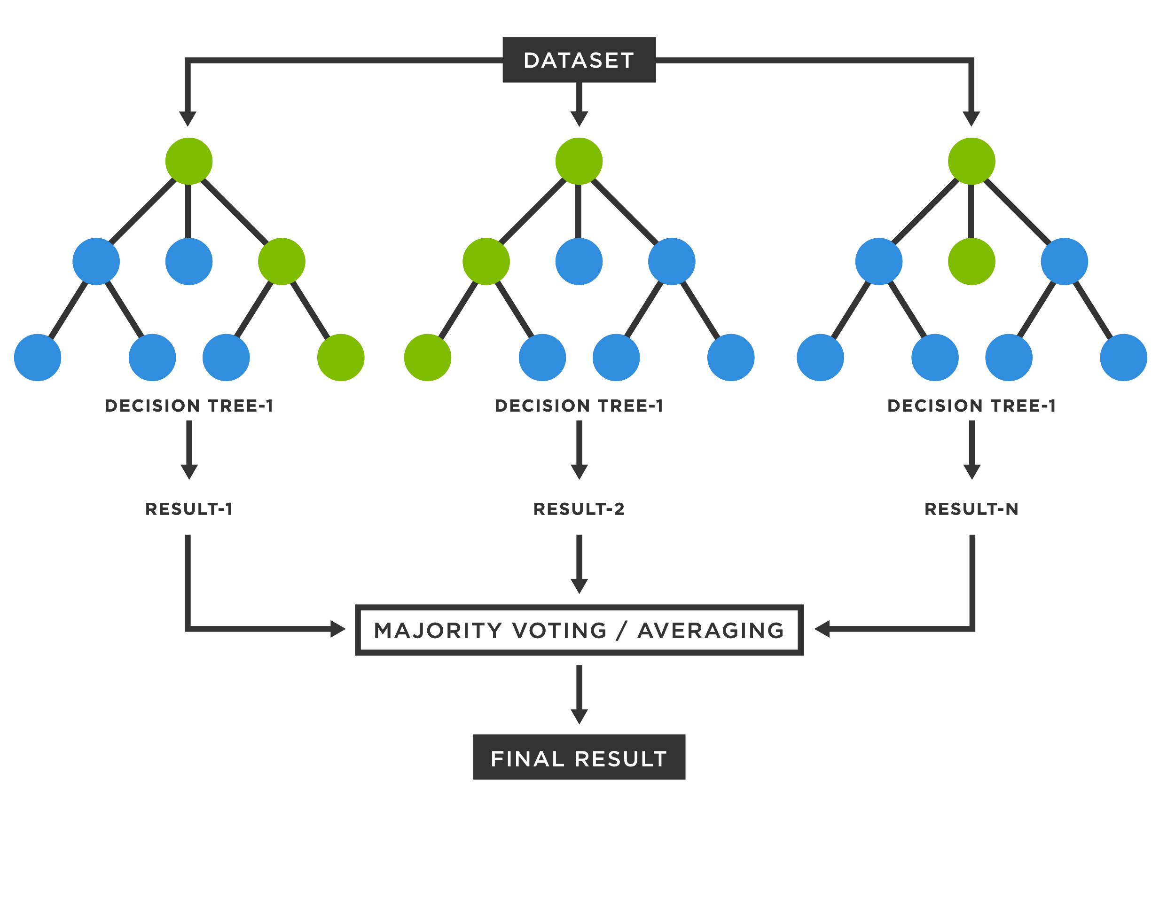
How to calculate Gini impurity>>>>>>>>>>.
Classification and regression:
Examples which differentiate classification and regression is whether student pass/fail this is classification but what percentage student got that is regression.

Slide 7
important hyperparameter:
n_estimator(number of tree) ,
max_features(number of feature to consider at every split), max_depth(maximum no of level in tree),
min_samples_split(min sample required to a split a node), min_sample_leaf(minimum no of samples required at each leaf node )

Slide 8
Motivation and Objective of the Work
Based on the literature review it is observed that:
random forest is collection of decision tree and it is based on bagging ensemble learning method in which output comes out as majority of voting in classification and average in the regression.
Important factor to create decision tree.
How to calculate entropy and Gini impurity.
How to differentiate whether problem is classification and regression .
This motivates the need to study …...
Objective of the Work
to study of random forest algorithm ,
optimum value of deposition angle(angle between horizontal axis (base plate) and major axis of the part) significantly varies with product geometry; hence, prediction and validation is performed using ensemble based random forest machine learning model.
to study the effect of different variables and terms in Random Forest.

Slide 9
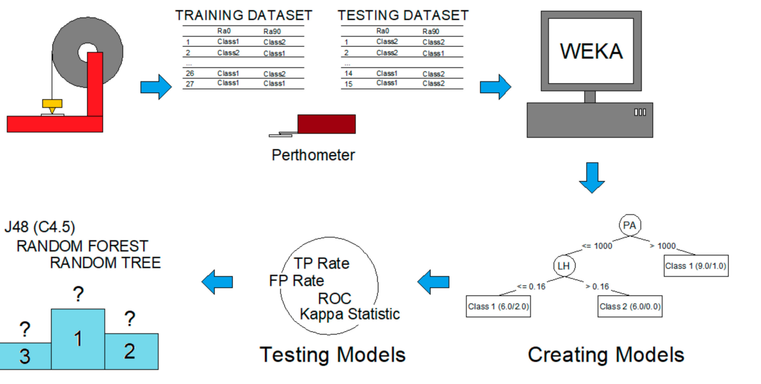
d).finding the surface roughness of model in Fdm
Numerical Formulation/Experimental Details:

Slide 10
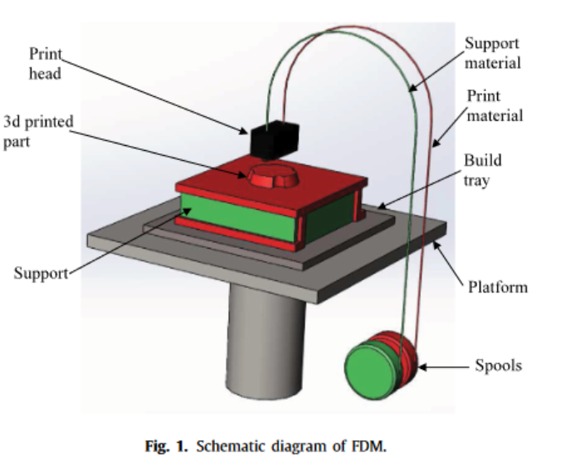
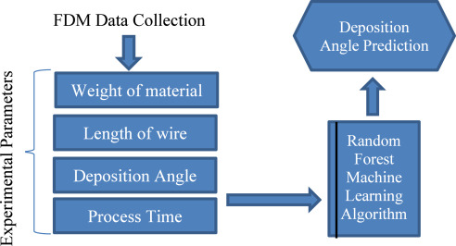

Slide 11
Details of input data or say train dataset:
Exp no. | x1 | x2 | x3 | x4 | x5 | output(y)
1 | 0.178 | 15 | 30 | 0.4564 | 0.004 | 12.48
2 | 0.254 | 0 | 60 | 0.4064 | 0.008 | 15.83
3 | 0.254 | 30 | 0 | 0.4064 | 0.008 | 10.78
4 | 0.127 | 0 | 0 | 0.5064 | 0 | 13.89
5 | 0.127 | 30 | 60 | 0.5064 | 0 | 11.83
6 | 0.178 | 15 | 0 | 0.4564 | 0.004 | 11.95
7 | 0.178 | 15 | 60 | 0.4564 | 0.004 | 11.87
8 | 0.178 | 0 | 30 | 0.4564 | 0.004 | 14.98
9 | 0.178 | 30 | 30 | 0.4564 | 0.004 | 12.28
10 | 0.254 | 30 | 60 | 0.4064 | 0 | 16.98
11 | 0.127 | 30 | 0 | 0.5064 | 0.008 | 11.13
12 | 0.178 | 15 | 30 | 0.4064 | 0.004 | 11.01
13 | 0.127 | 0 | 60 | 0.5064 | 0.008 | 13.58
14 | 0.127 | 30 | 60 | 0.4064 | 0.008 | 7.444
15 | 0.254 | 30 | 60 | 0.5064 | 0.008 | 10.78
16 | 0.127 | 0 | 60 | 0.4064 | 0 | 14.28
17 | 0.254 | 0 | 60 | 0.5064 | 0 | 16.29
18 | 0.127 | 0 | 0 | 0.4064 | 0.008 | 15.21
19 | 0.254 | 0 | 0 | 0.5064 | 0.008 | 16.18
20 | 0.127 | 30 | 0 | 0.4064 | 0 | 10.16
21 | 0.178 | 15 | 30 | 0.4564 | 0.004 | 11.31
22 | 0.254 | 30 | 0 | 0.5064 | 0 | 10.44
23 | 0.178 | 15 | 30 | 0.4564 | 0.004 | 12.88
24 | 0.127 | 15 | 30 | 0.4564 | 0.004 | 12.49
25 | 0.254 | 15 | 30 | 0.4564 | 0.004 | 12.34
26 | 0.178 | 15 | 30 | 0.4564 | 0.004 | 11.72
27 | 0.178 | 15 | 30 | 0.4064 | 0.004 | 11.56
28 | 0.178 | 15 | 30 | 0.5064 | 0.004 | 11.25
29 | 0.178 | 15 | 30 | 0.4564 | 0 | 12.26
30 | 0.178 | 15 | 30 | 0.4564 | 0.008 | 11.09
31 | 0.178 | 15 | 30 | 0.4564 | 0.004 | 12.67
32 | 0.254 | 0 | 0 | 0.4064 | 0 | 12.41
Training dataset: design of
experiment,
We will consider values instead of x1,…. as layer height (LH),
print temperature (T),
print speed (PS),
print acceleration (PA),
and flow rate (F). Whatever variable required

Slide 12
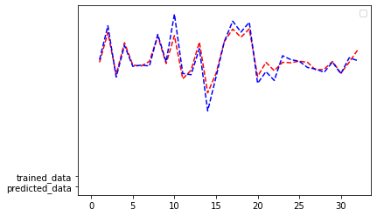
Results
The value of (output(y)) is given:
[12.17023054 15.42474 10.89914667 14.0054 12.05594 11.84943643 12.12832024 14.70604286 12.02283333 15.05776167 10.5121 11.35929333 14.07304 8.79262333 11.58156 14.10064 15.3915 14.61958 15.5517 10.67742833 12.17023054 11.645 12.17023054 12.21235714 12.42504329 12.17023054 11.35929333 11.62101879 12.31110984 10.92357006 12.17023054 13.6291 ]
R2_score = 0.829032831092849
Mean square error =
Root mean square error = 0.8148703526329523
0.664013691600152

Slide 13
Future Work
Try to analyze each of the decision tree are making and what is its entropy and Gini-index of each decision tree.
Studying deep in OOB_Score() means in ideal cases its value is around
36%, how it help the decision tree.
Why random forest are better in fdm in most of the cases example for depositon angle , surface roughness e.t.c.
Thank You !

