Slide 1
operators in R PROGRAMMING
MSBA

Slide 2
operators
An operator is a symbol that tells the compiler to perform specific mathematical or logical manipulations.
Arithmetic Operators (+, -, *, /, ^)
Relational Operators (>, <, ==, <=, >=, !=)
Logical Operators (&, |, !)
Miscellaneous Operators ( : )

Slide 3


ARITHMETIC operator
Arithmetic operators tells us how to perform basic calculations like addition, subtraction, multiplication, and division. The operators act on each element of the vector.
Operator(+):
Operator(-):

Slide 4



ARITHMETIC operator
Operator(*):
Operator(/):
Operator(^):

Slide 5
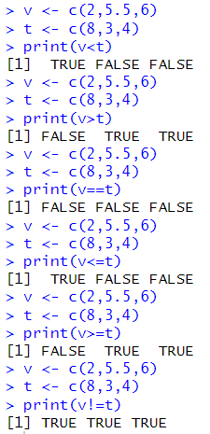
RELATIONAL operator
Each element of the first vector is compared with the corresponding element of the second vector. The result of comparison is a Boolean value.
Operator(>):
Operator(<):
Operator(==):
Operator(<=):
Operator(>=):
Operator(!=):

Slide 6
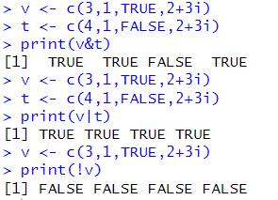
LOGICAL operator
Logical operators are applicable only to vectors of type logical, numeric or complex. All numbers greater than 1 are considered as logical value TRUE. Each element of the first vector is compared with the corresponding element of the second vector. The result of comparison is a Boolean value.
Operator(&): Returns TRUE if both the elements are
TRUE
Operator(|): Returns TRUE if either of the elements are
TRUE
Operator(!): Takes each element of the vector and gives
(not operator) the opposite logical value.

Slide 7


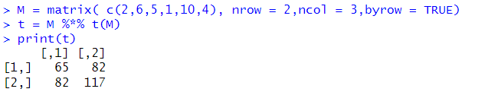
Miscellaneous operator
Miscellaneous operators in R are operators that are not used for general mathematical or logical computations but serve specific purposes.
Operator(:): Colon operator
Operator(%in%):This operator is used to identify if an element belongs to a vector.
Operator(%*%):This operator is used to multiply a matrix with its transpose.

Slide 8
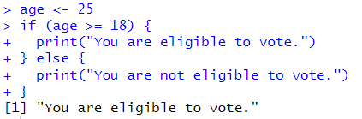
Decision MAKING
In R, decision-making is achieved through control flow statements that execute code based on specific conditions.
if statement: Evaluates a single condition. Executes a block of code if the condition is TRUE. Optional else statement can execute code if the condition is FALSE.

Slide 9
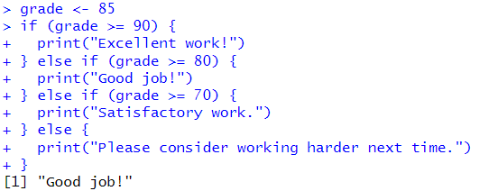
Decision MAKING
if-else-if ladder: Evaluates multiple conditions sequentially. Executes the first block of code
where the condition is TRUE. Can have multiple else if statements for additional conditions.
Optional else statement for when none of the above conditions are TRUE.

Slide 10
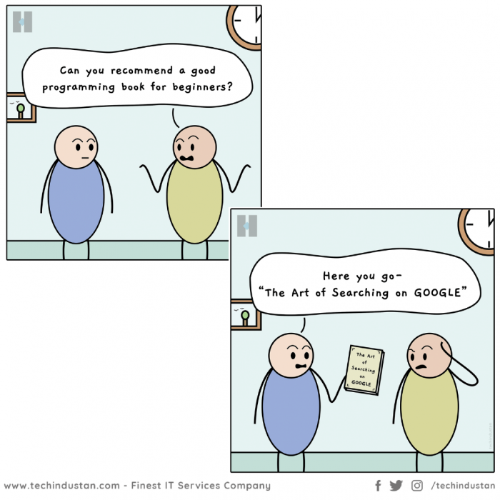

Slide 11
Loops
MSBA

Slide 12
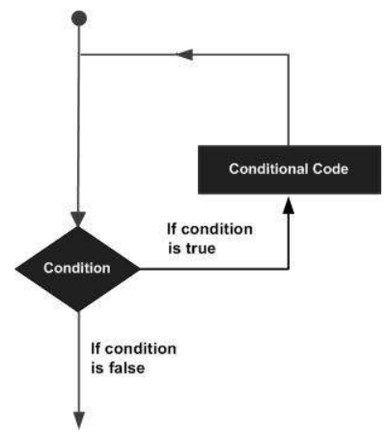
loops
A loop statement allows us to execute a statement or group of statements multiple times.​

Slide 13
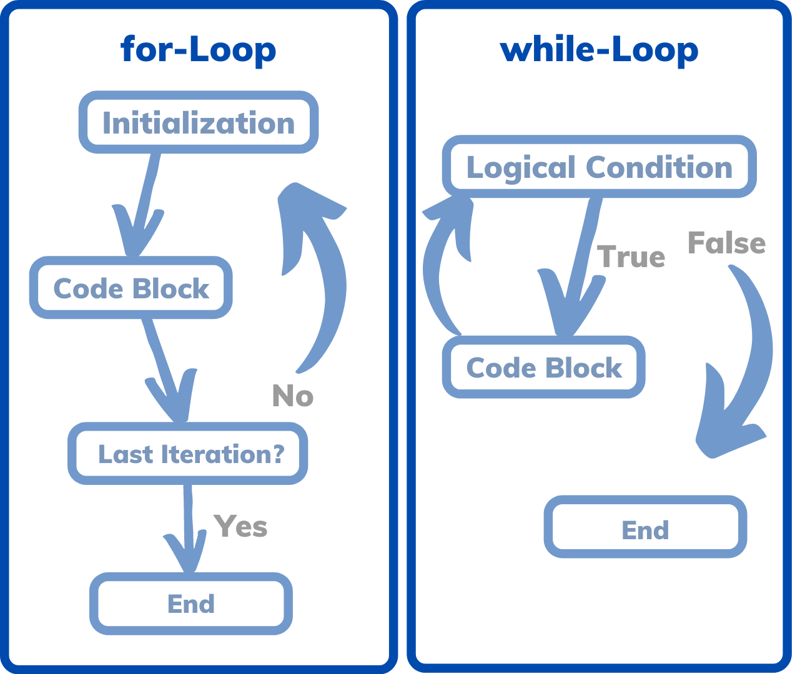
Types of loops

Slide 14
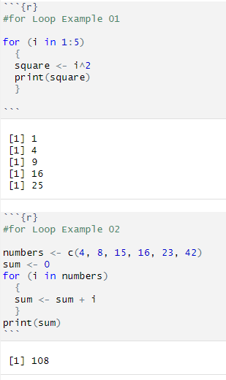
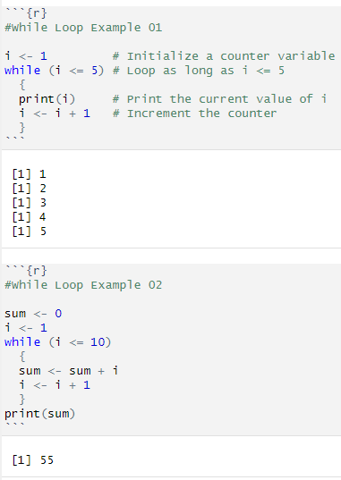
Types of loops

Slide 15
Types of loops
Use a for loop when you know exactly how many times you need to iterate.
Use a while loop when you need to iterate until a condition is met, but you don't know the exact number of iterations beforehand.

Slide 16
R - markdown
MSBA

Slide 17
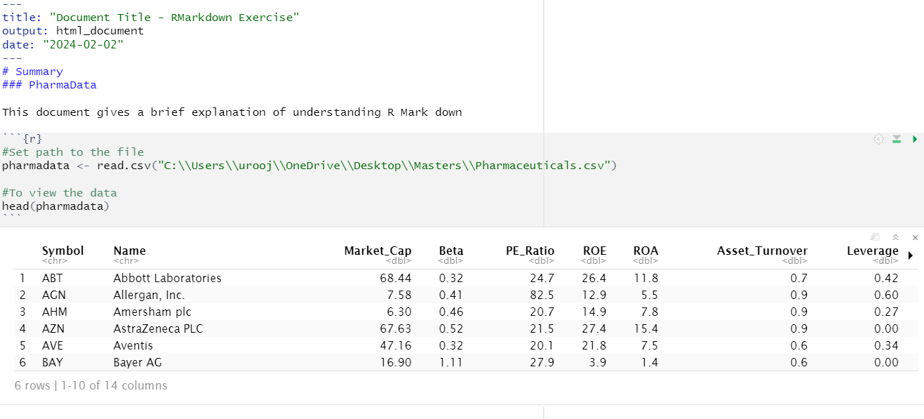
R Markdown interface

Slide 18
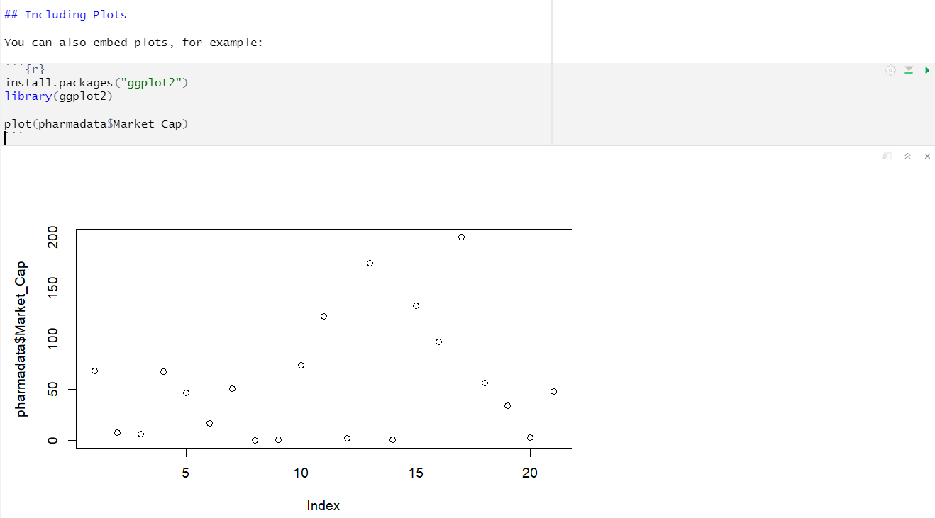
R Markdown interface

Slide 19
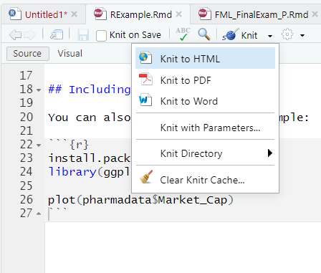
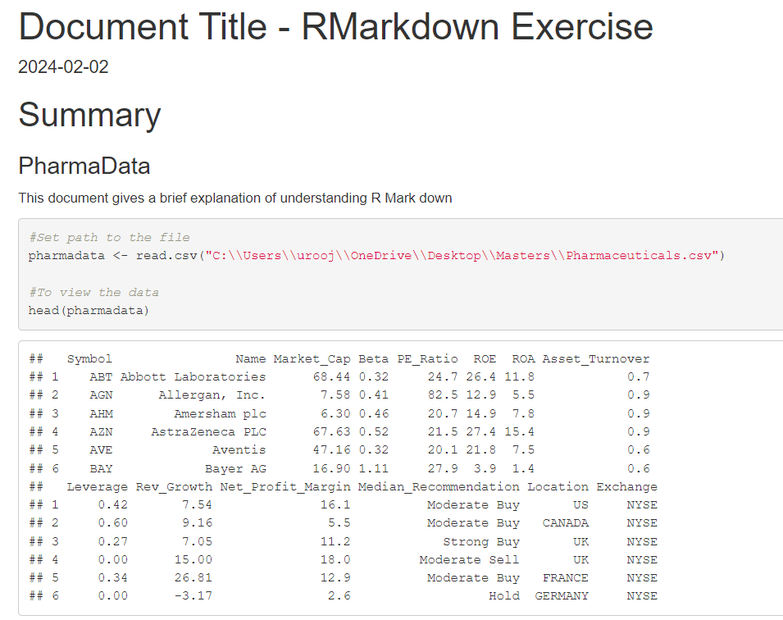
R Markdown interface

Slide 20
