Slide 1
INTRODUCTION TO R PROGRAMMING
MSBA

Slide 2
What is R?
R is a free software environment for statistical computing and graphics. It’s open source and therefore available free of charge.
R is an object-oriented programming language where we create objects and manipulate them as intended. Objects can be Data frames, vectors, matrices, lists, raw data, spatial objects , maps etc..​

Slide 3
Why r?
Statistical Excellence
Open Source and free
Visualization Virtuosity
Cross-Platform Compatibility
Scalability and Integration

Slide 4
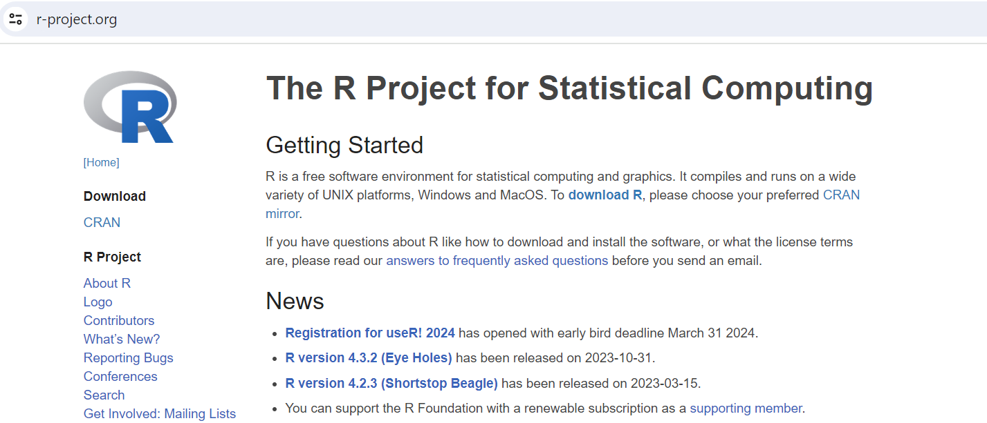
INSTALLATION OF r
https://www.r-project.org/
https://www.r-project.org/

Slide 5
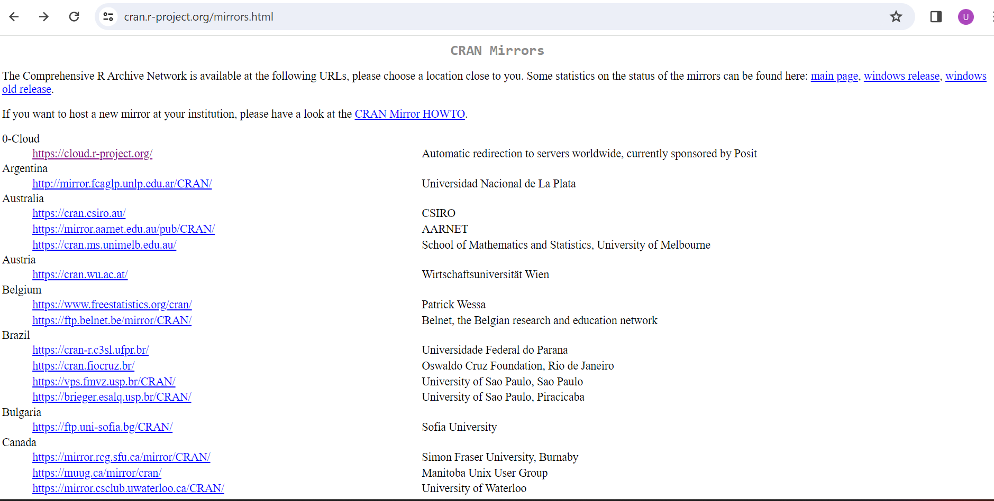
INSTALLATION OF r

Slide 6
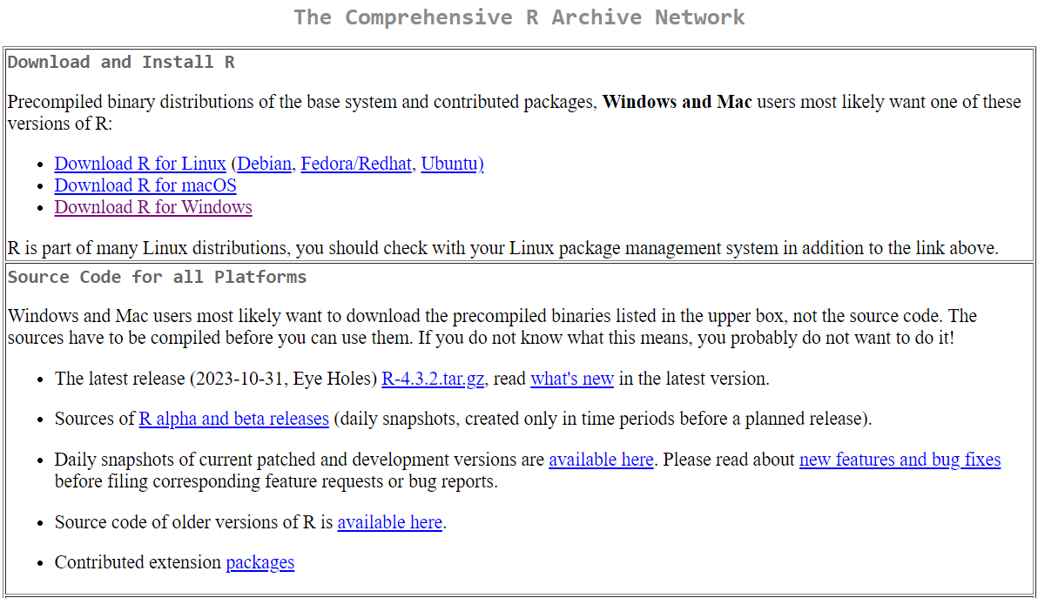
INSTALLATION OF r

Slide 7
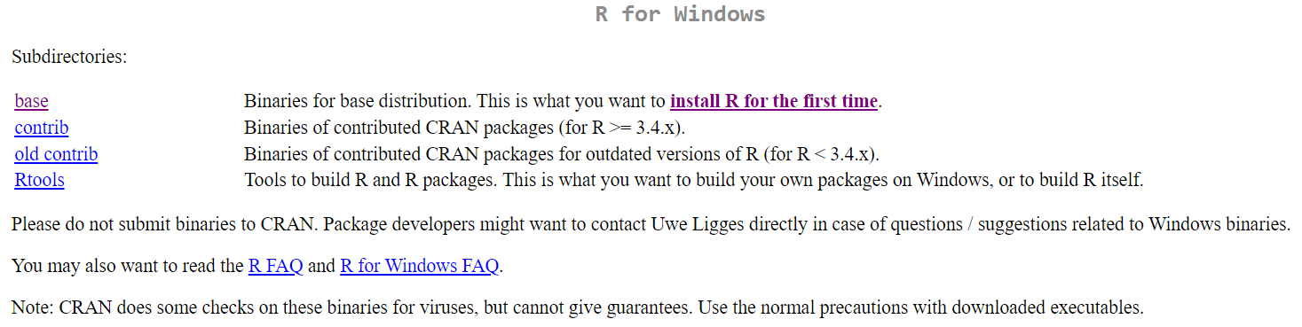
INSTALLATION OF r

Slide 8
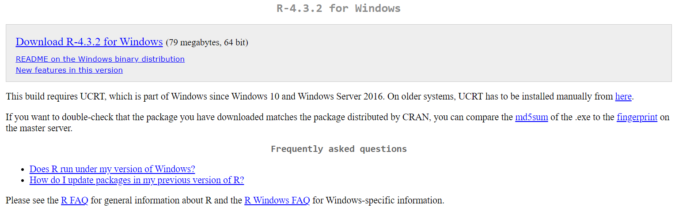
INSTALLATION OF r

Slide 9
R-STUDIO
R studio is a powerful and productive user interface for R. It's free and open source, and works great on Windows, Mac, and Linux.
It is open-source (i.e. free) and available at https://posit.co/download/rstudio-desktop/

Slide 10
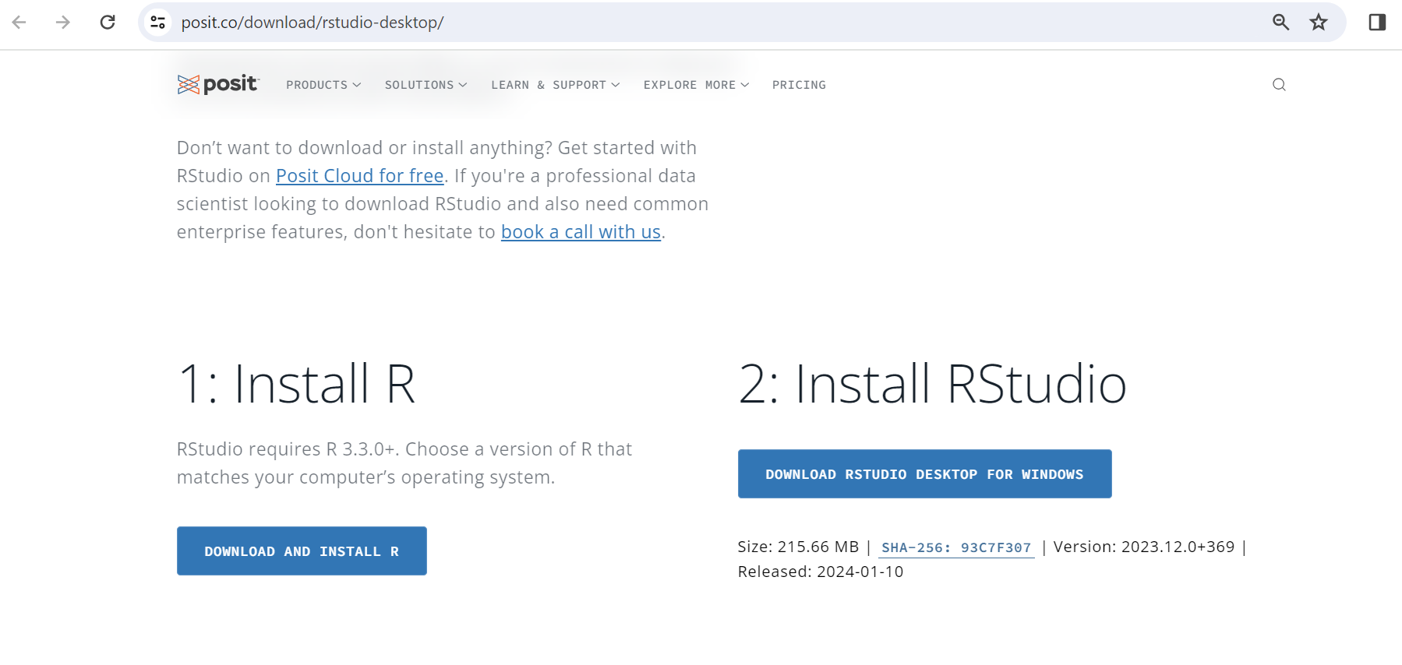
INSTALLATION OF r-Studio

Slide 11
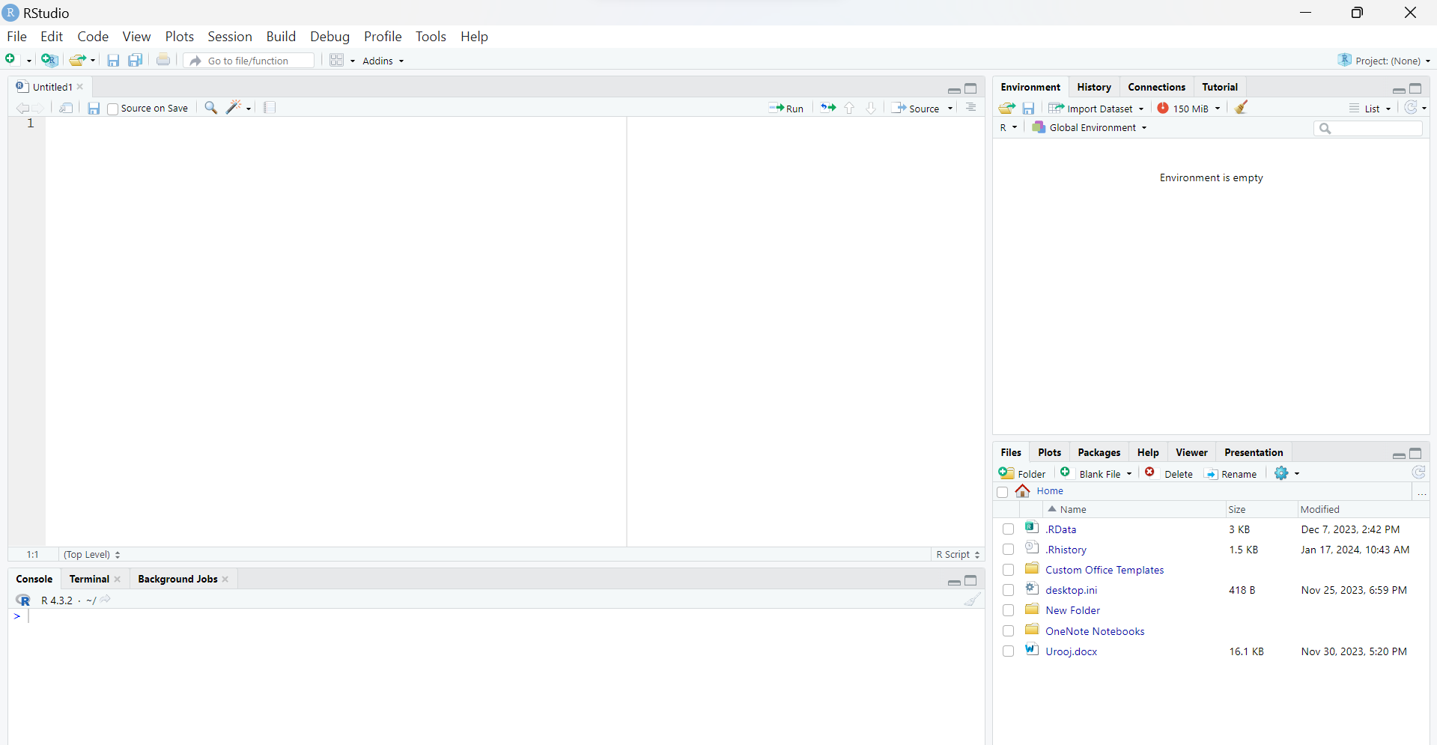
R-STUDIO INTERFACE

Slide 12
R PACKAGEs
An R package is a collection of R functions, compiled code, and sample data bundled together as a unit for distribution and installation in the R environment.
After you install a package, you need to use the function library( ) to load and attach the function before you can use it.

Slide 13
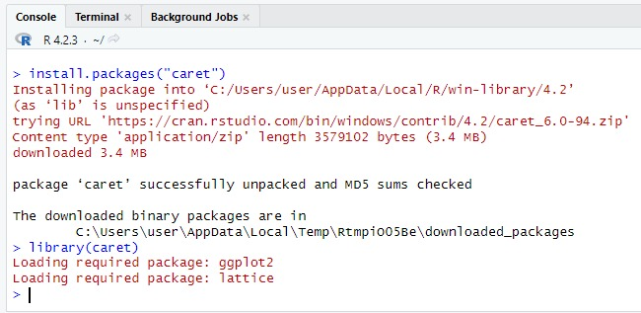
How to Install R package?

Slide 14
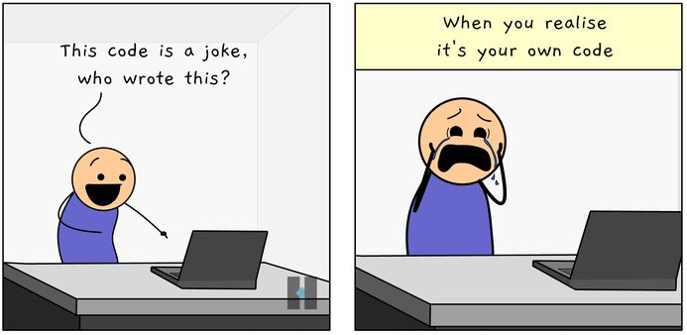

Slide 15
Data structures in R PROGRAMMING
MSBA

Slide 16
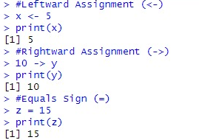
Value assignment
Value assignment in R involves storing data in variables for later use.

Slide 17
Data types
An information can be stored in various data types like
Character - “Female”
Integer - 6L
Double - 6.8
Logical - TRUE, FALSE

Slide 18
R objects
The variables are assigned with R-Objects and the data type of the R-object becomes the data type of the variable.
Vectors
Lists
Matrices
Arrays
Factors
Data Frames

Slide 19
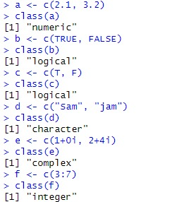
Vectors(1/2)
An atomic vector can be a vector of characters, logical, integers, numeric or complex values.
The c( ) function can be used to create vectors of objects by concatenating things together.
Unlike lists, a vector can only contain objects of the same class.

Slide 20
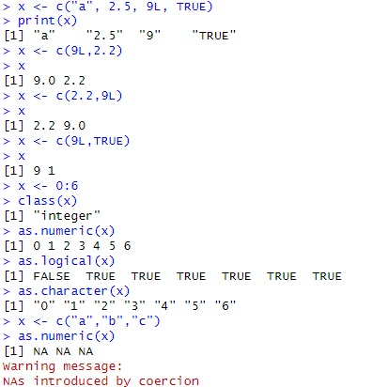
Vectors(2/2)
R has a hierarchy of data types, and it will attempt to coerce all elements to the most flexible common type to maintain consistency.
The general order of coercion : Character → Double → Integer → Logical

Slide 21
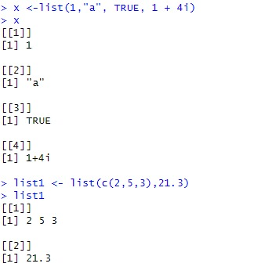
LISTS
Lists are a special type of vector that can contain elements of different classes. Lists can be explicitly created using the list() function.

Slide 22
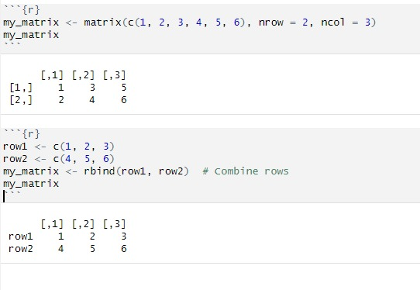


MATRICES
Matrices are two-dimensional arrays that arrange elements in rows and columns. They are essential for organizing and manipulating numerical data in structured ways.

Slide 23
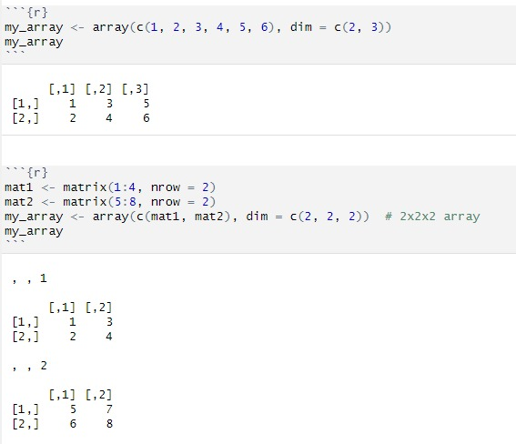
ARRAYS(1/2)
Arrays are multidimensional data structures that extend matrices to more than two dimensions.
They offer a flexible way to organize and manipulate numerical data in structured arrays.

Slide 24
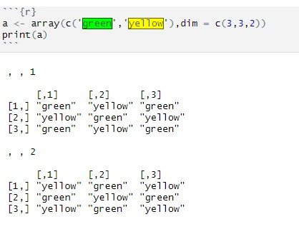
ARRAYS(2/2)

Slide 25
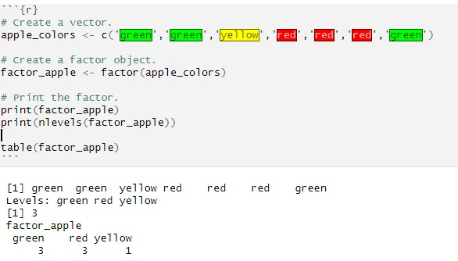
Factors
Factors are a special data type in R designed to represent categorical data. They store data as integer vectors with labels attached to each distinct value (level).

Slide 26
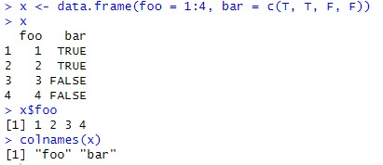
DATA FRAMES (1/2)
Data frames are tabular data objects. Unlike a matrix in data frame each column can contain different modes of data. The first column can be numeric while the second column can be character and third column can be logical. It is a list of vectors of equal length.
Example 01

Slide 27
DATA FRAMES (2/2)
Example 02

Slide 28


