Slide 1
Introduction to tableau
MSBA

Slide 2
Tableau products
Tableau Desktop
Tableau Cloud
Tableau Server
Tableau Prep

Slide 3

Tableau desktop
Function: Individual data visualization and analysis tool.
Focus: Create, edit, and explore data. Build dashboards and visualizations.
Key features:
Drag-and-drop interface for data manipulation.
Wide range of chart types and visualizations.
Ability to connect to various data sources.
Deployment: Installed on a single user's computer.
Suited for: Individual data analysts, and beginners learning Tableau.

Slide 4
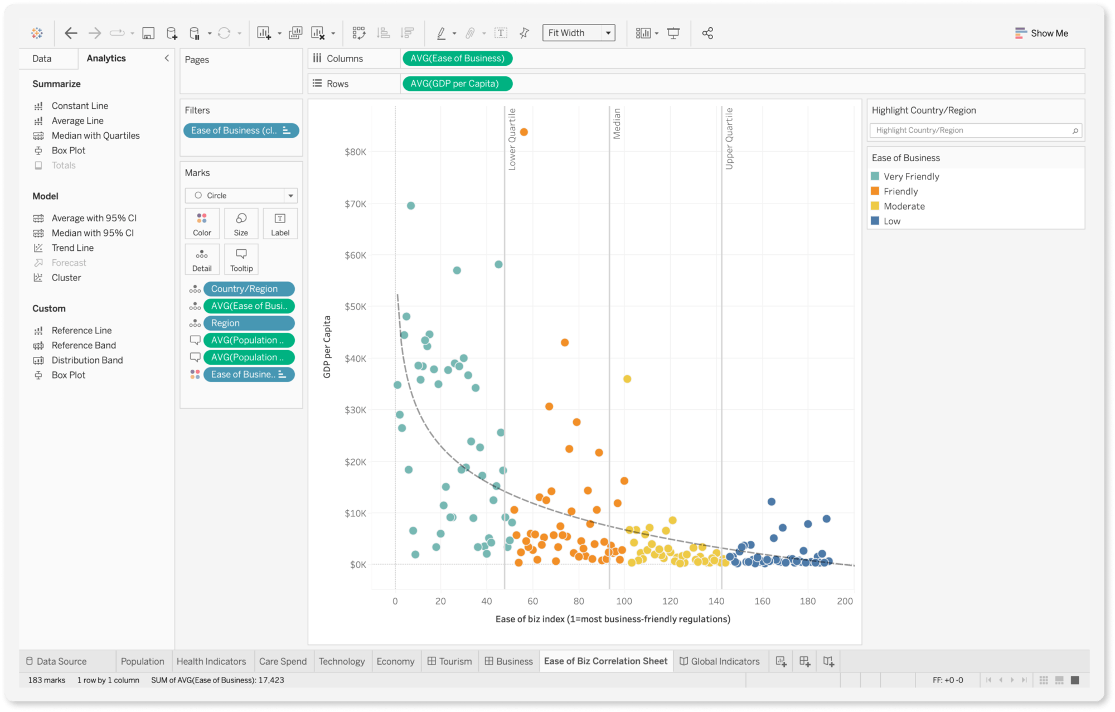
Tableau desktop

Slide 5

Tableau cloud/online
Function: Cloud-based platform for sharing and collaboration on visualizations.
Focus: Securely publish, distribute, and access dashboards and reports.
Key features:
Web-based access for users to view and interact with dashboards.
User management and permission controls.
Automated data refreshes.
Deployment: Cloud-hosted service managed by Tableau.
Suited for: Sharing insights with a wider audience, and collaborative analysis.

Slide 6
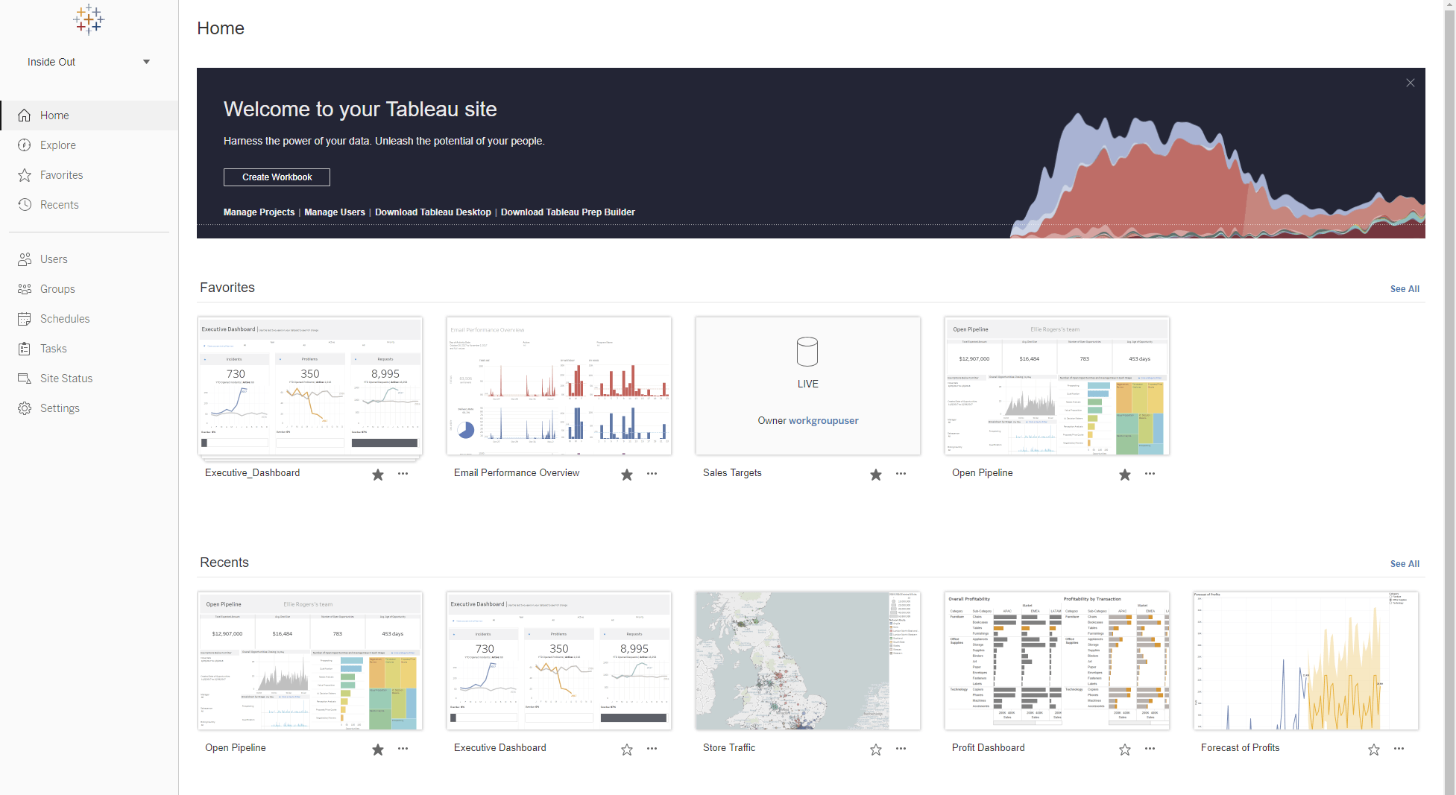
Tableau cloud/online

Slide 7

Tableau server
Function: On-premise platform for sharing and collaboration similar to Cloud.
Focus: Provides similar functionalities to Cloud but with on-site deployment and control.
Key features:
Similar features to Tableau Cloud for sharing and collaboration.
Offers more granular control over server administration and security.
Deployment: Installed on the organization's own server infrastructure.
Suited for: Organizations needing control over data security and server environment.

Slide 8
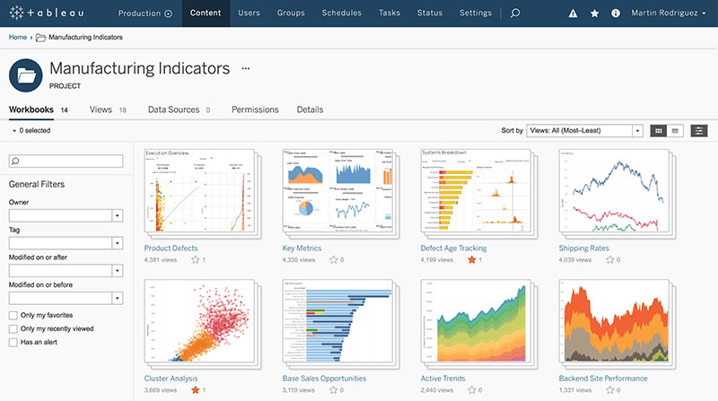
Tableau server

Slide 9

Tableau prep
Function: Data preparation tool for cleaning, shaping, and transforming data.
Focus: Refine and prepare data before analysis in Tableau Desktop.
Key features:
Data cleansing and transformation functionalities.
Visual data profiling tools.
Ability to schedule automated data refreshes.
Deployment: Installed separately like Tableau Desktop.
Suited for: Data analysts working with messy or complex datasets.

Slide 10
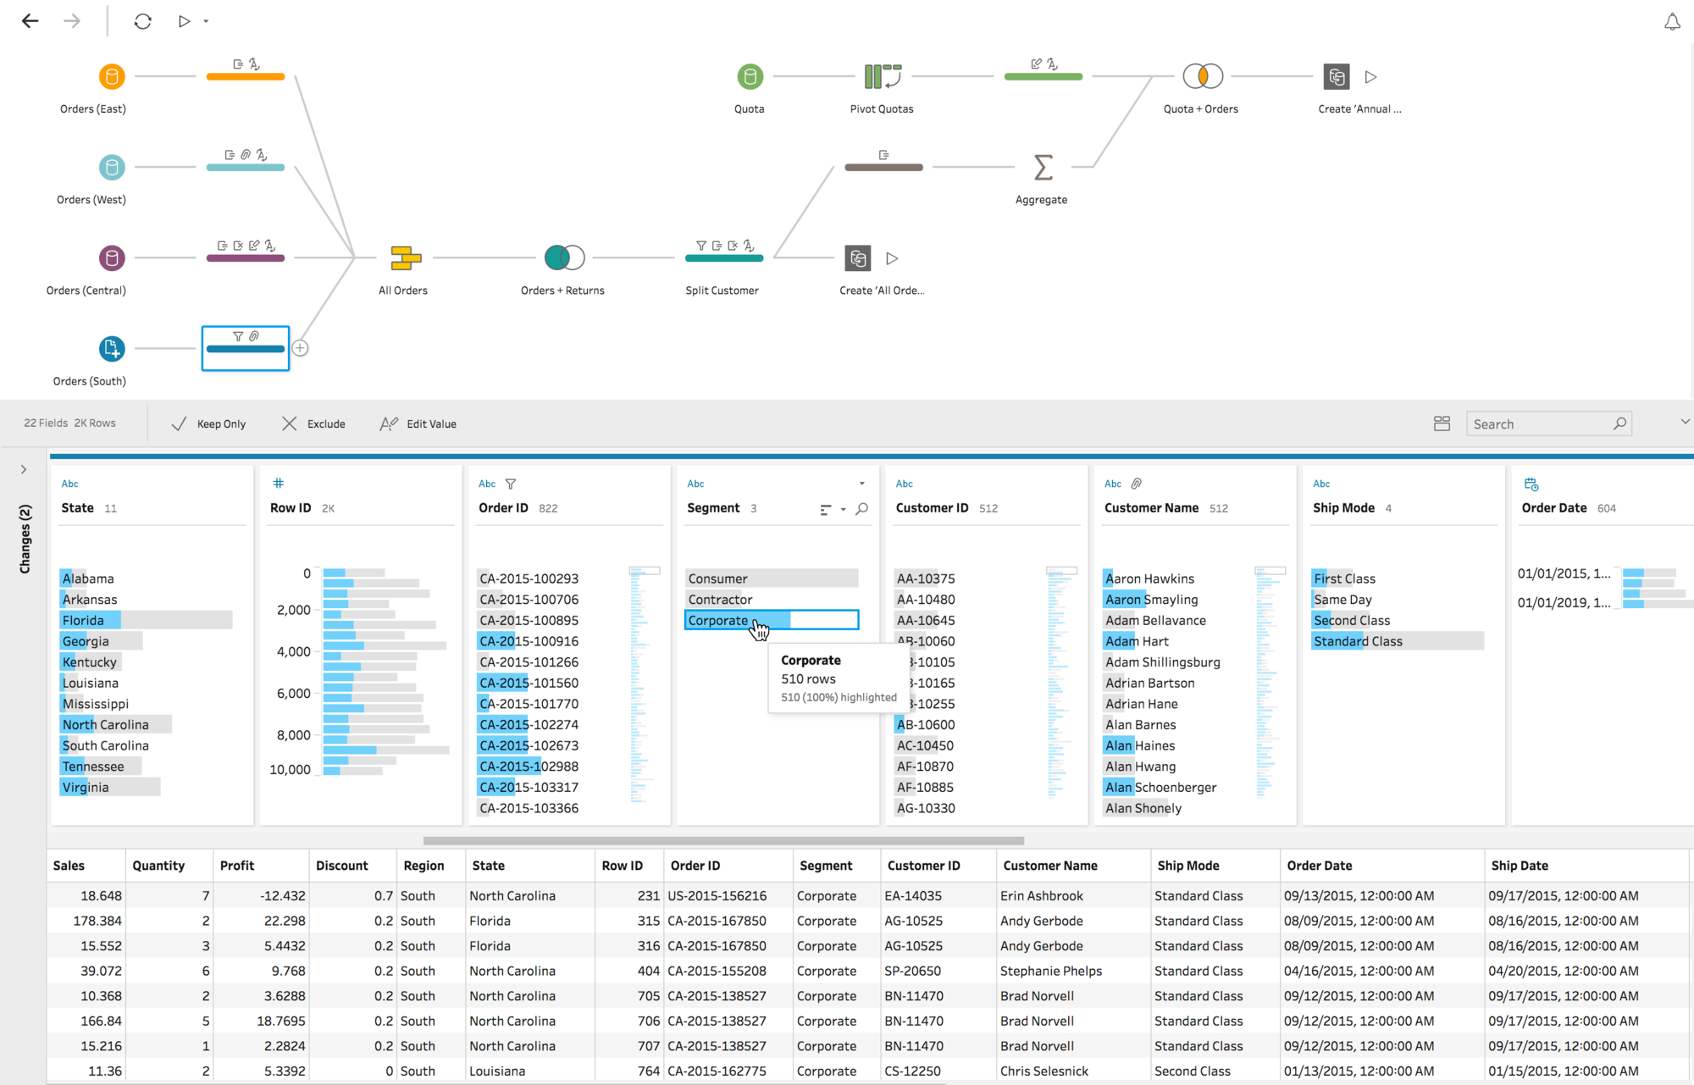
Tableau prep

Slide 11
IN SIMPLE TERMS
Desktop: Create visualizations yourself.
Cloud: Share and access visualizations with others. (Cloud-based)
Server: Share and access visualizations with others. (On-premise)
Prep: Clean and prepare data for better analysis in Desktop.

Slide 12
TABLEAU DESKTOP
MSBA

Slide 13
How Tableau Recognizes Database?

Slide 14
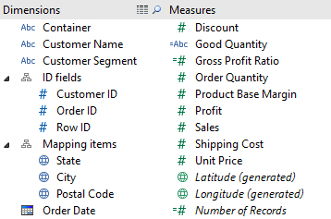
How Tableau Recognizes Database?

Slide 15
How Tableau Recognizes Database?

Slide 16
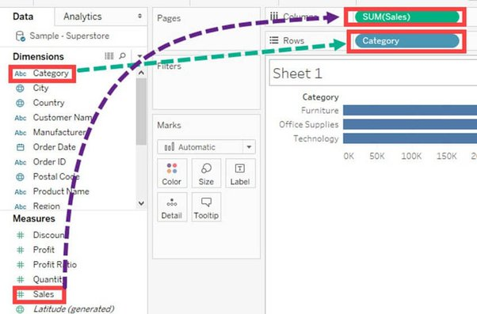
How Tableau Recognizes Database?

Slide 17
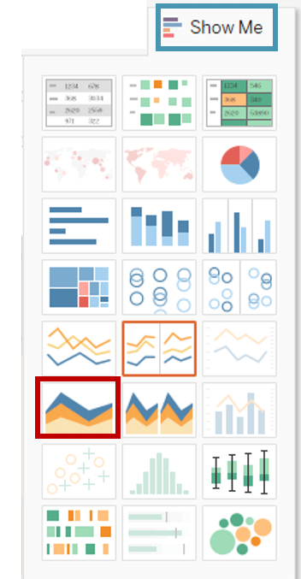
Different types of chart tableau support
Bar Chart
Stacked Bar Chart
Pie Chart
Line Chart
Scatter Plot
Packed Bubble Chart
World Map
Tree Map
Waterfall Map etc

Slide 18
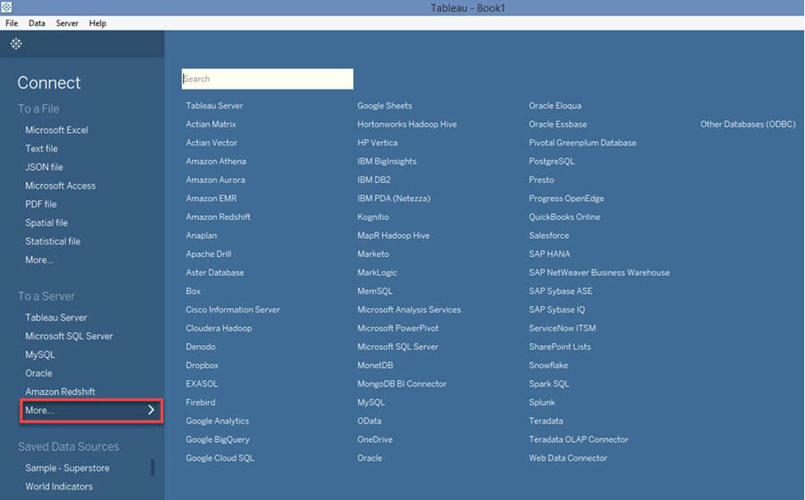
Different databases tableau can connect to

Slide 19
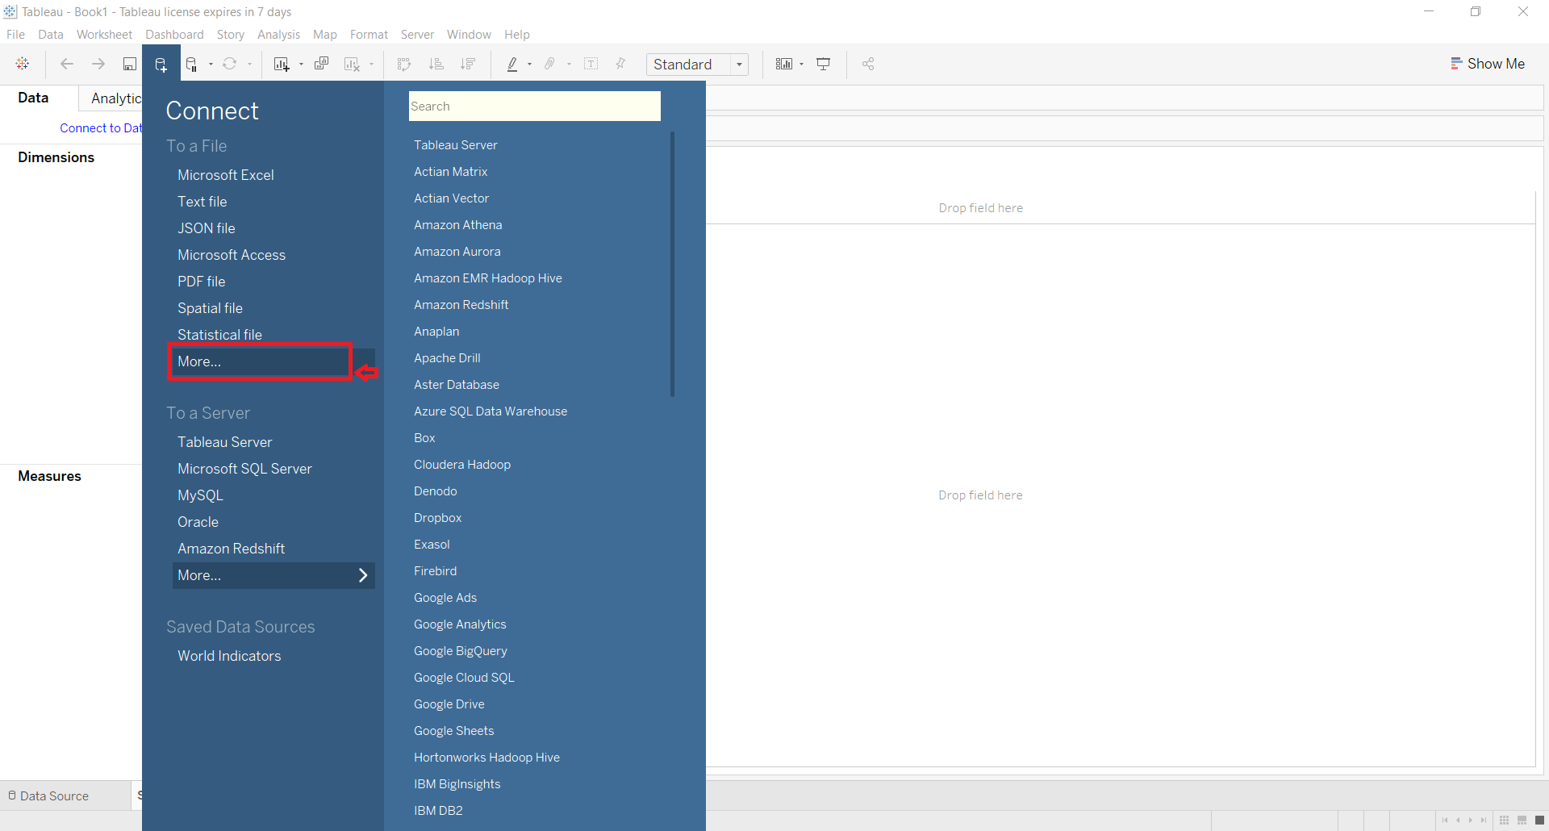
Different databases tableau can connect to

Slide 20
When a design is thoughtful,

Slide 21
When a design is thoughtful, the design will be ignored
- Prof. Dr. Murali Shanker

