Slide 1

MULTI-MODAL
MISNFORMATION DETECTION
USING VQA
MOHIT SHARMA

Slide 2

PROBLEM STATEMENT & DATASET:
Classify a multi-modal information sample (text-image pair) as fake or real
VQA should be utility of choice to query the image
Dataset: MediaEval 2015 task, tweet and image pairs
A total of 16326 samples generated from around 500 unique images

Slide 3
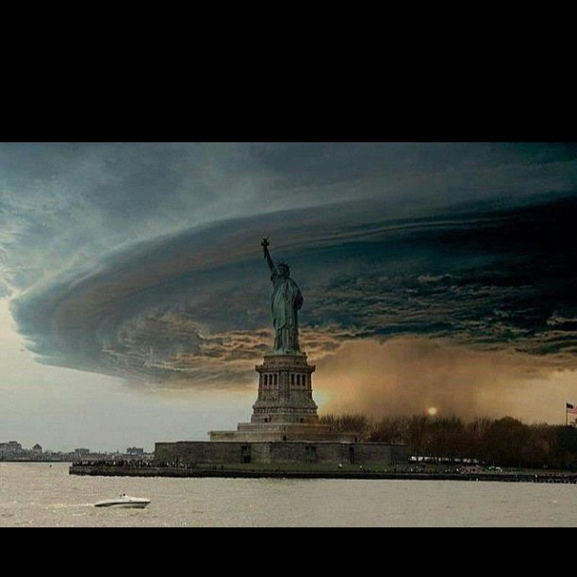
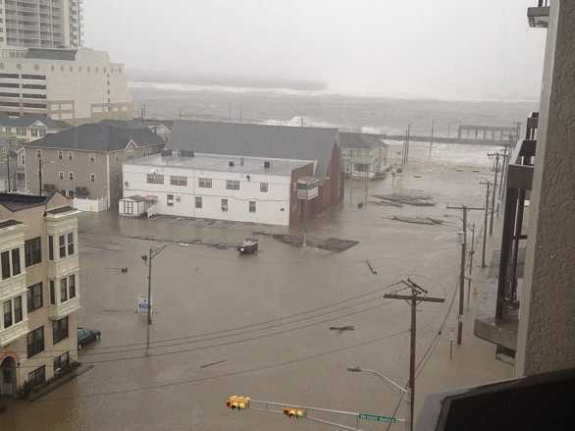
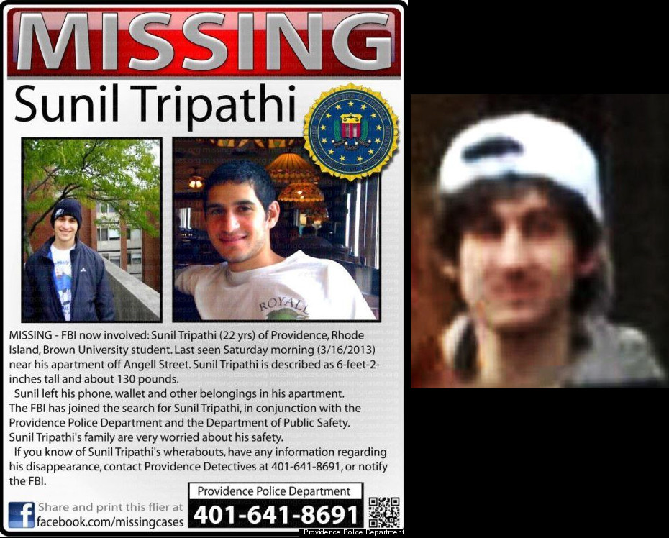
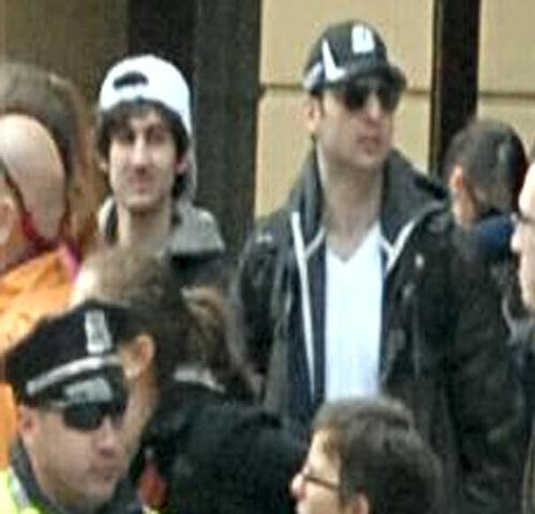
DATASET:
Just known this bcs of #jason #chen updated the pic! Everyone be safe! #newyork #sandy #hurricane #nature | Wow RT@billmckibben: Boardwalk floating in sections through the flooded streets of Atlantic City | Wow, so Sunil Tripathi is a Brown U Student that has been missing since March... | RIP Tamerlan and free Dzhokhar Tsarnaev. This corrupt society will never stop blaming people.
fake | real | fake | real

Slide 4
MODEL:
TWEET EVENT CLASSIFICATION (SUMMARIZER)
TWEET
EVENT 2 QUESTION
YES/NO VQA MODLE (ViLT)
IMAGE
Answer 2 label

Slide 5
DESIGN CHOICES:
Extraction of data from tweet: Tweet Event Classification (15 unique events), Summarisation as alternative.
Event 2 Question (yes/no questions, Is this & Does this as prefixes)
Binary VQA module (pre-trained Vision-and-Language Transformer (ViLT), fine-tuned on VQAv2)

Slide 6
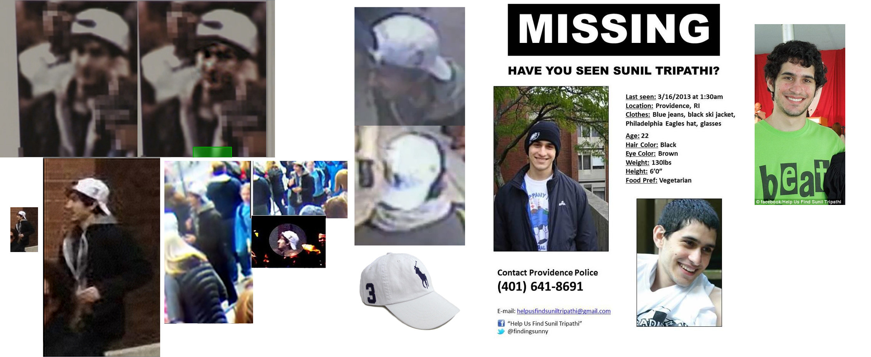
PIC: Comparison of #Boston suspect Sunil Tripathi's FBI-released images/video and his MISSING poster
TWEET EVENT CLASSIFIED AS "boston marathon bombing"
Question: Does this image correspond to boston marathon bombing?
YES/NO VQA MODLE (ViLT)
no (fake)

Slide 7
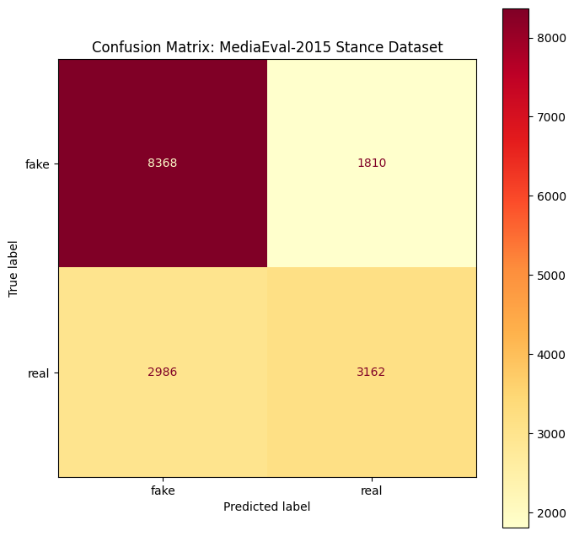
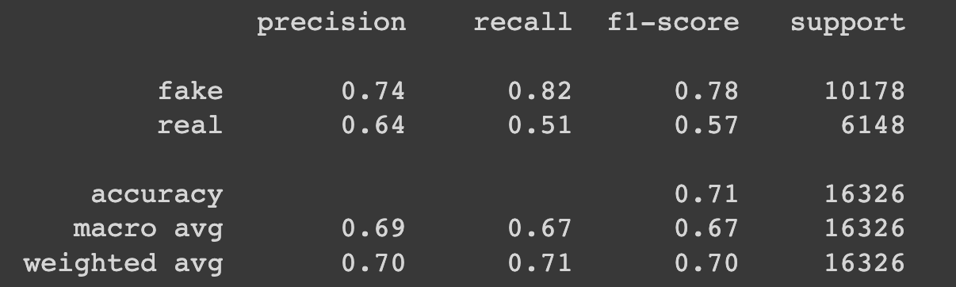
RESULTS:

