Slide 1




Tearing Down The Memory Wall
Zaid Qureshi*, Vikram Sharma Mailthody*, David Min*, Wen-mei Hwu
[University of Illinois at Urbana-Champaign]
I-Hsin Chung, Jinjun Xiong
[IBM Research]
Notes:
Hello everyone. I am Vikram. Today, I will be speaking about our work “Tearing Down the memory wall”. This work is done in collaboration with my colleagues, Zaid, David, I-Hsin, Jinjun and Wen-mei. This work would not have been possible without the generous support from IBM, ADA and SRC centers.

Slide 2

Agenda
Application and Compute Trends
Conventional System Architecture
Compute and Memory Gap
Hardware and software challenges
Erudite Design
Current hurdles limiting Erudite
Notes:
In today’s talk, I will attempt to make you rethink about current system architecture. To do so, I will first cover application and compute trends we observed in the last few years, followed by detailed discussion of challenges in fitting the three-decade old CPU-centric architecture into new emerging applications. I will then propose our Accelerator-Centric Erudite system architecture to address grand limitations present in CPU-centric design. Lastly, if time permits, I shall cover briefly the current hurdles limiting Erudite design and what we can do about it.

Slide 3
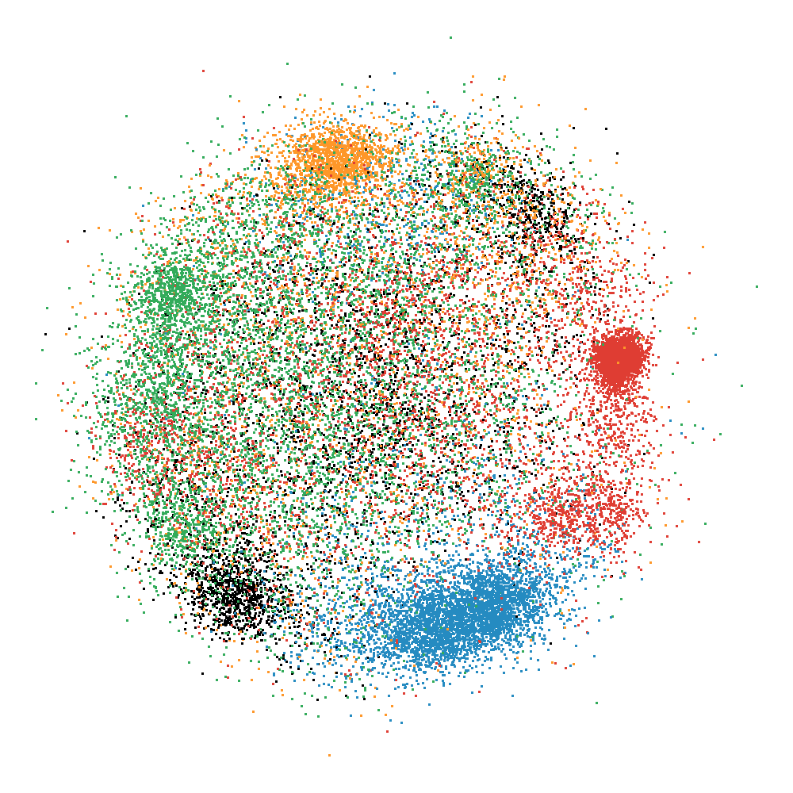
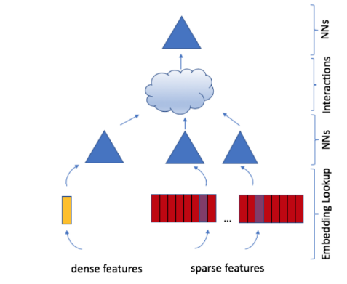
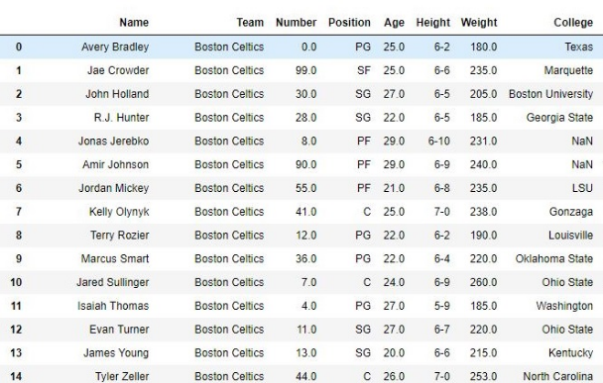
Apps Demand Memory
Recommendation Systems Training
1TB to 100PBs [1,2]
Data Analytics
TBs to PBs [3]
Large Graphs
~1-100 TBs [4]
https://arxiv.org/pdf/1906.00091.pdf
https://devblogs.nvidia.com/announcing-nvidia-merlin-application-framework-for-deep-recommender-systems/
https://rapids.ai/
EMOGI: Efficient Memory-access for Out-of-memory Graph-traversal In GPUs
Notes:
We are observing that emerging application demand a lot of memory. For example, applications such as recsys require TBs of memory capacity for efficient training and inference. Another example would be in memory Data analytics using machine learning tools requires parsing across entire dataset or even the graph analytics on network graph or community graphs need huge memory footprint and memory bandwidth.

Slide 4
Emerging Application Trends
507x
3 years
Notes:
However the challenge has been that these applications are growing at unprecedent rate. Here, in this graph I am showing emerging application memory foot print changes in this decade. The x-axis is time and y axis shows the number of parameters or edges present in these applications or datasets in log scale. From the graph, we can note that the application memory footprint needed for efficient execution has grown in unparallel manner. Taking NLP as an example, in the span of 3 years, the memory footprint needed has gone up by 507 times.

Slide 5
GPU Memory Capacity Wall
25%
Notes:
On the other hand, the memory available to execute these application on high-end computing device such as GPU has barely changed. In this graph, I am showing the memory capacity and compute throughput in the last 3 generation of NVIDIA GPU architecture. As you can see in the graphs, the memory capacity has barely increased.

Slide 6

Conventional System Architecture
Memory (<4TB)
100GBps
CPU
Root Complex
GPU(<40GB)
SSD (1-100TB)
32GBps
PCIe
32GBps
Switch
GPU has limited access to SSD
Slow CPU fetches data from SSD for fast GPU
Mismatch between compute and memory
Notes:
Now lets take a step back and look at the overall architecture of a modern system. Modern system have started to leverage high-end GPUs for compute and large non-volatile memories like SSDs for storing datasets.
However, from the systems stand point of view, we are still using 30-years old CPU-centric design for GPU-centric or accelerator-centric applications. Such an approach introduces several fundamental limitations. First, because the CPU is the master of data movement, GPU needs to constantly interact with the host CPU to access data from the host memory or SSD. Second, CPUs are slow and can get easily swamped by the large parallel requests from GPU. CPUs are incapable of fetching data from SSD or memory in a fast manner needed by the GPU And finally, conventional system architecture does not allow increase in compute and memory in a linear fashion. Next, lets dive a bit deeper into these limitations

Slide 7
Mismatch Between Compute and Memory
NVIDIA's latest A100 provides upto
Compute: 19.5 TFLOPS (FP32) and 312 TFLOPS (FP16)
1.5TBps of HBM bandwidth
Data stored | Interconnect | Data Reuse needed to achieve theoretical peak arithmetic throughput
 |  | FP 32 | FP 16 (TensorCore)
HBM | HBM | 50X | 400X
Host DRAM | NVLink | 260X | 2080X
Host DRAM | X16 PCIe4 | 2437X | 19500X
SSD | X16 PCIe4 | 2437X | 19500X
Notes:
First, lets discuss the mismatch between compute and memory in the latest high-end GPU. The table here shows data reuse required to achieve theoretical peak arithmetic throughput for NVIDIA Ampere A100 GPU depending on where the data resides in the memory hierarchy.
What we notice from the table is, as the data does not fit in the specified memory hierarchy, the amount of reuse required to achieve peak performance drastically increases. Failing to maintain such large re-use, essentially leads to underutilization of compute resources leading in poor application level performance.
We note that the emerging applications don't exhibit this order of reuse.

Slide 8
Slow CPU Fetches Data for Fast GPU
Control
Data
Traditional Pipelined Transfers
On-demand Page Faulting
GPU
CPU
SSD
GPU
CPU
SSD
Open(file)
mmap(file)
LaunchKernel()
Read(file, size, GPU)
page_fault()
page_fault_handler
Read DMA Transfer
LaunchKernel()
read(file)
Read DMA Transfer
GPU
Compute
Write(file, size GPU)
GPU
Compute
resolve_pagefault()
Write DMA Transfer
page_fault()
page_fault_handler
Notes:
Next we look into ways in which GPU threads can access large dataset stored in SSD. The left hand side shows the timeline of pipelined transfer of data patterns commonly observed in traditional applications. Here, CPU opens the file on the SSD. CPU then issues a read request after checking if the read falls in the valid range using the help of OS and informs the SSDs where to transfer the data. SSD then transfers the data from its flash chips to GPU memory and informs the CPU that it completed transfer either using interrupt or polling mechanism. Then the CPU launches the kernel to let GPU to perform the compute on the data that has just been moved to the GPU memory. Finally after the kernel computation is completed, CPU issues a write operation to persist the data from the GPU memory to the SSD.
However this traditional fashion of access does not cover all types of application. More recent applications such as graph and data analytics require fine-grain data-dependent access to large dataset. Currently this is enabled by the page fault mechanism where the GPU thread undergoes a gpu page fault on mmaped file which is then later handled by the CPU. The CPU checks if the data is available in its page cache or if it has to fetch from SSD. If it is miss in the page cache, then CPU undergoes a page fault to get the data to the CPU memory and then transferring to the GPU memory before instructing GPU that page fault is resolved. What should be noted here is that these ops must happen for each page fault triggered by the GPU threads . Of course there are optimizations but the fact that for both operation, CPU needs to get involved is a fundamental limitation. This is because CPUs are incapable of handling such large request level parallelism of the GPUs and becomes a serializing point of fully parallel execution pipeline.

Slide 9
Conventional System Architecture
Memory (<4TB)
100GBps
CPU
Root Complex
GPU(<40GB)
SSD (1-100TB)
32GBps
PCIe
32GBps
Switch
GPU has limited access to SSD
Slow CPU fetches data from SSD for fast GPU
Mismatch between compute and memory
CPU centric design is unscalable
Notes:
To summarize, GPU has limited access to the SSD and slow CPUs cannot match the performance requirements of fast GPU. Because of the physical limitation and design of CPU-centric architecture, compute and memory cannot be scaled linearly. Thus CPU-centric design is unscalable.

Slide 10
Proposal: Erudite System Architecture
Notes:
To address this, we propose Erudite System architecture. We aim for Erudite to be a scalable system that scales compute and memory capacity and bandwidth at the same rate

Slide 11
Erudite Design
Erudite Processing Unit (EPU)
SSDs
Erudite Compute Unit (ECU)
SM
SM
Erudite
LLC
HBM
Controller
SM
SM
Notes:
Erudite comprises of Erudite compute unit whose high level architecture is similar to that of a GPU. The difference here primarily comes from SM and LLC configuration and how the HBM is managed. ECU uses the HBM has large software cache. Each ECU is directly connected to the group of SSDs to provide large memory capacity using a tree network. However enabling direct access to the SSD, removes the security abstraction provided by the filesystem and traditional CPU-centric design. To address this, we add Erudite controller that virtualizes the SSDs and provides its own NVMe interface to the ECUs. This allows Erudite to bring NVMe control to the user-space providing fast and secure access to the SSDs from each GPU thread. The ECU’s programming model is very similar to the CUDA programming model, allowing the expression of massive parallelism with many threads. When the ECU threads want to issue reads or writes to the ECU controller, they can enqueue commands to the NVMe queues, ring the NVMe doorbell and poll for the command completion. The Erudite controller will read these commands and check if the application issuing the requests has the permission to access the requested blocks of data. If the permission checks pass, the command is appropriately forwarded to the backing SSDs and data is transferred between the HBM and the SSDs directly. When the command completes, the Erudite controller will write the completion entry which the EPC threads are polling for. Effectively, the Erudite controller runs a lightweight filesystem, with optional hardware acceleration, for organizing the data on the SSDs and providing permission checks for accesses to the non-volatile SSDs. With such a design, Erudite provides secure access to data without the involvement of the CPU or the operating system. This is because in Erudite, the Filesystem and security abstractions are decoupled and executed with the help of dedicated controller. To enable scalability, multiple EPUs can be connected together using a Erudite Switch, Erudite Switch provides EPUs with low-latency, high bandwidth and fine-grained access to the each other’s memory and SSDs.

Slide 12
Erudite Benefit
Data Transfer
GPU Time
CPU Time
Time
Syscall /
File
NVMe
DMA
Data
DMA
Data
Page Fault
System
Driver
NVMe
à
CPU
Preprocess
CPU
à
GPU
Process
(a) Conventional CPU Centric Flow
Reduction in
User File System
DMA
Data
Data
Number of Steps
w/ NVMe Ctrl
NVMe
à
GPU
Preprocess
Process
(b) Proposed GPU Centric Flow
Removes slow CPU and OS from access path
Notes:
We show the advantage Erudite system architecture in this slide, where the CPU time such as system calls or filesystem calls are completely removed during application execution. This reduces the number of steps required to process the data.
Moreover, Erudite architecture allows the programmer to exploit more parallelism by enabling the programmer to have millions of NVMe requests in flight, which the protocol was designed to support.
Finally, the programmer can manage their own memory, as in what is cached in the HBM, removing traditional performance issues caused by memory thrashing and pollution.

Slide 13
Erudite Benefit
Compute and Memory scale together
Notes:
Furthermore, Erudite can scale the compute and memory of a system at the same rate. When a user adds an EPU to the system it not only increases the compute capability, but also the memory capacity and bandwidth with the array of SSDs.

Slide 14
Challenges Affecting Erudite
Software Stack
File System
Page Cache
Programming Model
Communication
Flash Memory
Latency
Granularity of Access
Overheads of NVMe
PCIe
Notes:
However such an incremental system design change comes with many challenges.
For example, traditional software stacks are designed for CPU-centric computing and need to be revisited for a system like Erudite.
Furthermore, technology limits like granularity of access to Flash memory are other limitations Erudite faces. We are currently in the process of building Erudite and addressing these challenges.
Interested readers can refer our paper or talk to us offline.

Slide 15
Summary
CPU centric design of traditional system architecture is unscalable
Erudite proposes design that scales compute and memory together
Erudite removes slow CPU and OS from critical access path
Requires re-design of software-hardware stack for performance
We invite you to join us in this journey!
Thank you!
vsm2@illinois.edu
Notes:
To summarize, in this work we have shown the limitation of traditional system architecture in terms of memory capacity and bandwidth and proposed Erudite to overcome these limitations for emerging applications.
Erudite achieves this by design a processing unit that has not only a lot of compute capability but memory capacity as well.
Further, Erudite removes the slow CPU and OS from the critical data access path.
We recognize that there are many system challenges that must be overcome to fulfill the vision of Erudite.
We invite you along this journey to tackle these challenges and solve the memory wall.
Thank you.

