Slide 1
GPU-Initiated On-Demand
High-Throughput Storage Access in the
BaM System Architecture
Zaid Qureshi¹*, Vikram Sharma Mailthody¹*, Isaac Gelado²,
Seungwon Min¹, Amna Masood¹, Jeongmin Park¹,
Jinjun Xiong³, CJ Newburn², Dmitri Vainbrand²,
I-Hsin Chung⁴, Michael Garland², William Dally^{2,5}, Wen-mei Hwu^{1,2}
*Equal Contribution
¹University of Illinois Urbana-Champaign
²NVIDIA, ³University at Buffalo, ⁴IBM Research, ⁵Stanford University
Notes:
Hi, I am Zaid and I will be talking about our work on 'GPU-Initiated On-Demand
High-Throughput Storage Access in the BaM System Architecture'.
This work was done at the university of Illinois in collaboration with NVIDIA, IBM Research, University at Buffalo, and Stanford University.

Slide 2

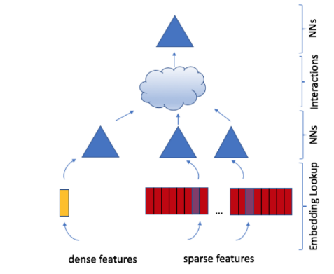
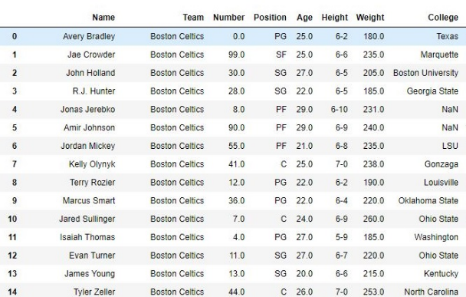
Emerging Apps for Accelerators
Recommendation Systems Training
Data Analytics
Graph Analytics
Accelerators becoming more widely used!
1
Notes:
Due to their impressive perforamnce, accelerators like GPUs are becoming a prominent part of more and more application pipelines.

Slide 3
Accelerator Memory Capacity Wall
Baidu
RecSys-E
Baidu
RecSys-C
Baidu
Amazon
Facebook
DLRM2
A100
(80GB)
V100
(32GB)
TPUv3
(32GB)
P100
(12GB)
Alibaba
A100
(40GB)
TPUv2
(16GB)
Youtube
Application memory demand increased by 10000x
Accelerator memory capacity increased by only 6.7x
2
Notes:
However, accelerator memory capacity is not keeping up with the demands of these applications.
For example, since 2016, in the span of 5 years, recommendation systems memory demand increased by 10000x, while accelerator memory capacity increased by less than 7x.
We term this the Accelerator Memory Capacity Wall

Slide 4
Traditional Solution of Proactive Tiling
Partitions data & compute and
orchestrates data movement
Memory (<4TB)
>100GBps
CPU
Root Complex
6-8GBps
Per SSD
GPU (80GB)
SSDs (1-100TB)
32GBps
PCIe
Switch
Incurs high I/O amplification in face of sparsity
May not apply to apps where threads need entire dataset in addressable memory
3
Notes:
The traditional solution to address the limited GPU memory capacity is to use the CPU to partition the data and orchestrate data movement.
As an example, when working on very large data, the CPU software will first fetch a tile of the data from storage into its memory, then copy a subtile to the gpu memory, and launch a GPU compute kernel that operates on the subtile.
The CPU software can pipeline these operations to cover the entire dataset.
Although this approach works well for traditional dense GPU applications, it faces some challenges for emerging applications.
First, if Gpu threads make sprase accesses to the data, then this technique can incur gross I/O amplification.
Furthermore, proactive tiling fails if the GPU threads ever need to address more data than can fit in GPU memory.

Slide 5

On-Demand Access using the CPU (UVM/GPUfs)
Memory (<4TB)
>100GBps
…
CPU
Root Complex
6-8GBps
Per SSD
GPU threads
rely on CPU
software to
complete requests
GPU (80GB)
SSDs (1-100TB)
32GBps
PCIe
Switch
CPU software overheads limit performance [1]
Often the GPU’s PCIe bandwidth is not even close to saturated [1]
4
[1] Min, Seung Won, et al. "Emogi: Efficient memory-access for out-of-memory graph-traversal in gpus." arXiv preprint arXiv:2006.06890 (2020).
Notes:
Alternatively, systems like Gpufs, pioneered by Professor Silberstein, enable GPU threads to make on-demand reuqests to software on the CPU to fetch and move the data on their behalf.
However, when the many Gpu threads attempt to make such requests in parallel, Cpu software overheads and costly synchronization can severely bottleneck the system’s performance.

Slide 6
Provisioning Abundant CPU Memory
Must copy entire dataset to CPU memory FIRST
Memory (<4TB)
>100GBps
CPU
Root Complex
6-8GBps
Per SSD
GPU threads can make fine-grain accesses to CPU memory
GPU (80GB)
SSDs (1-100TB)
32GBps
PCIe
Switch
Exorbitantly expensive as datasets grow
Must incur CPU memory initialization overhead
5
Notes:
Lastly, the user can provision sufficient CPU DRAM in the system,
pin the data in the CPU DRAM,
and then allow the GPU to directly access the data in the CPU DRAM.
Although this approach has shown to be quiet performant,
scaling the CPU DRAM with the dataset size is an EXTREMELY expensive proposition in the foreseeable future.
Furthermore, the application must first wait for the ENTIRE dataset to be copied from storage into the CPU DRAM before launching any compute on the GPU!

Slide 7

BaM: Expanding Effective GPU Memory with Storage
GPU
With BaM, GPU threads can directly access data where it is, be it memory or storage!
User Abstraction
Familiar array-like abstraction to ease integration
template <typename T>
struct bam::array {
T operator[](size_t i) const;
…
};
Software Cache
Leverage GPU memory & optimize storage bandwidth utilization
Storage I/O Queues
Enable GPUs to directly access data on storage
6
Notes:
Our solution to break the accelerator memory capacity wall is BaM, where we expand the effective GPU memory with more affordable Storage.
To this end,
1) we move the storage I/O queues to the gpu memory so GPU threads can issue I/O requests for data on storage directly
2) we design a highly-concurrent software-managed cache to leverage the fast GPU memory for data reuse and optimize the storage bandwidth utilization.
and
3) we provide an array-like high-level abstraction familiar to GPU programmers making it easy for them to integrate BaM into their applications With BaM, GPU threads can directly access data where it is, be it memory or storage.

Slide 8
BaM: Life of a GPU Thread
GPU Application CUDA Thread
val = data[idx];
❶
sqdb
Update cache state
❾
🅐
Wait for doorbell
Offset Calc
❷
Clean CQ and SQ
❽
🅑
Read SQ from GPU
hit(data)
Warp
Coalescer
❸
Poll for completion
❼
🅒
Process CMD
🅕
Submit CMD to SQ
❻
🅓
DMA write to GPU IO buffer
read(off,...)
❹
🅔
Cache lookup
❺
miss(off)
Prepare IO CMD
Write CQ in GPU mem
BaM Cache
BaM I/O Stack
Storage Controller
7
Notes:
Now that all the software components are in place, let me show you how GPU threads can use them to access large data efficiently.
GPU threads accesss data through an array like high-level abstraction.
Each thread then calculates the offset for the data it needs, and threads in a warp use our software coalescer to pick a leader and to reduce atomic contention in the cache state management.
The leader probes the cache, and if the access is a hit in the cache, the data is returned from the the cache to the threads.
We design the cache metadata and algorithm to support low latency and highly concurrent lookups.
If it’s a miss, the thread needs to prepare a storage I/O request for the needed cacheline.
The thread submits the command to a IO submission queue in GPU memory.
Here we develop a novel scheme to allow many threads to populate queue entries in parallel and coalesce doorbell writes efficiently.
Once the thread rings the doorbell, the storage controller processes the request, and will eventually post a completion queue entry in GPU memory.
The thread polls for this completion queue entry and once it finds it, it cleans up the completion and submission queues to make space for future requests.
Finally, the thread can update the cacheline state to mark it valid and can access the data from the cache.

Slide 9


Can BaM Tolerate the Storage Latency?
L = $λ$ W
Little’s Law:
Needed Queue Depth =
Storage Throughput $×$
Storage Latency
GPU
32GBps
PCIe
Switch
Raw PCIe Bandwidth: 32 GB/s each direction
Usable Bandwidth: ~25 GB/s
Max Throughput for 512-Byte Deliveries: $\frac{25 GB/s}{512Byte/delivery}$ = 50M deliveries/sec (IOPS)
Intel Optane P5800X SSD Example:
Throughput at 512-Byte: 5M deliveries/sec (requires 10 SSDs to achieve 50M deliveries/sec)
Total Latency: 10 us = 6 us (media) + 4 us (PCIe)
Little’s Law: 10 us $×$ 50M deliveries/sec = 500 $←$ Must be sustained over time (minimum)
8
Notes:
Now that the gpu threads can directly access storage, naturally the question is can BaM tolerate the relatively high storage latency.
We can model the minimum queue depth required to hide the storage latency and to achieve a specific throughput using Litte’s Law.
The GPU has a PCIe Gen4 x16 IO interface, which provides a unidirectional bandwidth of 32GB/s, of which 25GB/s is usable for data transfers.
If we want to move data in 512-byte granularity, then we need a target throughput of 50Million IO ops per sec to saturate the Gpu’s ingress bandwidth.
Take the Intel Optane P5800X SSD as an example.
It has a total access latency of 10us, and using little’s law we know we need to maintain a I/O queue depth of at least 500 request to saturate the GPU’s ingress bandwidth.
As this queue depth must be maintained over time, we need many more I/O requests in the system to sustain the desired bandwidth.

Slide 10

BaM Prototype and Evaluation Setup
Configuration​ | Specification​
CPU​ | 2x AMD EPYC 7702​ 64-core CPUs
DRAM​ | 1TB DDR4-3200​
GPU​ | NVIDIA A100-80GB PCIe​
PCIe Expansion​ | H3 Platform 4016​
SSDs​ | Up to 10x Intel Optane P5800X
Software​ | Ubuntu 20.04, CUDA 11.4, Nvidia Driver 470.82​
Supermicro 4124GS-TNR
Prototype
PCIe Switch
1 SSD
Supermicro 4124GS-TNR
CPU
1 SSD
1 SSD
PCIe Gen4 x16
1 SSD
Host Bridge
H3 Falcon 4016 Drawer
PCIe Switch
1 SSD
1 SSD
A100
1 SSD
A100
Topology
9
Notes:
To see if BaM can sustain such high I/O level parallelism, We prototype BaM on real hardware using a PCIe expansion chassis connected to a host system whose specifications are shown here.
The PCIe expansion chassis features high-end PCIe switches that allow us to scale the number of PCIe devices in the system and provide high-throughput peer-2-peer access between the devices.
We populate the expansion chassis with an Nvidia A100 GPU and upto 10 Intel Optane P5800x SSDs.

Slide 11

BaM’s I/O Throughput
Peak Measured PCIe Gen4 x16 Bandwidth:
25GB/s
4KB Access
512-byte Access
BaM can easily saturate the GPU’s PCIe Gen4 x16 bandwidth with storage
10
Notes:
We measure BaM’s achievable I/O throughput while scaling the number of SSDs. Here we launch a GPU kernel where each thread makes 1 IO request to an SSD.
For 4KB accesses, BaM easily saturates a single’s SSD’s throughput of 1.5Million IOPs and continues to scale up to 4 SSDs at which point BaM very nearly saturates the GPU’s PCIe bandwidth.
Furthermore, for 512-byte accesses, given enough ssds, BaM can easily scale upto 45Million IOPs, again nearly saturating pcie bandwidth.

Slide 12
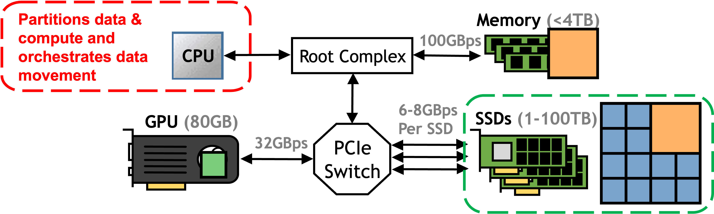
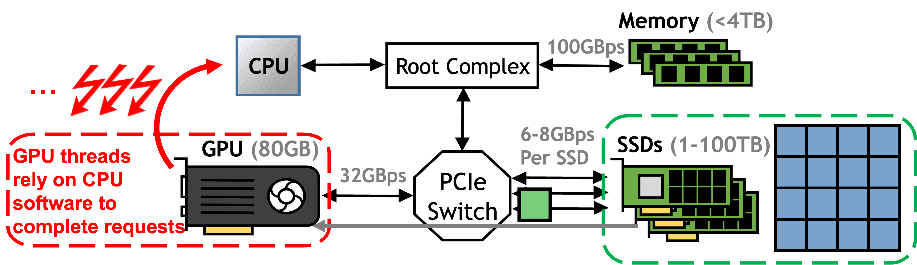
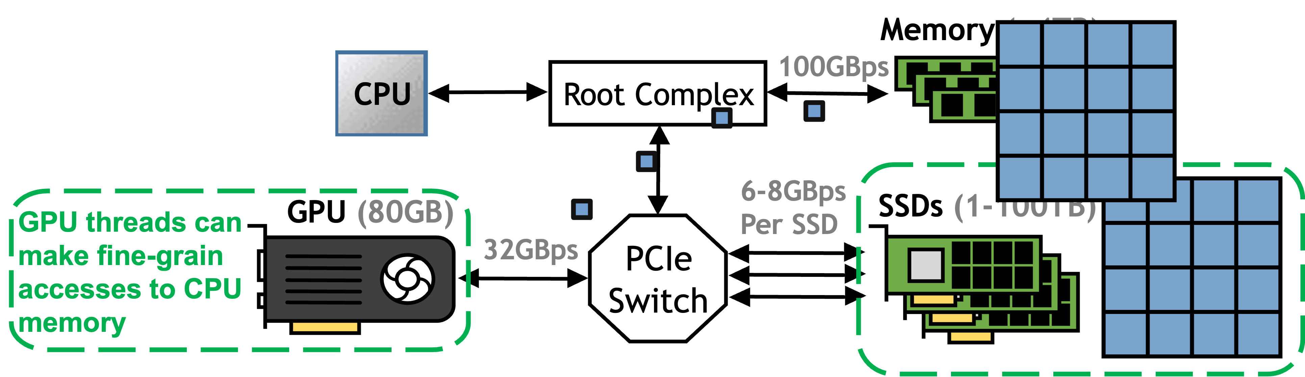
Is Saturating the GPU’s PCIe Bandwidth Sufficient?
Proactive Tiling
UVM/GPUfs
Using Abundant CPU Memory
GPU
32GBps
PCIe
Switch
Every system must get the data to the GPU memory through its PCIe interface!
11
Notes:
But is saturating the GPU’s PCIe bandwidth sufficient? Recall, that the state-of-the-art solutions for using Gpus to process large datasets, namely proactive tiling, UVM/GPUfs, or using abundant CPU memory, all require to get data into the GPU through its PCIe interface!
As such, efficient utilization of the GPU’s PCIe interface is key for performance.
#So the question is can BaM overcome its software overheads and saturate the GPU’s PCIe interface for real applications.

Slide 13
Graph Analytics Evaluation Dataset and Baseline
Largest graphs from SuiteSparse [1]
Graph | #Vertex | #Edges | Size (GB)
GAP-kron (K) | 134.2M | 4.22B | 31.5
GAP-Urand (U) | 134.2M | 4.29B | 32
Friendster (F) | 65.6M | 3.61B | 26.9
MOLIERE (M) | 30.2M | 6.67B | 49.7
Uk-2007 (Uk) | 105.9M | 3.74B | 27.8
Target Baseline [2]
NVIDIA A100 GPU (80GB)
Memory (1TB)
32GBps
PCIe Root Complex
Edge List
1
2
0
2
3
4
Vertex List
0
2
6
(Abundant CPU memory solution + file read time)​
(Very optimistic baseline)​
[1] Kolodziej, Scott P., et al. "The suitesparse matrix collection website interface." Journal of Open Source Software 4.35 (2019): 1244.
[2] Min, Seung Won, et al. "Emogi: Efficient memory-access for out-of-memory graph-traversal in gpus." arXiv preprint arXiv:2006.06890 (2020).
12
Notes:
To see if BaM can overcome latency for real-world applications we evaluate BaM using two graph analytics workloads, BFS and CC.
We execute these workloads on the 5 largest graphs from the SuiteSparse Matrix collection.
For the Target baseline, we use a state of the art graph traversal library for GPUs that pins the graph’s edge list in the host CPU memory, allowing the GPU to directly access it in very fine granularity.
For the baseline, We time both the memory initialization overhead as well as the app execution.
We note this a very optimistic baseline as it assumes there is abundant CPU memory in the system for the dataset.

Slide 14
Graph Analytics Evaluation
T: Target System with 4 SSDs B: BaM with 8GB Cache, 4KB CLs and 4 SSDs
With 4 SSDs, BaM is on average 1.0x and 1.5x as fast as the Target baseline for BFS and CC, respectively.
13
Notes:
Here we plot the execution time of the Target Baseline and BaM both with 4 SSDs.
BaM is on avg 1x and 1.5x as fast as the optimistic target for BFS and CC, respectively, for 2 reasons.
First, BaM entirely avoids the initial file read overhead as BaM enables threads to make on-demand accesses to storage..
Second, these applications expose large amounts of data parallelism, allowing BaM to keep many I/O requests in flight and to almost always saturate the Gpu’s PCIe bandwidth.

Slide 15

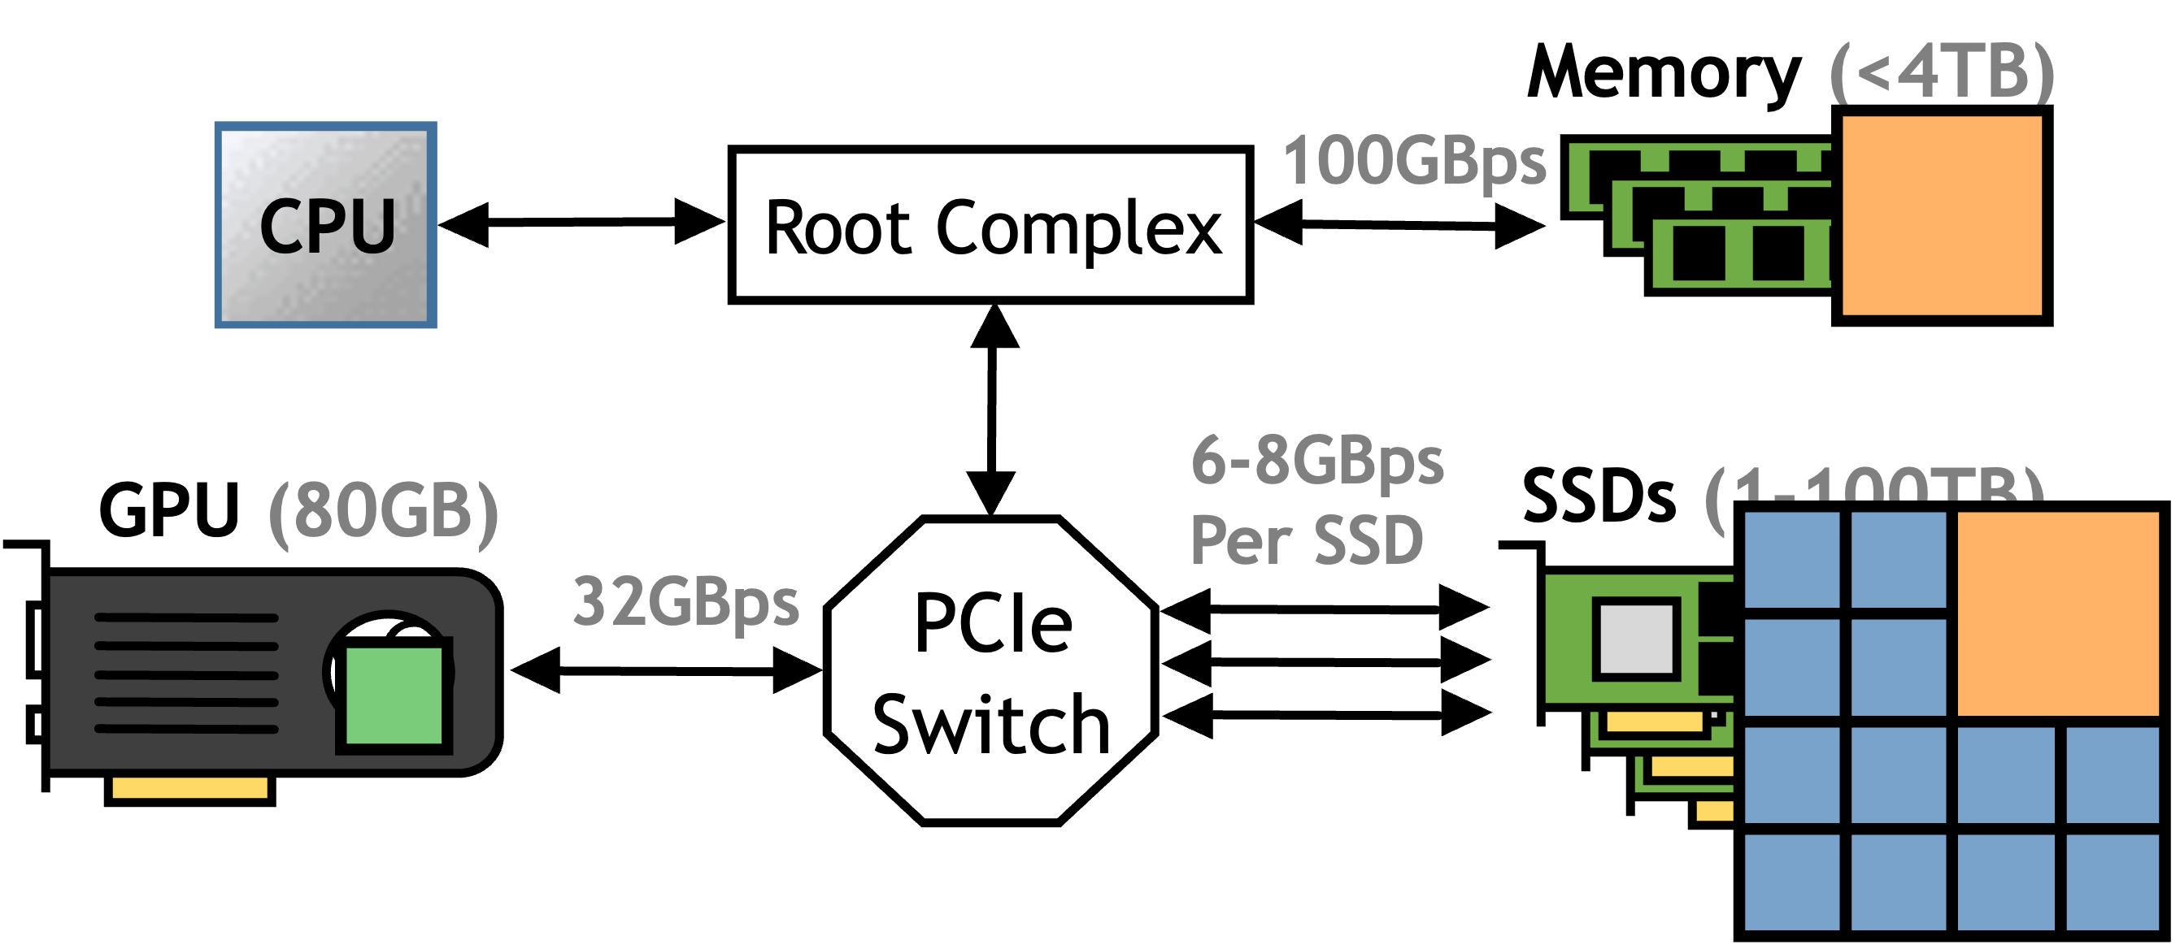
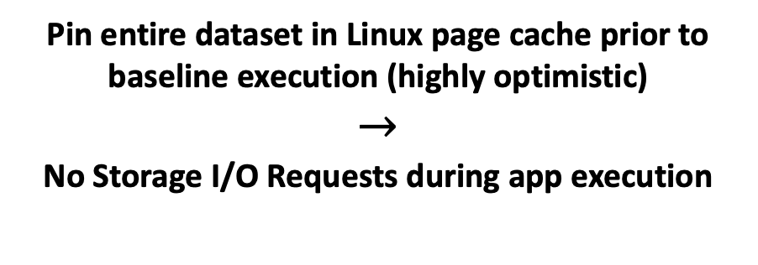
Data Analytics Evaluation Dataset and Baseline
NYC Taxi Ride Dataset [1]
RAPIDS v21.12 [2]
Proactive Tiling
>1.7 Billion Taxi Rides since 2009
Various metrics
Trip distance
Cost
Weather conditions
…
~200GB ORC encoded file
Pin entire dataset in Linux page cache prior to baseline execution (highly optimistic)
$$→$$
No Storage I/O Requests during app execution
14
[1] The City of New York. 2023. TLC Trip Record Data. https://www1.nyc.gov/site/ tlc/about/tlc- trip- record- data.page.
[2] Nvidia. CUDA RAPIDS: GPU-Accelerated Data Analytics and Machine Learning. https://developer.nvidia.com/rapids.
Notes:
Next we evaluate BaM with the data analytics workload.
We use the NYC Taxi rides dataset that contains data for over 1.7 Billion taxi rides organized in a 200GB orc file.
For the Baseline, we use the state-of-the-art GPU accelerated data analytics framework RAPIDS by Nvidia.
This baseline uses the proactive tiling approach to process datasets that are larger than GPU memory.
However to get an optimistic baseline, Before execution of any query, we pin the entire dataset into the Linux page cache, thus during execution the baseline makes no storage I/O requests.

Slide 16
Data Analytics Evaluation Queries
Query: Get average $/mile the driver makes for taxi rides that are at least 30 miles
Query 1: Avg trip distance for trips that are at least 30 miles
Query 2: Avg total cost per mile for trips that are at least 30 miles
Query 3: Avg ( total cost – improvement surcharge ) per mile for trips that are at least 30 miles
Query 4: Avg ( … – e-hail fee ) per mile for trips that are at least 30 miles
Query 5: Avg ( … – tolls ) per mile for trips that are at least 30 miles
Query 6: Avg ( … – MTA tax ) per mile trips that are at least 30 miles
15
Notes:
- For this evaluation we look at a query to get the avg $/mile the driver makes for trips that are at least 30 miles
we can build this query by starting with a query that only scans the trip distance column,
then we can add each needed data dependent column one by one to get sub queries until we reach the penultimate query in query 6

Slide 17
Data Analytics Evaluation
BaM configured with 8GB Cache, 4KB CLs and 4 SSDs
BaM reduces I/O amplification by up to 3.7x and improves performance by up to 4.6x!
16
Notes:
Here we plot BaM’s and RAPIDS’ throughput and I/O amplification for processing each of the queries.
BaM is up to 4.6x faster than RAPIDS, as it reduces IO amplification by up to 3.7x and uses the GPU’s parallelism to manage memory and IO in a high throughput manner.

Slide 18
BaM: Expanding Effective GPU Memory with Storage
GPU
With BaM, GPU threads can directly access data where it is, be it memory or storage!
User Abstraction
Our prototype with NVMe SSDs and an NVIDIA A100 GPU shows that BaM
template <typename T>
struct bam::array {
T operator[](size_t i) const;
…
};
increases the GPU’s effective memory capacity by 10-100x
reduces I/O amplification by up to 3.7x
Software Cache
improves end-to-end performance by up to 5.3x
is up to 21.7x less expensive
compared to the DRAM based state-of-the-arts for emerging GPU applications using real world data.
Storage I/O Queues
17
Notes:
In conclusion, to break the Accelerator Memory Capacity Wall we propose BaM, where GPU threads can directly access data where it is, be it memory or storage.
Our prototype system shows that
BaM not only increases the GPU's effective memory capacity,
but also reduces IO amplification,
improves application performance
and
Is signficiantly less expensive
compared to the DRAM-based state-of-the-arts
for emerging GPU appplications.

Slide 19
Future Research Directions and Vision
GPU
Accelerators for data access and movement
Optimizing/Specializing caching for applications
User Abstraction
template <typename T>
struct bam::array {
T operator[](size_t i) const;
…
};
Leverage emerging interconnects (e.g. CXL)
Improved I/O protocols for parallelism
Software Cache
Multi-GPU/Multi-Node support (scalability)
File system and cloud infrastructure support
...
Storage I/O Queues
Vision: Programmers write code operating on data,
BaM figures out where the data is and moves it efficiently!
18
Notes:
BaM has opened up new interstesting research questions and opportunities in the accelerator memory-storage hierarchy.
We envision in the future programmers write accelerator code operating on data and systems like BaM figure out where the data is and move it efficiently.

Slide 20










Acknowledgements
19
Notes:
We thank all of our collaborators and supporters, without whom this work wouldn’t have completed in a timely manner.

Slide 21
We hope to see you at the poster session tomorrow!
Thank You!
Notes:
For more details we invite you to our poster session tomorrow!
There might be some treats in it for you if you can figure out what BaM stands for.
Thank you!

Slide 22
BaM vs ActivePointers (Hit)
Both: 4KB Cache lines
BaM provides 8.4x higher cache hit bandwidth than ActivePointers!
Notes:
As we add more and more data dependent columns, RAPIDS IO ampflication increases by almost 6x while BaM’s IO amplification increases by only 1.6x as BaM allows threads to make on-demand accesses for the data that they need.

Slide 23
BaM vs ActivePointers (Miss)
BaM: 4x Intel Optane P5800x SSDs
ActivePointers: Data pinned in CPU memory (No storage I/O)
Both: 4KB Cache lines
BaM provides 9x higher miss bandwidth than ActivePointers!
Notes:
As we add more and more data dependent columns, RAPIDS IO ampflication increases by almost 6x while BaM’s IO amplification increases by only 1.6x as BaM allows threads to make on-demand accesses for the data that they need.

Slide 24
Using Slower SSDs (versus Intel Optane P5800X)

Slide 25
BaM Source of Improvement

Slide 26
BaM Software Overhead Breakdown

Slide 27
Data Analytics Evaluation (I/O Amplification)
BaM configured with 8GB Cache and 4KB CLs
BaM suffers 3.7x less I/O amplification as it makes on-demand accesses
15
Notes:
As we add more and more data dependent columns, RAPIDS IO ampflication increases by almost 6x while BaM’s IO amplification increases by only 1.6x as BaM allows threads to make on-demand accesses for the data that they need.

