Slide 1


Slide 2

core
Notes:
*

Slide 3
About Presenters
Shashikant Mokkarala
  Designation : Senior Software Engineer
  In Prokarma: Been with ProKarma from 5 years.
  Project: ITOS

Slide 4
PRESENTATION AGENDA
Introduction To Spring
IOC and Dependency Injections
Beans and Configurations
Bean Lifecycle and Post Processors
Bean aware of containers
Property Placeholders

Slide 5
Why Spring?
Because of many problems with traditional J2EE Architecture
  Complexity
    EJB, JNDI, JTA, JDBC etc
    Too many APIs
    EJB is over used
  Heavy weight runtime environment
    Hard to Unit Test
    Components need to be explicitly deployed to be able to run, even for testing
    Slow change-deploy-test cycle

Slide 6
What Is Spring?
Spring Framework is an Application Framework and Inversion Of Control (IOC) for the Java Platform.
Can be used in any Java Application.
Can be used to build Web Applications on top of J2EE stack using few extensions of Spring.
MVC framework
AOP – Uses OOP concepts in a different approach.

Slide 7
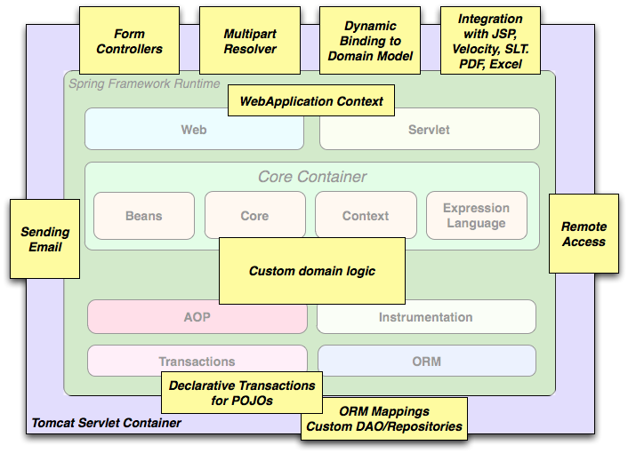
Spring Usage Scenario

Slide 8
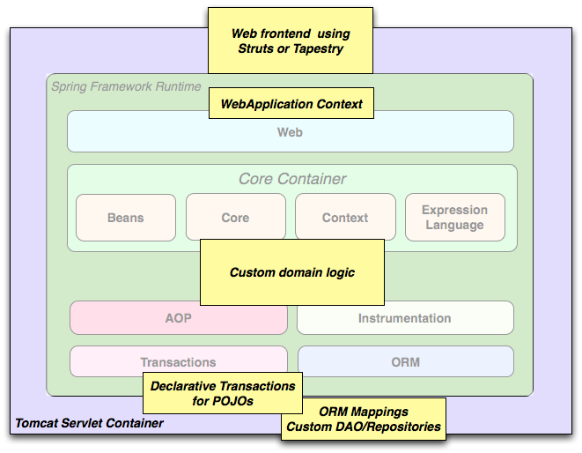
Spring Usage Scenario

Slide 9
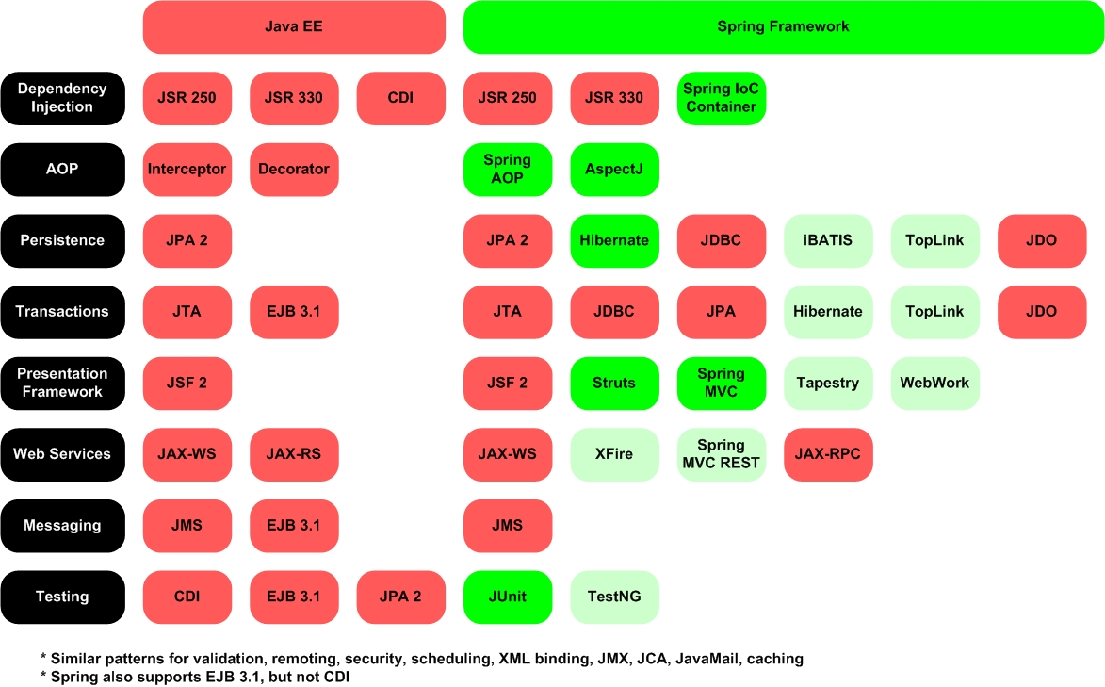
J2EE Stack Vs Spring

Slide 10
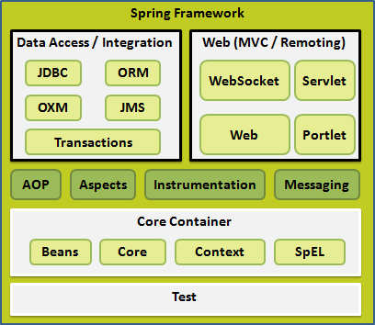
Architecture Of Spring

Slide 11
Spring Features
Dependency Injection
Inversion Of Control
Transaction Management
AOP
Web Services
Messaging
Testing

Slide 12
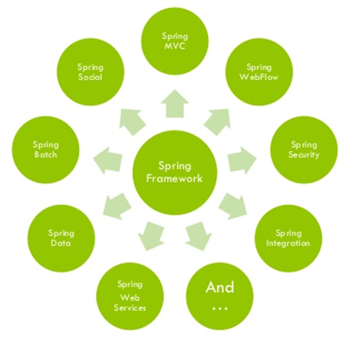
Spring Projects

Slide 13
Spring Core
Spring Beans
Spring Core
Spring Context

Slide 14
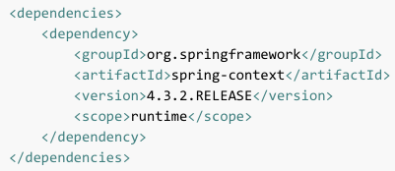
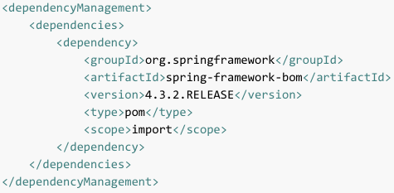
Maven Dependency For Spring
Notes:
GroupId ArtifactId Description
org.springframework spring-aop Proxy-based AOP support
org.springframework spring-aspects AspectJ based aspects
org.springframework spring-beans Beans support, including Groovy
org.springframework spring-context Application context runtime, including scheduling and remoting abstractions
org.springframework spring-context-support Support classes for integrating common third-party libraries into a Spring application context
org.springframework spring-core Core utilities, used by many other Spring modules
org.springframework spring-expression Spring Expression Language (SpEL)
org.springframework spring-instrument Instrumentation agent for JVM bootstrapping
org.springframework spring-instrument-tomcat Instrumentation agent for Tomcat
org.springframework spring-jdbc JDBC support package, including DataSource setup and JDBC access support
org.springframework spring-jms JMS support package, including helper classes to send and receive JMS messages
org.springframework spring-messaging Support for messaging architectures and protocols
org.springframework spring-orm Object/Relational Mapping, including JPA and Hibernate support
org.springframework spring-oxm Object/XML Mapping
org.springframework spring-test Support for unit testing and integration testing Spring components
org.springframework spring-tx Transaction infrastructure, including DAO support and JCA integration
org.springframework spring-web Web support packages, including client and web remoting
org.springframework spring-webmvc REST Web Services and model-view-controller implementation for web applications
org.springframework spring-webmvc-portlet MVC implementation to be used in a Portlet environment
org.springframework spring-websocket WebSocket and SockJS implementations, including STOMP support

Slide 15
Spring Configuration
<?xml version="1.0" encoding="UTF-8"?>
<beans xmlns="http://www.springframework.org/schema/beans"
xmlns:xsi="http://www.w3.org/2001/XMLSchema-instance"
xsi:schemaLocation="http://www.springframework.org/schema/beans http://www.springframework.org/schema/beans/spring-beans.xsd">
<!– All Your Beans Go Here →
</beans>
Notes:
Demo

Slide 16
Setting Up Environment
Create a Maven Project.
Add Required Spring libraries.
Create a main class that loads the Spring Context.
Create a Bean.
Create a Bean Dependency for the created Bean.
Load the Spring Application Context.
Load the Bean.
Display its content.

Slide 17
Questions???

Slide 18
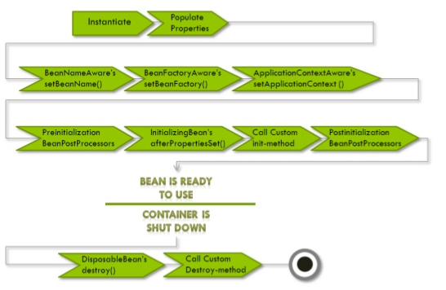
Bean Lifecycle

Slide 19
Bean LifeCycle
InitializingBean - afterPropertiesSet();
DisposableBean – destroy();
BeanPostProcessor to process callbacks.
Lifecycle Interface:
  Start();
  Stop();
  isRunning();
Lifecycle callback Interfaces:
  Initialization callbacks
  Destruction callbacks
Default Callbacks:
  init()
  initialize()
  dispose();

Slide 20
Spring Container
It is the core of Spring Framework.
Container is repsponsible for,
  Creating Objects
  Wiring the Objects
  Configuring the Objects
  Manage the LifeCycle till its Destruction.

Slide 21
Bean Configuration
<bean name=“” class=“” alias=“”>
<constructor-arg index=“” ref=“”>
</constructor-arg>
<constructor-arg type=“int” value=“”>
</constructor-arg>
<property name=“ ref=“>
</property>
</bean>
**bean **property
**name **alias
**class **index
**constructor-arg **type
**ref **value

Slide 22
Bean Configuration ..Continued
lazy-init: Create only on first request.
autowiring-mode: Another way of injecting beans. By using autowire, there is no need for us to specifically inject the bean using constructor-arg or property.
scope: This decides the scope of the objects created.
initialization-method: To be called once the bean creation is done by setting all the properties.
destruction-method: To be called once the bean is destroyed.
Notes:
Demo for:-
initialization-method
Destory-method

Slide 23
Dependency Injection And Inversion Of Control
The objects in the application has dependencies on each other.
A process in which objects define their dependencies through,
  Constructor arguments
  Arguments to Factory methods
  Setting properties after object is created
The dependencies are injected after object is created, hence it is called as IOC.

Slide 24
Advantages of DI/IOC
Code is cleaner
Decoupling is more effective.
Object does not have to look for its dependencies.
Testing is easy.

Slide 25
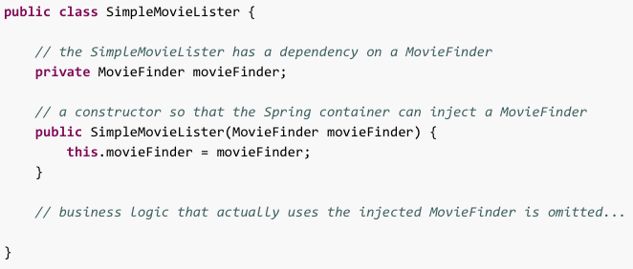
Dependency Injection Variants
Constructor-based Dependency Injection
Notes:
Demo

Slide 26
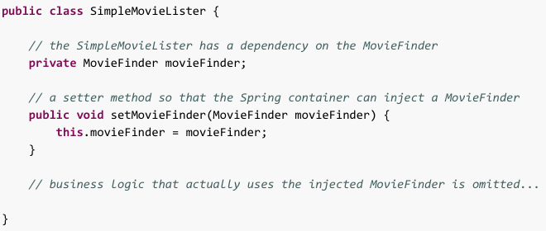
Dependency Injection Variants
Setter-based Dependency Injection
Notes:
Demo – Show by adding both class and property.

Slide 27
DEMO
Abstract class in a bean
Parent class for a bean
Injecting List
Injection Set
Injection Map
Notes:
Demo – Show by adding both class and property.

Slide 28
Questions???

Slide 29
Bean Scope
Singleton: This scopes the bean definition to a single instance per Spring IoC container (default).
Prototype: This scopes a single bean definition to have any number of object instances.
Request: This scopes a bean definition to an HTTP request. Only valid in the context of a web-aware Spring ApplicationContext.
Session: This scopes a bean definition to an HTTP session. Only valid in the context of a web-aware Spring ApplicationContext.
global-session: This scopes a bean definition to a global HTTP session. Only valid in the context of a web-aware Spring ApplicationContext.
Notes:
Demo on singleton and prototype

Slide 30
Bean Scope
Application: This scopes a single bean definition to the lifecycle of an ServletContext. Only valid in the context of a web-aware spring ApplicationContext.
Websocket: This scopes a single bean definition to the lifecycle of a websocket.Only valid in the context of a web-aware spring.

Slide 31
Other Types Of Bean Instantiations
Static-factory: When creating such bean, you use the class attribute to specify the class containing the static factory method and an attribute named factory-method to specify the name of the factory method itself.
Instance-factory: Just like static-factory, this invokes a non-static method of an existing bean from the Continer to create a new bean.
Notes:
Demo on Static-factory and instance-factory

Slide 32
Autowiring
Allowing the spring to resolve the dependencies for us.
Autowiring can significantly reduce the need to specify properties or constructor arguments.
Autowiring can update a configuration as your objects evolve. That means, there is no need for us to change the xml when the bean changes.
To use autowire mode, just add an autowire attribute to the creation of bean in the bean configuration.
There are multiple ways to autowire a bean.

Slide 33
Autowiring - Modes
No: This is the default value set to autowire.
byName: Autowiring by property name. Spring looks for a bean with the same name as the property that needs to be autowired.
byType: Allows a property to be autowired if exactly one bean of the property type exists in the container. If more than one exists, a fatal exception is thrown.
Constructor: Just like byType, but uses constructor.
Notes:
Demo

Slide 34
Autowiring - Disadvantages
Explicit dependencies in property and constructor-arg settings always override autowiring.
You cannot autowire simple properties such as primitives, Strings, and Classes
Multiple bean definitions within the container may match the type specified by the setter method or constructor argument to be autowired.

Slide 35
Questions???

Slide 36
Topics Covered
Spring and Architecture
Setting up the environment for Spring Application.
Spring Container
Dependency Injection
Inversion of Control
Bean Configuration
Bean Scopes
Other types of Bean Instantiations
Autowiring

Slide 37
Special Beans
BeanNameAware
  Bean aware of its name in the bean factory
ApplicationContextAware
  Bean aware of the application context which created it
BeanFactoryAware
  Bean aware of the bean factory which created it
BeanPostProcessor
  Do something before and after initializing a bean
InitializingBean
  Do something like validating bean properties after a bean is initialized
DisposableBean
  Do something like resource cleaning before the bean is going to destroy

Slide 38
BeanPostProcessor
The BeanPostProcessor interface defines callback methods that you can implement to provide your own instantiation logic, dependency-resolution logic etc.
You can configure multiple BeanPostProcessor interfaces and you can control the order in which these BeanPostProcessor interfaces execute by setting the order property provided the BeanPostProcessor implements the Ordered interface.
An ApplicationContext automatically detects any beans that are defined with implementation of the BeanPostProcessor interface and registers these beans as post-processors, to be then called appropriately by the container upon bean creation.
Notes:
Demo

Slide 39
BeanNameAware
When an ApplicationContext creates a class that implements the org.springframework.beans.factory.BeanNameAware interface, the class is provided with a reference to the name defined in its associated object definition.
public class Book implements BeanNameAware {
private String bookName;
@Override
public void setBeanName(String beanName) {
System.out.println(beanName +" bean has been initialized." );
}
public Book(String bookName) {
System.out.println("--Inside Constructor--");
this.bookName = bookName;
}
public String getBookName() {
return bookName;
}
}
Notes:
http://docs.spring.io/spring/docs/current/spring-framework-reference/html/beans.html#beans-factory-aware

Slide 40
ApplicationContextAware
When an ApplicationContext creates an object instance that implements the org.springframework.context.ApplicationContextAware interface, the instance is provided with a reference to that ApplicationContext
public class ApplicationContextAwareTest implements ApplicationContextAware {
ApplicationContext context;
public ApplicationContext getContext() {
return context;
}
@Override
public void setApplicationContext(ApplicationContext context)
throws BeansException {
this.context=context;
}
}
Notes:
http://www.concretepage.com/spring/example_applicationcontextaware_spring
http://www.concretepage.com/spring/example_beannameaware_spring
http://docs.spring.io/spring/docs/current/spring-framework-reference/html/beans.html#beans-factory-aware

Slide 41
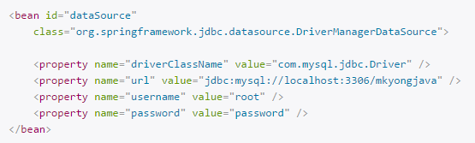
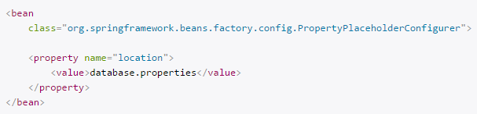

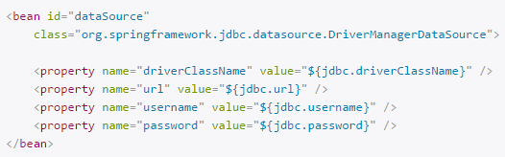
Property Placeholder
Without Property Placeholder
With Property Placeholder
Notes:
http://www.concretepage.com/spring/example_applicationcontextaware_spring
http://www.concretepage.com/spring/example_beannameaware_spring
http://docs.spring.io/spring/docs/current/spring-framework-reference/html/beans.html#beans-factory-aware

Slide 42
Questions???

Slide 43
msashikanth@prokarma.com
+919949126027
Questions?

