Slide 1


Human-Robot Collaboration: Affect-Driven Functional Coexistence
An Overview of Affective Motivational Collaboration Theory
Mahni Shayganfar, Charles Rich, Candace L. Sidner
AAAI'16 Workshop on Symbiotic Cognitive Systems

Slide 2
Collaboration is a special type of coordinated activity in which the participants work jointly, together performing a task or carrying out the activities needed to satisfy a shared goal.
Some of the key points about collaboration:
Participants with different beliefs and capabilities,
Participants with partial knowledge of the collaborative activities,
Collaborative plans are more than the sum of individual plans,
Collaborators are required to maintain mutual beliefs about their shared goal throughout the collaboration,
Collaborators need to be able to communicate with others effectively,
Collaborators need to commit to the group activities and to their role in it,
Collaborators need to commit to the success of others,
Collaborators need to reconcile between commitments to the existing collaboration and their other activities,

Slide 3
SharedPlans Theory
A general theory of collaborative planning,
Accommodates multi-level action decomposition hierarchies,
Allows the process of expanding partial plans into full plans,
Shows how a group of agents can incrementally form and execute a shared plan,
Describes how a shared plan coordinates agents’ activities towards achieving a shared goal,
Emphasizes that collaborative plans are an interleaving of mutual beliefs and intentions about the actions in the plan (rather than simply a collection of individual plans),
Agents have a library of how to do their actions (recipes),
Agents communicate their beliefs and intentions about the actions they can contribute to the shared plan,
This communication leads to the construction of a shared plan,
Communication makes the agents to mutually believing that there is an agent responsible to execute an action in the plan, and that agent has intention to do so, and the actions in the plan contribute to the goal.
Notes:
<number>

Slide 4
Appraisal Theory
Appraisal theory describes the cognitive process by which an individual evaluates the situation in the environment with respect to the individual's well-being and triggers emotions to control internal changes and external actions.
Cognitive appraisal process:
Distinct components of emotions,
Components are called appraisal variables,
Agent Evaluates the stimuli with respect to their consequences ;
According to Scherer’s appraisal objectives (i.e., relevance, implication, coping, and normative significance),
Objectives include different appraisal variables,
Specific values will be assigned to appraisal variables,
Determined appraisal variables are mapped onto a particular emotion,
Appraisal variables are the semantic primitives fro representing emotions.
Notes:
<number>

Slide 5
Problem
Collaboration requires awareness
Awareness requires evaluation
Collaboration induces some changes to appraisal
None of appraisal models focus on collaboration
Notes:
<number>

Slide 6
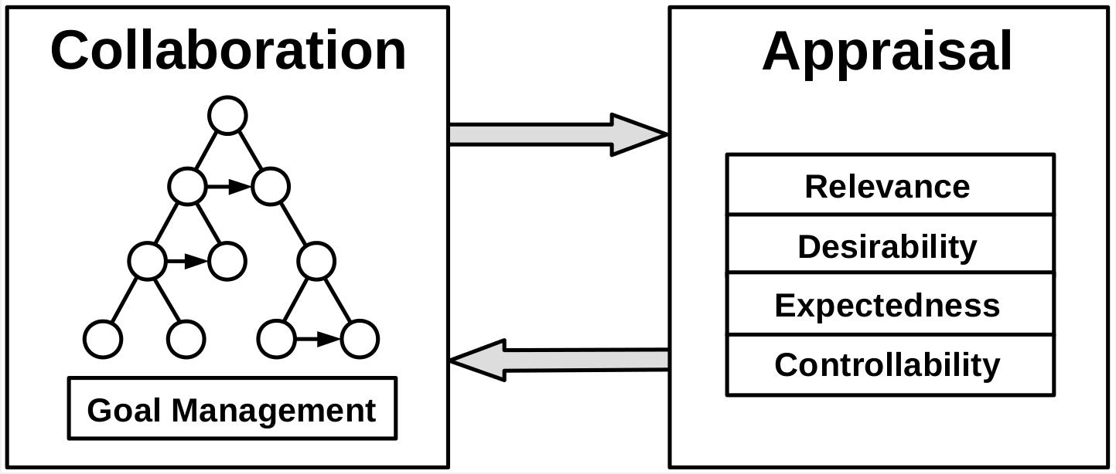
Solution
Notes:
<number>

Slide 7
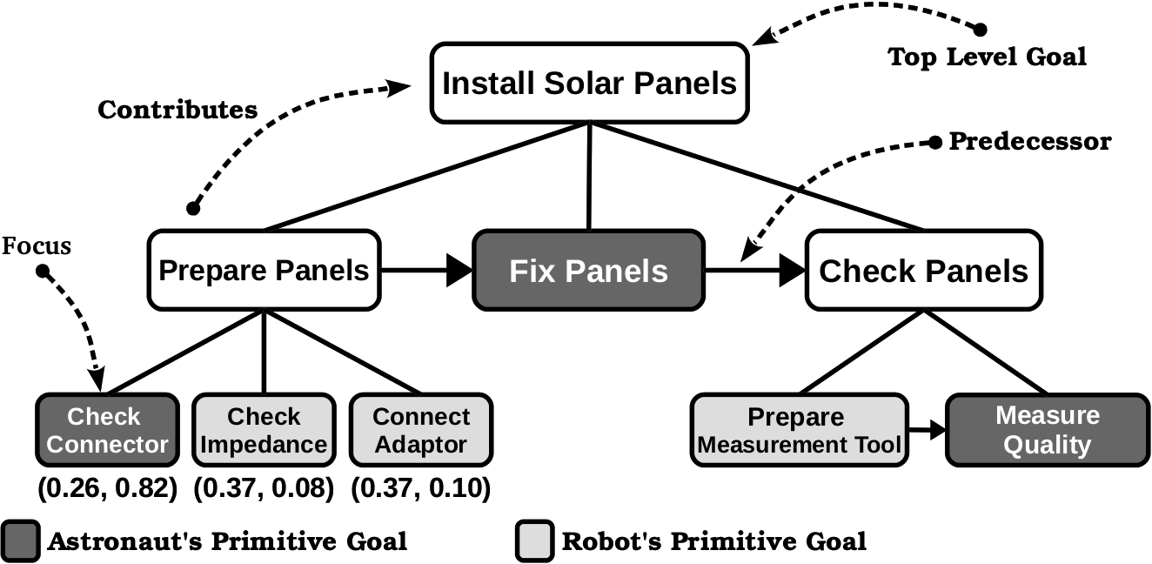
Example
Notes:
<number>

Slide 8
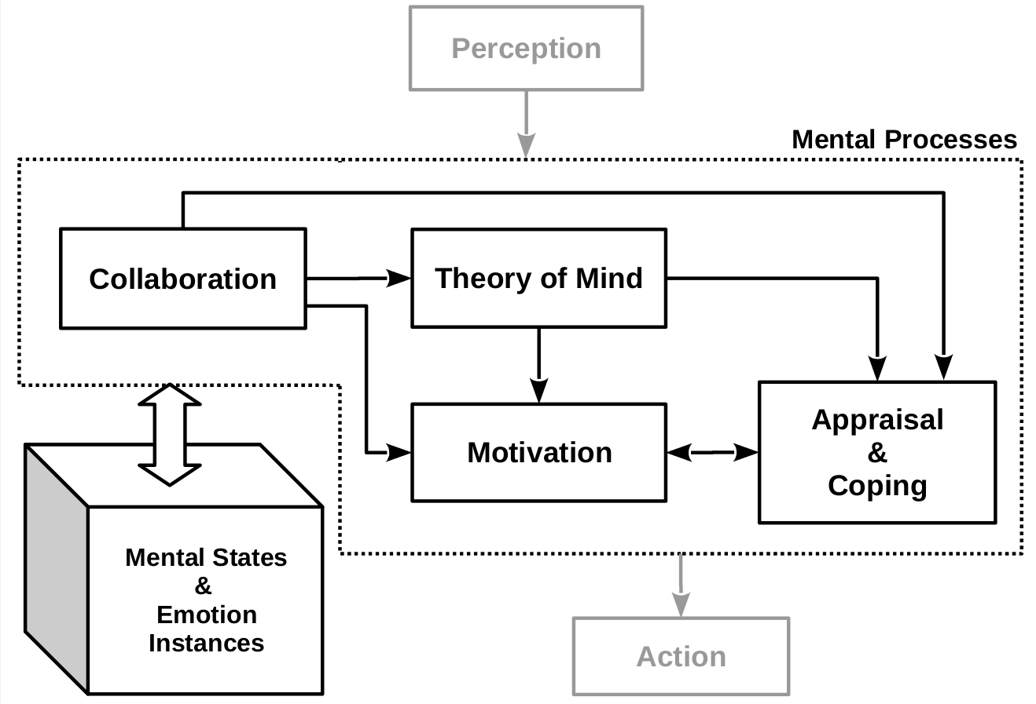
Affective Motivational Collaboration Theory
Notes:
<number>

Slide 9
Future Work
Action Selection in Coping Mechanism
Motivation and Theory of Mind Mechanisms
End-to-End Study
Notes:
<number>

